Slide 1
Unit-I Hormonal relationship in animal production-I
Chemical Bioregulation in Physiological functions
Course No. – VPY- 609
Credit Hrs. – 3+0=3
Dr. Pramod Kumar
Asstt. Professor
Deptt. of Veterinary Physiology
BVC, Patna

Slide 2
Overview
Hormone-dependent sex differences in growth rate and FCE (feed conversion efficiency) are higher in intact males than in castrates. The availability of hormones and other natural or synthetic substances displaying hormonal activity led to experiments aiming at their use to increase production. Beginning in the mid-1950s, DES (diethylstilboestrol) and hexoestrol were administered to cattle increasingly in the US and the UK respectively, either as feed additives or as implants, and other types of substances also gradually became available.
While the use of hormonally active substances in animal production rose, opposition to their use also increased, possibly residues in edible tissues might endanger consumers. However, as regards risks due to the presence of residues in meat produced according to regulations, no documented deleterious effects have ever been reported in human from any other substance with hormonal activity.

Slide 3
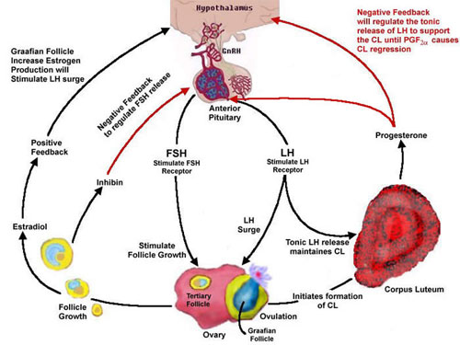
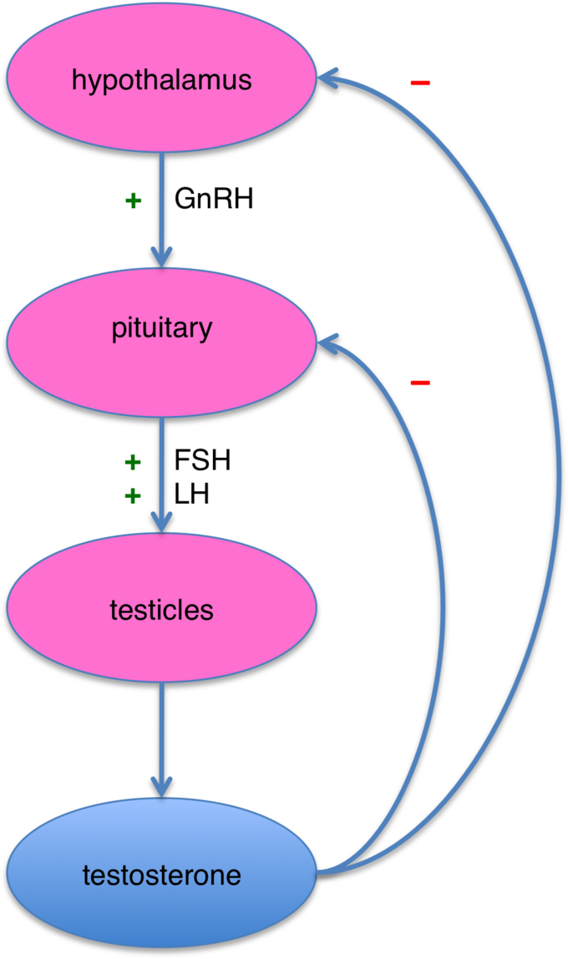

Slide 4
A distinction should be made between the hormones as such, for which the metabolism in the body is relatively well known, and synthetic or other substances for whose metabolic inactivation the body may not possess the enzymes necessary. When natural hormones are used in animal production, claims of zero-tolerance residue levels are not meaningful, since these compounds occur in detectable and highly variable concentrations in body fluids as well as in the tissues of all animals, treated or not.
(Weiert Velle)
Hormones of endogenous origin
It comprise the “classical” steroid sex hormones, oestradiol-17β, testosterone and progesterone. The first two are used in the free form or as esters. Esterification generally causes prolongation of the half-life of the compounds in the body by 40 to 50%. The natural hormones having low bioavailability when administered orally, owing to rapid conjugation and metabolic transformation in the liver, therefore administered by S/c implantation.

Slide 5
Hormones of exogenous origin
The synthetic androgens comprise a large number of substances, most of which are steroids. Trenbolone acetate possesses strong anabolic properties and has received much attention during recent years, used alone or in combination with an oestrogen. Another anabolic steroid is methyl-testosterone.
Exogenous hormones are used as implantation, the site usually being the base of the ear or less frequently, the dewlap.

Slide 6
MODE OF APPLICATION
Most preparations have been administered as implants, whose effect is usually limited to 80 to 100 days. Practice varies with management systems. Animals may be implanted at live weights from 270 to 450 kg. Depending upon the age and weight at the time of implantation, the animals are either slaughtered at the end of this first period, or fed for an additional period, either without further treatment or after a second implant to act for another 80 to 100 days. Most types of implants in use are not removable, but removable types have also showed good result. When tested in steers, no reduction in performance was recorded when the implants were withdrawn 32 and 39 days before slaughter.
Implantation is subcutaneous, usually at the base of the ear, thus eliminating the risk that residues of the implantation site will be present in edible tissue.

Slide 7
ALTERNATIVES TO THE USE OF HORMONES
Growth rates are influenced by many factors, especially genetic constitution and feeding. Over time, selection as well as improvements in management systems, feed composition and feeding programmes have contributed much to increasing productivity in meat as well as milk.
In addition to the use of hormones, many avenues are still open for increasing productivity in meat and milk production including breeding programmes, regulation of rumen fermentation, optimalization of the balance between the indirect and direct feeding of the ruminant organism proper and disease control.

Slide 8
Breeding programmes - Systematic selection of high-quality sires combined with an increase in the number of offspring from high-yielding females through embryo transfer may bring about further improvements in beef and milk production. The establishment of effective breeding associations and the strict organization of programme planning and execution are prerequisites for realizing the potentials in this sector.
Regulation of rumen fermentation - The microbial systems in the rumen are extremely complex and the balance between the various strains of bacteria is susceptible to changes brought about by many factors. Since the very extensive breakdown of carbohydrates and protein represents loss of much energy, research is currently being conducted in many laboratories in order to find new methods of increasing FCE.

Slide 9
Optimalization of the balance between the indirect and direct feeding of the ruminant organism
Feeding a ruminant means feeding the rumen microbes which then themselves serve as feed for the organism proper. This is indirect feeding and expensive in energy.
In the post-ruminal part of its digestive tract, all the enzymes necessary for utilizing all types of nutrients except cellulose. The rumen microbes are necessary for the utilization of cellulose, which globally represents an enormous source of energy.

Slide 10
To sustain an adequate microbial population in the rumen even when ruminal breakdown of part of the easily digestible nutrients is prevented. Enabling nutrients to bypass the rumen will increase the utilization of feed for production and also create a more adequate supply of amino acids. Increased rumen bypass of nutrients can be brought about by several means, including formaldehyde and heat treatment of protein-rich feeds.
Method on aiming more at specific substances that may be rate-limiting for production (certain amino acids) of significance in treatment of diseases is protection against rumen degradation by such means as incorporation into the ration of long-chain fatty acid mixtures in the form of small pellets.

Slide 11
Disease control
Various study has disclosed that investment in disease control is an important aspect for augmentation of animal protein production. Annual world mortality losses from disease exceed 50 million cattle and buffalo, and 100 million sheep and goats. Non-lethal diseases are believed to lead to an equivalent reduction in production.
In the global context it is impossible to adopt one approach to the exclusion of others. As long as preparations exist that combine positive effects on yield and feed utilization with low or non-existing risk to the consumer, there will be a market for them. The use of hormonally-active substances in the future may not be limited and common to the present compounds, natural or synthetic, is that they are degraded in the body only to a limited extent. An entirely different situation exists for protein hormones, which are broken down completely to amino acids, leaving no residues whatever. An example is the growth hormone which not only stimulates growth but also milk secretion, even in high-yielding cows. This anabolic hormone is available only in small quantities for research. However, a recent breakthrough in the use of recombinant DNA technique has made large-scale microbial production of species-specific peptide hormones.

