Slide 1


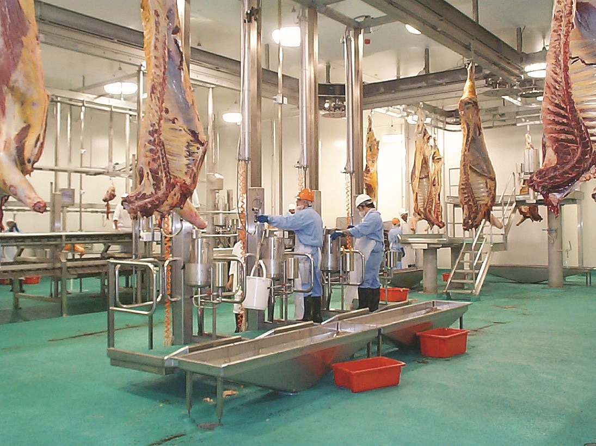
types and components of abattoir

Slide 2
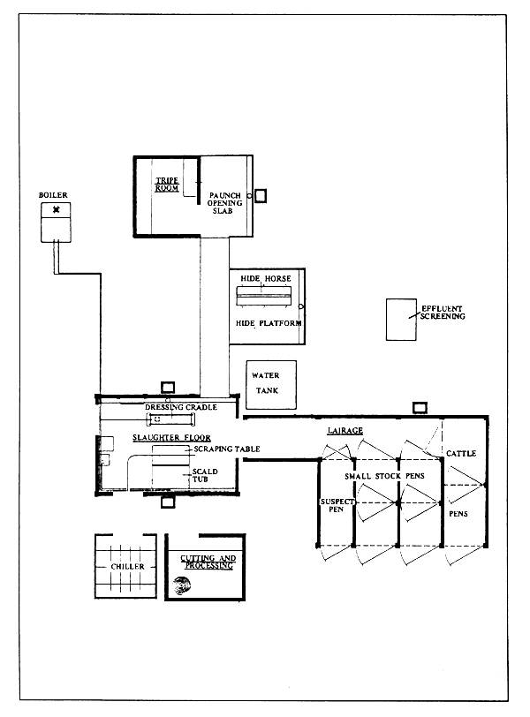
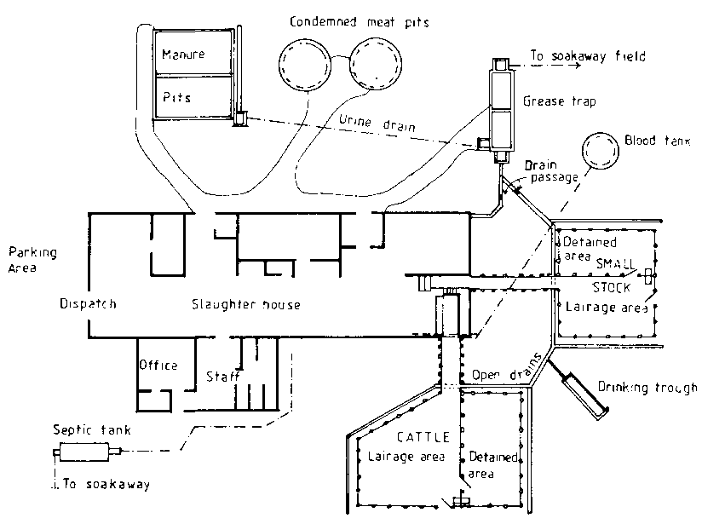
Principles of construction
Absolute need-expansive affair
Multiple abattoir-religion
Slaughter capacity
Experienced people
Primary goal
Economics
Facilities

Slide 3
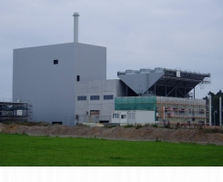
Hygienic principles
Separation between clean and dirty area
Unidirectional processed floor
Pest proof window
No cracks in floor and walls
Away from human dwelling
Closer to animal production area
Separate slaughter for different species
Different entrance and dispatch area

Slide 4
Slaughter capacity- livestock unit (LU)
1 LU= 1 cattle= 2 pigs= 3 calves= 5 sheep
Through put-number of animals to be
slaughtered per hour or per day

Slide 5
Size of abattoir
Small abattoir- 1-2 acres, upto 30000 LU per year
Medium abattoir- 2-4 acres, upto 50000+ LU per year
Large abattoir- 4-6 acres, > 1 lakh LU per year

Slide 6
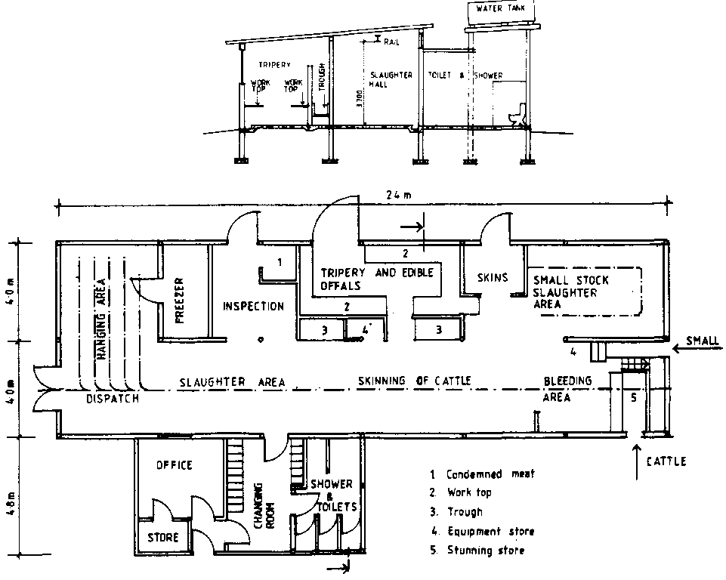

Slide 7
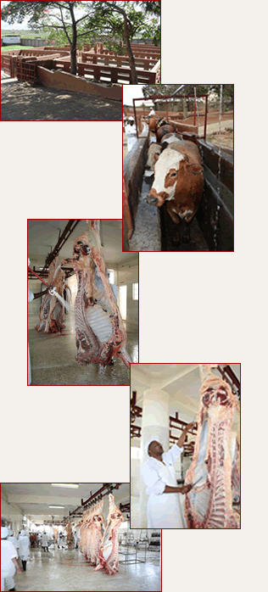
Selection of Site
Away from human dwelling (45 km from airport)
Contiguity with uncongested roads
Main municipal water supply
Electricity supply
Facility for municipal sewage
No water logging and free from flood

Slide 8
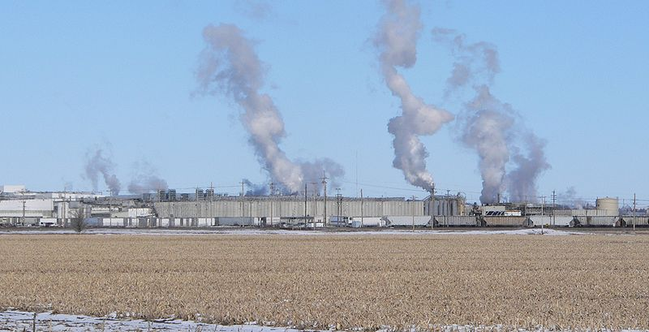
Selection of Site
Cheap labor
Proximity of public transport system
Site free from pollution of other industries
Good availability of raw material
Future expansion

Slide 9
Three types of site
Urban site- should be avoided
Nominated industrial site- good facilities but problems of other industries and future expansion
Rural site- no availability of basic constituents

Slide 10
Construction of abattoir
Clearance / licenses by state animal husbandry
NOC from environmental ministry
Approval for electricity, water supply, labor, appropriate of weight and measures
Environmental impact assessment from environmental ministry during construction and operational phase
License from APEDA for export purpose

Slide 11
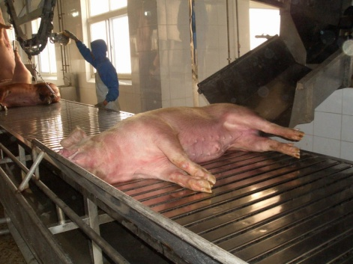
Facilities in abattoir
Receiving area
Adequate lairage
Slaughter hall
Emergency slaughter hall
Blood room
Suspect meat room
Condemned meat room
Weighing cabin
Processing room

Slide 12
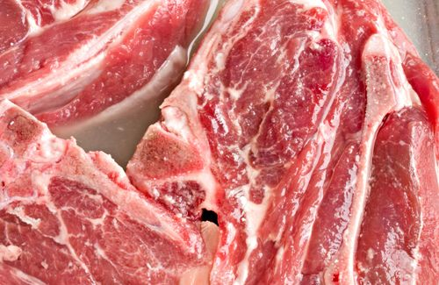
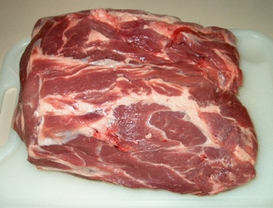
Facilities in abattoir Cont…
Edible offals room
Inedible offals room
Room for emptying stomach and intestine
Gut and tripe dressing room
Hide room
Storing room for horns, hooves, bristles

Slide 13
Facilities in abattoir
Cont…
Exclusive room for veterinarian
Maintenance room
Veterinary laboratory
Cold storage room
First aid room
Changing room
Toilets
Canteen/dinning room
Bins/ trolley washing room

Slide 14
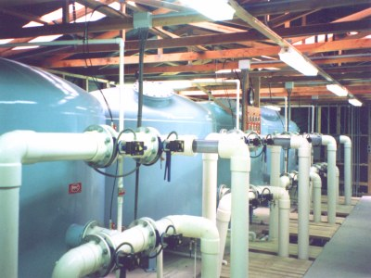
Water supply
Portable & non portable water supply
Red coating of pipes for non portable water
No leakage & no drainage of blood to water
Proper storage & purification facilities
15 psi & hot water at 82⁰C
For slaughtering area only:
    Cattle-272 liters
    Pigs-454 liters
    Sheep/goat-45 liters
    (+ 25% extra for each)

Slide 15
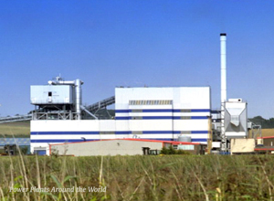
Electricity
3 phase industrial supply
Stand by generator facility
Electrical steam boiler for hot water supply
Ventilation
Essential for hygiene to avoid damping, rusting of equipment's
To avoid accumulation of heat and condensation of moisture
Facility of extractors and ventilators
Screened openings

Slide 16
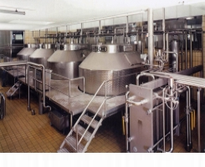
Drainage
In wet area- slope should be 1:50
Below the rails, valley- slope 1:20
1 drain for every 40 square meters
Drainage should be in proper trap figures to prevent escape of gases, insects and to avoid entry of meat and bone pieces
Equipment's
Non rusted materials
If wooden, proper lamination

Slide 17
Lightening
Adequate natural and artificial light
Direct solar rays should be avoided
Monochromatic light
Intensity of light:
# Inspection area- 540 lux at 50 foot candles
# Working area- 220 lux at 20 foot candles
# Other areas- 110 lux at 10 foot candles
    (Measurement of light from 0.9 meter / 3 feet)

Slide 18
Floor and wall finishes
Capable of easily cleaned and sanitized
Ceiling should be laminated
Made up of non slippery, non absorbent and non toxic material
No sharp corners
Finishing with tiles upto 3 meter height
Floor of reinforced concrete, apoxyfloors, industrial tiles
Walls of tiles, stainless steel or al sheets

Slide 19
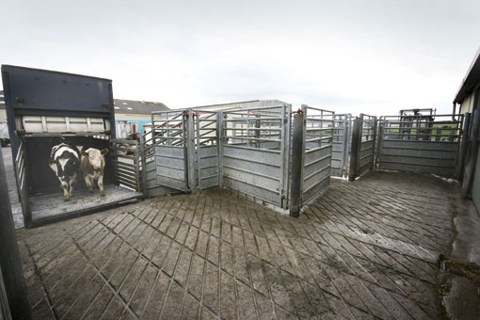
Receiving area
Non slippery, adequate space
Unloading vehicle and unloading ramp height should be equal
Separation of bullying and aggressive animals
Sufficient time to move forward, no beating
No sudden moving objects, curved path instead of straight path
Near to vehicle washing area

Slide 20
Lairage
Main objective to provide rest and to accumulate the animals before slaughter
Near to receiving area
Proper ventilation and light supply
Feeding of animals if kept for longer period
Ad libitum water supply
Prime importance to animal natural behavior

Slide 21
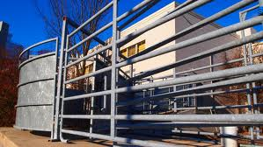
Lairage
Stock density:
Cattle- 2.3 m²/ animal
Pig- 0.6 m²/ animal
heavy pig (>100kg)- 0.7 m²/animal
Cattle-7.6m×6.0m for 20-25 cattle, gate should be 2.4 m wide

Slide 22
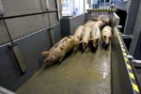
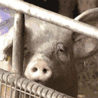
For sheep- 0.9 m height and 0.9 m wide
Cattle and sheep can be housed under one roof but not pigs
Pig-pens should be long and narrow, fine water spray

Slide 23
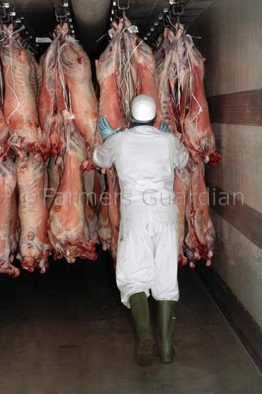
Slaughter hall
Provision of stunning, slaughter and dressing
Open hall with generous floor space
Two types of system:
1. Booth/ floor system
2. Over head rail system:
A. Gravity rail system
B. Intermittent power system
C. Continuous power system
D. Canpak system

Slide 24
Gravity rail system- carcass moves through gravity by pitch of the rail and stopped at particular point, lowest through put
Intermittent power system-lever will carry the carcass as per the predetermined time, power is supplied, 10-75 cattle/hour
Continuous power system- no stoppage, mechanically more complex, 40-120 cattle/hour
Canpak system- by canada packers ltd., Carcass suspended by runner. 50-150 cattle/hour

Slide 25
Emergency /casualty slaughter
# For acute pain, fracture, acute tympanitis, dislocation and chronic cases like downer’s cow syndrome, hip dislocation
# Connected and nearer to suspect meat room and by products room
# From animal welfare point of view

Slide 26
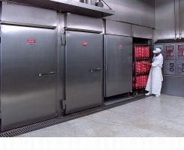
                Chilling room
# Immediately after slaughter, to ante room for 10-15 minutes for drainage of blood and water, then to chilling room
# To attain <7⁰c and PH<6.0
# Series of chilling rooms instead of one
# Temperature 0-4⁰c, RH-88-92%, air velocity-3-5m/sec.
# Floor- smooth, impervious, easily clean and sanitized
# walls- no tiles, made up of laminated gi sheets

Slide 27
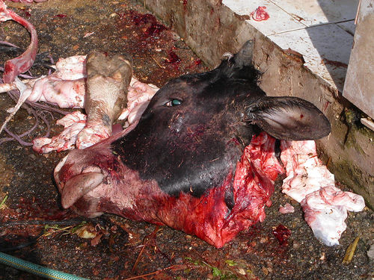
Detained meat room
#Adjacent to slaughter hall
#Also in communication with condemned room and by product room
#Near to laboratory
Condemned meat room
# Direct communication with detained and by products room
Hide and skin store room
#Here flesching machine for removal of meat, fat etc. from hide
# Chute- long cylindrical pipe of stainless steel with large diameter, to transfer some material by vacuum suction without human handling

Slide 28
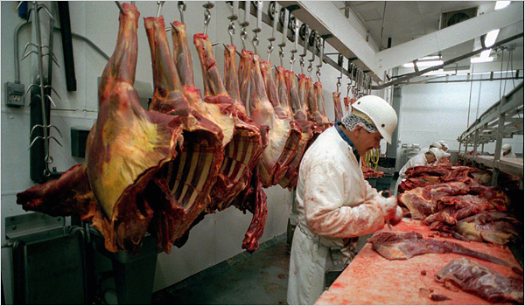
Gut and tripe room
# Transfer of stomach & intestine through paunch conveyor
# Paramentiere- big drums, having rough surface with sodium carbonate and hot water for scalding of rumen, reticulum etc. to remove mucous lining
Red offals room
# Tongue, heart, messator muscle, liver etc.
# Washing, cleaning, reexamination & processing

Slide 29
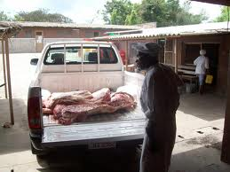
Edible fat room
#Fat obtained by gut and tripe room are stored till dispatch and used for edible purpose
Inedible room
#Denotes rendering unit
#Should be away from edible and processing area
#Also the materials unfit for human consumption is processed here, except hides and skins

Slide 30
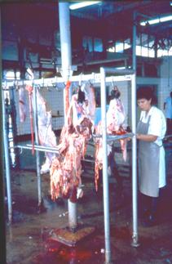
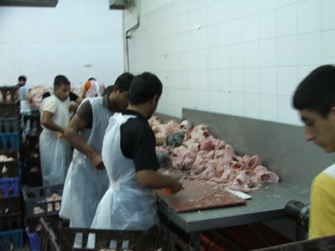
Cutting room
Also known as processing room/ deboning room
Temperature 10-12⁰C, RH-60-70%
Well lightened large room for working of 400-500 people
Floor and walls should be smooth, impervious, easy to clean and sanitize

Slide 31
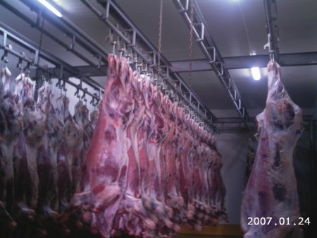
Freezing room
#Temperature maintained at -30 to -34⁰C
#Objective to keep the meat temperature at -18⁰C
#Instead of one large, series of small freezer to reduce the heat load
Dispatch area
#Under Indian conditions no chilling or freezing
#Maintained at 12⁰C
#Docking system, where vehicle will come and remain in close contact with area’s entrance

Slide 32
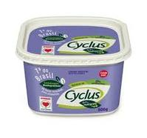
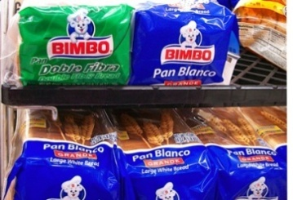
Dry goods store
#Storage for packaging material, tapes, chemicals, meat additives etc.
#Avoid pest infestation
Manure bay (pit)
#Located away from slaughter hall and nearer to the Lairage and animal holding pan
#Stomach and intestinal materials are processed along with manure or separately
#Impervious walls and appropriate drainage

Slide 33
Facilities for personals
Cloak/shower/toilet area
Locker facilities, small prayer hall
Laundry facilities
First aid room
Communication facilities
Canteen /dinning area
Security arrangement

Slide 34
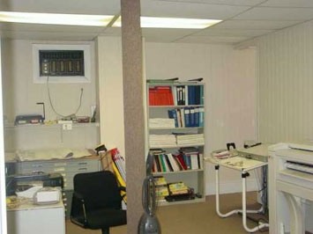
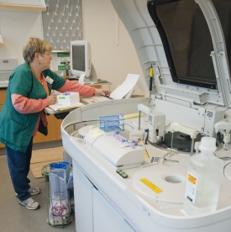
Exclusive veterinarian room
#Well equipped lockable room for exclusive use of veterinary services
#Hand washing, shower facilities, locker for clothing
Veterinary laboratory
#All facilities for water analysis, nutritional, microbial and biochemical analysis
#Mainly for tuberculosis, anthrax, parasitic condition
#For pig/ horse, mainly Trichinellosis

