Slide 1
Department of Veterinary Medicine Bihar Veterinary College, Patna – 800 014 (BASU, Patna)
ANIMAL WELFARE(CLASS-1)
Dr. Ranveer Kumar Sinha Assistant Professor cum Junior Scientist
E-mail: ranveervet@rediffmail.com

Slide 2
INTRODUCTION
As per the Indian tradition and culture, animals always had respect and a special place in society.
Hindu God or Goddess is seen with an animal
With population explosion, urbanization and consumerism catching up, animals are easy prey for human greed and prime candidates for exploitation.

Slide 3
Definition
An animal is in a good state of welfare if (as indicated by scientific evidence) it is healthy, comfortable, well nourished, safe, able to express innate behaviour, and if it is not suffering from unpleasant states such as pain, fear, and distress. Good animal welfare requires disease prevention and veterinary treatment, appropriate shelter, management, nutrition, humane handling and humane slaughter.
Protecting an animal's welfare means providing for its physical and mental needs and when necessary, humane euthanasia.

Slide 4
Example
Calves are kept hungry and emaciated.
Rhesus monkeys and Dancing Bears performing on the streets.
Animals performing in the circuses
Research on animals
With tremendous pressure from animal welfare groups in the developed countries, companies are bringing their research work to India, where the laws are not strict and they can get away with just about anything.

Slide 5
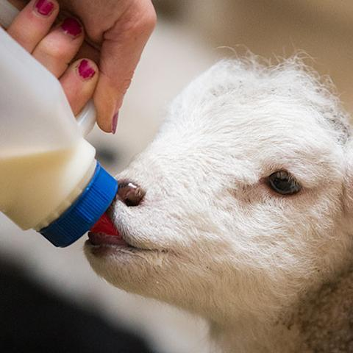

Slide 6
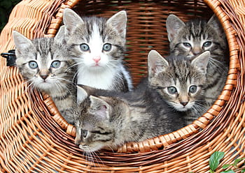

Slide 7
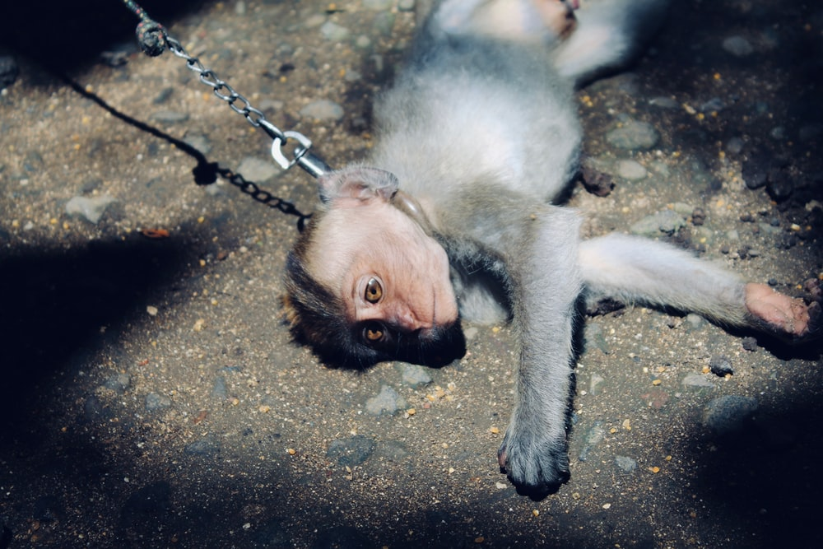

Slide 8
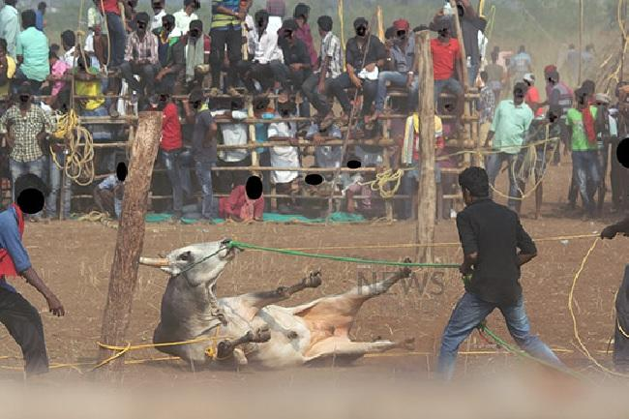
Animal during Jallikattu. PETA seeks ban on this sport

Slide 9
Control
NGOs also treat the sick, injured animals or house the abandon animals(e.g. PETA)
The Government of India is trying to encourage setting up of an SPCA in each District of the country
Adv. of television.
Awareness about animal issues and environment is spreading among youngsters watching channels like Animal Planet, National Geographic and Discovery.
Organize the animal welfare and awareness programs in schools, collages, and socials groups which is playing very effective role in bringing wider vision for animal issues among the adult and children.

Slide 10
THANKS YOU !

