Slide 1
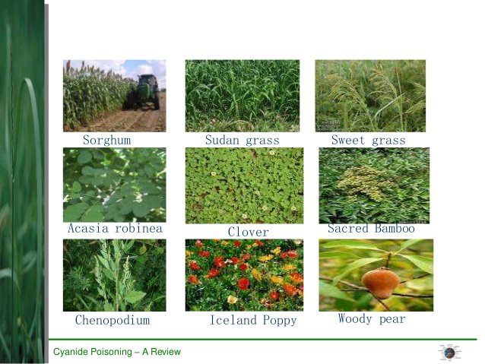
CYANIDE POISONING IN ANIMALS
M.V.Sc Programme:VPP 609
Dr. Sanjiv Kumar,
Assistant Professor,
Department of Veterinary Pathology,
BVC, Patna

Slide 2
Source
Cyanides are found in:
i. plants,
ii. fumigants,
iii. soil sterilizers,
iv. fertilizers and
v. rodenticides (eg, calcium cyanomide).
Toxicity can result from improper or malicious use, but in the case of livestock, the most frequent cause is ingestion of plants that contain cyanogenic glycosides.

Slide 3
Plant Containing Cyanides
Triglochin maritima (arrow grass),
Hoecus lunatus (velvet grass),
Sorghum spp (Johnson grass, Sudan grass, common sorghum),
Prunus spp (apricot, peach, chokecherry, pincherry, wild black cherry),
Sambucus canadensis (elderberry),
Pyrus malus (apple), Zea mays (corn), and Linum spp (flax).
The cyanogenic glycosides in plants yield free hydrocyanic acid (HCN), otherwise known as prussic acid, when hydrolyzed by β-glycosidase or when other plant cell structure is disrupted or damaged, eg, by freezing, chopping, or chewing.
Microbial action in the rumen can further release free cyanide.

Slide 4
Glycosides

Slide 5
Mechanism of toxicity

Slide 7
Factors affecting cyanide concentration
In Sorghum spp forage grasses, leaves usually produce 2-25 times more HCN than do stems; seeds contain none.
New shoots from young, rapidly growing plants often contain high concentrations of prussic acid glycosides.
The cyanogenic glycoside potential of plants can be increased by heavy nitrate fertilization, especially in phosphorus-deficient soils.
Spraying of cyanogenic forage plants with foliar herbicides such as 2,4-D can increase their prussic acid concentrations for several weeks after application.
Grazing stunted plants during drought is the most common cause of poisoning of livestock by plants that produce prussic acid.

Slide 8
Frozen plants may release high concentrations of prussic acid for several days.
After wilting, release of prussic acid from plant tissues declines.
Dead plants have less free prussic acid. When plant tops have been frosted, new shoots may regrow at the base; these can be dangerous because of glycoside content and because livestock selectively graze them.
Ruminants are more susceptible than monogastric animals, and cattle slightly more so than sheep. Hereford cattle have been reported to be less susceptible than other breeds.

Slide 9
Risk factors

Slide 10
Clinical Findings
Signs can occur within 15-20 min to a few hours after animals consume toxic forage.
Excitement can be displayed initially, accompanied by rapid respiration rate.
Dyspnea follows shortly, with tachycardia. Salivation, excess lacrimation, and voiding of urine and feces may occur.
Vomiting may occur, especially in pigs.
Muscle fasciculation is common and progresses to generalized spasms before death.
Animals stagger and struggle before collapse.
Mucous membranes are bright red but may become cyanotic terminally.

Slide 11
Death occurs during severe asphyxial convulsions.
The heart may continue to beat for several minutes after struggling and breathing stops.
The whole syndrome usually does not exceed 30-45 min. Most animals that live ≥2 hr after onset of clinical signs recover, unless continuous absorption of cyanide from the GI tract occurs.

Slide 12
Chronic Poisoning

Slide 13
Lesions
In acute or peracute cyanide toxicoses, blood may be bright cherry red initially but can be dark red if necropsy is delayed; it may clot slowly or not at all.
Mucous membranes may also be pink initially, then become cyanotic after respiration ceases.
The rumen may be distended with gas, and the odor of “bitter almonds” may be detected after opening.
Agonal hemorrhages of the heart may be seen.
Liver, serosal surfaces, tracheal mucosa, and lungs may be congested or hemorrhagic; some froth may be seen in respiratory passages.

Slide 14
Neither gross nor histologic lesions are consistently seen.
Multiple foci of degeneration or necrosis may be seen in the CNS of dogs chronically exposed to sublethal amounts of cyanide.

Slide 15
Diagnosis
Appropriate history, clinical signs, postmortem findings, and demonstration of HCN in rumen (stomach) contents or other diagnostic specimens support a diagnosis of cyanide poisoning.
Specimens recommended for cyanide analyses include the suspected source (plant or otherwise), rumen or stomach contents, heparinized whole blood, liver, and muscle.
Antemortem whole blood is preferred; other specimens should be collected as soon as possible after death, preferably within 4 hr. Specimens should be sealed in an airtight container, refrigerated or frozen, and submitted to the laboratory without delay.

Slide 16
Differential diagnosis
Includes poisonings by nitrate or nitrite, urea, organophosphate, carbamate, chlorinated hydrocarbon pesticides, and toxic gases (carbon monoxide and hydrogen sulfide), as well as infectious or noninfectious diseases that cause sudden death.
Many clinical signs of nitrate and prussic acid poisoning are similar, and injecting sodium nitrite induces methemoglobinemia identical to that produced by nitrate poisoning.

Slide 17
Treatment
Immediate treatment is necessary.
Sodium nitrite therapy may be carefully repeated at 10 mg/kg, every 2-4 hr or as needed.
Sodium thiosulfate alone is also an effective antidotal therapy at ≥500 mg/kg, IV, plus 30 g/cow, PO, to detoxify any remaining HCN in the rumen. Oxygen may be helpful in supplementing nitrite or thiosulfate therapy, especially in small animals.

