Slide 1
History of Microbiology
DR. SUDHA KUMARI
Assistant Professor
DEPARTMENT OF VETERINARY MICROBIOLOGY BIHAR VETERINARY COLLEGE, PATNA -14
Bihar Animal Sciences University , Patna

Slide 2
History of Microbiology
Microbiology is the study of microorganisms.
Or, microbes which is visible only with a microscope.
The diverse group of organisms includes algae, archaea, bacteria, cyanobacteria, fungi, protozoa, viruses.
History of microbiology starts in the 3rd century BC with Hippocrates recording ideas of infections and diseases.
Distribution in Nature:
Omnipresent: nearly everywhere in Nature.
Grow where they get food moisture and temperature suitable for growth. ie

Slide 3
Air,
Soil,
Oceans,
Food we eat
Surfaces of our body and inside alimentary canal
Most of the microorganisms are harmless. 99% are good.
Eg: Cyanobacteria (blue green algae) 1% are bad.
Microbiology includes study of Bacteria Fungi Viruses Protozoa Algae. etc.

Slide 4
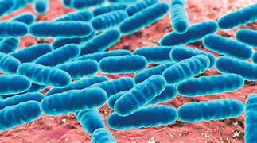
Bacteria:
Size: 0.2-1.5 by 3-5 µm
Characteristics:
Prokaryotic
Unicellular
Simple Internal structure
Grow on artificial laboratory media
Reproduction

Slide 5
Significance:
Some cause diseases
Some perform role in natural cycling of elements and increase soil fertility
Manufacture of valuable compounds in Industry
Viruses :
Size: 0.015-0.2 nm
Important Characteristics:
Do not grow on artificial media require living cells within which they reproduce

Slide 6
Obligate parasites
Electron microscopy required to observe Practical significance
Cause diseases in humans animals plants
Also infect microorganisms
Fungi (Yeasts) Size: 5.0-10.0 µm Important Characteristics:
Eukaryotic
Unicellular
Grow on artificial laboratory media
Reproduction asexual (cell division/ budding) or sexual Practical significance

Slide 7
Some cause diseases
some are used as food supplements
Manufacture of alcoholic beverages
Fungi (Molds)
Size: 2.0-10.0 µm by several mm
Important Characteristics:
Eukaryotic
Multicellular
Many distinctive structural features
Cultivated on artificial laboratory media

Slide 8
Reproduction asexual or sexual.
Significance:
Decomposition of many materials.
Industrial production of many chemicals like antibiotic's.
Can cause diseases.
Protozoa
Size: 2.0-200 µm.
Important Characteristics:
Eukaryotic.

Slide 9
Unicellular Some cultivated on laboratory media while some are intracellular parasites
Reproduction asexual or sexual
Practical significance:
Some cause diseases.
Food for aquatic animals.
Algae
Size: 1.0 µm to several centimetres.

Slide 10
Important Characteristics:
Eukaryotic.
Unicellular or Multicellular.
Photosynthetic.
Most occur in aquatic environments.
Reproduction asexual or Sexual.
Practical significance:
Production of food in aquatic environments.
Source of food and in Pharmaceuticals but some produce toxic substances.

Slide 12
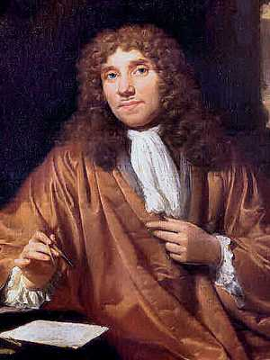
Discovery Era, Transition Era, Golden Era , and Modern Era:
DISCOVERY ERA:
Spontaneous generation
384-322 Aristotle and others believed that living organisms could develop from non-living materials.
In 13th century, Rogen Bacon described that the disease caused by a minute “seed” or “germ”.
Antony Van Leeuwenhoek (1632 – 1723)
Descriptions of Protozoa, basic types of bacteria, yeasts and algae.
Father of Bacteriology and protozoology.

Slide 13
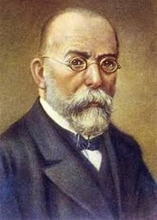
Father of Bacteriology and protozoology.
In 1676, he observed and described microorganisms such as bacteria and protozoa as “Animalcules”.
In 1878, the term microbe is used by Sedillot.
Robert Koch (1893-1910)
Father of Bacteriology.
Introduced methods for isolation of pure culture.
Use of solid media for isolation of bacteria.
Staining techniques.

Slide 14
He demonstrated the role of bacteria in causing disease.
He perfected the technique of isolating bacteria in pure culture.
Discovered Anthrax bacillus (1876),
Tubercle bacillus (1882) and cholera vibrios (1883)
Robert Koch used gelatin to prepare solid media but it was not an ideal because

Slide 15
Since gelatin is a protein, it is digested by many bacteria capable of producing a proteolytic exoenzyme gelatinase that hydrolyses the protein to amino acids.
(ii) It melts when the temperature rises above.
Koch’s postulates
Microorganism can be accepted as the causative agent of an infectious disease only if following conditions are fulfilled
Disease agent must be present in every organism suffering from the disease but should be absent in healthy organism.
It should be possible to isolate the microorganism in its pure culture from lesion of the disease.

Slide 16
The isolated microorganism when introduced into suitable laboratory animal should produce the similar disease
It should be possible to re-isolate the microorganism in its pure culture from lesions.
Produced in experimental animals:-

Slide 18
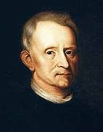
Fanne Eilshemius Hesse (1850 - 1934)
One of Koch's assistant first proposed the use of agar in culture media.
It was not attacked by most bacteria.
Agar is better than gelatin because of its higher melting pointing (96°c) and solidifying (40 – 45°c)points
Robert Hooke 1678
Developed Compound microscope .
.

Slide 19
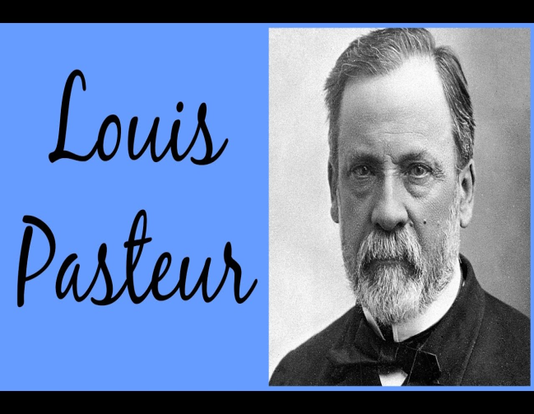
Richard Petri (1887)
He developed the Petri dish (plate), a container used for solid culture media.
GOLDEN ERA: Louis Pasteur
Father of Microbiology.
He pointed that no growth took place in swan neck shaped tubes because dust and germs had been trapped on the walls of the curved necks but if the necks were broken off so that dust fell directly down into the flask, microbial growth commenced immediately.
In 1897, Pasteur suggested that mild heating at 62.8°C (145°F) for 30 minutes rather than boiling was enough to destroy the undesirable organisms without ruining the taste of the product, the process was called Pasteurization.

Slide 20
He invented the processes of pasteurization, fermentation and the development of effective vaccines i.e. rabies and anthrax.
Contributions of Loius pasteur
He coined the term “microbiology”, aerobic, anaerobic.
He disproved the theory of spontaneous germination.
He demonstrated that anthrax was caused by bacteria and also produced the vaccine for the disease.
He developed live attenuated vaccine for the disease.

Slide 21
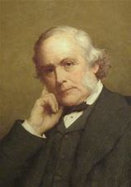
John Tyndall (1820 - 1893)
He discovered highly resistant bacterial structure, later known as endospore.
Prolonged boiling or intermittent heating was necessary to kill these spores, to make the infusion completely sterilized, a process known as Tyndallisation.
Lord Joseph Lister (1827-1912)
Known as father of antiseptic surgery.
Lister concluded that wound infections too were due to microorganisms.

Slide 22
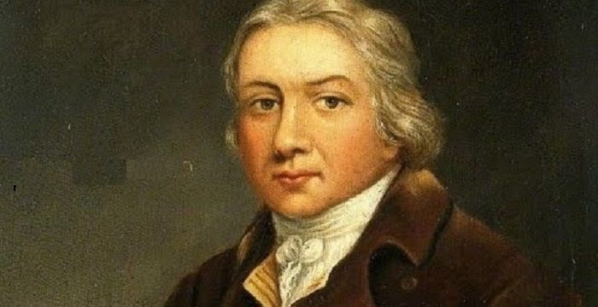
Edward Jenner (1749-1823)
First to prevent small pox.
He discovered the technique of vaccination.
Alexander Flemming
He discovered the penicillin from penicillium notatum that destroy several pathogenic bacteria.
Paul Erlich (1920) Father of Chemotherapy.
He discovered the treatment of syphilis by using arsenic
He Studied toxins and antitoxins in quantitative terms & laid foundation of biological standardization.

Slide 23
Father of Bacteriology and protozoology.

Slide 26
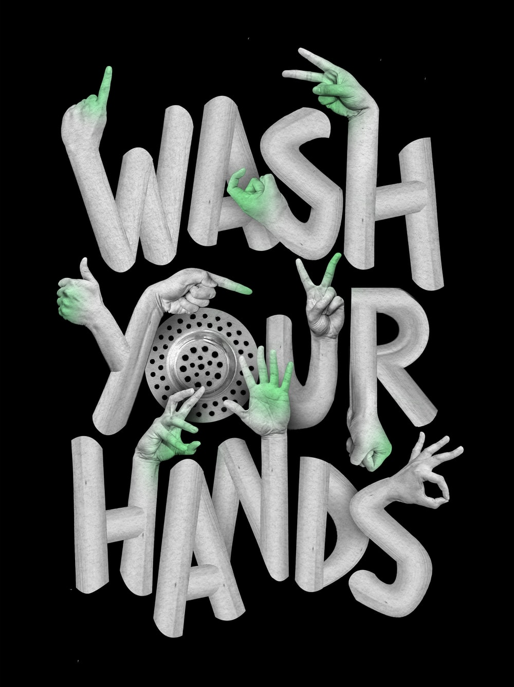
Thank you
Save of life

