Slide 1
Nucleotide Metabolism
Ajeet Kumar

Slide 2
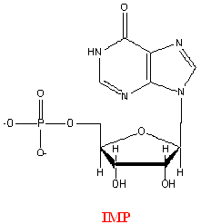
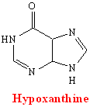
Nucleotide Metabolism
PURINE RIBONUCLEOTIDES: formed de novo
i.e., purines are not initially synthesized as free bases
First purine derivative formed is Inosine Mono-phosphate (IMP)
The purine base is hypoxanthine
AMP and GMP are formed from IMP

Slide 3
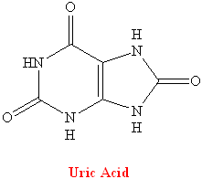
Purine Nucleotides
Get broken down into Uric Acid (a purine) Buchanan (mid 1900s) showed where purine ring components came from:
N₁: Aspartate Amine
C₂, C₈: Formate
N₃, N₉: Glutamine
C₄, C₅, N₇: Glycine
C₆: Bicarbonate Ion

Slide 4
Purine Nucleotide Synthesis

Slide 5
Purine Nucleotide Synthesis at a Glance
ATP is involved in 6 steps
PRPP in the first step of Purine synthesis is also a precursor for Pyrimidine Synthesis, His and Trp synthesis
Role of ATP in first step is unique– group transfer rather than coupling
In second step, C₁ notation changes from α to β (anomers specifying OH positioning on C₁ with respect to C₄ group)
In step 2, PP_{i} is hydrolyzed to 2P_{i} (irreversible, “committing” step)

Slide 6
Regulatory Control of Purine Nucleotide Biosynthesis
GTP is involved in AMP synthesis and ATP is involved in GMP synthesis (reciprocal control of production)
PRPP is a biosynthetically “central” molecule (why?)
ADP/GDP levels – negative feedback on Ribose Phosphate Pyrophosphokinase
Amidophosphoribosyl transferase is activated by PRPP levels
APRT activity has negative feedback at two sites
ATP, ADP, AMP bound at one site
GTP,GDP AND GMP bound at the other site
Rate of AMP production increases with increasing concentrations of GTP; rate of GMP production increases with increasing concentrations of ATP

Slide 7
Purine Catabolism and Salvage
All purine degradation leads to uric acid (but it might not stop there)
Ingested nucleic acids are degraded to nucleotides by pancreatic nucleases, and intestinal phosphodiesterases in the intestine
Group-specific nucleotidases and non-specific phosphatases degrade nucleotides into nucleosides
Direct absorption of nucleosides
Further degradation
Nucleoside + H₂O → base + ribose (nucleosidase)
Nucleoside + P_{i} → base + r-1-phosphate (n. phosphorylase)
NOTE: MOST INGESTED NUCLEIC ACIDS ARE DEGRADED AND EXCRETED.

Slide 8
Intracellular Purine Catabolism
Nucleotides broken into nucleosides by action of 5’-nucleotidase (hydrolysis reactions)
Purine nucleoside phosphorylase (PNP)
Inosine → Hypoxanthine
Xanthosine → Xanthine
Guanosine → Guanine
Ribose-1-phosphate splits off
Can be isomerized to ribose-5-phosphate
Adenosine is deaminated to Inosine (ADA)

Slide 9
Intracellular Purine Catabolism
Xanthine is the point of convergence for the metabolism of the purine bases
Xanthine → Uric acid
Xanthine oxidase catalyzes two reactions
Purine ribonucleotide degradation pathway is same for purine deoxyribonucleotides

Slide 10
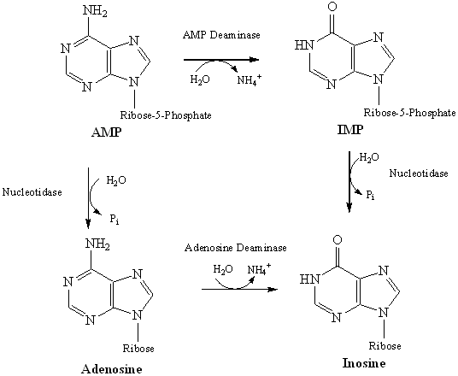
Adenosine Degradation

Slide 11
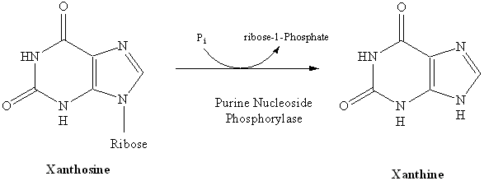
Xanthosine Degradation
Ribose sugar gets recycled (Ribose-1-Phosphate → R-5-P )
– can be incorporated into PRPP (efficiency)
Hypoxanthine is converted to Xanthine by Xanthine Oxidase
Guanine is converted to Xanthine by Guanine Deaminase
Xanthine gets converted to Uric Acid by Xanthine Oxidase

Slide 12
Xanthine Oxidase
A homodimeric protein
Contains electron transfer proteins
FAD
Mo-pterin complex in +4 or +6 state
Two 2Fe-2S clusters
Transfers electrons to O₂ → H₂O₂
H₂O₂ is toxic
Disproportionated to H₂O and O₂ by catalase

Slide 13
Purine Salvage
Adenine phosphoribosyl transferase (APRT)
Adenine + PRPP ➔ AMP + PP_{i}
Hypoxanthine-Guanine phosphoribosyl transferase (HGPRT)
Hypoxanthine + PRPP ➔ IMP + PP_{i}
Guanine + PRPP ➔ GMP + PP_{i}
(NOTE: THESE ARE ALL REVERSIBLE REACTIONS)
AMP,IMP,GMP do not need to be resynthesized de novo !

Slide 14
Gout
Impaired excretion or overproduction of uric acid
Uric acid crystals precipitate into joints (Gouty Arthritis), kidneys, ureters (stones)
Lead impairs uric acid excretion – lead poisoning from pewter drinking goblets
Fall of Roman Empire?
Xanthine oxidase inhibitors inhibit production of uric acid, and treat gout
Allopurinol treatment – hypoxanthine analog that binds to Xanthine Oxidase to decrease uric acid production

Slide 15
Pyrimidine Ribonucleotide Synthesis
Uridine Monophosphate (UMP) is synthesized first
CTP is synthesized from UMP
Pyrimidine ring synthesis completed first; then attached to ribose-5-phosphate
N₁, C₄, C₅, C₆ : Aspartate
C₂ : HCO₃⁻
N₃ : Glutamine amide Nitrogen

Slide 16
Pyrimidine Synthesis

Slide 17
UMP Synthesis Overview
2 ATPs needed: both used in first step
One transfers phosphate, the other is hydrolyzed to ADP and Pi
2 condensation rxns: form carbamoyl aspartate and dihydroorotate (intramolecular)
Dihydroorotate dehydrogenase is an intra-mitochondrial enzyme; oxidizing power comes from quinone reduction
Attachment of base to ribose ring is catalyzed by OPRT; PRPP provides ribose-5-P
PP_{i} splits off PRPP – irreversible
Channeling: enzymes 1, 2, and 3 on same chain; 5 and 6 on same chain

Slide 18
OMP DECARBOXYLASE : THE MOST CATALYTICALLY PROFICIENT ENZYME
FINAL REACTION OF PYRIMIDINE PATHWAY
ANOTHER MECHANISM FOR DECARBOXYLATION
A HIGH ENERGY CARBANION INTERMEDIATE NOT NEEDED
NO COFACTORS NEEDED !
SOME OF THE BINDING ENERGY BETWEEN OMP AND THE ACTIVE SITE IS USED TO STABILIZE THE TRANSITION STATE
“PREFERENTIAL TRANSITION STATE BINDING”

Slide 19
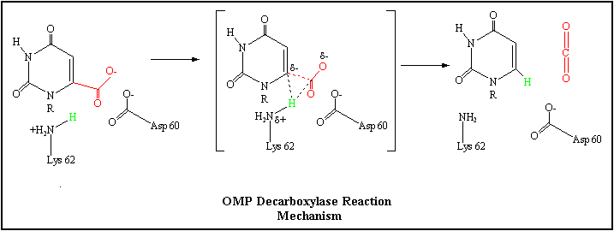

Slide 20
UMP ➔ UTP and CTP
Nucleoside monophosphate kinase catalyzes transfer of P_{i} to UMP to form UDP; nucleoside diphosphate kinase catalyzes transfer of P_{i} from ATP to UDP to form UTP
CTP formed from UTP via CTP Synthetase driven by ATP hydrolysis
Glutamine provides amide nitrogen for C₄ in animals

Slide 21
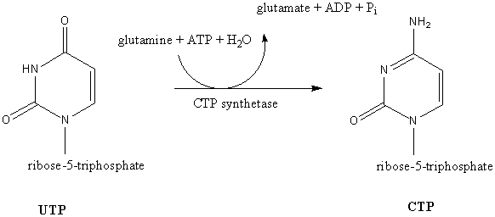

Slide 22
Regulatory Control of Pyrimidine Synthesis
Differs between bacteria and animals
Bacteria – regulation at ATCase rxn
Animals – regulation at carbamoyl phosphate synthetase II
UDP and UTP inhibit enzyme; ATP and PRPP activate it
UMP and CMP competitively inhibit OMP Decarboxylase
*Purine synthesis inhibited by ADP and GDP at ribose phosphate pyrophosphokinase step, controlling level of PRPP → also regulates pyrimidines

