Slide 1
CLIENT MANAGEMENT & PUBLIC RELATION
(Clinical Practice – II, VSR-603)
DR. ARCHANA KUMAR
Assistant Professor
Department of Surgery and Radiology
Bihar Veterinary College, BASU

Slide 2
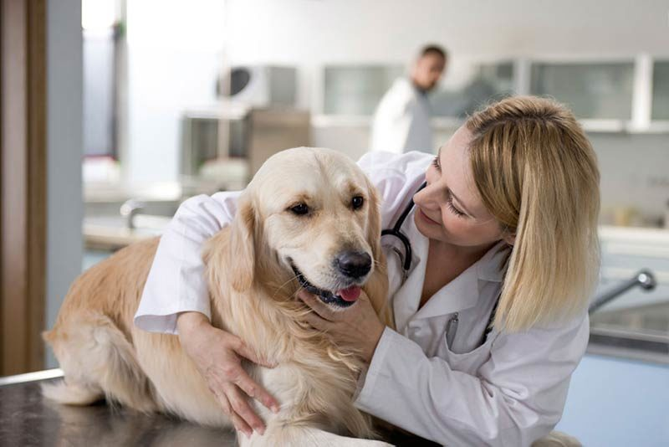
CONTENT
INTRODUCTION.
CLIENT MANAGEMENT.
PUBLIC RELATION WITH VETERINARIAN.
PRINCIPLES OF VETERINARY ETHICS TO PUBLIC RELATION.

Slide 3
INTRODUCTION
Public relation and communications are very important for the proper management of an disease animal . The veterinarian client patient relationship is the basis for interaction among veterinarians their client and their patients and is critical to the health of animals.

Slide 4
Animal that fall sick or get injured receive care and treatment in veterinaries hospital, clinic and practices.
Veterinaries doctors need to keep track of their patient details including information of vaccination diagnostic treatment and follow-up .

Slide 5
CLIENT MANAGEMENT
The veterinarian has sufficient knowledge of the patient to initiate at least preliminary diagnosis of the medical condition of the patient.

Slide 6
2. Veterinarian has assumed the responsibility for making clinical judgments regarding the health of the patient and the client has agreed to follow the veterinarian’s instruction.

Slide 7
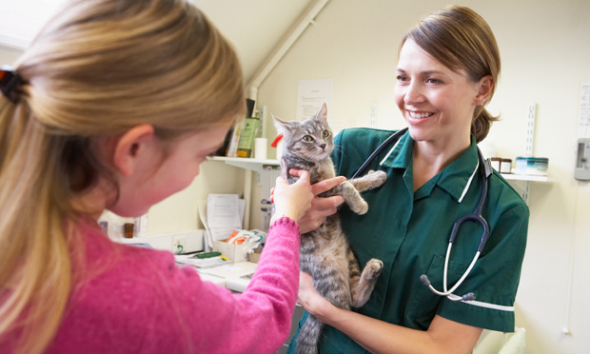
Veterinarian is personally keeping and care of patient with timely examination.
4. Veterinarian has perform any operation than timely visit where the patient is managed.

Slide 8
5. The veterinarian is readily available for follow-up evaluation or has arranged for the following;-
Veterinary emergency
Coverage
Continuing
Treatment
6. Veterinarian have patient records are maintained.

Slide 9
PUBLIC RELATION WITH VETERINARIAN:-
1.Return all call :- do not make the mistake of judging which call are important which are not all client calls are important.
2.Hare technician holds the patient as opposed to the owner. They can generally do a better job and the owners can gives their attention to doctor or just relax and enjoy the office visit.

Slide 10
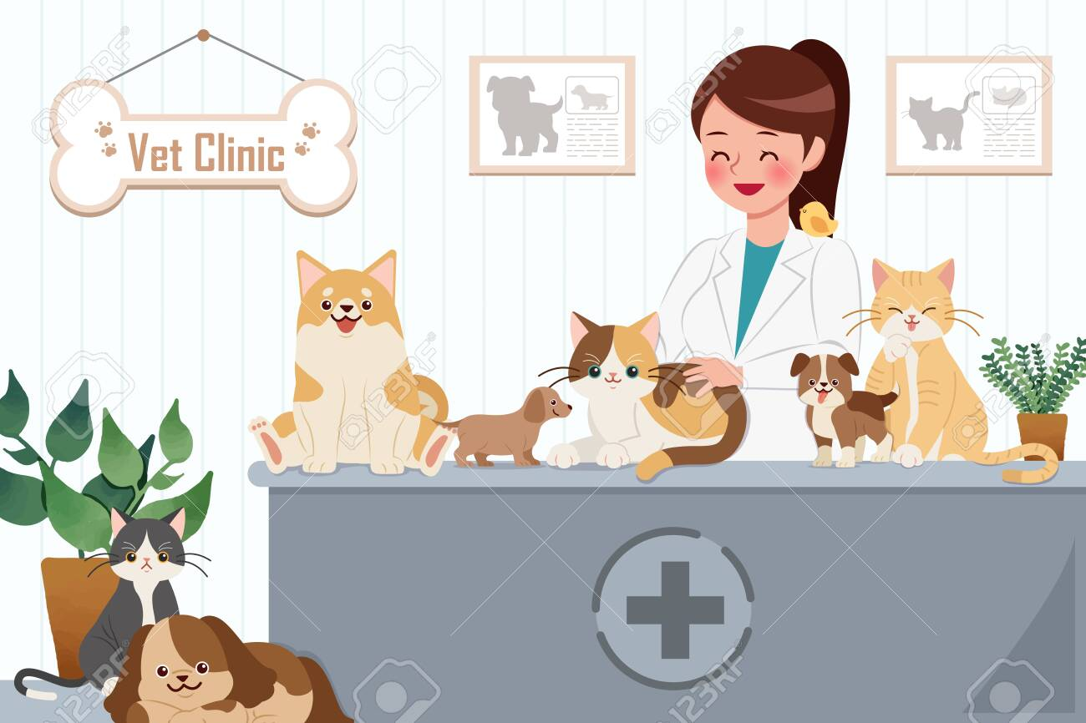
Extend hospital hours for client convenience according to need.
4. Have dog food and other supplies carried out to the car, especially if client has children or is a senior citizen.
5. Allow and encourage to tour clients through the hospitals. Needless to say, your facilities should be spotless.

Slide 11
6. Develop animal placement programmes .Bulletin board with quotes and information posted etc.
Puppy and kitten care kits are placed at good place for hospital information and samples.
Lectures or talk by paraprofessional to local school. Show the animal breed and attracts towards it.

Slide 12
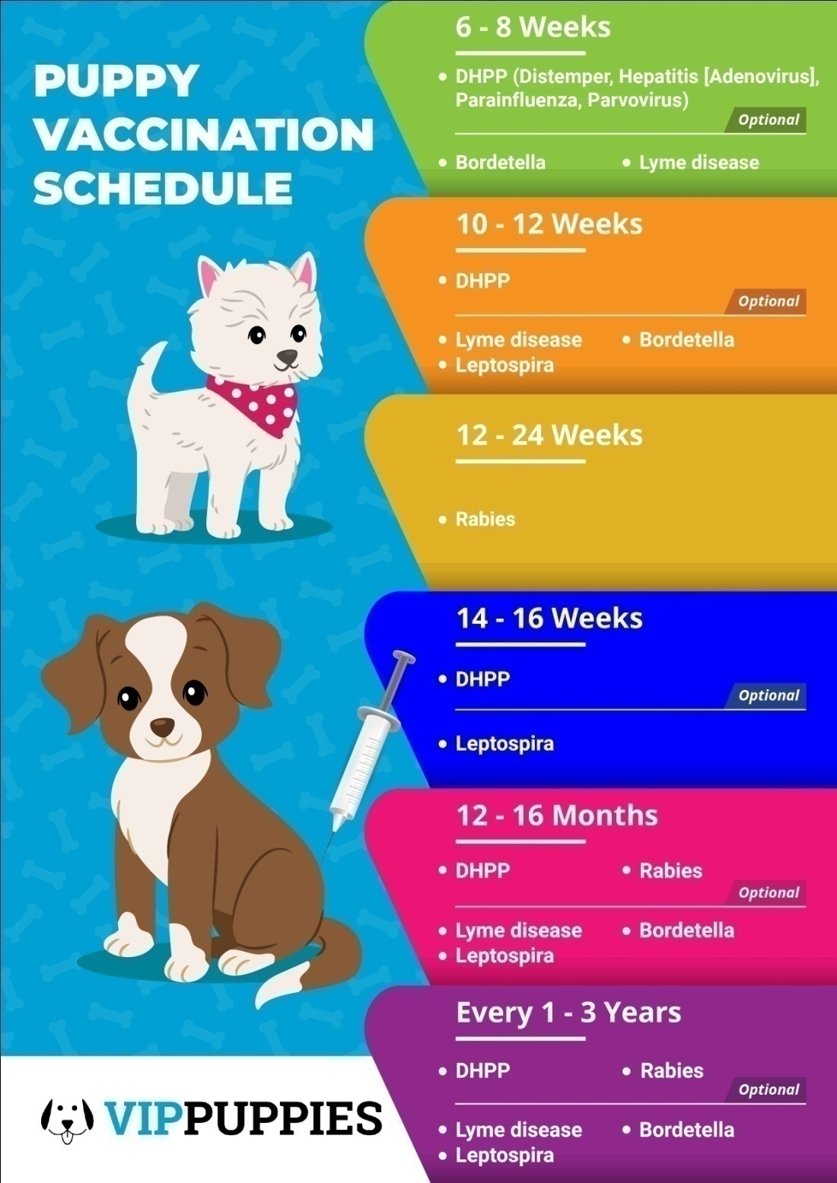

Slide 13
9. No charge for suture removal: This can be way of thanking the client for allowing us to serve them.
10. Newsletters :- A timely information newsletters can educate client about service provide them.
11. Parking should be provided for clients.

Slide 14
Coffee or Tea :- For clients who must wait or arrive early.
Estimated fee:- written Clients sees the value.
Get well card to client :- Those who are ill or hospitalized.
15. Acknowledge newspaper notes about client :- Graduations, wedding, accomplishment ,death etc.

Slide 15
16. Personal notes :- If see something would be of interest to a particular client , like magazine or, newspaper articles etc. make a copy and mail it to them.
17. Staff education :- educated staff represent better view.
18. Computer.

Slide 17
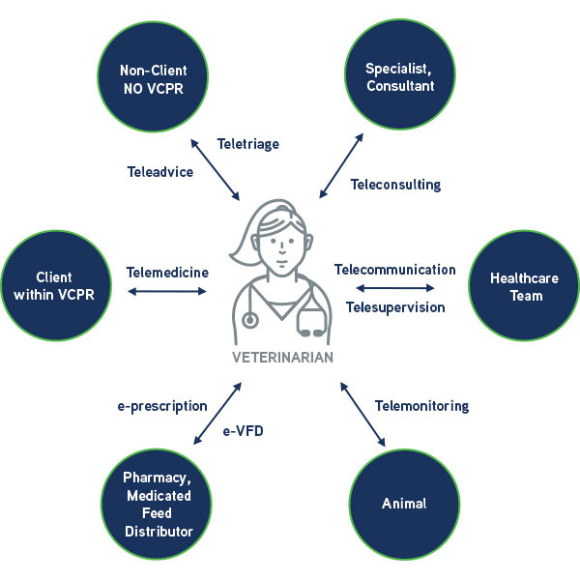

Slide 18
Principles of veterinary ethics related to public relation:-
following principles of veterinary ethics should be followed by every veterinarian:-
1. A veterinarian as a representative of a profession devoted to public service never refuse treatment without a good cause and without ensuring that his action will not be detrimental to the welfare of the patient.

Slide 19
2. A veterinarian called in by the owner of the animal to attend to an urgent case of accident or illness.
3. It is unprofessional for any veterinarian to give testimonial in favour of proprietary or patent article,medicine or, animal foods.

Slide 20
4. The relation between veterinarian whether based on a contract of employement or, whether based on their professional relationship with each other, must be founded on honour , good faith and mutual trust.

Slide 21
No veterinarian should employ or use or permit any unqualified person , whether in his employment or not to
Diagnose any disease of animals
Give an medical treatment to animal
Give any surgical treatment to animal
6. In private practice partnership should be clearly express in writing

Slide 22
When a veterinarian is sitting up in private practice in a district he should communicate to all other veterinarians in that district the knowledge of his setting up in practice and his address and phone no.
8. A veterinarian in private practice devoted to the relief , pain and suffering, should make proper provision for service to the public at all time to be given either through himself, or through other professional colleagues.

Slide 23
9. Unprofessional to advertise or describe himself by titles like ‘consultant’ specialist’ ‘canine’ or ‘feline surgeon’
10. A Veterinarian shall not give or receive any gift or commission from any person for in consideration for the referring or procuring of any client.

Slide 24
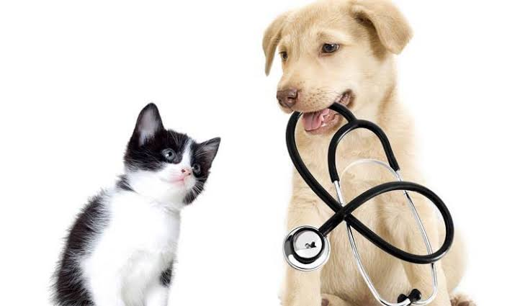
Thank you

