Slide 1
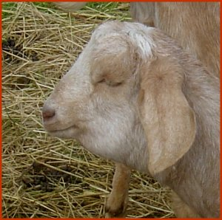
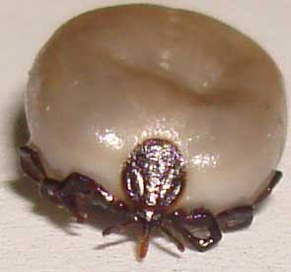
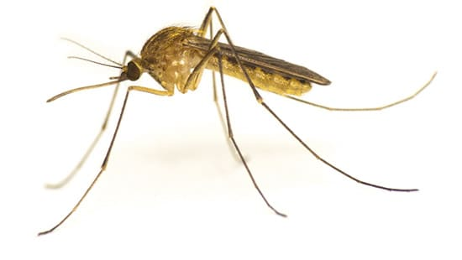
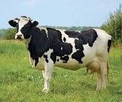
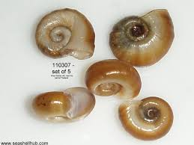
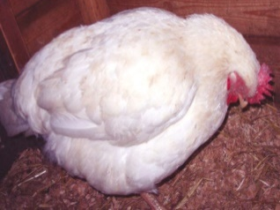
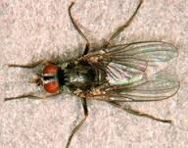
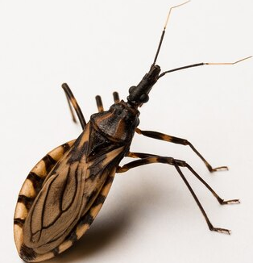
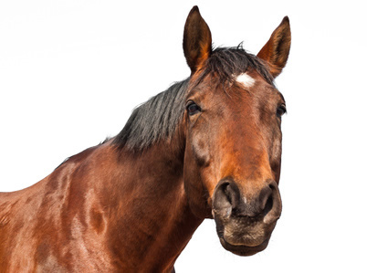
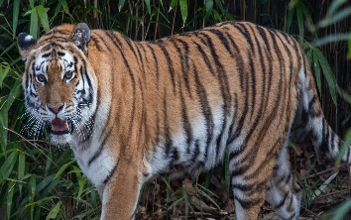
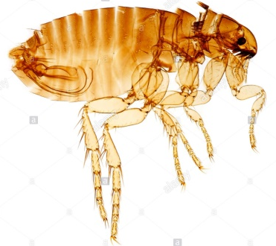
Types of Hosts and Vectors
Dr. AJIT KUMAR
HoD
Department of Veterinary Parasitology
Bihar Veterinary College
Bihar Animal Sciences University
Patna-800014
Image source: Google image

Slide 2
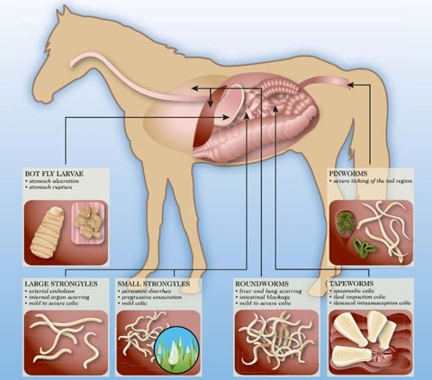
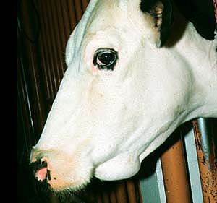
HOST
Host:
It is an organism or animal which carries or harbours a parasite.
It is always larger than the parasite.
Examples-
Parasite Host
Ascaris suum Pig
Fasciola hepatica Sheep
Entamoeba histolytica Man
Image source: Google image

Slide 3
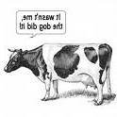
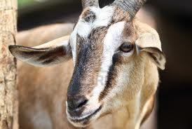
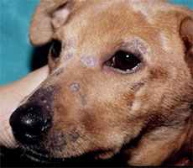
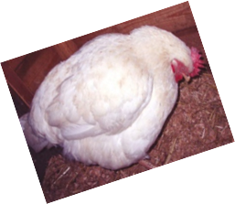
Types of Hosts
Final Host or Definitive Host: Host which harbours the adult stage of the parasite and parasite reach the sexual maturity in it.
Parasites | Common name | Definitive hosts
Toxocara canis | Arrow headed worm | Dog
Syngamus tarchea | Gape worm) | Birds
Oxyuris equi | Pin worm of horse | Horse& Donkey
Paragonimus westermani | Lung fluke | Dog, cat, tiger etc.
Dipylidium caninum | Commonest tapeworm of dog | Dog
Trypanosoma evansi | - | Horse, dog, cattle, Tiger etc.
Eimeria tenella | - | Poultry
Image source: Google image

Slide 4
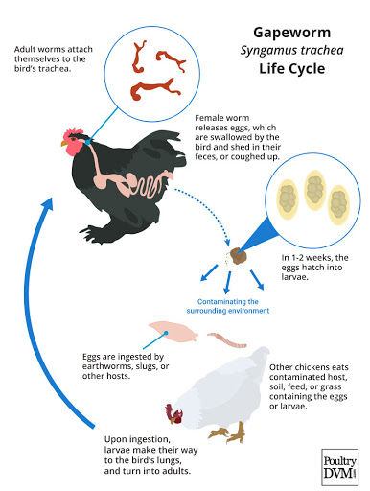
Types of Hosts (Definitive host)
Parasites | Common name | Definitive hosts
Syngamus tarchea | Gape worm) | Birds
Image source: Google image

Slide 5
Types of Hosts (Definitive host)
Parasites | Common name | Definitive hosts
Oxyuris equi | Pin worm of horse | Horse& Donkey
Oxyuris equi
Image source: Google image

Slide 6
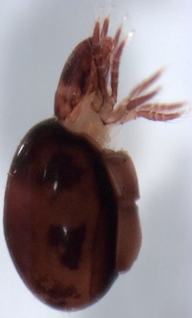
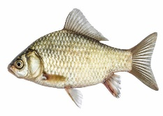
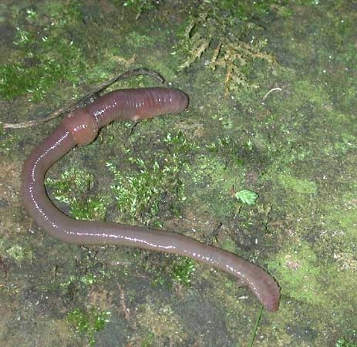
Types of Hosts
Intermediate Host: Host, which harbours the larval stages or the developing stages of the parasite.
Parasites | Definitive hosts | Intermediate hosts (I.H.)
Fasciola hepatica | Cattle, sheep, goat etc. | Snail (Lymanea luteola)
Moniezia expansa | Cattle | Oribatid mite
Taenia solium | Man | Pig, Man
Davainea proglottina ( Smallest tapeworm of poultry) | Poultry | Ant
Dioctophyma renale | Dog | Aquatic annelid ( Oligochaete)
Dicrocoelium dendriticum | Cattle, pig etc. | First I.H.- Snail Second I.H.- Ant
Diphyllobothrium latum ( Fish tapeworm or Broad tapeworm) | Man, dog, cat etc. | First I.H.- Cyclops Second I.H.- Fishes
Image source: Google image

Slide 7
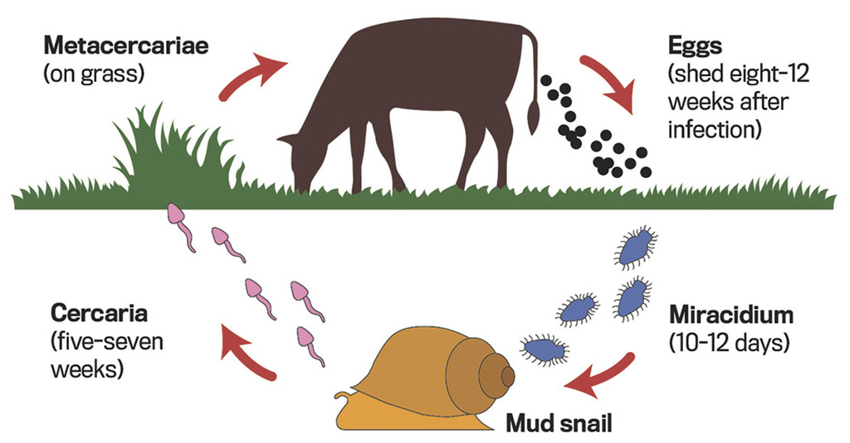
Types of Hosts (Intermediate hosts)
Parasite | Final Host | Intermediate host
Fasciola hepatica ( C.N: Liver fluke) | Cattle, sheep, goat etc. | Snail (Lymnaea luteola)

Slide 8
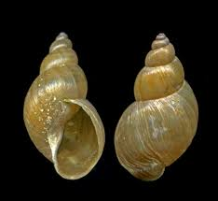
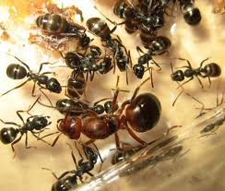
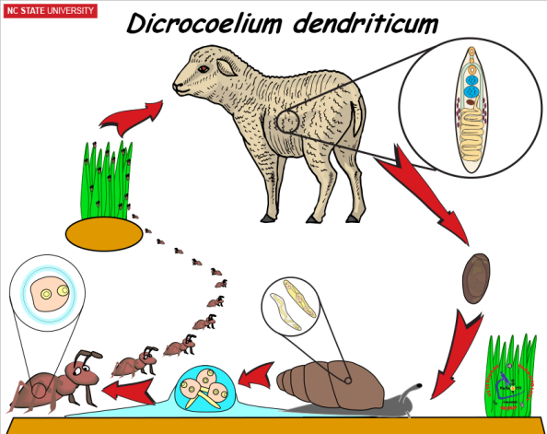
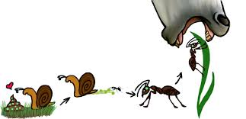
Types of Hosts (Intermediate hosts)
Parasite | Final Host | First Intermediate host | Second Intermediate host
Dicrocoelium dendriticum ( C.N: Lancet fluke) | Cattle, sheep, goat, pig etc. | Land snail ( Cionella etc.) | Ant ( Formica fusca)
Image source: Google image

Slide 9
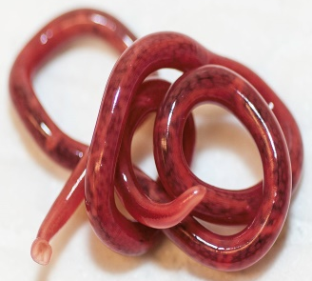
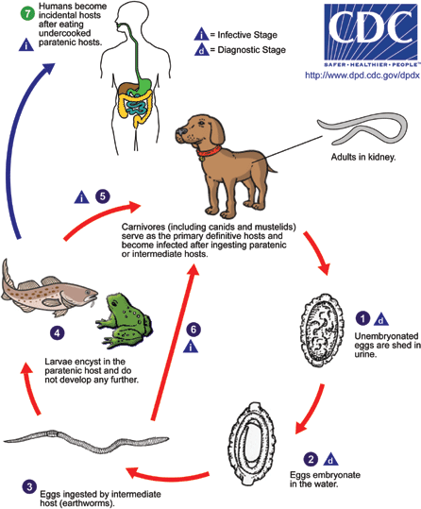
Types of Hosts (Intermediate hosts)
Parasite | Final Host | Intermediate host
Dioctophyma renale ( C.N.: Kidney worm of dog) | Dog | Aquatic annelid ( Oligochaete)
Image source: Google image

Slide 10
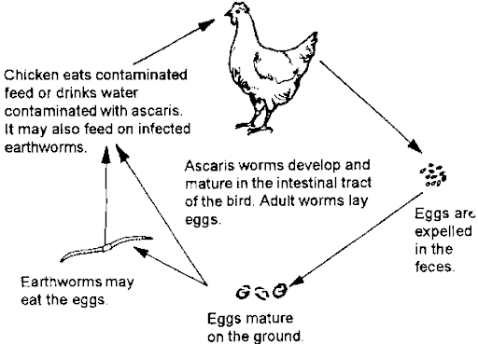
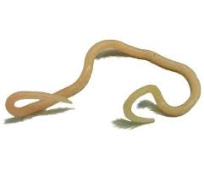
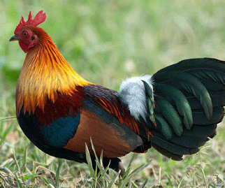
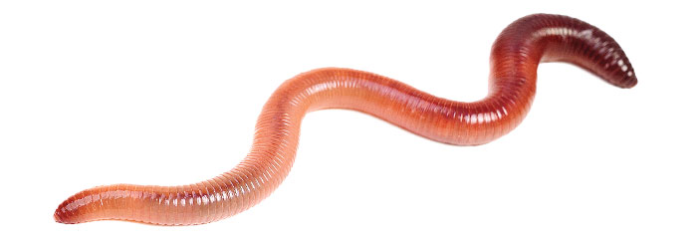
Types of Hosts
Paratenic Host: When the parasitic stage is simply sheltered by a host and no biological development occurs in it.
e.g. Earthworm for Ascaridia galli.
Parasite | Final host | Paratenic host
Ascaridia galli | Poultry | Earthworm
Image source: Google image

Slide 11
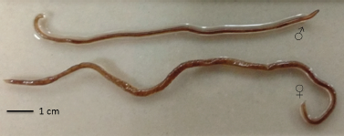
Types of Hosts (Paratenic host)
Parasite | Final host | Intermediate host | Paratenic host
Spirocerca lupi (Common Name: Oeophageal tumour worm of dog) | Dog | Coprophgous beetles | Birds, amphibia, reptiles, lizard , rabbit etc.
Image source: Google image

Slide 12
Types of Hosts
Reservoir Host: It is a vertebrate host, which harbours the parasites without manifesting the disease. It serves as an important source of infection for other definitive host in which it may produce disease.
Parasite | Reservoir host
Balantidium coli | Pig
Trichinella spiralis | Pig
Leishmnia tropica | Rodents

Slide 13
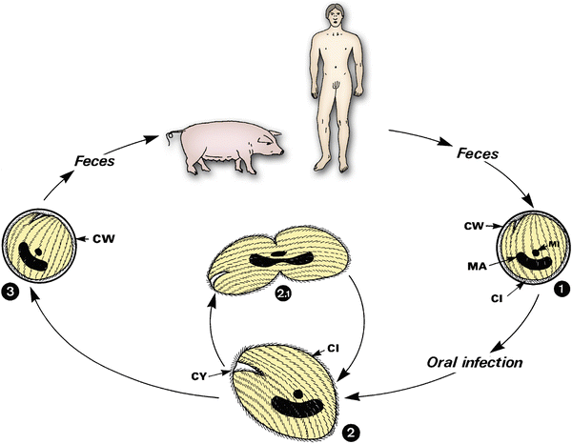
Types of Hosts (Reservoir Host)
Balantidium coli
Image source: Google image

Slide 14
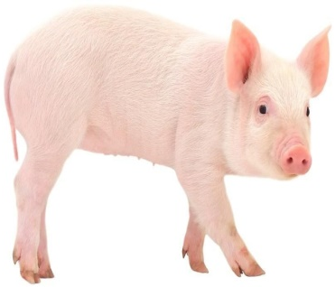
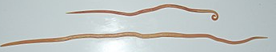
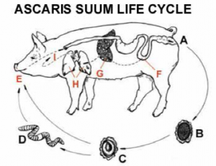
Types of Hosts
Natural hosts: Host which is naturally infected with certain species of parasite.
Parasite | Natural host
Ascaris suum | Pig
Image source: Google image

Slide 15
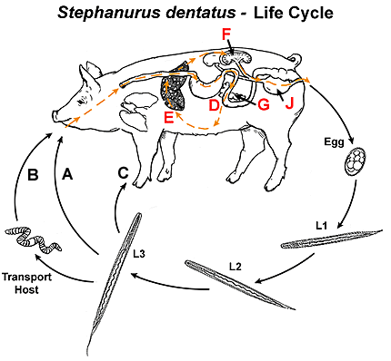
Types of Hosts (Natural host)
Parasite | Natural host
Stephanurus dentatus ( Kidney worm of pig) | Pig
Image source: Google image

Slide 16
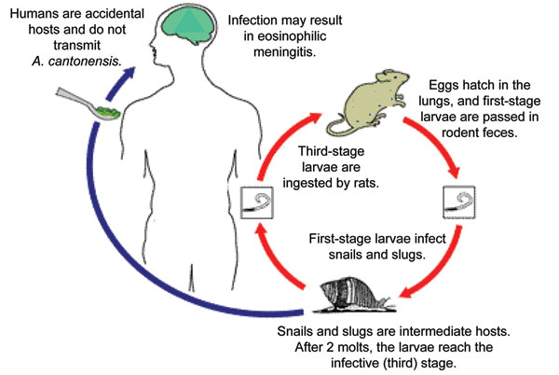
Types of Hosts
Accidental host (Unnatural host): Host in which particular parasite is usually not found but may infect and develop. e.g. Angiostrongylus cantonensis ( Rat lung worm) in man caused eosinophilic meningitis.
Life-cycle of Angistrongylus cantonensis
Image source: Google image

Slide 17
VECTOR
Vector:
It is a Latin word means bearer.
It is usually an arthropod or any other invertebrate which transmits the parasites from vertebrate host to another.
Vector: Two types: Mechanical Vector And Biological vector
Parasites | Definitive host | Vector
Trypanosoma evansi | Domestic animals, wild animals etc. | Tabanus fly
Babesia spp. | Domestic animals, wild animals etc. | Tick
Theileria annulata | Cattle, sheep. Goat etc. | Tick
Plasmodium sp. ( malarial parasite) | Man, birds, etc. | Mosquitoes
Image source: Google image

Slide 18
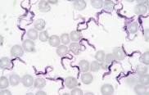
VECTOR
Mechanical vector: Vector in which parasite does not multiply or develop and transmits the parasites in the short period.
Parasite | Definitive host | Mechanical vector
Trypanosoma evansi | Domestic animals, Wild animals etc. | Tabanus fly
Image source: Google image

Slide 19
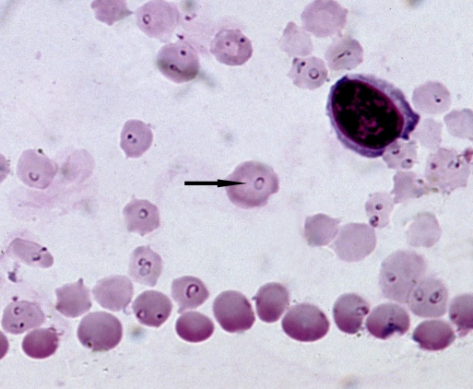
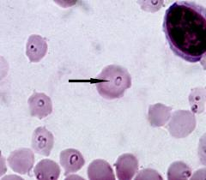
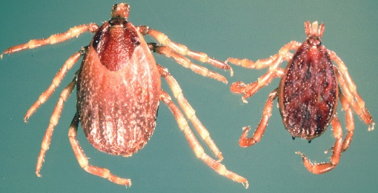
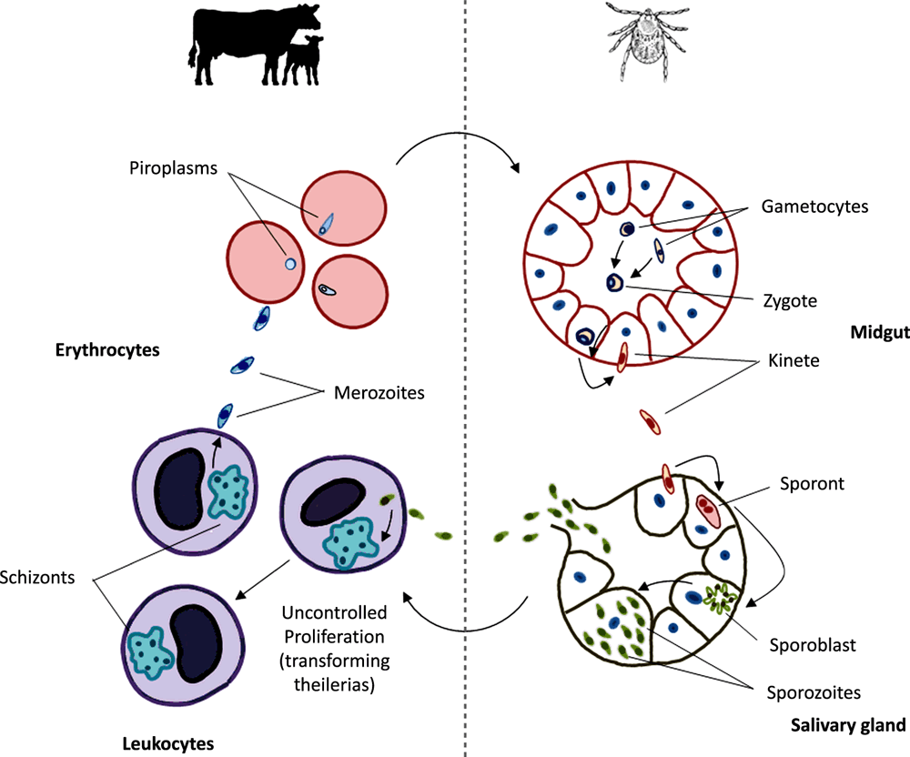
VECTOR
Biological vector: Vector in which parasites develop or multiply and make it infective for a susceptible host.
Parasite | Definitive host | Biological vector
Theileria annulata | Cattle | Tick (Hyalomma anatolicum anatolicum )
Image source: Google image

Slide 20
THANK YOU

