Slide 1
PROCESSING OF MILK (Part-2)
BY-
Dr. SUSHMA KUMARI
HOD,
DEPT. OF LPT,BVC,
Bihar Animal Sciences University, Patna

Slide 2
Milk processing (part-2)
.
4. Filtration- removal of visible foreign matter.
by cloth or strainer.
5. Clarification- removal of foreign matter by clarifier
6. Standardization- refers to the adjustment
i.e. level of fat & SNF % to a desired value.
Can be done by –
Addition of milk or cream with higher or lower fat % or by removal.

Slide 3
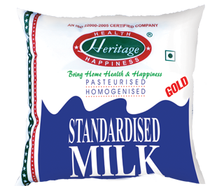
Standardized Milk

Slide 4
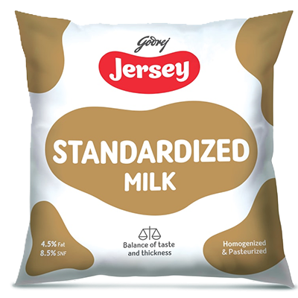
Standardized Milk

Slide 5
7.Pasteurization- term coined by Louis Pasteur of France.
Methods of Pasteurization-
(i) Batch/ Holding / LTLT- 63 C for 30 min. in water jacketed vat.
(ii )HTST- 72 C for 15 sec by plate heat exchanger.
(iii) (vacreation) or Vaccum pasteurization-
Pasteurization of high fat containing milk (more than 6%) or cream under reduced pressure by direct steam.

Slide 6
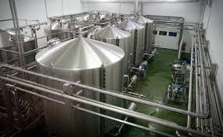
Pasteurization of Milk

Slide 7
HTST Pasteurization

Slide 8
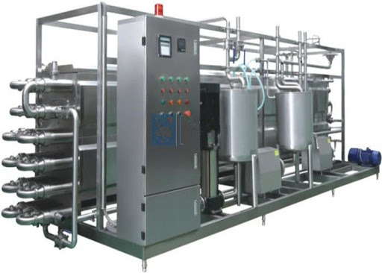
UHT Pasteurization

Slide 9
(iv) Stassanization-
Pasteurization is carried out in a tubular heat exchanger consisting of three concentric tubes. milk is heated to desired temp. ( 74 C for 7 sec) by passing milk between two water heated pipes through the narrow space of 0.6-0.8 mm. The immediately cooled.
(v) UHT (ultra high temperature)-135-150 C for no holding time.
(vi) Uperization- 150 C for a fraction of sec. (1/2 or ¾ sec).

Slide 10
THANKS

