Slide 1
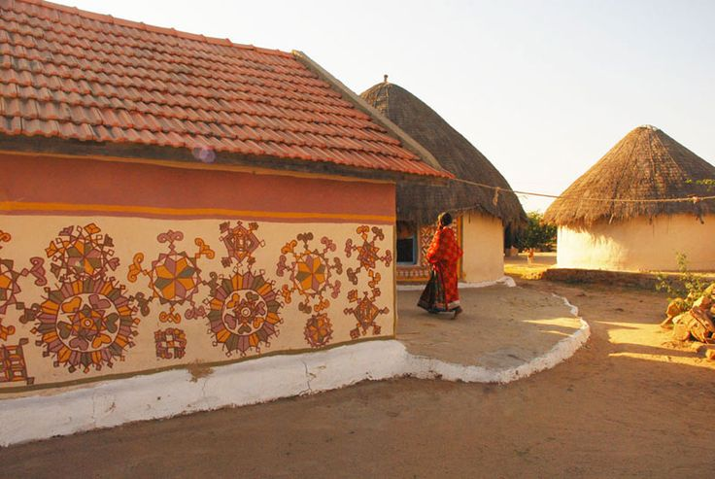
AHE 611 (GENDER AND LIVESTOCK DEVELOPMENT )
05/11/2020
Dr. Pankaj Kumar
Department of Veterinary & Animal Husbandry Extension Education, BVC

Slide 2
women in agriculture and livestock

Slide 3
“In order to awaken the people, it is the woman who have to be awakened. Once she is on move, the family moves, the village moves, the nation moves”
Pandit Jawaharalal Nehru

Slide 4
Status of women worldwide
Women and Poverty
70 % of the 1.2 billion people living in poverty are women
Women as Workers
Women do more than
67% of the hours of work done in the world Earn only 10% of the world’s income
And own only 1% of the world’s property
The value of unremunerated work was estimated at about $16 billion, from which $11 billion represents the invisible contribution of women

Slide 5
Cont…
Women are paid 30-40% less than men for comparable work on an average.
60-80% of the food in most developing countries is produced by women.
Women hold between 10-20% managerial and administrative jobs.
Women make up less than 5% of the world’s heads of state.

Slide 6
Status of women in India
† Census 2001, women - 48.26 % of the total population of India.
Among the total population
† literacy rate -54.16%
† Rural women literacy rate -31.6%
† Urban women literacy rate-54.01%
† Female share of non-agricultural wage employment is only 17%
† Participation of women in the workforce is only
13.9% in the urban sector and
7

Slide 7
Cont…….
Women’s wage rates are, on an average
only 75 % of men’s wage rates
constitute only 25% of the family income
In no Indian State women and men earn equal wages in agriculture.
Women occupy
only 9% of parliamentary seats
less than 4% seats in High Courts and Supreme Court less than 3% administrators and managers are women.

Slide 8
Distribution of women workers in India
Year | Total Female Population Million | Cultivators(%) | Agricultural Labourers (%) | Industry and Service (%)
1951 | 173,543 | 45.3 | 31.3 | 23.3
1961 | 212,467 | 55.7 | 23.9 | 20.4
1971 | 263,900 | 29.6 | 50.5 | 19.90
1981 | 321.357 | 33.2 | 46.2 | 20.6
1991 | 402,813 | 34.5 | 43.6 | 21.9
2001 | 494 million | 36.5 | 43.5 | 20.0
Source : Registrar General of India, New Delhi, 2001

Slide 9
Women – Contribution and Status
Women contribute to two-thirds of the world’s work hours, produce 50 per cent of the world’s food supplies
Women work in fields, take care of families and manage household
Despite the services rendered by women in the family and work place, they make up for nearly 70 per cent of the world’s poor and more than 65 per cent of the illiterates

Slide 10
Share of Farm Women in Agricultural Operations
Activity | Involvement (percentage )
Land preparation | 32
Sowing and cleaning | 80
Intercultural activities | 86
Harvesting –reaping, winnowing, drying, cleaning and storage | 84

Slide 11
Time and Energy Distribution by Rural Women
Activities | Duration Hours/day | Energy K.cal | Percentage
Domestic activities | 7.55 | 903 | 40.5
Agriculture allied activities | 7.00 | 283 | 39.69
Sleep | 6.50 | 283 | 12.76
Rest and recreation | 2.15 | 155 | 6.97
Total | 23.20 | 2255 | 100.0
Joshi (1999)

Slide 12
Why women in agriculture?
In order to eradicating poverty
To ensure food security
To increase their stake in agriculture To increase economic contribution Ownership in land , livestock, etc.

Slide 13
Importance of women in agriculture
Woman is the moulder and builder of any nation’s destiny.
They play a significant role in any economy.
They are regarded as the backbone of the rural scene.
Most of the women perform various types of work for their livelihood and agriculture is considered as the biggest unorganized sector where large number of rural women take part actively.

Slide 14
Multi-Dimensional Role of Women
Agriculture :Sowing,transplanting,weeding,irrigation fertilizer application, plant protection, harvesting, winnowing, storing etc.
Domestic: Cooking, child rearing, water collection, fuel wood gathering, household maintenance.
Allied Activities: Cattle management, fodder collection milking etc.

Slide 15
Cont…
Horticulture: vegetable production, flower production, fruit production.
Sericulture: silk worm rearing, cocoon production.

