Slide 1
AMINO ACID METABOLISM-II
P.G.
VBC-607
Unit-1
10.10.2020

Slide 2
PROTEIN AND AMINO ACID
METABOLISM
1. Body proteins have life times. They undergo degradation and re-synthesis. About 6 gm of protein is synthesized and broken down per kg body weight per day.
2. Aged proteins, damaged or modified proteins and non-functional proteins of the body undergo degradation.
3. Protein degradation may play important role in shaping tissues and organs during pregnancy and development.
4. In starvation, diabetes and tissue injury, protein degradation is more.
5. Protein synthesis and degradation is an integral part of cellular adaptation to changed environment.
6. Excess amino acids can not be stored in the body. First amino group is extracted as ammonia and then carbon skeleton is oxidized to produce energy.
7. Ammonia, which is toxic to cells is converted to urea in the liver. Conversion of ammonia to urea is impaired in some inherited diseases and liver disease.
8. Amino acids are needed for the formation of specialized products like hormones, purines, pyrimidines, porphyrins, vitamins, amines, creatine and glutathione.
9. Amino acid degradation is impaired in several inherited diseases due to lack of enzymes.
10. Amino acid degradation is more in starvation, diabetes and high protein diet.
11. Some cancer cells have high amino acid (aspargine) requirement.

Slide 3
Nitrogen Balance
An individual’s nitrogen balance is dependent on a combination of:
1) Dietary nitrogen intake
2) Physiological state
Nitrogen balance status can be:
1) In balance
2) Positive
3) Negative

Slide 4
1) In balance
Nitrogen intake = nitrogen excretion
Dietary amino acids, nucleotides etc.
Urine, faeces, hair and skin loss, perspiration

Slide 5
2) Positive
Nitrogen intake > nitrogen excretion
Possible causes:
Childhood and adolescent growth
Pregnancy
Body building

Slide 6
3) Negative
Nitrogen intake < nitrogen excretion
Possible causes:
Illness
Starvation
Post-surgery

Slide 7
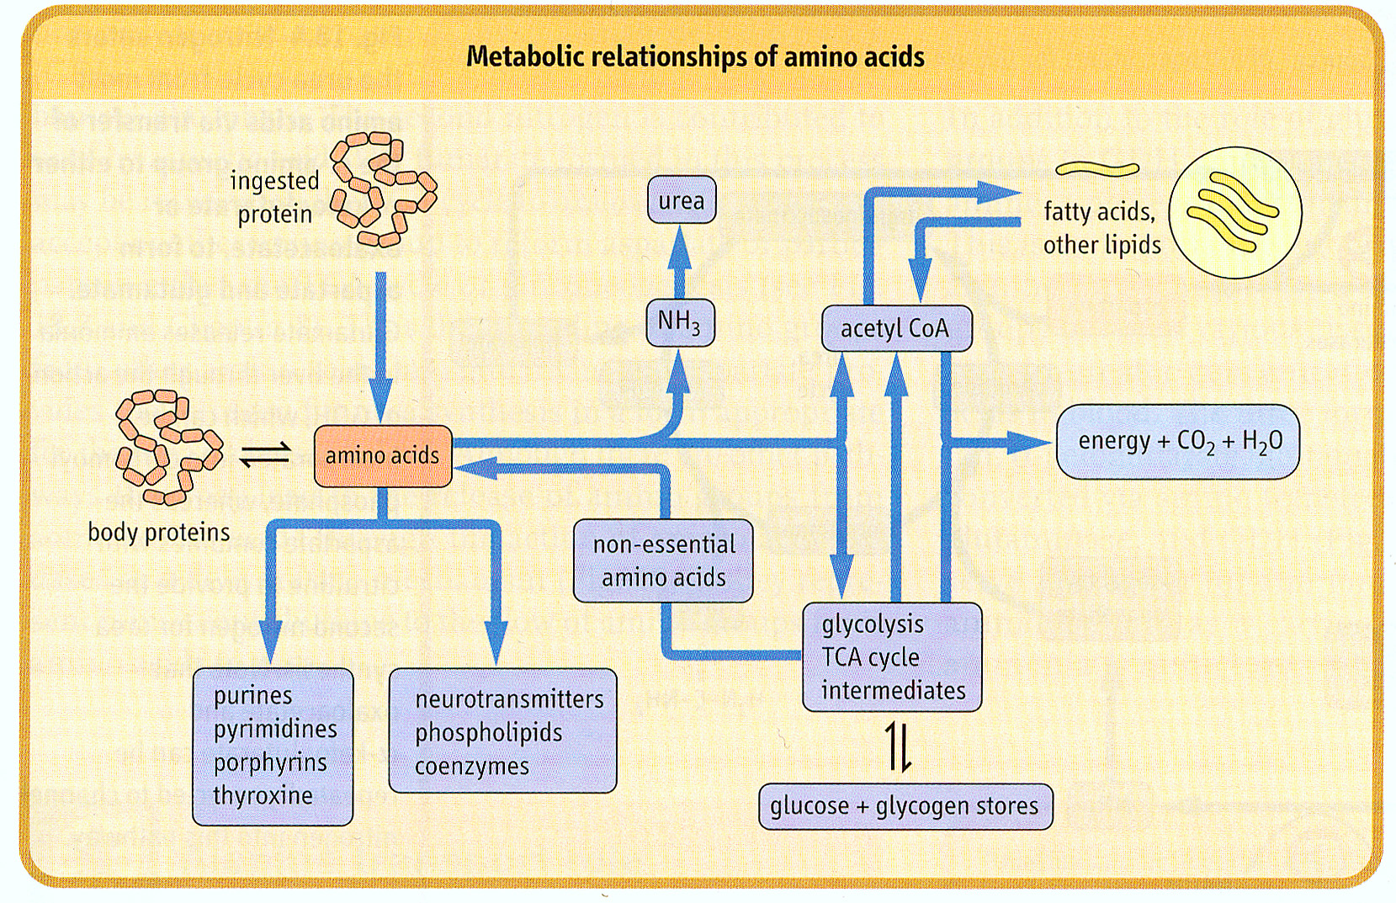
Amino acids are the major source of dietary N

Slide 8
Excess or insufficient dietary amino acid intake leads to the catabolism of amino acids
Excess amino acids can be used for energy
Insufficient dietary amino acids lead to the catabolism of proteins
For amino acids to be utilised for energy, they must have their a-amino groups removed
Amino acid metabolism
Metabolism of amino acids differs, but 3 common reactions:
Transamination
Deamination
Decarboxylation

Slide 9
Transamination
In transamination
Amino acids are degraded in the liver.
An amino group is transferred from an amino acid to an α-keto acid, usually α-ketoglutarate.
The reaction is catalyzed by a transaminase or aminotransferase.
A new amino acid, usually glutamate, and a new α-keto acid are formed.
9

Slide 10
Role of transamination in metabolism
Transamination allows for:
1) the generation of amino acids in short supply
2) the provision of carbon skeletons for energy generation
3) the safe removal of excess amino groups

Slide 11
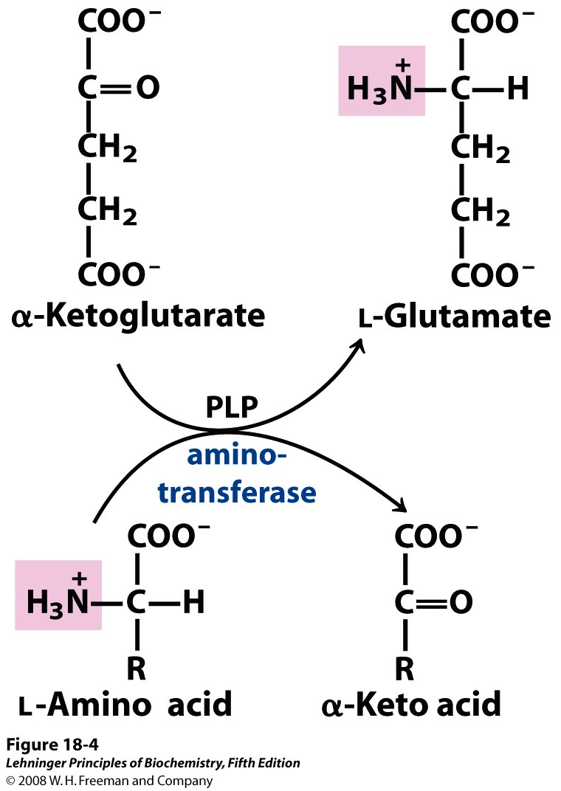
Enzymatic Transamination
Typically, α-ketoglutarate accepts amino groups
L-Glutamine acts as a temporary storage of nitrogen
L-Glutamine can donate the amino group when needed for amino acid biosynthesis
All aminotransferases rely on the pyridoxal phosphate cofactor

Slide 12
Amino Group Transfer - Aminotransferase
Enzymatic removal of α-amino groups

Slide 13
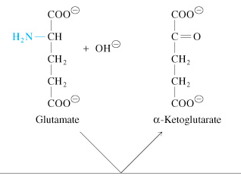
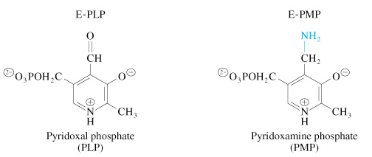
Ping-pong kinetics of aspartate transaminase
(next slide)

Slide 14
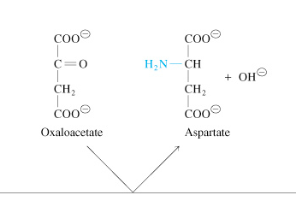
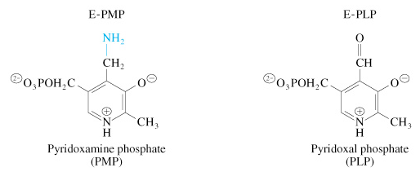
(from previous slide)

Slide 15
Transamination
Notes:
Figure 7.22 Transamination reactions. Transfer of an amino group from alanine (top) and aspartate (bottom) to form other amino acids from their respective α-keto acids.
Transamination reactions involve the transfer of an amino agroup from one amino acid to an amino acid carbon skeleton or alpha keto acid. The carbon skeleton/alpha keto acid that gains the amino group becomes an amino acid, and the amino acid that loses its amino group becomes an alpha keto acid. Enzymes catalyzing these reactions typically require vitamin B6 in its coenzyme form, pyridoxal phosphate.
Amino transferases are found in different concentrations in different tissue and serum concentrations can be an indicator of trauma to a particular organ.

Slide 16
The 3-C α-keto acid pyruvate is produced from alanine, cysteine, glycine, serine, & threonine.
Alanine deamination via Transaminase directly yields pyruvate.

Slide 17
The 4-C Krebs Cycle intermediate oxaloacetate is produced from aspartate & asparagine.
Aspartate transamination yields oxaloacetate.
Aspartate is also converted to fumarate in Urea Cycle. Fumarate is converted to oxaloacetate in Krebs cycle.

Slide 18
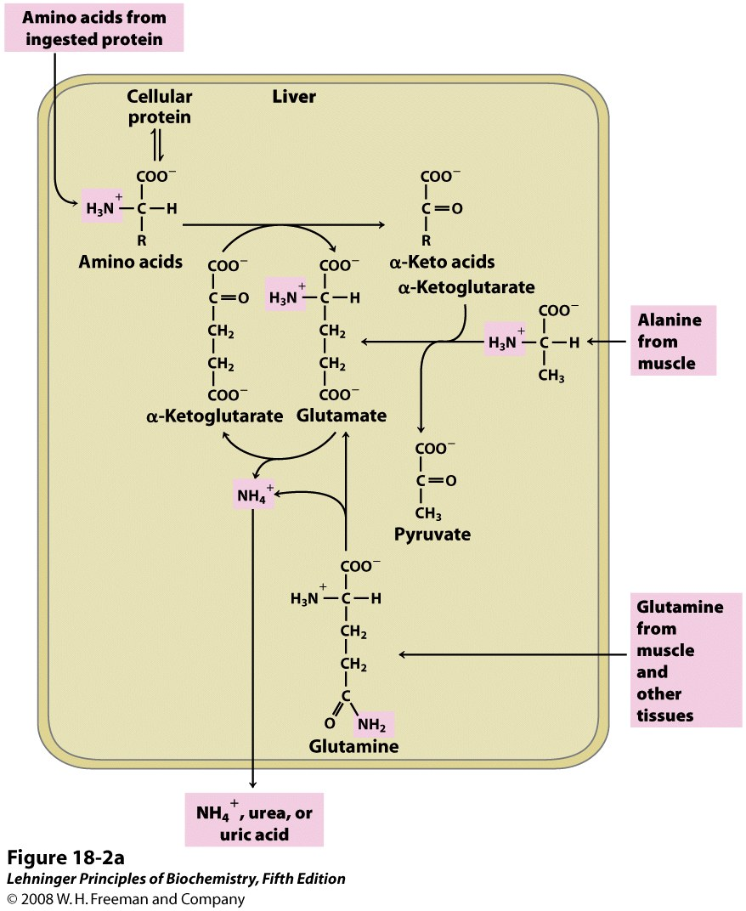
The Amino Group is Removed From All Amino Acids First

