Slide 1
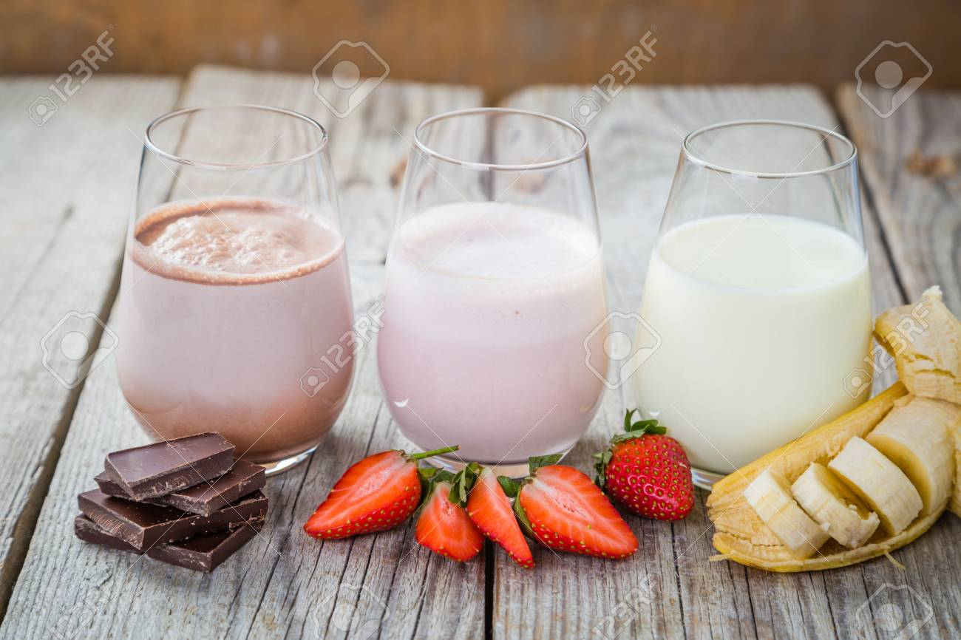
Flavoured milk
Department- Dairy Technology
Semester-5th
Course-By Product Technology
Teacher- Bipin Kumar Singh

Slide 2
Flavoured milk
Flavoured milk is a dairy drink made with milk, flavourings and sugar, often enriched with vitamins and calcium. As a result, these drinks have traditionally been targeted at children and are included in school meal plans in several countries, for example in the US and India.

Slide 3
Types
Chocolate Marshmallow Milk.
Cherry Milk.
Caramel Milk.
Peppermint Milk.
Banana Milk.
Warm Vanilla Milk.
Rose Milk.
Lavender Milk Steamer.

Slide 4
Health Benefits
Flavoured milk contains all the same nutrients and health benefits of plain milk. Although many varieties contain added sugar, evidence shows flavoured milk does not lead to weight gain or tooth decay. Drinking flavoured milk also helps increase intake of the dairy food group.

Slide 5
Cont...
Flavored milk, either cow, soy, almond, or camel, contains sugar, colorings, and flavorings (one prominent example being the artificial strawberry flavor, ethyl methylphenylglycidate). These flavorings can be sold as a powder to be added to plain milk, or bought pre-mixed alongside other milk products. Flavoring can be included in a straw, and some flavored milk products are designed as dietary supplements by including additional vitamins or minerals.

Slide 6
Preparation of Chocolate Milk Drink
The milk on receipt is standardized to 2% fat level for preparation of drink. Standardized milk is then pre-heated to 35-40°C and filtered; alternatively, after standardization it is pre-heated to 60°C, homogenized at 2500 psi and then clarified. To the warm milk, cocoa powder (1 to 1.5%), sugar (5 to 7%) and stabilizer(sodium alginate – 0.2%) are slowly added and stirred to dissolve them properly. The mixture is then pasteurized at 71°C/30 min., cooled rapidly to 5°C, bottled and kept under refrigeration (5°C) until used. The detailed flow diagram for the manufacture of chocolate milk/ drink is given below:

Slide 7
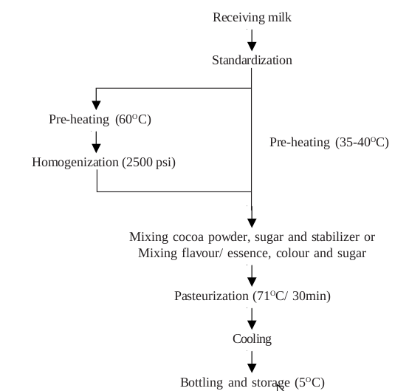

Slide 8
Preparation of Fruit Flavoured Milk
The method of preparation of fruit flavoured milk is similar to that used for chocolate milk/drink. Instead of cocoa powder, permitted fruit flavours/essence, together with permitted (matching) colours and sugar are used. The common flavours used are strawberry, orange, lemon, pineapple, banana, vanilla, etc. In order to obtain good results, the following precautions should be taken:
No acid (citric or tartaric) should be added to the fruit syrup, as this may cause curdling of milk.
Excessive sweet syrup should be avoided. The best sugar content of the syrup is 45-55 per cent.
Add 1 part of fruit syrup to 5 parts of milk.
Care should be taken to see that there is a pleasant blend of sweet, fruity and milky flavours (together with an appealing colour)

Slide 9
Preparation of Sterilized Flavour Milk
Receiving of milk—Cold storage—Preheating—Filtration– Mixing color/sugar/flavor—Bottle filling---Sterilization(108-110C/25-30min)---Cooling (room temperature)—Storage(room temperature)

Slide 10
Packages
Tetra Rex
Tetra Top
Tetra Prisma Aseptic
Tetra Brik Aseptic
Tetra Wedge Aseptic
Tetra Fino Aseptic
Bottles
Polythene

