Slide 1
MILK PRODUCTS (Part-2)
BY-
Dr. SUSHMA KUMARI
Asst.Prof.,
DEPT. OF LPT,BVC,
Bihar Animal Sciences University, Patna

Slide 2
Preparation of milk products
CURD/ DAHI-
Curd is a fermented milk product prepared by inoculation of heated milk with starter culture or lactic acid producing harmless bacteria.
Starter culture-
Streptococcus lactis
Str. cremoris
Str. diacetalactis

Slide 3
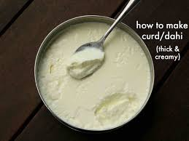

Slide 4
Benefits of dahi-
More nutritious than original milk
More palatable and digestible
Therapeutic value in the stomach and during intestinal disorder due to presence of antibiotics.

Slide 5
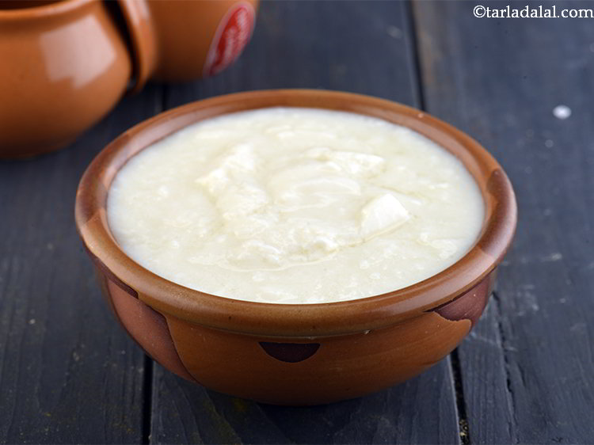

Slide 6
Flow chart for curd
Milk
Pre-heating (35-40 C)
Filtration/clarification
Standardization
Homogenization
Pasteurization
Cooling (25 C)

Slide 7
Inoculation (1% starter culture)
Packaging
Incubation (25 C for 16-18 hrs)
Curd/yoghurt
Cooling and storage

Slide 8
yoghurt
Milk
Heating
Cooling (40C)
Inoculation (Lactobacillus bulgaricus :
Streptococcus thermophillus 1:1)
Incubation (40C) for 16-18 hrs
yoghurt

Slide 9
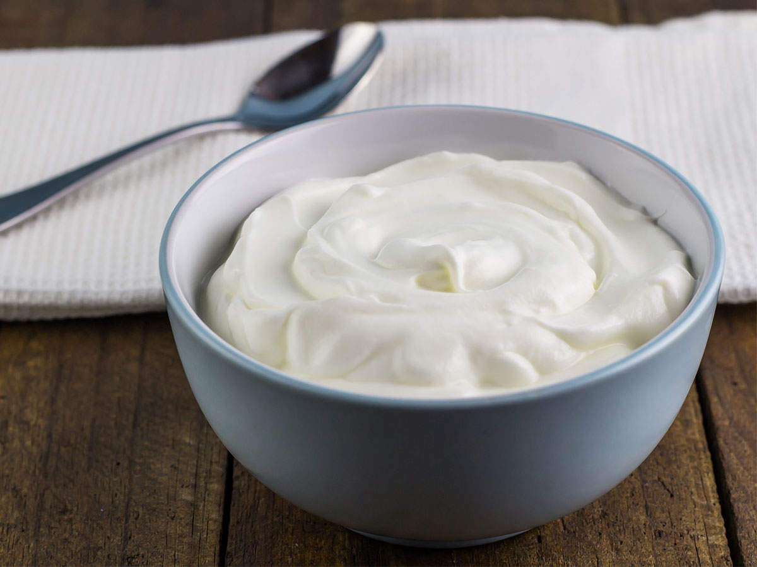

Slide 10
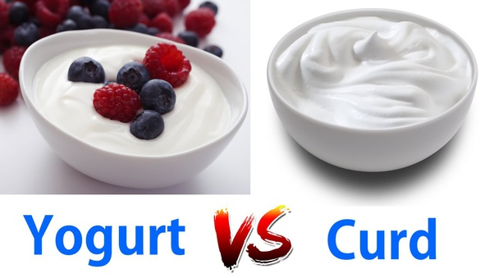

Slide 11
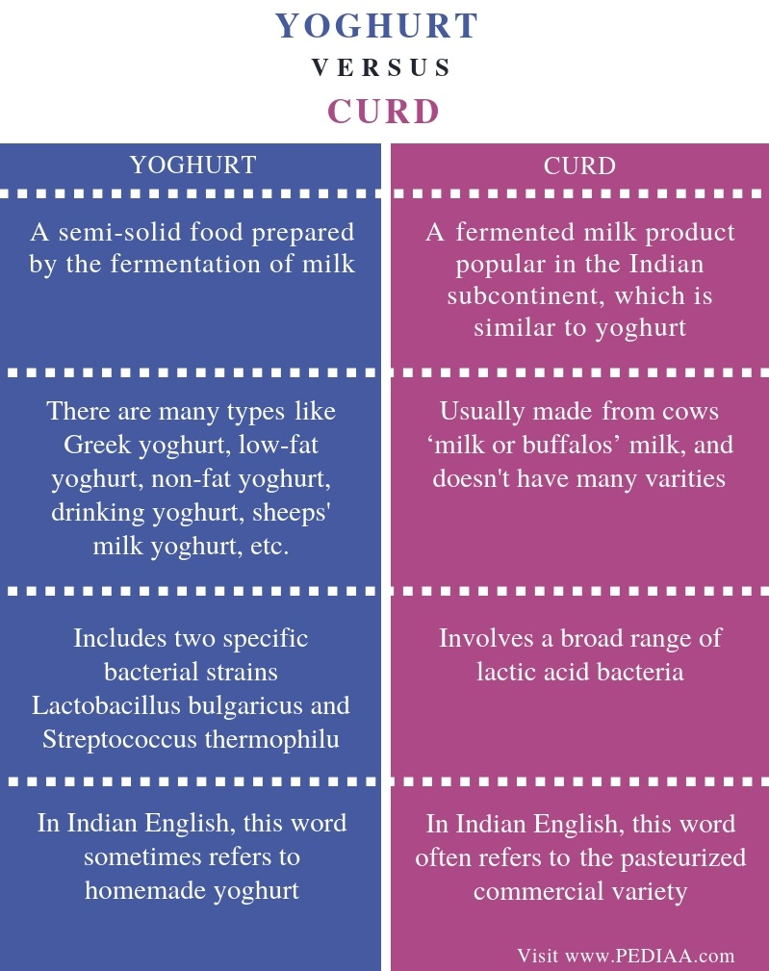

Slide 12
THANKS

