Slide 1
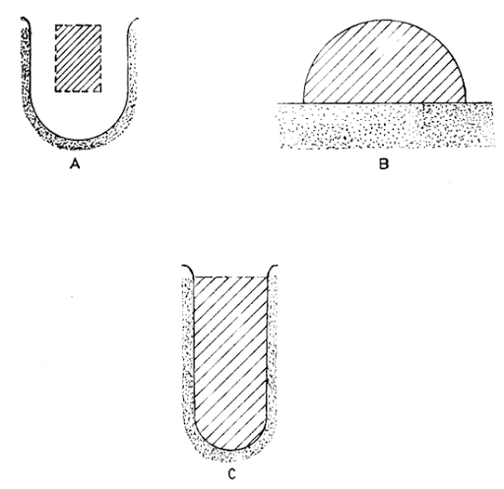
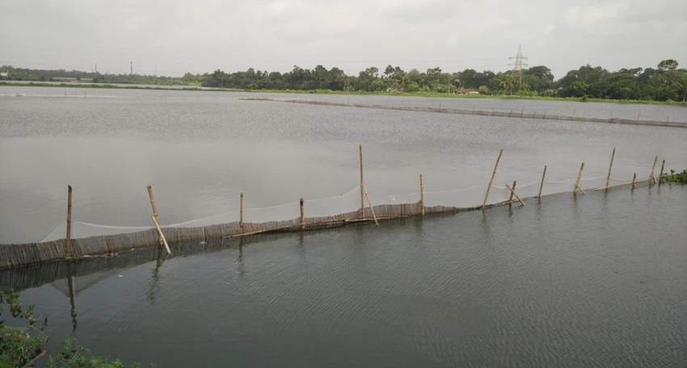
Pen Culture
Mr. Bhartendu Vimal
Guest faculty-Assistant professor
CoF, Kishanganj, BASU, Patna

Slide 2
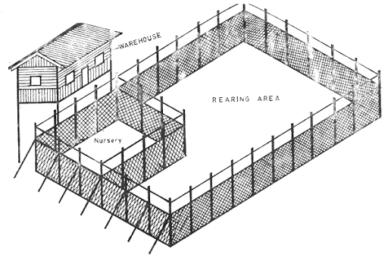
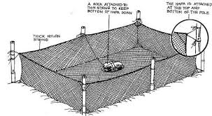
Contents
Meaning of Pen Culture
History of Pen Culture
Types of Barriers in Pen Culture
Types of Enclosures Used in Pen Culture
Merits of Pen Culture
Demerits of Pen Culture

Slide 3
Meaning of Pen Culture
‘Cage culture’ & ‘Pen culture’ both terms are often used interchangeably, particularly in N. America, where ‘sea pens’ and ‘sea cages’ describe the same method of culture.
Generally ‘enclosure culture’ is used to describe what more precisely could be defined as cage or pen culture.
Both cage and pen culture are types of enclosure culture, i.e. holding culturable aquatic organisms in captivity within an enclosed space whilst maintaining a free exchange of water.
The two methods (cage and pen culture), however, are distinct from one another.
A cage is totally enclosed on all sides by mesh or netting, whereas in pen culture the bottom of the enclosure is formed by the lake or sea bottom

Slide 4
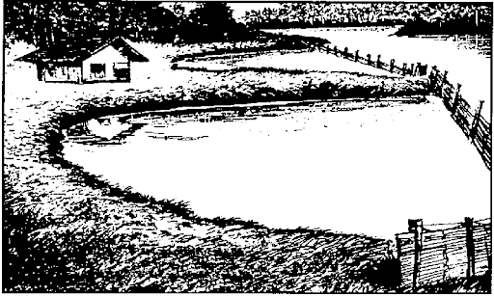
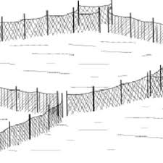
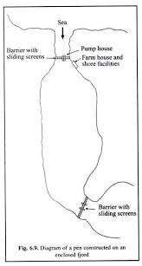
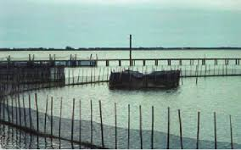

Slide 5
History of Pen Culture
The origin of pen culture is more obscure, but it also seems to have begun in Asia.
According to Alfarez (1977) and others, pen culture originated in the inland sea area of Japan in the early 1920s.
It was adopted by the People’s Republic of China in the early 1950s for rearing carps in freshwater lakes
Later, introduced to Laguna de Bay and San Pablo Lakes in Philippines by the Bureau of Fisheries and Aquatic Resources (BFAR) and Laguna Lake Development Authority (LLDA) between 1968 and 1970 in order to rear milk fish (Chanos chanos).
Pens are still constructed at old pattern except that nylon or polyethylene mesh nets have replaced the traditional split bamboo fences.
The nets are attached to ports set every few meters, and the bottom of the net is pinned to the substrate with long wooden pegs. Buttressing may be used to strengthen the structures in exposed areas.

Slide 6
Where Pens are Built?
Pens are usually built in shallow (< 10 m) waters, are 3-5 m deep, and 2-7 ha in size. Although there are much larger enclosures in N. America measuring up to 50 ha and up to 120 ha or more in Japan.
The areas with too much silt and decomposing organic matter should be avoided.
The bottom soil should be muddy, clayey, clay-loam or sandy mud with detritus.
Flow of water should be 0.2-0.5 m/sec. Soft substrates are preferable.
Pens are formed by damming a bay, fjord or an arm of river, lake or reservoir, estuary or sea
Barriers in Pen Culture
There may be one or one series of barriers when the blind end of the aquatic body is to be enclosed.
In the enclosures, where continuous flow of water takes place, there may be two or two series of barriers—one being upstream and another being downstream.

Slide 7
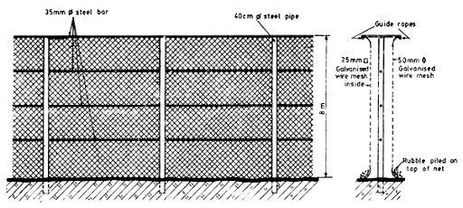
Types of Barriers in Pen Culture:
The barriers may be of the following types:
Site Material-Dependent Barriers: The barriers or dams may be built with concrete or stones, sand or soil depending upon the availability of the materials at the sites.
Such type of barriers are generally equipped with screens which are made of vertical aluminium or galvanized metal bars with little spacing.
Screens function to check the escape of the fish stock.

Slide 8
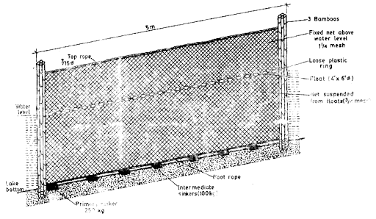
ii. Wire-Mesh Barriers: It is uncommon type of barrier and includes galvanized wire mesh or chain links.
At the bottom of the poles or pilings under water, such net barrier is fixed through a rope along the sea bed for approximately 1 m, until it terminates in a lead line.
Generally, the net is embedded in the silt or sand of the bottom, sealing it properly, so as the entry of predators and escape of aquatic culturable organism is checked.

Slide 9
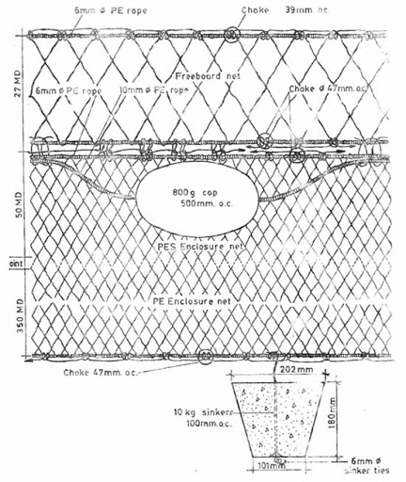
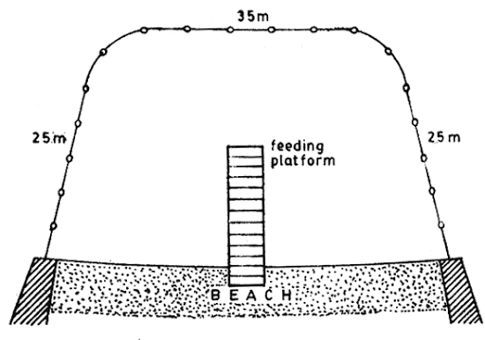
Nylon-Net Barriers: It is an enclosure system used to partition off areas of an open aquatic body, e.g., intertidal areas of the sea or foreshore areas of large lakes and reservoirs.
Normally, the enclosure is framed on one side by the shore and the rest three sides by a wall of nylon netting hung from the ropes.
Sometimes to provide adequate support for the net stone or concrete walls of approximately 3 m wide core constructed.
Net barriers may be hung from steel cables tied between wall. The latter are anchored to large anchor blocks by steel cables, to check any lateral oscillation of the piles.

Slide 10
Types of Enclosures Used in Pen Culture:
The enclosures used in pen culture may be of following types:
(I) Bamboo Scaffolding-Enclosure:
It is generally used in Bays of Philippines and lakes of China.
These enclosures are of various sizes (about 2.5 m high and 5-10 cm wide).
A gap or interspace of approximately 1.0-1.5 cm is essential between two bamboo splits for free exchange of water in pens.
(II) Floating-Net-Enclosure:
It is a type of improved net enclosure.
Here, the enclosure is held in place by concrete block sinkers with a series of small weights on the foot rope which is secured to a chain link between the sinkers.
The net is kept floating by floats attached to the headrope. To prevent fishes from jumping, a horizontal net is stretched at the top of the enclosure.
This type of enclosure has been proved useful for the culture of tilapia and milk fish in the lakes.

Slide 11
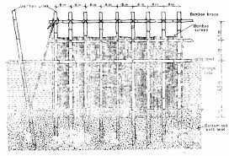
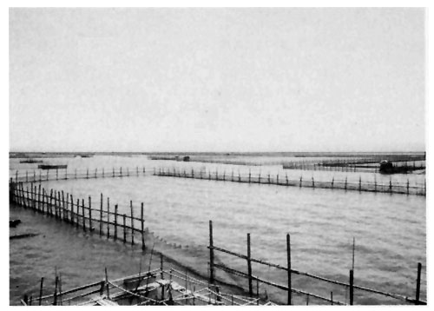
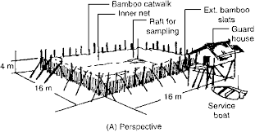
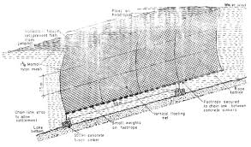
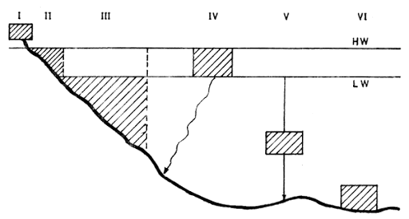

Slide 12
(III) Single Layered Pens of Nylon Webbing:
In this type of enclosure, Palmyra (a tropical Asian Fan palm) poles are used for support which are pointed at one end.
The size of the poles are 3 m length, 15 cm wide and 5 cm thick.
The poles are driven into the mud at about 50 cm and are 1.5 m apart.
A 20-25 mm thick polythene rope serves as a head rope and foot rope.
Head rope is connected to a nail driven at the top of the poles so that webbing is firmly held to the poles. The laterite stones are attached to the foot rope at an interval of about 1.5 m.
The stones along with foot rope and webbing are anchored roughly 40-45 cm in the mud.

Slide 13
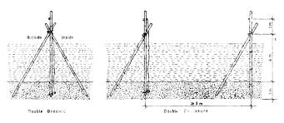
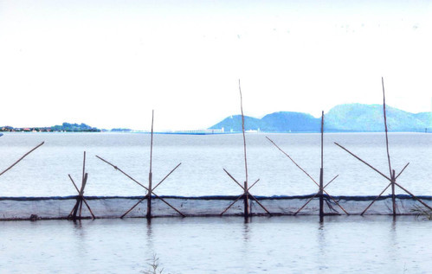
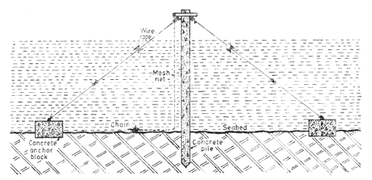

Slide 14
The mesh size of knotless nylon webbing is about 10-20 mm, and the approximate area enclosed by such nets is up to 1.0 hectare.
Scare-line composed of tender leaves of Palmyra is attached to a polyethylene twine at an interval of about 1.0 m inside the enclosure about 40-50 cm above the bed of the pen. It is because, the fingerlings and juveniles may not dash against the webbing and get themselves injured.
(IV) Double-Layered Pens:
These are suitably applied as nurseries for fish or prawn seeds.
Double-layered pens contain an inner nylon enclosure of less than 1.0 cm mesh size and an outer enclosure of split bamboo mass.

Slide 15
Aquatic Species Suitable for Pens
The market demand and the availability of seed greatly influence the selection of candidate species for pen culture.
The main desirable characteristics for enclosure aquaculture are faster growth rate, high survivability, capacity to withstand overcrowding, acceptance of artificial feeds, high FCR, and resistance to diseases.
IMC, EMC, Air-breathing catfishes, Tilapia, Murrels and prawns can be cultured in the pens.
The principal fish species cultured in south east Asian countries like Phillipines and China are milk fish (Chanos chanos) and carps viz., grass carp (Ctenopharyngodon idella); Silver carp (Hypophthalmichthys molitrix); bighead carp (Aristichthys nobilis).
Some experimental culture of carps has been carried out in pens in oxbow lakes in Hungary and other countries such as Bangladesh and Egypt have expressed interest in their use.

Slide 16
The production of tilapias in net pens is also being evaluated in Philippines. Generally, the fish species which are herbivores or detritovores, fast growing and tolerant to salinity changes in coastal areas are preferred the most.
Chanos chanos (milkfish), Mugil sp. and Etroplus suratensis are highly suitable fish-species for mono or polyculture.
Some carnivorous fish species, viz., Lates calcarifer, Polynemus tetradactylum, Elops sp., Megalops etc. may also be stocked in separate pens.
Apart from fishes, certain species of prawns and edible clams may also be cultured in pens.
Stocking Density in Pens:
The stocking density of fish or shell fish for pens may range from 10-100 individuals/m²

Slide 17
Merits of Pen Culture:
More than arrange production is assured in a limited space with rich food and oxygen supply.
It is a non-stop process because of continuous water supply.
Maximum growth is possible in pens as energy is saved towards locomotion and feeding.
No danger for mass mortality of fishes, since the toxic wastes like ammonia are flushed regularly.
It generates employment opportunities for the coastal fisher-folk.
It reduces over-exploitation of the fry.
It requires comparatively low capital outlay.
It requires simple technology of operation.

Slide 18
Demerits of Pen Culture:
Nylon—webbing enclosures may be cut or damaged by some species of crabs.
Predator fishes, if not eradicated periodically, may cause considerable damage to cultured individuals viz., fry, fishes and prawns.
The abundance of weeds in the surroundings of pens may disturb the environment by lowering the oxygen level through release of H₂S upon death and decay.
Few barnacles and algae like Ectocarpus when adhered to the bamboo poles, nets or other material of the pens may cause biofouling.
Terrestrial insects also take shelter in exposed portions of pens and may cause damage.
Unfavorable climatic conditions may damage the pen.

Slide 19
Pen culture may be adversely affected with the occasional abundance of red-tide causing organisms such as dinoflagellates, especially during summer or southwest monsoon.
Pen culture may not be suitable for all fish species.
Because fishes kept in pens have access to the benthos, the conversion of primary production to fish biomass is likely to be higher.
The major drawback of pen culture seems to be in harvesting i.e., fish stocked in the pens reveal less percentage of recovery.
Fishes culture in pens are bounded to bear toxic industrial pollution, if happens.
Pens are largely restricted to lentic water bodies.
There may not be largely intensive culture in pens i.e., it is only used for extensive and semi-intensive culture.

Slide 20
Points to ponder:
Extensive culture relies solely on naturally available food such as plankton, detritus, benthos and drift, and no supplementary feeding are given.
Semi-intensive culture involves the addition of low protein (< 10%) feedstuffs, usually compounded from locally available plants or agricultural byproducts to supplement the intake of natural food,
whereas in intensive culture operations, fishes rely almost exclusively on an external supply of high protein (< 20%) food, usually based on fish meal.
In fast flowing rivers, however, intensive and semi-intensive fish culture is not advisable due to excessive loss of feed.
At present, pen culture is of much less importance and is largely restricted to a few countries in Southeast Asia.

