Slide 1
Fish Pharmacology
Topic: Routes of drug administration
Mr. Bhartendu Vimal
Guest faculty-Asst. Prof.
CoF, Kishanganj, BASU, Patna

Slide 2
Introduction
Fish pharmacology is essential for undertaking treatment of fishes using any therapeutic and chemicals or drugs.
Before recommending any medicine to treat the fish diseases the following factors should be considered:
Water quality
Pathogens
Fish mortality rate
Legal issues
Economics of treatment

Slide 3
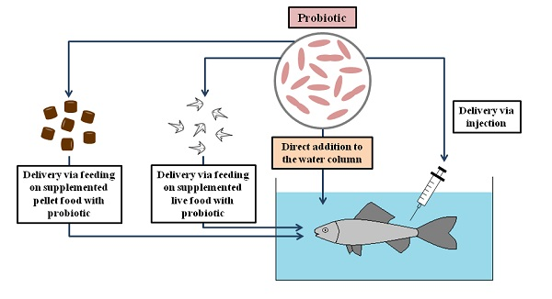
Routes of drug administration

Slide 4
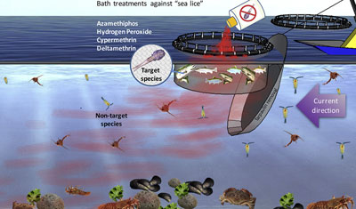
Routes of drug administration
Water medication
This is the commonest method
Drug administered to the fish by medication of water in which the fish inhabits
Merits
It is adaptable to mass medication of large numbers of fish

Slide 5
Immersion or Dipping
The preparation of small volume of medicated water in a separate container from that holding the fish
The fish, usually held in the net, are immersed in it for a short period of time and then returned to their normal environment
Advantage
Use of certain antibacterial drugs in aquaria where filters are used to effect the bacterial oxidation of ammonia to nitrites and nitrates
Disadvantage
Fish are exposed to the stresses of chasing, handling and netting

Slide 6
Hyperosmotic infiltration
HI is development of immersion designed to accelerate the absorption of macromolecules or even of particles such as antigenic bacteria
It primarily consists of two solution.
1st animal is dipped into a pharmacologically inert solution, hypertonic to fish plasma followed immediately by the solution to be absorbed.

Slide 7
Flushing
Here fish are kept in running water which is not recirculated, for example in a raceway, immersion can be achieved by flushing, or, as process sometimes called, a California flush
Flushing is more wasteful, and hence more environmentally polluting than dipping
It may be difficult to obtain a homogenous distribution of the medication in water

Slide 8
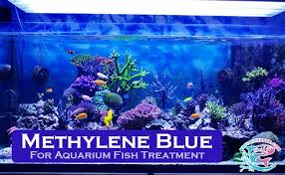
Bath treatment
In bathing the bottom of the net cage is raised, typically to 2 meters, thus limiting the volume of water to be medicated
This reduces the weight of drug required and hence reduces both the cost and degree of environmental contamination
Disadvantage
Bath treatment is wasteful and environmentally contaminating
Labour-intensive

Slide 9
Oral/Enteral medication
In-feed medication
Less wasteful method of administration than water medication
In-feed medication is standard practice for a large number of diseases but it is more prophylactic than therapeutic
Pelleted medicated feed
The ideal way to medicate feed is to add the medicinal product to the feed-mix prior to pelleting

Slide 10
Surface coating pelleted feed
This process is suitable to the medication of small batches of feed and can be used for drugs which are heat-labile.
It is therefore the normal means of medicating feed on fish farms
Spray-medication of pelleted feed
Sex hormones are important examples of a class of drugs which are, for practical purposes, insoluble in water and which are used in very small doses.

Slide 11
Leaching
Leaching of drug into the water occurs with all forms of in-feed medication but is a particular problem associated with surface-coated feed.
Extent of leaching varies according to the water solubility of the active ingredient and time for which the feed remains in the water
The smaller the pellets the faster will be the leaching

Slide 12
Micro-encapsulation of drugs
One established method to make micro capsule structure is to use a calcium alginate core into which the drug is mixed and a chitosan-alginate shell
Whether a micro-capsule is retained in the stomach or not, largely question of its size

Slide 13
Artemia Enrichment
To enrich Artemia cysts they are decapsulated and placed in seawater which has been pre-sterilized by UV light and is well oxygenated
Disadvantage
Only healthy fish can be treated
In addition it is extremely wasteful and costly affair

Slide 14
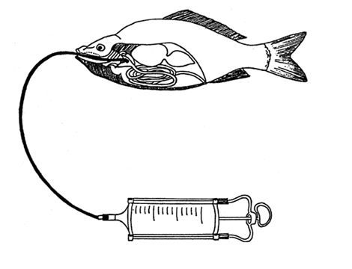
Gavage
Gavage is a form of oral administration extensively used in experimental work
It is rarely used in routine fish management as it is labour intensive and stressful to the fish.
A few fish such as brood fish or valuable ornamentals have to be dosed orally

Slide 15
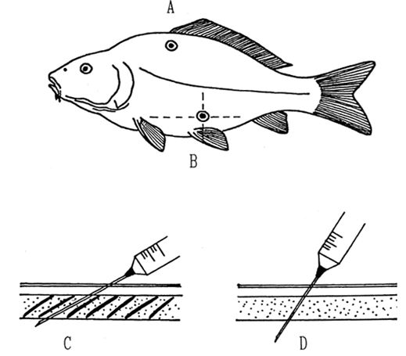
Injection
Intramuscular injection
Intraperitoneal injection
Injection into dorso-median sinus
Automatic injectors
Machine injection

Slide 16
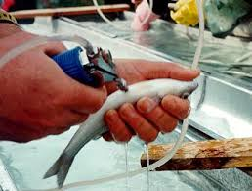
Implantations
Implantations may be intramuscular or intraperitoneal
Prolonged medication with a drug
It is sometimes formulated with as a pellet or capsule for implantation

Slide 17
Topical application
Topical applications of drugs in fish is rare;
where it is done it is usually for the treatment of skin ulcers on valuable ornamental fish

Slide 18
Drug metabolism in fish
The detoxification of all drugs and chemicals in fish is carried out by liver
The rate is metabolism is about one tenth of that mammals.
Temperature optimum for many of the phase I reaction (oxidation, reduction, hydrolysis) and phase II reactions (conjugate formation and subsequent excretion) in fish is close to temperature of the natural environments of the fish

Slide 19
Pharmacokinetics
Fish being poikilothermic has an influence on its metabolic rate and activities by differences in water temperature resulting in pharmacokinetic complexity than in other vertebrates.
Reduced water temperature: slow metabolic rate causing slower drug absorption, metabolism and excretion and consequently longer withdrawal period
Predicted change in the environment of fish over a period of weeks following treatment must be considered carefully when planning the treatment

Slide 20
Withdrawal period and Maximum residual limit: the withdrawal period is the amount of time required following the administration of last treatment for measurable residues of the drug or a metabolite to decrease to below an established safe level. This safe level is MRL, or tolerance
Degree days are calculated by adding the mean daily water temperature in ⁰C for total number of days measured. At higher optimum temperature for the fish, the required degree days could be achieved in less number of days.

