Slide 1

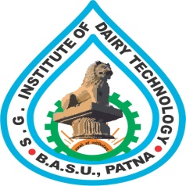
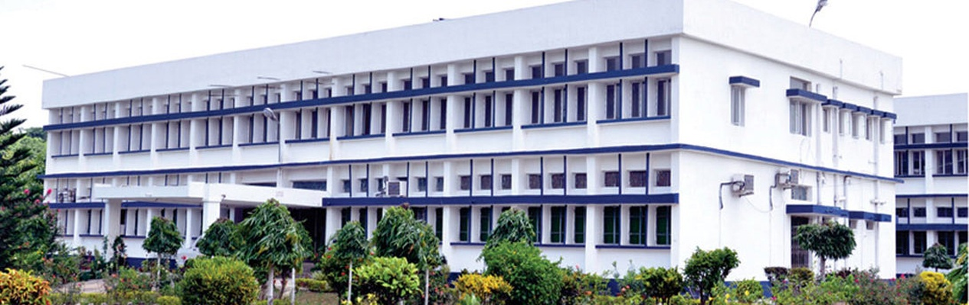
BIOCHEMISTY
Course No.-DTC-111, Credit Hours – 2 (1+1)
MECHANISM OF ENZYME ACTION
BINITA RANI
ASSOCIATE PROFESSOR (DAIRY CHEMISTRY)
FACULTY OF DAIRY TECHNOLOGY
S.G.I.D.T., BVC CAMPUS,
P.O.- BVC, DIST.-PATNA-800014

Slide 2
Enzymes do two important things:
they recognize very specific substrates, and
they perform specific chemical reactions on them at fantastic speeds.
Their role is:
to make and break specific chemical bonds of the substrates at a faster rate and
to do it without being consumed in the process.
At the end of each catalytic cycle => enzyme is free to begin again with a new substrate molecule.

Slide 3
Catalysis is simply making => reaction go faster
it follows that => activation energy of a catalyzed (faster) reaction is lower than => activation energy of an uncatalyzed reaction.
Thus enzymes work by => lowering the activation energy of the reaction they catalyze.
The way they accomplish all this can be described by => a number of different models => each one of which accounts for => some of the behavior that enzymes exhibit.
Most enzymes make use of => all these different mechanisms of specificity and/or catalysis.

Slide 4
Enzyme catalysis

Slide 5
1. Lock-and-Key Model of Enzyme-Substrate Binding
In this model, active site of unbound enzyme is => complementary in shape to the substrate.
As if the key fits in the lock will then open the lock => It accounts for why the enzyme only works on certain substrates.

Slide 6
2. Induced-Fit Model of Enzyme-Substrate Binding
In this model => enzyme changes shape on substrate binding.
The active site forms a shape => complementary to the substrate only after the substrate has been bound.
Binding of the correct substrate => triggers a change in the structure of enzyme => that brings catalytic groups into => exactly the right position to => facilitate the reaction.
In the induced-fit model => structure of the enzyme is different => depending on whether the substrate is bound or not.
The enzyme changes the shape (undergoes a conformational change) => on binding the substrate.
This conformation change converts => enzyme into a new structure in which => the substrate and catalytic groups on the enzyme are properly arranged to => accelerate the reaction.

Slide 8
3. Multi Substrate Reaction Mechanism
Most reactions in biological systems usually include => two substrates and two products and => can be represented by =>
bisubstrate reaction.
Majority of such reactions entail => transfer of a functional group => such as a phosphoryl or a hydroxyl group => from one substrate to the other.
There are three general mechanisms which describe multi-substrate enzyme system.
• Ordered mechanism
• Random mechanism
• Ping-Pong mechanism

Slide 9
a) Ordered mechanism
In this type of reaction => all substrates must bind to the enzyme before any product is released.
Consequently => in a bi-substrate reaction => a ternary complex of the enzyme and both substrates forms.
In ordered mechanism => substrates bind the enzyme in a defined sequence.
Many enzymes that have => NAD+ or NADH as a substrate => exhibit => the sequential ordered mechanism.
Consider lactate dehydrogenase => an important enzyme in glucose metabolism.
This enzyme reduces => pyruvate to lactate while oxidizing NADH to NAD+.
In the ordered sequential mechanism => coenzyme always binds first, and => lactate is always released first.

Slide 10
This sequence is represented below :
Conversion to lactate

Slide 11
Ordered Mechanism

Slide 12
b) Random mechanism
In this mechanism also => enzyme exists as a ternary complex => first, consisting of enzyme and substrates and, after catalysis, => enzyme and products.
In the random sequential mechanism => the order of addition of substrates and release of products is random.
Sequential random reactions are illustrated by => formation of phosphocreatine and ADP from ATP and creatine => a reaction catalyzed by creatine kinase.
Phosphocreatine is => an important energy source in muscle.
Although the order of certain events is random => the reaction still passes through the ternary complexes including => first, substrates and => then, products.

Slide 13
Random Mechanism

Slide 14
c) Double-displacement (Ping-pong) reactions.
In double-displacement, or Ping-Pong, reactions => one or more products are released before => all substrates bind the enzyme.
The defining feature of double-displacement reactions is => existence of a substituted enzyme intermediate, in which => the enzyme is temporarily modified.
Reactions that shuttle amino groups between amino acids and α-keto acids are => classic examples of double-displacement mechanisms.
The enzyme aspartate aminotransferase catalyzes => transfer of an amino group from aspartate to αketoglutarate.

Slide 16
The sequence of events can be portrayed as the following diagram:
Double-displacement (Ping-pong) reactions
After aspartate binds to the enzyme => the enzyme removes aspartate's amino group to form => substituted enzyme intermediate.
first product => oxaloacetate => subsequently departs.
second substrate => α-ketoglutarate => binds to the enzyme => accepts the amino group from the modified enzyme => and is then released as the final product => glutamate.
In this => substrates appear to bounce on and off => the enzyme analogously => to a Ping-Pong ball bouncing on a table.

Slide 17
THANKS

