Slide 1
Unit-II Fat metabolism in health and disease-III
Clinical Physiology
Course No. – VPY- 607
Credit Hrs. – 2+1=3
Date: 01.12.2020
Dr. Pramod Kumar
Asstt. Professor
Deptt. of Veterinary Physiology
BVC, Patna

Slide 2
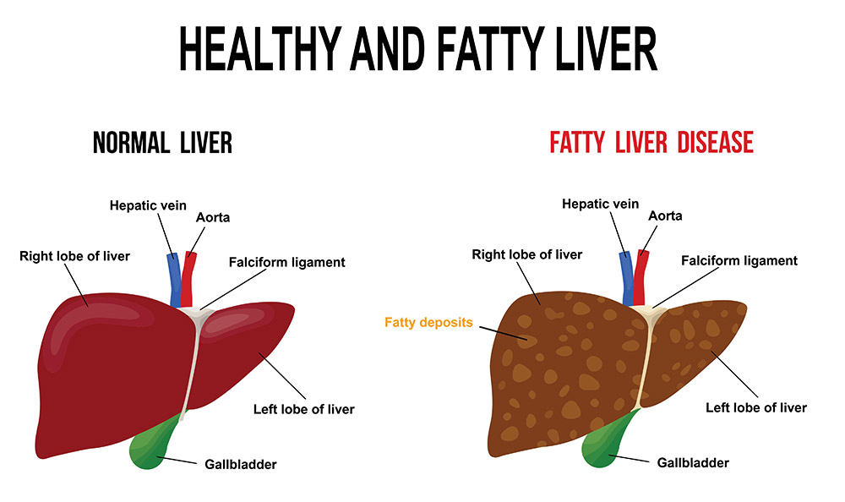

Slide 3
Lipid Metabolism
Metabolism is the process your body uses to make energy from the food you eat. Food is made up of proteins, carbohydrates and fats. Chemicals in your digestive system (enzymes) break the food parts down into sugars and acids as body's fuel. It can be stored as the energy in your body tissues.
Lipid metabolism disorders involve lipids. Lipids are fats or fat-like substances. They include oils, fatty acids, waxes and cholesterol. If anyone is having these disorders, they may not have enough enzymes to break down lipids or the enzymes may not work properly and the body can't convert the fats into energy. They cause a harmful amount of lipids to build up in the body. Over time, that can damage the cells and tissues, especially in the brain, peripheral nervous system, liver, spleen and bone marrow. Many of these disorders can be very serious, or sometimes even fatal.

Slide 4
It was found that adipose tissue is the primary anatomical site for fatty acid synthesis in non-lactating ruminants and swine. In contrast, in humans and avian species, the liver is the primary site, and in rodents and rabbits, both the liver and adipose tissue are primary sites for fatty acid synthesis.
Three major pathways can generate cytosolic NADPH for fatty acid synthesis: the pentose phosphate, malate dehydrogenase and iso-citrate dehydrogenase pathways.
In ruminants, 50–80% of NADPH needed for fatty acid synthesis in adipose tissue is produced by glucose oxidation via the pentose phosphate pathway. The rest of the NADPH is generated via the iso-citrate dehydrogenase pathway, which can provide up to 50% of NADPH needed for fatty acid synthesis in the mammary gland.

Slide 5
The significance of the isocitrate dehydrogenase pathway is that it can provide reducing equivalents for fatty acid synthesis from acetate in the absence of glucose oxidation.
In porcine adipose tissue, the pentose phosphate pathway generates 60–90% of NADPH needed for fatty acid synthesis with the rest of the NADPH possibly produced via the malate dehydrogenase pathway as evidenced in rat adipose tissue.
Lipid digestion in ruminants is unique in that after ingestion feed lipids are placed into a hydrolytic and reductive environment. The result is that glycerol from triacylglycerols and phospholipids is fermented to VFA and that unsaturated fatty acids are hydrogenated to mostly saturated fatty acids before absorption.

Slide 6
Fatty acids and skin disease
There are two main ways in which differing fatty acid profiles contribute to skin disease—as part of inflammation and affecting membrane fluidity.
People with atopic eczema have been shown to have a different fatty acid profile in their skin than people without atopic eczema. In particular, they have shorter fatty acids within their skin than unaffected individuals. This difference is suggested to lead to impaired skin barrier.
As similar, pruritic dogs have a different fatty acid profile compared to dogs with healthy skin. More recently, dogs with atopic dermatitis whose diets were supplemented with n-3 PUFA improved significantly more than those given the placebo.

Slide 7
Cancer is the result of aberrant cellular processes. Many genes and proteins are differentially expressed in tumor tissue compared to non-tumor tissue. The fatty acid profiles are likely to be altered in tumors compared to non-tumor tissue and this has indeed been demonstrated in breast and prostate cancer.
The differential dietary intake of fatty acids can either reduce or increase risk of disease, including cancer. A meta-analysis relating breast cancer risk with n-3 PUFA intake showed that overall increasing n-3 PUFA intake reduced the risk of developing breast cancer. In transgenic mice in which males develop prostate cancer, n-3 PUFA intake from marine sources suppressed tumorigenesis.

Slide 8
Effects of fatty acids on fertility and during pregnancy and development
Many animal have established that restriction of a range of nutrients within the maternal diet throughout pregnancy results in offspring that are programmed to be at increased risk of later hypertension and metabolic disease including diabetes and obesity. This theory has become known as the “developmental origins of health and disease” (DOHaD) hypothesis.
Fatty acid intake has been shown to have effects even before pregnancy as severe undernutrition of specific fatty acids has resulted in low reproductive rates in males and females.
In male cats, a linoleic deficient diet results in tubular degeneration of the testes and low fertility rates and in females, the litters were not viable.

Slide 9
Birth defects in offspring from females fed on low fatty acid diets but arachidonate was a key contributor to viable offspring.
In rodents, increased fat intake during pregnancy are often associated with an overall decrease in food intake which limits their usefulness. The timing of a nutritional insult is also important in determining the outcome for offspring, differential results have been observed in studies investigating early or late gestational nutritional insults in animal.
A high-fat diet increasing adipocyte and ectopic lipid accumulation and may also decrease glycogen deposition in skeletal muscle. Increased plasma free fatty acids impair insulin-stimulated glucose disposal, including glycogenesis and glucose uptake—resulting in reduced skeletal muscle glycogen content.

Slide 10
In younger pigs (7 or 14 days of postnatal age) designated low, normal or high to birth weight, molecular differences have been observed in adipose tissue and skeletal muscle genes known to regulate lipid metabolism including uncoupling proteins (UCPs), peroxisome proliferator-activated receptor (PPAR) α and γ, fatty acid-binding protein (FABP) 3 and 4 and the glucocorticoid receptor.
The maternal low protein diets in rats demonstrated that post-weaning, offspring had significantly increased hepatic PPARα expression due to decreased methylation as a result of differences in overall dietary fat intake
PPARs are a nuclear hormone receptor family and have involvement in adipogenesis, lipid metabolism, insulin sensitivity, inflammation and blood pressure.

Slide 11
PPARγ regulates transcription of genes involved in lipid metabolism by binding to responsive elements in the promoters of respective genes. This transcription regulation stimulates fatty acid storage in adipose tissue by increasing the storage capacity and the quantity of fatty acids that enter adipocytes and also plays a key role in adipocyte differentiation, promoting the formation of mature lipid-laden adipocytes.
The activities of PPARγ are regulated by fatty acids and are often referred to as the “genetic sensor” for fat and is responsible for high-fat feeding which may provide benefits to the animal by protecting against lipotoxic species.

Slide 12
PPARα also acts as a ligand-activated transcription factor and is expressed in tissues which have a high rate of fatty acid catabolism such as skeletal muscle and liver.
PPARα has a key role in stimulating lipid oxidation pathways to prevent storage of fats as well as increasing insulin sensitivity and glucose tolerance.
The expression of PPARs may represent one of the molecular factors driving excess tissue lipid uptake, storage and production in animals that experienced a sub-optimal environment in utero, in particular low birth weight offspring; ectopic lipid storage, especially intra-myocellular, is associated with glucose intolerance and type-2 diabetes.

Slide 13
The regulation of fatty acids is also an important factor during the lactation period. The relative fatty acid content of milk differs depending on the species. Donkeys have milk more similar to humans than cows, with lower levels of saturated fats and higher essential fatty acids than cows, more akin to humans.
Milk from humans, dog and guinea pig are mostly comprised from long-chain fatty acids (48–54 acyl carbon atoms), cow, sheep and goat have more short-chain acids (28–54 acyl carbon atoms) and horses tended to have medium-chain fatty acids (26–54 carbon atoms range).
Maternal diet can also have an impact on the fatty acid contents of her milk. The pregnancy status of the mother also vastly changes milk fatty acid composition. These are important factors when assessing whether the mother is receiving an appropriate diet, assessing whether she is pregnant or not and whether milk replacement formulae contain the appropriate levels of fatty acids.

Slide 14
Fatty acid-binding proteins and lipid modulation
Fatty acids are crucial components of cellular signaling cascades in regulating lipid metabolism and FAs are ligands for transcription factors.
Fatty acids are carried through tissue membranes and in the cytosol by chaperones known as fatty acid-binding proteins (FABPs), of which there are a number of tissue-specific isoforms. Knock-out mice not expressing the adipocyte-specific FABP4 exhibited protection from the metabolic effects (e.g. insulin resistance and hypercholesterolaemia) of a high-fat diet, suggesting FABP4 modulates a number of components of the metabolic syndrome.
In skeletal muscle, a fat-rich diet increases the expression of the cytosolic and plasma membrane specific FABP.

Slide 15
Insulin resistance is characterized by a decrease in the enzymes and proteins involved in lipid oxidation.
Lipogenesis and adipogenesis are modulated by the enzymes acetyl-CoA carboxylase 1 and 2 and AMP-activated protein kinase; both enzymes are potential drug targets to treat obesity and the metabolic syndrome.
The AMPKα subunit is activated during periods of metabolic stress by phosphorylation and inhibits the activity of ACC1 and 2, thus promoting fatty acid oxidation, glucose uptake and inhibits lipid synthesis and thereby reducing ectopic lipid storage.
An iso-caloric high-fat diet inhibit AMPK in rats. Despite great potential for modulation by maternal diet expression of ACC and AMPK is required.

Slide 16
Remedy/Treatment
These disorders are inherited. New-born babies get screened for some of them, using blood tests. If there is a family history of one of these disorders, parents can get genetic testing to see whether they carry the gene. Other genetic tests can tell whether the fetus has the disorder or carries the gene for the disorder.
Enzyme replacement therapies can help with a few of these disorders. For others, there is no treatment. Medicines, blood transfusions, and other procedures may help with complications.

