Slide 1
ANIMAL GENETICS & BREEDING UNIT – I Biostatistics & Computer Application Lecture – 8 &9
Correlation
Dr K G Mandal Department of Animal Genetics & Breeding Bihar Veterinary College, Patna Bihar Animal Sciences University, Patna

Slide 2
Correlation
Correlation: Association or relationship or interdependence between two or more variables.
Variables: Continuous and discrete
Attributes: qualitative traits
Types of correlation
1.According to direction:
(i) Positive
(ii) Negative
(iii) Zero

Slide 3
2. According to number of variables:
(i) Simple
(ii) Multiple
(iii) partial
3. According to proportionate change between two variables:
(i) Linear
(ii) Non-linear

Slide 4
According to direction:
(i) Positive correlation – Both the variables move in the same direction.
Example 1.– height and weight
Height (inch) : 50, 51, 52, 53, 54, 55
Body wt.(kg) : 60, 61, 62, 64, 65, 67
Example 2.
variable (X) : 60, 55, 50, 45, 40, 35, 30
variable (Y) : 40, 35, 30, 25, 20, 15, 10
Body weight increases with the increase in height. Both are moving in the same direction.

Slide 5
(ii) Negative correlation – Both the variables move in the opposite direction.
Example – Milk yield & fat percentage
Daily M Y (kg): 10, 12, 14, 16, 17, 18, 20
Fat % : 6.5, 6, 5.5, 5, 4.5, 4.5, 4
One variable is increasing while the other is decreasing. With the increase in milk production, the fat % in milk is going down.

Slide 6
(iii)Zero correlation – One variable increases or decreases but the other variable remains constant.
Example 1.
Variable X – 2, 5, 6, 8, 10, 12
Variable Y – 5, 5, 5, 5, 5, 5
Example 2.
Variable X : 15, 12, 10, 8, 6, 4, 2
Variable Y : 6, 6, 6, 6, 6, 6, 6
With the increasing or decreasing in one variable there is no change in the second variable.

Slide 7
(B) According to no. of variables:
(i) Simple – only two variables are studied at a time. Eg. Height & Body wt.
(ii) Multiple – three or more variables studied at a time.
Example – feed quality, quantity given, feed conversion, body weight, etc.
(iii) Partial correlation – studied three or more variables but find out correlation between two variables at a time while others kept constant.
Eg. Correlation between crop yield and amount of fertilizer given while number of irrigation given is kept as constant.

Slide 8
( C)According to proportionate change between variables:
(i) Linear - Both the variables move at a constant ratio throughout.
Example: X 5, 10, 15, 20, 25
Y 10, 20, 30, 40, 50
constant ratio ½.
(ii) Non-linear – Variables do not follow a constant ratio throughout.
Example: X = 10, 15, 20, 25, 30, 35, 40
Y = 8, 10, 12, 13, 18, 20, 25

Slide 9
Coefficient of correlation:
It measures the degree of association or degree of interdependence or relationship between two or more variables.
Denoted as ‘r’, i.e., r_{xy} so that, r_{xy} = r_{yx}
Concept given by Karl Pearson.

Slide 10
Properties of correlation coefficient:
(i) Ranges from -1 to +1
(ii) Pure number
(iii) No unit
(iv) + 1 is perfect positive correlation
(v) - 1 is perfect negative correlation
(vi) when r = 0, it means no correlation
(vii) r_{xy} = r_{yx}

Slide 11
Methods to estimate coefficient of correlation:
Pearsonian method:
r_{xy} = $\frac{\text{Cov}\text{xy}}{\text{sd}\text{x}\text{.}\text{sdy}}$
Cov _{xy} = $\frac{\text{[∑}\text{xy}\text{ – (∑}\text{x}\text{)(∑}\text{y}\text{)/}\text{N}\text{]}}{\text{(}\text{N}\text{−1)}}$
sd_{x} =$\sqrt{\frac{\text{[∑}\text{x}\text{2 }\text{ − (∑}\text{x}\text{)2/}\text{N}\text{]}}{\text{N}\text{ – 1}}}$
sd_{y} = $\sqrt{\frac{\text{[∑}\text{y}\text{2 }\text{ − (∑}\text{y}\text{)2/}\text{N}\text{]}}{\text{N}\text{ − 1}}}$

Slide 12
$\frac{\text{[∑}\text{xy}\text{ – (∑}\text{x}\text{)(∑}\text{y}\text{)/}\text{N}\text{]}}{\text{(}\text{N}\text{−1)}}$
r_{XY} = ------------------------------------------------------------------------------
$\sqrt{\frac{\text{[∑}\text{x}\text{2 }\text{ − (∑}\text{x}\text{)2/}\text{N}\text{]}}{\text{N}\text{ – 1}}}$ $\sqrt{\frac{\text{[∑}\text{y}\text{2 }\text{ − (∑}\text{y}\text{)2/}\text{N}\text{]}}{\text{N}\text{ − 1}}}$
r_{XY} = $\frac{\text{(}\text{N}\text{−1)}\text{[∑}\text{xy}\text{ – (∑}\text{x}\text{)(∑}\text{y}\text{)/}\text{N}\text{]}}{(N−1)\sqrt{\text{[∑}\text{x}\text{2 }\text{ − (∑}\text{x}\text{)2/}\text{N}\text{]} \text{[∑}\text{y}\text{2 }\text{ − (∑}\text{y}\text{)2/}\text{N}\text{]}}}$
Where, N = pair number of observation

Slide 13
Problem 1. Estimate the coefficient of correlation between two variables x & y from the following set of data.
r_{XY} = $\frac{\text{[∑}\text{xy}\text{ – (∑}\text{x}\text{)(∑}\text{y}\text{)/}\text{N}\text{]}}{\sqrt{\text{[∑}\text{x}\text{2 }\text{ − (∑}\text{x}\text{)2/}\text{N}\text{]} \text{[∑}\text{y}\text{2 }\text{ − (∑}\text{y}\text{)2/}\text{N}\text{]}}}$
= $\frac{\text{[}\text{250}\text{ – }\text{30}\text{x}\text{40}\text{/}\text{5}\text{]}}{\sqrt{\text{190} \text{ − }\text{30}\text{x}\text{30}\text{/}\text{5}\text{]} \text{[330} \text{ − }\text{40}\text{x}\text{40}\text{/}\text{5}\text{]}}}$
Sl. No. | X | Y | X2 | Y2 | XY
1 | 4 | 6 | 16 | 36 | 24
2 | 5 | 7 | 25 | 49 | 35
3 | 6 | 8 | 36 | 64 | 48
4 | 7 | 9 | 49 | 81 | 63
5 | 8 | 10 | 64 | 100 | 80
Total | 30 | 40 | 190 | 330 | 250

Slide 14
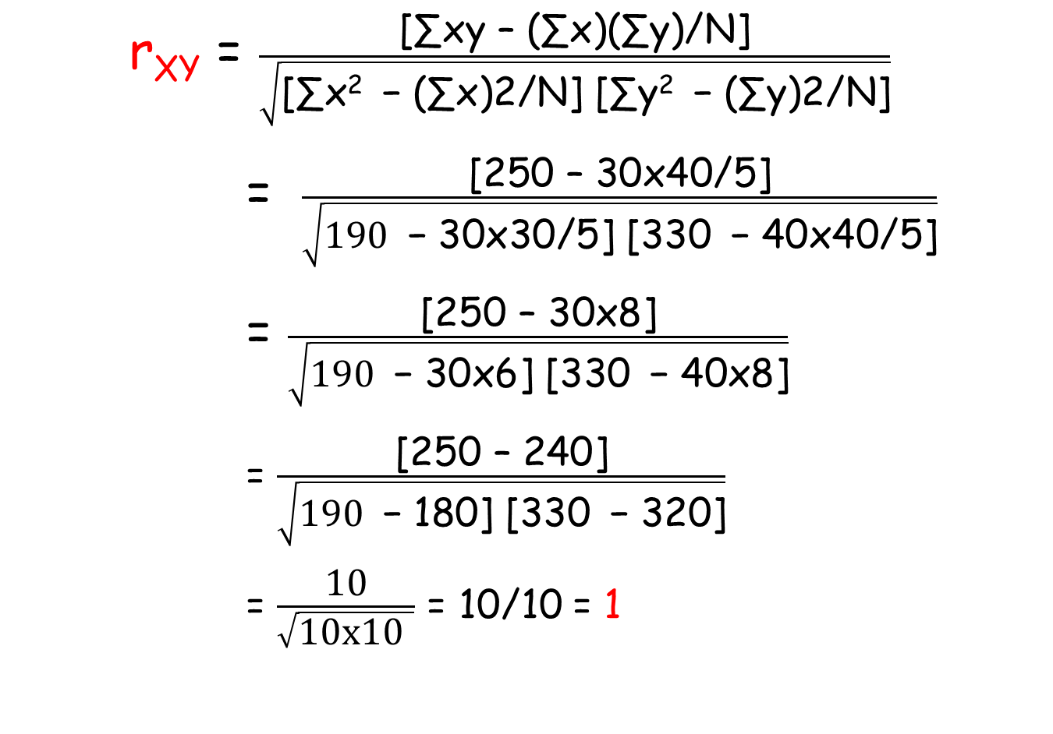
r_{XY} = $\frac{\text{[∑}\text{xy}\text{ – (∑}\text{x}\text{)(∑}\text{y}\text{)/}\text{N}\text{]}}{\sqrt{\text{[∑}\text{x}\text{2 }\text{ − (∑}\text{x}\text{)2/}\text{N}\text{]} \text{[∑}\text{y}\text{2 }\text{ − (∑}\text{y}\text{)2/}\text{N}\text{]}}}$
= $\frac{\text{[}\text{250}\text{ – }\text{30}\text{x}\text{40}\text{/}\text{5}\text{]}}{\sqrt{\text{190} \text{ − }\text{30}\text{x}\text{30}\text{/}\text{5}\text{]}\text{ [330} \text{ − }\text{40}\text{x}\text{40}\text{/}\text{5}\text{]}}}$
= $\frac{\text{[}\text{250}\text{ – }\text{30}\text{x}\text{8}\text{]}}{\sqrt{\text{190} \text{ − }\text{30}\text{x}\text{6}\text{]}\text{ [330} \text{ − }\text{40}\text{x}\text{8}\text{]}}}$
= $\frac{\text{[}\text{250}\text{ – }\text{240}\text{]}}{\sqrt{\text{190} \text{ −}\text{ 180}\text{]}\text{ [330} \text{ − }\text{320}\text{]}}}$
= $\frac{\text{10}}{\sqrt{\text{1}\text{0}\text{x}\text{10} }}$ = 10/10 = 1

Slide 15
Other methods to estimate Coefficient of Correlation:
1. Scatter diagram method
2. Graphic method
3. Rank correlation method
4. Least squares method

Slide 16
Exercise No. 1. Estimate the coefficient of correlation between X and Y variables from the following data.
Sl. No. | X | Y | X² | Y² | XY
1. | 2 | 4
2. | 4 | 6
3. | 6 | 8
4. | 8 | 10
5. | 10 | 12

Slide 17
Exercise no. 2. Calculate the coefficient of correlation between daily milk yield(kg) and fat percentage (%) in milk of following cows.
Sl. No. | DMY (X) | Fat % (Y) | X2 | Y2 | XY
1. | 5 | 6.0
2. | 6 | 6.0
3. | 7 | 5.5
4. | 8 | 5.5
5. | 9 | 5.0
6. | 10 | 5.0
7. | 11 | 4.5
8. | 12 | 4.0
9. | 5 | 6.0
10. | 6 | 6.0
Total

Slide 18
Rank correlation:
i)It measures the degree of association between the ranks of two variables.
ii) Concept given by Spearman.
iii) No unit
iv) Ranges from -1 to + 1
v) R = 1 - $\frac{\text{6∑}\text{di}\text{2}}{\text{n}\text{(}\text{n}\text{2}\text{ – 1)}}$

Slide 19
Where,
di = xi – yi
xi = ith rank of x variable
yi = ith rank of y variable
n = pair number of observation
∑di = 0
To avoid the mathematical complexity the differences between the ranks are squared.

Slide 20
Example: Estimation of rank correlation between the ranks of students secured for marks obtained in two subjects.
AGB 605 | Mid-term (x) | Rank (Xi) | Final (y) | Rank (Yi) | di = xi – yi | di²
A | 60 | 6 | 58 | 6 | 0 | 0
B | 70 | 4 | 68 | 5 | -1 | 1
C | 90 | 1 | 78 | 3 | -2 | 4
D | 65 | 5 | 88 | 1 | 4 | 16
E | 75 | 3 | 84 | 2 | 1 | 1
F | 85 | 2 | 72 | 4 | -2 | 4
Total |  |  |  |  | ∑di = 0 | ∑di2= 26

Slide 21
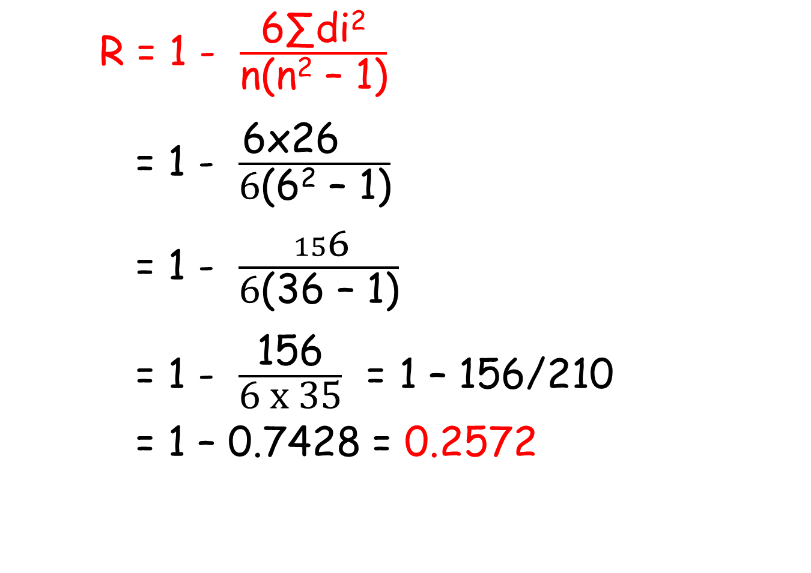
R = 1 - $\frac{\text{6∑}\text{di}\text{2}}{\text{n}\text{(}\text{n}\text{2}\text{ – 1)}}$
= 1 - $\frac{\text{6}\text{x}\text{26 }}{\text{6}\text{(}\text{6}\text{2}\text{ – 1)}}$
= 1 - $\frac{15\text{6}}{\text{6}\text{(}\text{36}\text{ – 1)}}$
= 1 - $\frac{\text{156}}{\text{6 }\text{x}\text{ 35}}$ = 1 – 156/210
= 1 – 0.7428 = 0.2572

Slide 22
Standard Error (S.E.) of r :
S. E. of r = (1- r²)/ √N
Probable Error (P.E.) of r :
P.E.(r) = 0.6745 (1 – r²)/ √N
If r < SE or PE, there is no correlation.
If r > 6PE, the coefficient of correlation is said to be certain and significant.

Slide 23
Test of significance:
Coefficient of correlation is tested through t – test at N – 2 d.f.
T- test:
t _{(N-2)} d.f. = $\frac{r\sqrt{\text{(}\text{N}\text{ – 2)}}}{\sqrt{\text{(1 – }\text{r}\text{2}\text{)}}}$
Interpretation : The calculated value of ‘r’ is compared with tabulated value of r at 0.05 and 0.01 significant levels for (n-2) df. Greater calculated r represents significant correlation.

Slide 24
Use of Correlation coefficient:
i) Prediction of future performance on the basis of past record.
y’ = Y + r$\frac{\text{S}\text{y}}{\text{S}\text{x}}$(x – x)
Where,
y’ = predicted value of y
y = mean of y
r = correlation coefficient
x = mean of x
S_{x} & S_{y} = SD of x and y variables respectively

Slide 25
Measures the degree of relationship between two variables (characters).
The square of correlation coefficient between breeding value and phenotypic value (r² _{AP}) measures the heritability.
It maintains relationship with regression.
b_{yx} = r_{xy}$\frac{\text{6}\text{y}}{\text{6}\text{x}}$ &
b_{xy} = r_{xy}$\frac{\text{6}\text{x}}{\text{6}\text{y}}$

Slide 26
Exercise no. 3. One cow yielded 3000kg milk in her first lactation. Predict how much milk she will give in her second lactation on the basis of following information.
1st lactation milk yield(X) = 3000 kg | 2nd lactation milk yield = Y
X = 2200 kg | Y = 2500 kg | r_{XY} = 0.80
SD (X) = 150 kg | SD (Y) = 160 kg

Slide 27
THANK YOU

