Slide 1
Diseases of Urinary System Part-2
Dr. Pallav Shekhar
Asstt. Professor
Veterinary Medicine
Unit 2

Slide 2
Acute Renal Failure (ARF)
Acute renal failure (ARF) is by sudden onset of filtration failure by the kidneys, accumulation of uremic toxins, and dysregulation of fluid, electrolyte, and acid–base balance. It is potentially reversible if diagnosed quickly and treated aggressively.

Slide 3
Etiology
Shock
Malignant hypertension
Heart failure, thromboembolism
Heatstroke
Excessive vasoconstriction (e.g., administration of nonsteroidal anti-inflammatory drug [NSAID])
Excessive vasodilation (e.g., administration of angiotensin-converting enzyme [ACE] inhibitor or antihypertensive drug)
Prolonged anaesthesia
Administration of antimicrobials
Aminoglycoside
Sulfonamide
Cephalosporin
Amphotericin B
Chemotherapeutic agent (e.g., cisplatin and doxorubicin)
Thiacetarsamide
NSAIDs
Radiographic contrast agents
Ethylene glycol
Heavy metals (e.g., lead, mercury, arsenic, and thallium)
Insect or snake venom
Heme pigment
Calcium
Leptospirosis
Immune-mediated glomerulonephritis and arteritis
Septicemia
DIC
Hepatic failure
Heat stroke
Transfusion reaction
Bacterial endocarditis
Pyelonephritis
Cortical necrosis
Lymphosarcoma

Slide 4
Clinical signs
Sudden onset of anorexia
Listlessness
Vomiting (± blood)
diarrhea (± blood)
Halitosis
Ataxia
Seizures
Oliguria/anuria or polyuria

Slide 5
Diagnosis
Clinical signs
Normal or high PCV
Variable leukocytosis
Elevated BUN, creatinine, and phosphate, potassium and glucose
Low bicarbonate and calcium
Inability to concentrate urine.

Slide 6
Treatment
Discontinuation of nephrotoxic drugs
Treatment of etiology
Maintenance hemodynamic stability
Peritoneal dialysis and hemodialysis.

Slide 7
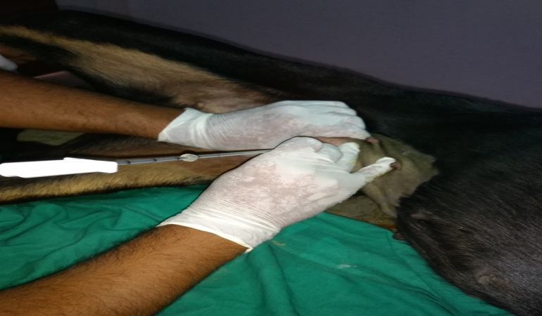
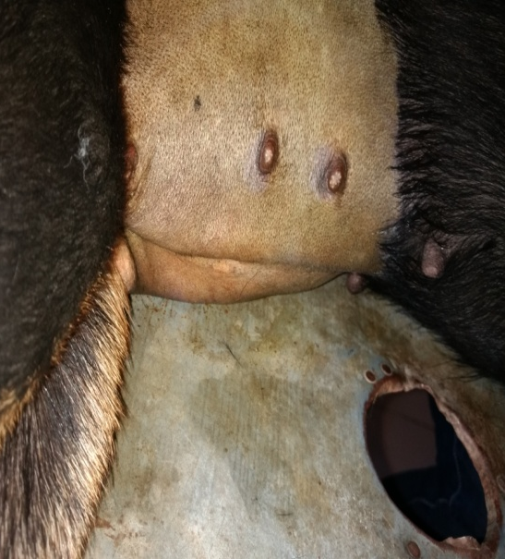
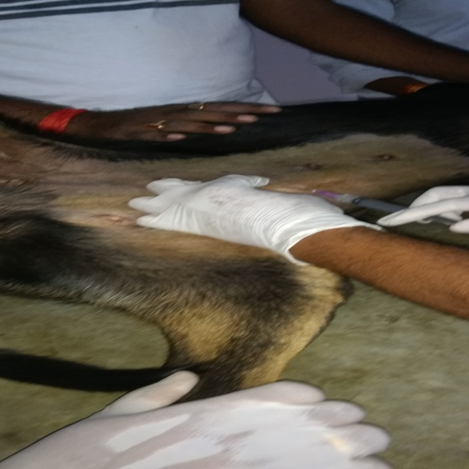
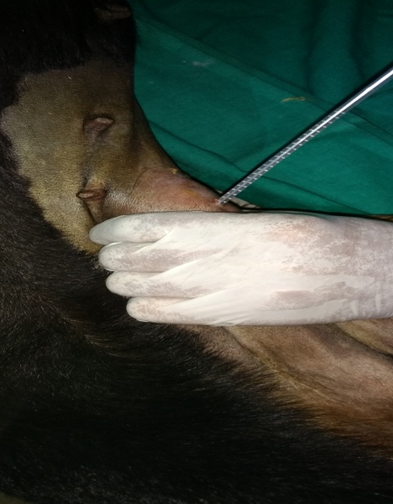
Fig Procedure of Peritoneal Dialysis

Slide 8
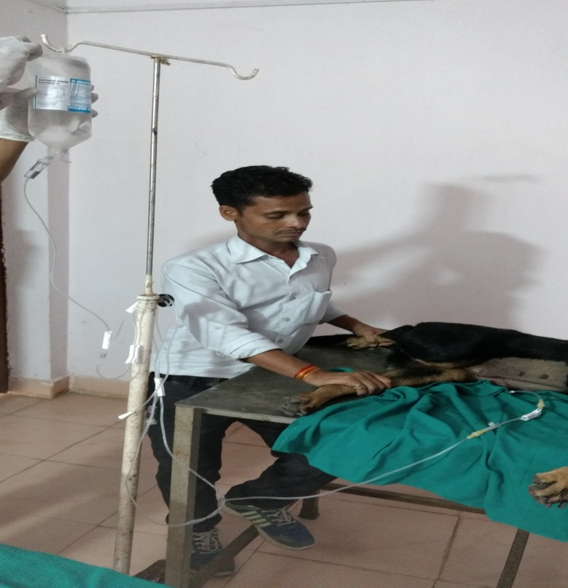
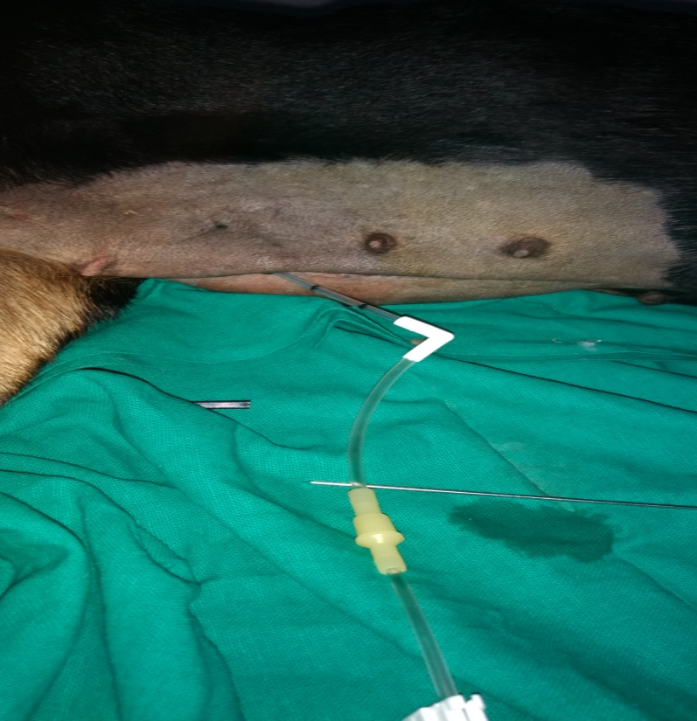

Slide 9
Chronic Renal failure
Occurs in every dog and cat breed at any age.
Older animals are more frequently affected than younger ones.

Slide 10
Etiology
Glomerulonephritis (e.g., autoimmune) amyloidosis intoxications
Hypoxia (anaesthesia-surgery)
Intoxications (e.g.,heavy metals)
Viral infections chronic subclinical leptospirosis
Pyelonephritis focal nephritis
Many congenital disorders (e.g., renal dysplasia, amyloidosis)

Slide 11
Clinical signs
Polyuria-polydipsia
Weight loss
Anorexia
vomiting
Anaemia
Foul smelling urine (Pyourea) – pyelonephritis.
Frequent micturation
straining during urination i.e. “stranguria”,
Red urine (haematuria),

Slide 12
Diagnosis
Anuria, polyuria, abnormal constituents, urinary colic, dysuria.
Urine analysis :
Pyuria, Proteinuria, microscopic examination reveals presence of epithelial casts cells.
Serum biochemistry – BUN, serum creatinine
Culture of urine.
USG: Chronic renal failure Shrinkage of kidney
Kidney appear small K/a “End stage kidney”

Slide 13
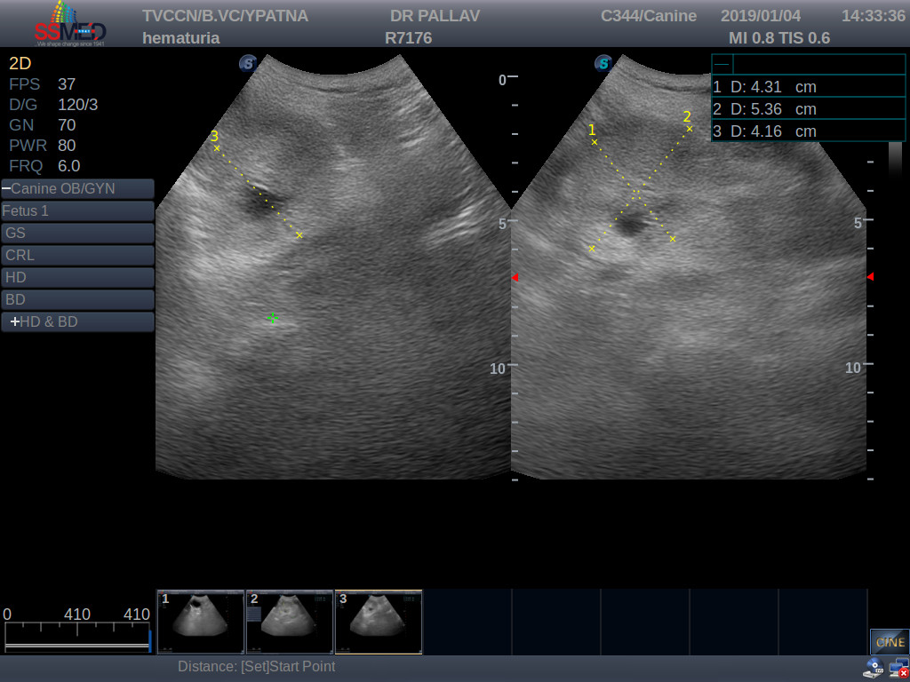

Slide 14
Treatment
A protein-restricted kidney diet, phosphate restriction is beneficial, sodium restriction and alkalinization, increasing the dietary ω3: ω6 fatty acid ratio and active Vitamin D (calcitriol) and phosphate binders added to feed, Erythropoietin and blood transfusion.
General Treatment :
Antibiotics for 2-4 weeks
Supportive & Symptomatic
Urinary alkalizers to change pH.
Use of diuretics e g. Frusemide @ 1 mg/kg I/M
Parenteral @ complex may be given.
Antacids in case of gastritis due uremia
Eg. Ranitidine @ 1-2 mg/kg IV or P.O.

Slide 15
Nephrosis:
Nephrosis is degenerative and inflammatory lesions primarily affecting renal tubules. Nephritis means inflammation of kidney
It may occurs due to renal ischemia or due to toxic insult to kindney

Slide 16
Nephrosis-Ischemia
Ischemia
Acute
Chronic

Slide 17
Classification
Nephritis
Glomerulonephritis
Interstitial Nephritis
Pyelonephritis
Embolic Nephritis

Slide 18
Glomerular nephritis :It means inflammation of glomeruli. It is cause of CRF in equine. Incidentally found in Cattle, sheep and goat.
It is very rare in animal
It is usually acute in nature.
It is may be primary or secondary.
Primary – disease affects glomeruli.
Secondary – Disease occurs secondary is disease affecting other body system.

Slide 19
Etiology: It is considered as an autoimmune disease, E.coli, streptococci, ICH virus, Dirofilaria immitis (Heart worm) may acts as antigen..

Slide 20
Interstitial nephritis:
It means inflammation of interstitial tissue of kidney.
It is very common in dog and rare in other animal.
It may be acute or chronic in nature.
Etiology:
Bacteria : E.coli, Leptospira canilcola icterohaemorrhagica.
Virus – ICH (adenovirus).
Parasites Dictyophyema renale (kidney worm).
Toxins – Lead, Arsenic, Mercury.
Drugs sulphomamide , Paracetamol. Kidney parenchyma indorgo inflammatory changes which blocks the tubules together that is cellulr infiltration.

Slide 21
Pyelonephritis :
It means inflammation of renal parenchyma & pelivis. It is highly fatal pyogenic inflammation of renal pelvis and parenchyma normally due to ascending infection with bacteria.
It is chronic supportive inflammation of kidney.
It is common in cows but has been recorded in sheep, goat, horses, buffalo, dog.
It is common in recently asteriated and advanced pregnant animals/female.
Etiology :
Specific causes :
Cerynobacterium renale (most common ) and E.coli in cattle.
Eubacterium suis in pig.
Ascending infections from lower urinary tract infection or genital tract is the most common way of infection.
e.g. Metritis, vaginitis, cystitis, orchitis .
Infection by hematogenous route e.g. septicemia caused by Pseudomonas aeruginosa may also occur).

Slide 22
Embolic nephritis
Inflammation of kidney due to emboli
Emboli may originate from localized septic process :
Valvular endocarditis in all spp.
Suppurative lesions in uterus, udder, navalnegia or peritoneal cavity in cattle.
Embolic associated with systemic infection
Septicemia in neonatal animals, shigellosis it foals, colibacilosis, salmonellosis.
Erysipelas in pig.
Septicemic strangles in horses.

Slide 23
Ureteritis and Urethritis
Inflammation of ureter and urethra It is characterized by abdominal pain, scanty turbid urine and painful urination.
Etiology: Corynebacterium renale, E. coli, Staphylococcus sp, Proteus sp
Clinical signs: Abdominal pain, dysuria, Animals remain in urinary posture after cessation of urine for long, Straining during urination.
Treatment: Similar to cystitis

Slide 24
Cystitis: Inflammation of urinary bladder is called as cystitis.
Etiology :
Trauma :
Corrosive chemicals toxic substances, calculi, improper catheterisetion or direct injury.
Bacteria :
E.coli, corynebocutanium renale, Proteins spp. Infection may be
(a) Ascending – from urethra or genital tract.
(b) Decending – from suppurative nephritis.
Infection is mostly ascending type
Urine is (favours microbial growth )
Urolithiasis (Calculi, neoplasm, stricture of urethra, dystokia), Prolapse of uterus.

Slide 25
Urolithiasis:
The presence of calculi in the urinary system is referred to as urolithiasis.
Calculi may be present in kidney tubules, pelvis, ureter, bladder or urethera.
It is more common in male and in ruminant more in castrated males ( bullock) at the sigmoid flexure.
In canine it is more common in UB.
Clinical Findings: Severe pain, Stiff gait, grunting at urination, hydronephrosis and Uremia
Treatment: Correction of obstruction by urethrotomy, cystotomy or ureterotomy
Ruminants: feeding of NaCl, ammonium chloride (10g/sheep).
Dog: Change of Urinary pH

