Slide 1
Sulphonamides (Part 1) …………………………………………………………………………………………………………………………………………………………………………………………………………………………………………… Chemotherapy (VPT-411) (Lecture-8)
Dr. Kumari Anjana
Asstt. Professor
Deptt. of Veterinary Pharmacology & Toxicology
Bihar Veterinary College, Bihar Animal Sciences University, Patna

Slide 2
Content of the chapter
Sulphonamides
Introduction,
History
chemistry,
Principles of sulphonamide therapy
classification
spectrum of activity
MOA
Administration

Slide 3
Introduction
Sulphonamide is a class of organic compounds that are amides of sulphonic acids.
Sulfonamides are the first AMAs effective against pyogenic bacterial infections.
These are most widely used AMAs in veterinary medicine, mainly because of their relative efficacy in some common bacterial diseases in animals and of low cost.

Slide 4
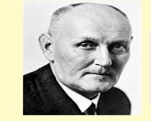
History
In 1935, it was discovered that a red dye called prontosil had antibacterial properties in vivo (i.e. when given to laboratory animals).
But no antibacterial effect was observed in vitro.
In other words, prontosil could not kill bacteria grown in the test tube.
Fig: Domagk
Source : Google image
German bacteriologist and Pathologist
Working in dye manufacturing company
Awarded Nobel Prize in 1939 (Medicine)

Slide 5
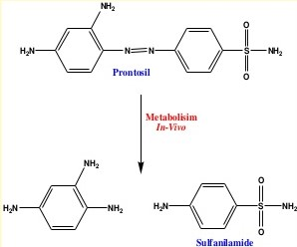
Later it was discovered that prontosil was metabolized by bacteria present in the small intestine of the test animal to give a product called sulphanilamide.
It was this compound which was the true antibacterial agent.
Prontosil was an early example of a prodrug.
Source : Google image

Slide 6
Chemistry and SAR
All sulfonamides are derivatives of sulfanilamide (para-aminobenzene sulfonamide), the antibacterial component of an azo dye (prontosil).
In the chemical structure of sulfonamide--
sulfanilamide nitrogen designated as N1 and an amino nitrogen called N4.
Most antibacterial sulfonamides have been synthesized by chemical substitution at N1 position.
Sulphanilamide group
Fig: sulfonamides
Source : Google image
The individual members differ in the nature of N1 substitution, which governs the solubility, potency and pharmacokinetic property of the compounds.

Slide 7
A free amino group in N4 position is essential for antibacterial activity’
Generally N4 substituted sulfonamides have reduced antibacterial activity.
N4 substituted sulfonamides provide antibacterial action within the lumen of Gl tract.
They are white crystalline powders, insoluble in water.
Fig: sulfonamides
Source : Google image

Slide 8
Principles of sulphonamide therapy
It should be administered as early as possible in the course of an infection.
In server infection large dose should be given by parenteral route (IV or IM).
The initial large dose should be followed by regular smaller maintenance doses.
Plenty of water and urinary alkaliser (sodium bicarbonate) is to be given with sulfa drugs to prevent crystalluria.
If there is any sign of anuria and hematuria sulfa therapy should be stopped and plenty of water and urinary alkaliser is to be given.

Slide 9
Sulfonamides should not be given for more than one week because it may cause interference with normal flora and vitamin synthesis and cause development of drug resistance.
If response does not occur within first 2-3 days, suphonamide therapy should be stopped as no response could then be expected.
As sulfonamides are bacteriostatic, their dosing should be continued for about 48 hrs. after the disappearance of clinical symptoms.

Slide 10
Classification of Sulphonamide On the basis of site and duration of action
Systemically acting Sulphonamides -
Short acting (duration < 12 hours)
Sulfacytine, sulfadiazine, sulfamerazine, sulfisoxazole, sulfamethizole, sulfathiazole, sulphanilamide, sulfapyridazine, sulphasomidine
Intermediate acting- (duration 12-24 hours)
sulphadimidine, sulfamethoxazole, sulfasimazole, sulfamoxole, sulfaphenazole
Long acting- (duration 24-48 hours)
sulphadimethoxine, sulfamethoxypyridazine, Sulfaethoxypyridazine, and Sulfachloropyridazine
Ultra long acting-
sulfadoxine, sulphamethopyrazine
Locally acting Sulphonamides—
Gut acting Sulphonamides—
Succinylsulfathiazole, phthalylsulfathiazole
Phthalylsulfacitamide,
sulphaguinidine and
sulfasalazine
Topical agents-
Silver sulfadiazine,
mafenide,
sulfacitamide

Slide 11
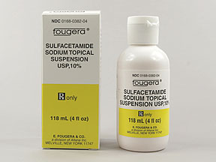
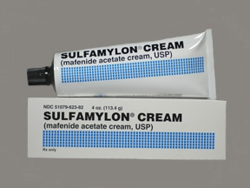
Classification of Sulphonamide On the basis of clinical uses
Sulfonamides used topically
To treat eye infection:
Sulfacetamide Sodium:
As 30% Solution or 10% Ointment (highly Soluble
and yield nonirritating neutral solution).
To treat burn and wound infections :
Mafenide (Sulfamylon),
silver Sulfadiazine
Source : Google image

Slide 12
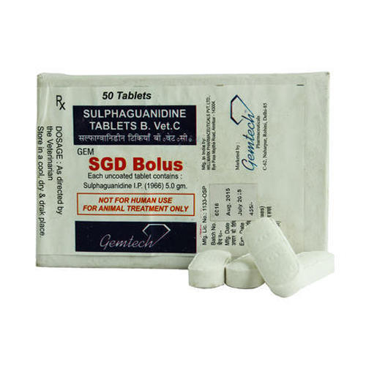
Sulphonamides used to treat gut infections (Gut-active Sulphonamides)
Phthalylsulpfthiazole
Succinylsufathiazole
Sulphaguinidine Source : Google image
These are poorly soluble and are not absorbed from GIT. Phthalylsulpfthiazole and Succinylsufathiazole are inactive as such and hydrolyse in the GIT by intestinal micro flora to phthalic and Succinic acid and active Sulfathiazole.
Salicylazosulfapyridine (Sulfasalazine) is also hydrolysed in large intestine to Sulfapyridine and aminosalicyclic acid (anti-inflammatory agent) and is used in ulcerative Colitis in Dogs.

Slide 13
Sulfonamides used to treat urinary tract infections:
Sulfisoxazole (Sulfafurazole),
Sulphisomidine
These are highly water soluble, rapidly excreted via urine, mostly unchanged.
Undergo least acetylation or acetylated crystals are highly soluble even in acid urine (So less propensity to cause crystalluria) and attain high concentration in urinary tract.

Slide 14
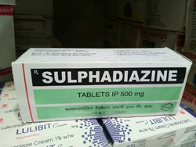
Sulphonamides used in meningitis
Sulphadiazine
Sulphadimidine
Sulphonamides used in respiratory tract infection
Sulphaphenazine
cotrimoxazole
Source : Google image

Slide 15
Sulphonamides used in Leprosy:
Dapsone, solapsone
Sulphonamides used in Bowl disinfection
Sulphasalazine, phthalylsulfathiazole
Sulphonamides used in Malaria
Sulphadoxine + Pyrimethamine
Sulphonamides used in Nocardiosis
Sulphadiazine, sulfisoxazole

Slide 16
Spectrum of activity
Sulphonamides are broad spectrum antimicrobial agents.
Effective against bacteria, chlamydia, toxoplasma and coccidia.
Mycobacteria, mycoplasma rickettsias, pseudomonas and spirochaetes are however resistant.
They are bacteriostatic but in very high concentration, especially in urinary tract, may be bactericidal.
Sulphonamide therapy should be initiated in rapidly multiplying stage of bacteria i.e. in acute conditions.
They are less effective in chronic diseases.

Slide 17
The sulfonamide therapy is continued till complete removal of infection.
If therapy is discontinued before complete elimination of microorganisms, more resistant strains of bacteria can emerge.
The therapeutic blood concentrations of sulfonamide ranges between 5 to 15 mg%.
Emergence of drug resistant is frequent.
Resistance may develop due to enzyme adaptation, alternate enzyme pathway, chromosomal mutation or plasmid mediation (R-factor).
Cross resistance is commonly observed.

Slide 18
Mechanism of Action of Sulfonamides
Many bacteria synthesize their own folic acid for which paminobenzioc acid (PABA) is an essential constituent.
Sulfonamides are structural analogs or competitive antagonists of PABA.
They are competitive inhibitors of dihydropteroate synthetase, a bacterial enzyme responsible for the union of PABA with pteridine residue in bacterial formation of dihydropteroic acid.
Dihydropteroic acid further conjugates with glutamic acid to produce dihydrofolic acid.

Slide 19
The antagonism thus leads to inhibition of synthesis of folic acid and resulting in bacteriostatic effect.
The organisms, which synthesize their own folic acid and cannot utilize preformed folic acid are sensitive to sulfonamides.
Sulfonamides do not affect mammalian cells since they require preformed folic acid supplied in diet and need not synthesize it.

Slide 20
Contd…
PABA + pteridine
Dihydropteroic acid
Dihydrofolic acid
Tetrahydrofolic acid
Purines and Pyrimidine Thymidine Methionine, Glycine
DNA Nucleic acid synthesis Proteins
Sulphonamides
Dihydropteroate synthetase
Glutamic acid
Trimethoprim
Dihydrofolate reductase
Cell division leading to bacterial multiplication and growth

Slide 21
Administration
Sulfonamides are administered orally, IV (in acute cases), IM, SC, IP, intrauterine or topically.
The parent sulfonamides are administered by oral or topical route.
The monosodium salts of most sulfa drugs are given IV, but not by other parenteral routes (less solubility and cause severe irritation).
The disodium salts can be used for IV as well as IM or SC administration (highly water soluble).
Drug combined with urea is prescribed for uterine infection.

Slide 22
Summary
Sulfonamides are the first AMAs effective against pyogenic bacterial infections.
These are most widely used AMAs in veterinary medicine.
In 1935, it was discovered from red dye called prontosil.
Sulfonamides are structural analogs or competitive antagonists of PABA.

Slide 23
Thank You

