Slide 1
Clean Milk Production
Milk plant and dairy equipment hygiene

Slide 2
Clean Milk Production
Milk is an excellent medium for growth of microorganisms.
If produced un-hygienically, and handled carelessly, it gets contaminated very easily leading to its earlier spoilage.
To prevent this, production of clean milk is emphasized.
Clean milk: Milk that is drawn from under of healthy animals, which is collected in clean dry utensils, which are free from extraneous matter like dust, flies, hair, manure, etc., which has normal composition & natural milk flavour, low bacterial count and completely safe for human consumption.

Slide 3
Predisposing factors that influence microbiological quality of milk at different stages of production and handling:
1. Milch animals
Health of the animal:
Free from systemic diseases (Mycobacterium tuberculosis, Coxiella burnetti, Brucella abortus can be communicated to man through milk).
Free from bacterial diseases such as salmonellosis, anthrax, Shigellosis, enteropathogenic Escherichia coli, Streptococcus, and other bacterial infections.
Viral infections such as vaccinia, pseudo cowpox, louping ill (Tick-borne encephalitis), foot-and-mouth disease, etc.
Cleaning of animals:
Dung, mud, bedding materials, straws contaminated by micrococci, staphylococci, streptococci and enterococci.
To prevent the entry of these contaminants into milk, routine grooming, brushing and washing should be carried out.
Washing of teat with towel soaked in bleaching powder (10mg/litre) or potassium permanganate (1%) should be adopted.
The foremilk may contain the microorganisms and it should be collected in a small pail and removed from the cow shed.

Slide 4
2. Environment
Stables/cow-shed/barns:
Should be clean, well ventilated and well lighted.
If the stall is built with its length North-South, it gets benefit of both the morning and evening sun.
The stall air should always be fresh, pure and free from dust and dirt.
Good housing and manure disposal system:
It is essential that the place where milking is done is kept clean atleast 1 hour before the milking starts.
Accumulations of dung and urine in barns should be avoided.
It should be protected from flies, mosquitoes, rats, cockroaches and birds, etc.
White washing of walls should be done periodically.

Slide 5
3. Feed and water:
Feeds:
Giving off flavour should be avoided.
The feed which has been contaminated with aflatoxins, plant toxins, heavy metals and radioactive substances should be avoided.
Water supply:
One of the most important sources of microbial contamination.
The quality of water used at farm for different purposes should be of satisfactory quality.
Clean potable water supply should always be available.

Slide 6
4. Utensils:
Microbial contamination of milk with dust at the time of milking can be minimized by using small topped containers.
Milking pails and utensils should be cleaned and sterilized regularly to avoid contamination.
Use of strainer to remove large sized objects.
Freshly drawn milk has a temperature of approximately 38⁰C which is highly suitable for bacterial growth.
Hence milk should be cooled to less than 10⁰C as quickly as possible after milking.

Slide 7
5. Milker’s hygiene:
The milker should be clean and he should avoid sneezing, coughing, smoking as well as chewing of tobacco just before and during milking.
Milker should be free from contagious diseases like cholera, typhoid, diphtheria and tuberculosis and should be monitored for these diseases rigorously on regular basis.
Milkers should thoroughly clean their hands and arms before milking.
Fingernails should be kept trim.
Soap and clean towels should always be provided for the milkers.
Milker should avoid the wrong milking practice like knuckling and incomplete milking, which leads to multiplication of organisms in the left over milk.

Slide 8
6. Educative propaganda and incentive payment plan:
In India due to population explosion and urbanization, the demand of liquid milk outstrips the supply.
Short supply of liquid milk is the major cause of adulteration in India.
Each farmer contributes very small quantities of milk and farmers are by and large not well aware of good practices of milk production.
Therefore, there is a need to train and educate the farmer for ensuring the adoption of good animal husbandry practices, which will result in limiting bacterial contamination.
To maintain the highest standards of bacteriological quality of milk, the present system of payment, which is based on fat and SNF needs to be changed to incorporate the payment based on bacteriological quality (methylene blue reduction time).
This will ensure that the raw milk of highest bacteriological quality is available for production of milk products that would meet the international standards.

Slide 9
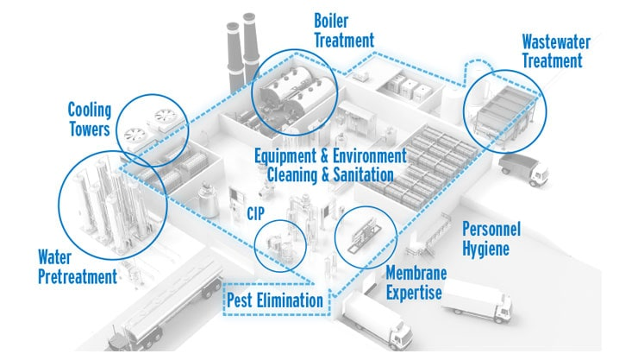
Dairy plant hygiene
The prerequisite for production of a high quality product is the cleaning and sanitization of the milk and milk product contact surfaces, which contributes to 60% of the total contamination.
Not only the dairy equipment should be clean but also the dairy plant atmosphere should be free from pathogens.

Slide 10
The following factors influence the dairy plant hygiene:
Buildings:
Maintenance of hygiene in the plant depends upon the design of the building.
Floor should be impervious and sloped for efficient drainage of water.
In walls, 2m height should be tiled, help in efficient cleaning.
Doors and windows should be self-closing type.
A distance of 3m between walls and the equipment and a minimum of 42cm to 52cm between the bottom of equipment and floor is necessary for proper cleaning.
Proper ventilation is essential to remove odour, heat, moisture and to minimize condensation on cooled surfaces.
The light requirement in storage areas, boiler room and compressor room is 13w/sq. m.; 21w/sq. m. on processing equipment like homogeniser and pasteurizers and 41w/sq. m. in laboratory and packaging areas for efficient cleaning and sanitization.

Slide 11
Equipment, materials and design:
Stainless steel and aluminium alloys are widely used for equipment and utensils in dairy industry.
The equipment surface should be free from dents, pits, rough spots, crevices and also it should be nontoxic, non-corrosive and non taintable.
For effective cleaning, length of pipes when dismantled should not be more than 2m.
Gaskets, stationary ring, dead ends inaccessible to mechanical cleaning should be designed specifically for CIP (cleaning in place).

Slide 12
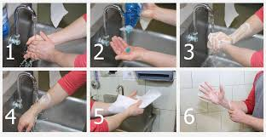
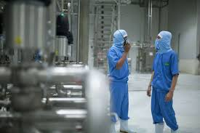
Personnel:
Persons working in the dairy plant should be educated on hygienic handling of milk and milk products.
They should wear washable clean white cloths and caps.

Slide 13
Water supply:
Uninterrupted
Uncontaminated
Non-chlorinated
Potable
Soft water with hardness not exceeding 112 mg/litre is essential.

Slide 14
Laboratory control:
Efficiency of cleaning and sanitization has to be tested for residual sanitizers and contamination in the laboratory from time by swab method or rinse method.

Slide 15
Air quality:
Contamination of air in the plant can be controlled by spraying sanitizers at a level of 0.048 mg/litre, which inactivates lactic bacteriophages.
Irradiations are used to sanitize the air in culture transfer room and packaging materials.
Common sanitizers used in dairy industry are hot water, steam, chlorine (200 mg/litre), iodophor (25 mg/litre) and quaternary ammonium compounds (200 mg/litre).
Among these, commonly chlorine is used in the dairy industry as it is considered better than other sanitizers due to its ideal qualities.

Slide 16
Hygienic control equipment
Cleaning:
Cleaning of dairy equipment refers to removal of soil which includes milk residues, water deposits, detergent and sanitizer residues, dust, sediments or any foreign matter.
Cleaning is chiefly dependant-upon:
The type of soil,
Hardness of water,
Surface of dairy equipment (contamination by micro-organism like coliforms, Bacillus etc.)

Slide 17
Cleaning and sanitization are complementary to each other, which include the following steps:
Pre-draining:
Draining should be carried out thoroughly to minimize product loss, reduce the load on the sewage and thereby helps in cleaning.
Pre-rinsing with water:
Pre- rinsing helps for flushing of milk residues, prevents drying and sticking of milk to the surface.
Lukewarm water should be used for pre-rinsing and temperature should not exceed 60⁰C to avoid coagulation of proteins.
Cleaning with detergent:
Blended detergents at an optimum temperature and mechanical scrubbing helps in removal of soil from the surface.
Common alkaline detergents used in dairy are sodium carbonate, caustic soda, sodium sesquicarbonate, sodium bicarbonate, sodium sulphate at a concentration of 0.2 – 2.0% while sodium silicate is used as a protective agent for aluminium.
Acid detergents widely used include nitric acid 0.5% and phosphoric acid at 2.0%.
Acid detergents help to remove the milk stones and water scale.

Slide 18
Hot water rinsing (post-rinsing):
Post – rinsing with lukewarm water removes all traces of detergents, displaced dirt and prevent deposition of line scale.
Sanitizing:
It involves effective bactericidal treatment with chemical/thermal agents to reduce the bacterial count including pathogens to a safe level on the utensils and equipment.
Sanitizing solution used are hypochlorites, organic solution of chlorine with 100-200 mg/litre of available chlorine, mixed halogens – 25 mg/litre of available iodine.
Post- draining and drying: This is to prevent contamination of milk the residual sanitizer.

Slide 19
Cleaning in place (CIP)
Manual cleaning is usually practised for easily accessible utensils and equipment.
CIP is practised in bigger dairies where it is difficult to dismantle and reassemble.
In this method detergent and sanitizers are circulated for a specific period of time at specified speed and in a specific sequence.
The CIP system saves time and labour, is cost effective
The efficiency of cleaning can be evaluated by visual inspection (by light, feel and odour) or staining procedure.
Microbiological efficiency of epifluorescent filter technique. Among these, swab test and rinse method are popular.
Swab test is carried out for equipment surface and rinse method for cans.
In swab test a specified area is swabbed in diluent and in rinse method utensil is rinsed with specific volume of diluent followed by pour plate technique.

Slide 20
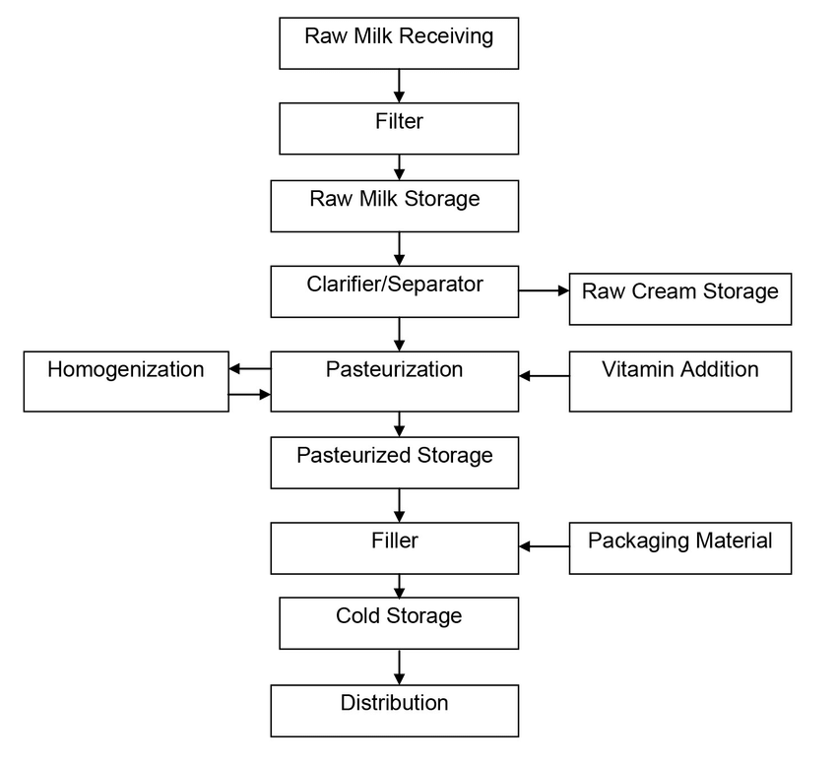
HAZARD ANALYSIS AND CRITICAL CONTROL POINTS (HACCP)

Slide 21
Hazard Analysis & Critical Control Point
Internationally accepted
food safety management
system
Ensures that the
product is safe and
will not cause harm
to the consumer
The HACCP system is solely related to FOOD SAFETY and not PRODUCT QUALITY

Slide 22
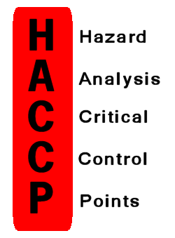
HACCP:-
Is a systematic preventative approach to food safety that addresses:-
physical,
chemical and
biological hazards
as a means of prevention rather than finished product inspection.
Used in the food industry to identify potential food safety hazards, so that key actions, known as Critical Control Points (CCP’s) can be taken to reduce or eliminate the risk of the hazards being realised.

Slide 23
HISTORY
HACCP programs first began as a natural extension of GMPs.
A system was needed by NASA starting in the late 1950’s to feed future Astronauts.
In 1959, the Pillsbury company work with NASA to develop a process from ideas employed in engineering systems development know as Failure Mode & Effect Analysis (FMEA).
HACCP concept was advanced by H.E. Bauman in 1971.
In 1971, the HACCP approach was presented at the first American National Conference for food protection.
In 1973, the US FDA apply HACCP to Low Acid Canned Foods Regulations.
After 1988, HACCP principles have been promoted and incorporated into food safety legislation in many countries around the world.
In 1996, the USDA established a detailed Pathogen Reduction / Hazard Analysis & Critical Control Point (PR/HACCP) program under the Food safety &Inspection Service (FSIS) to regulate the production of raw meat products by large scale facilities.

Slide 24
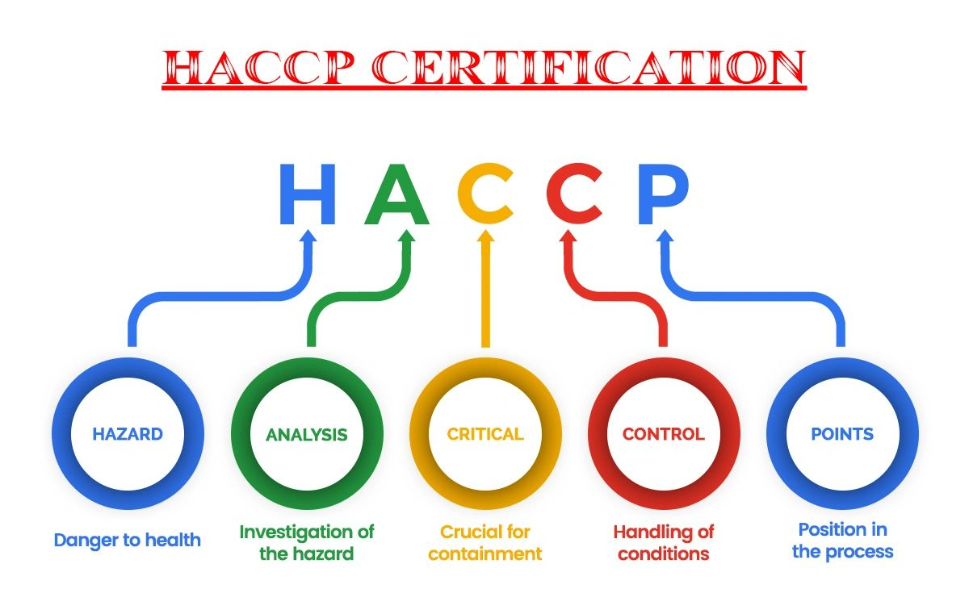
Hazard analysis:
The process of collecting and evaluating information on hazards and conditions leading to their presence to decide which are significant for food safety and therefore should be addressed in the HACCP plan.
Critical Control Point (CCP):
A step/point at which control can be applied and is essential to prevent or eliminate a food safety hazard or reduce it to an acceptable level.
CCP1: elimination of hazard
CCP2: Control of hazard
Critical limit:
A criterion which separates acceptability from unacceptability.

Slide 25
Hazard: A biological, chemical or physical agent in, or condition of, food with the potential to cause an averse health effect.
Corrective action: Any action to be taken when the results of monitoring at the CCP indicate a loss of control.
Deviation: Failure to meet a critical limit.
Monitor: The act of conducting a planned sequence of observations or measurements of control parameters to assess whether a CCP is under control.
Validation: Obtaining evidence that the elements of the HACCP plan are effective.
Verification: The application of methods, procedures, tests and other evaluations, in addition to monitoring to determine compliance with the HACCP plan.

Slide 26
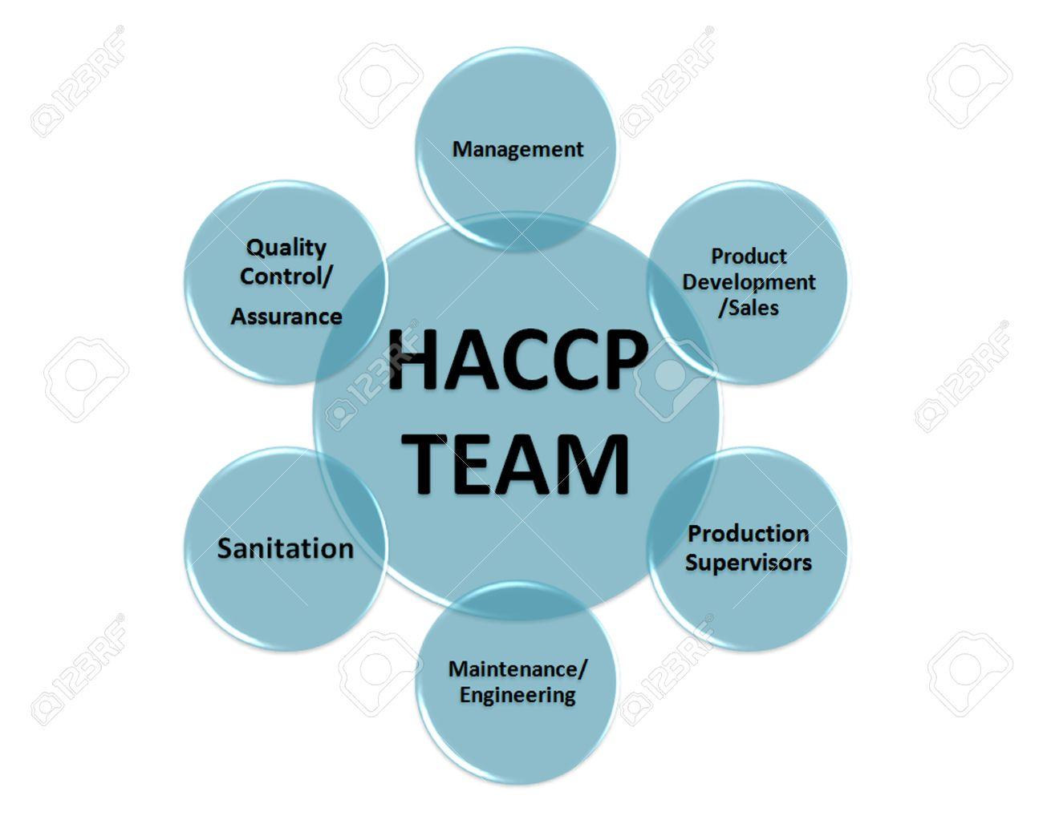
Prerequisite for HACCP
Define terms of reference
Clearly spells out scope, extent, resources committed, terms of appointment of outside consultants, third party auditors, levels of authority and accountability for implementation.
Select the HACCP team
Include product and process team members.
Describe the product and process
Identify intended use
Construct a flow diagram
Schematic flow that describes the process.
On-site confirmation of flow diagram
Walk through.

Slide 27
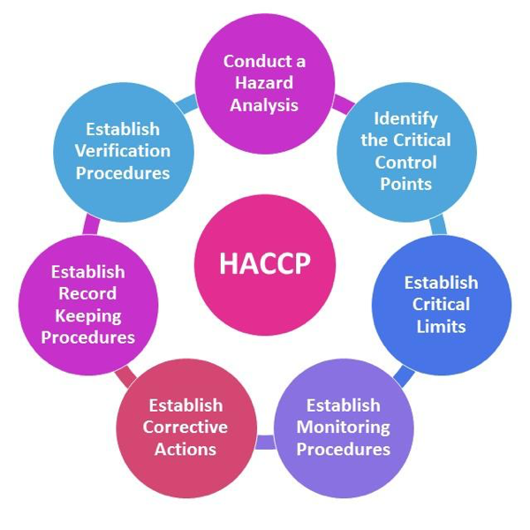
SEVEN PRINCIPLES OF HACCP SYSTEM
Conduct a Hazard analysis
Determine critical control points (CCP’s)
Establish Critical Limits.
Establish a system to monitor & control CCP’s.
Establish corrective action to be taken when monitoring indicated that a particular CCP is not under control.
Establish procedures for verification to confirm that HACCP system is working effectively.
Establish Documentation concerning all procedures and records appropriate to these principles and their applications.

Slide 28
Hazards
Control
Measures
Critical Limits
Critical Control
Points (CCPs)
HACCP PLAN
Monitoring
Corrective
Actions
Validation
Verification

