Slide 1
Transport and Packaging of Milk and Milk Products
By-
Dr. SUSHMA KUMARI
ASST.PROF., DEPT. OF LPT, BVC, PATNA

Slide 2
TRANSPORT OF MILK AND MILK PRODUCTS
Milk can be transported in milk cans or bulk tankers, which should be suitable for effective cleaning and sanitization. Generally, milk from small-scale milk producers is transported in milk cans by the producers themselves or by milk collectors (informal traders and intermediaries).
The key factor in the transport and storage of short shelf‐life products is temperature control throughout the whole distribution chain.

Slide 3
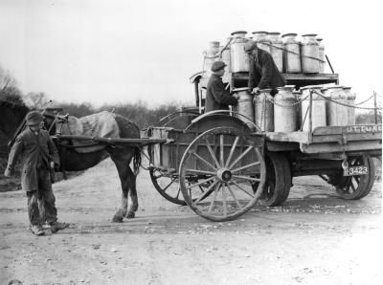
Milk Transport

Slide 4
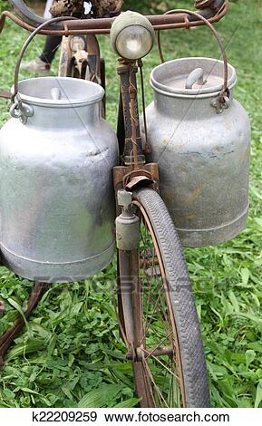
Milk Transport

Slide 5
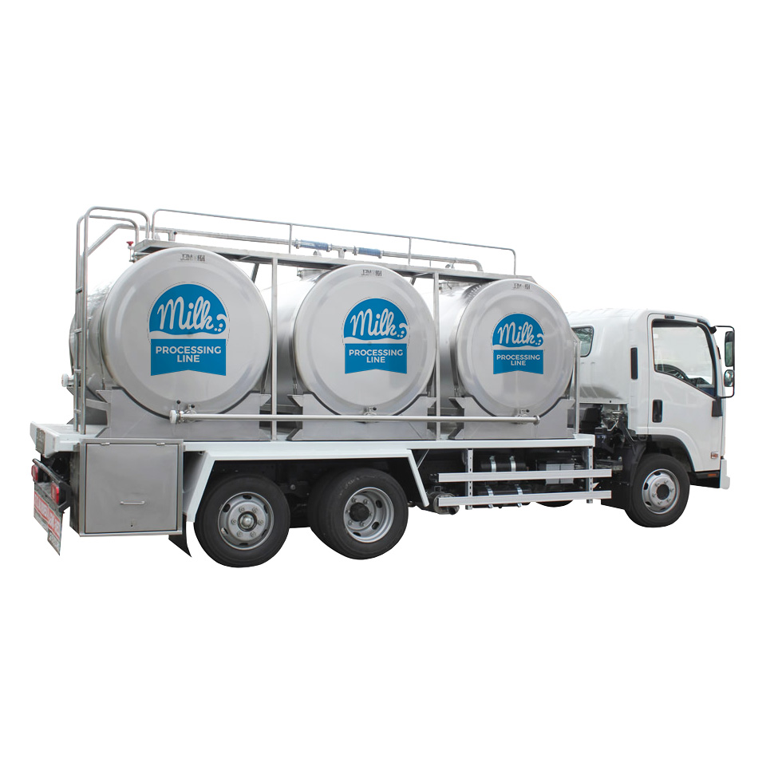
Milk Transport

Slide 6
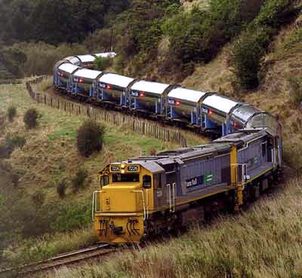
Milk Transport

Slide 7
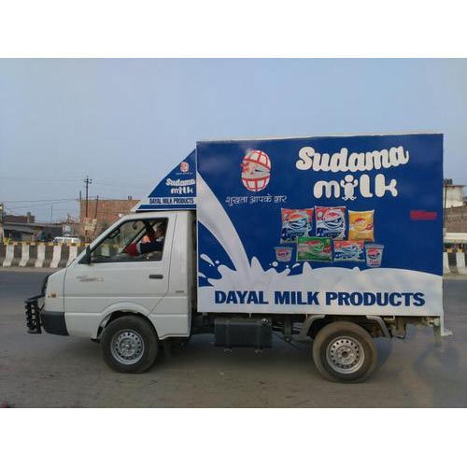
Milk Products Transport

Slide 8
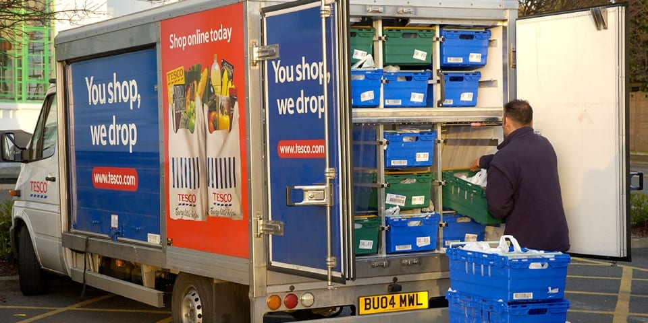
Milk Products Transport

Slide 9
Packaging Materials for milk and dairy products
Paper and paper based products. The paper and paper based products form an excellent packaging material for milk and milk products. ...
Glass. The glass may be transparent or opaque. ...
Tin plate. ...
Aluminium foil. .....
Plastics. ...
Low polymers. ...
High polymers.

Slide 11
Milk Packages

Slide 12
RECYCLABLE TETRA PAK CARTONS
Tetra Pak cartons are primarily made from paper. 75% of the Tetra Pak carton is made from paperboard, 20% of polyethylene and 5% of aluminium. These three materials are layered together using heat and pressure to form a six layered armour which protects the contents from light, oxygen, air, dirt and moisture.
Furthermore Tetra Pak cartons are lightweight, easy to transport and fully recyclable. The aseptic technology allows the product inside to stay fresh, without the need of any preservatives. The pack need not be refrigerated until opened.

Slide 13
Tetra Pak layers (6layers)

Slide 14
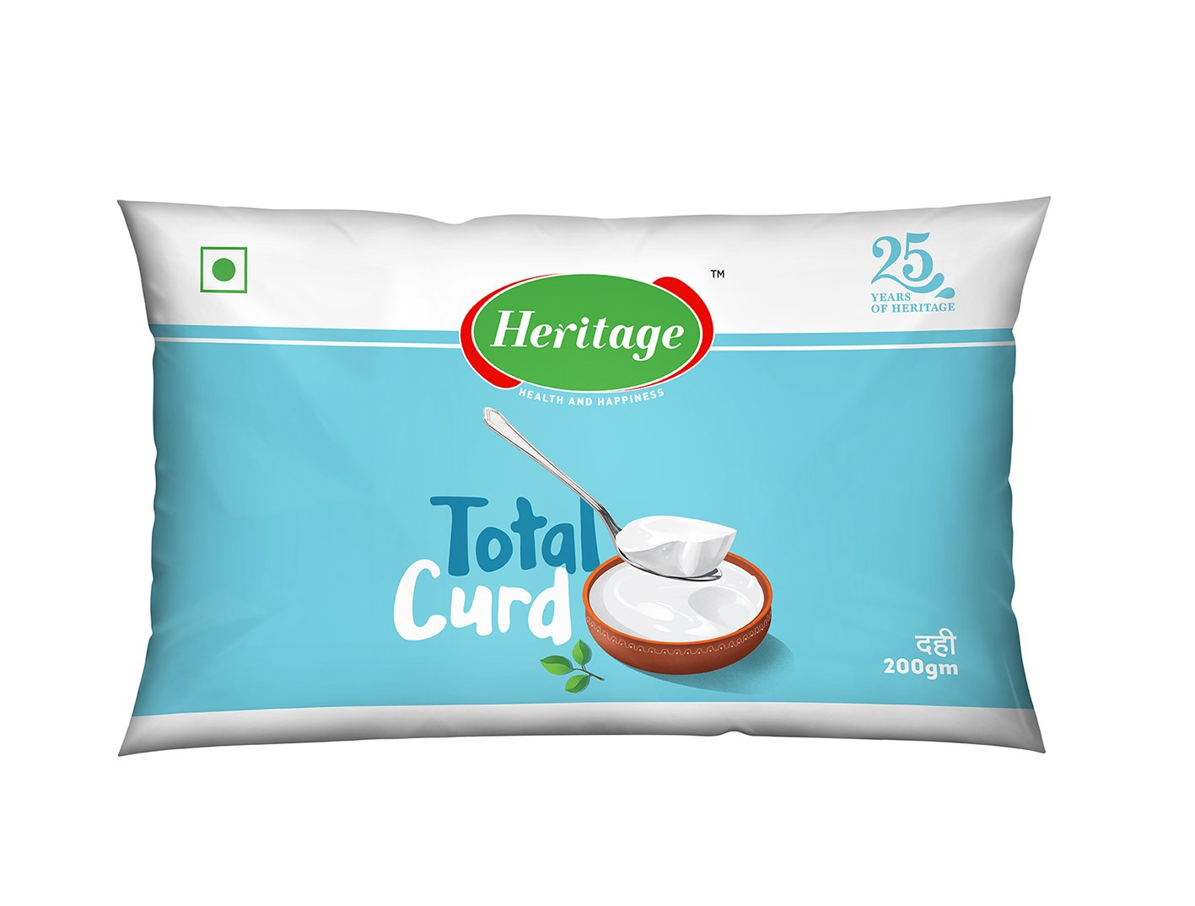
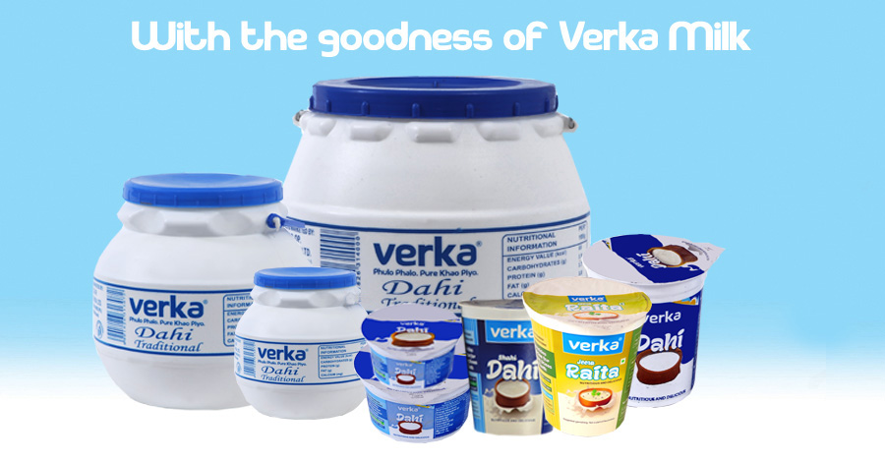
Curd packages

Slide 15
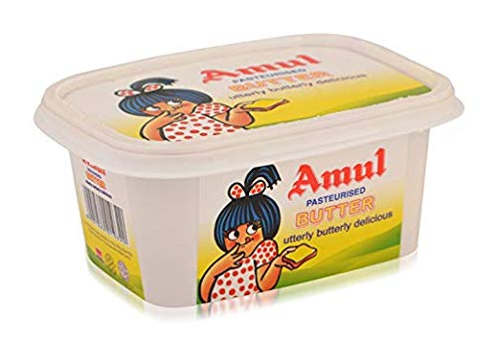
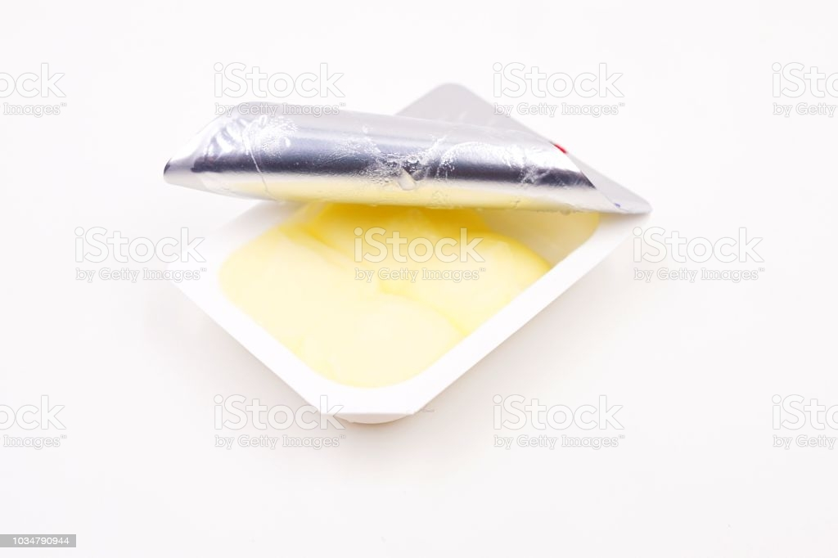
Butter packages

Slide 16
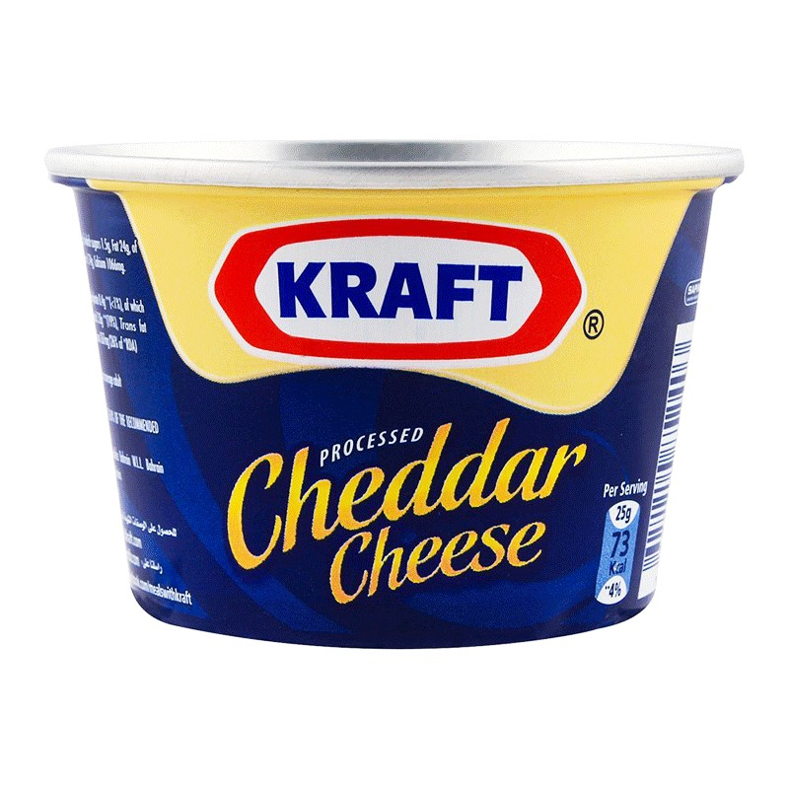
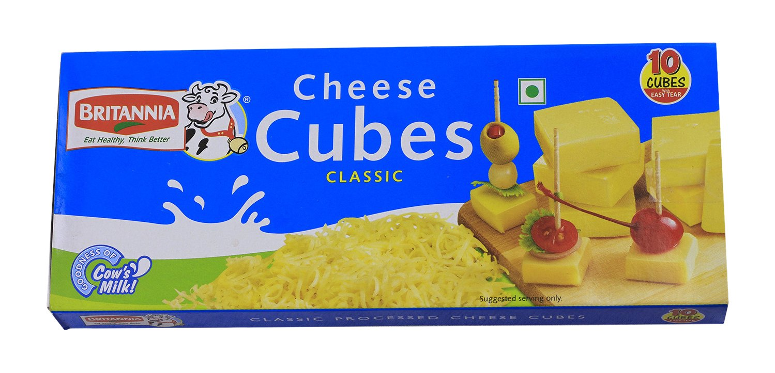
Cheese packages

Slide 17
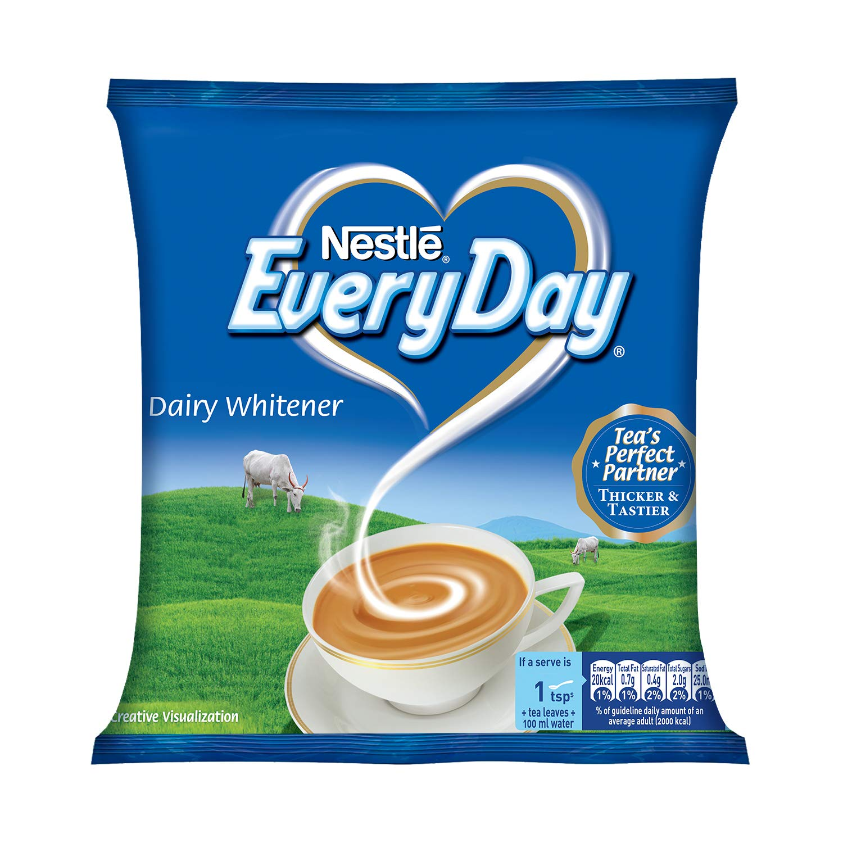
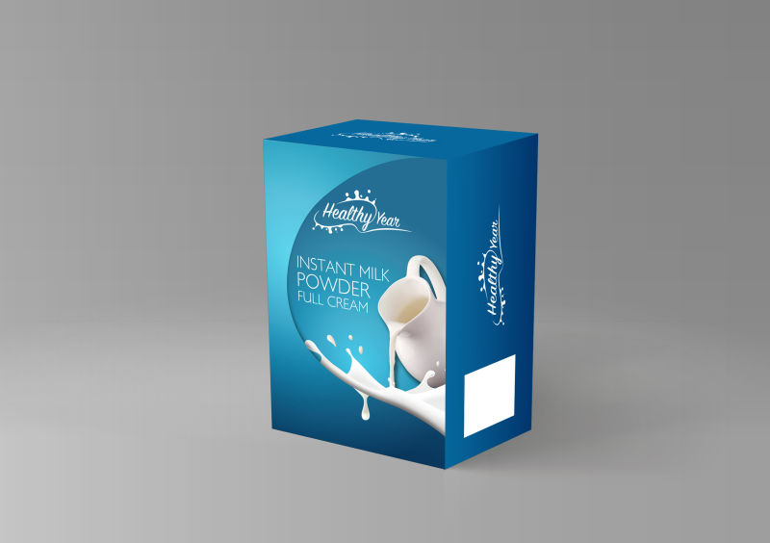
Milk powder

Slide 18
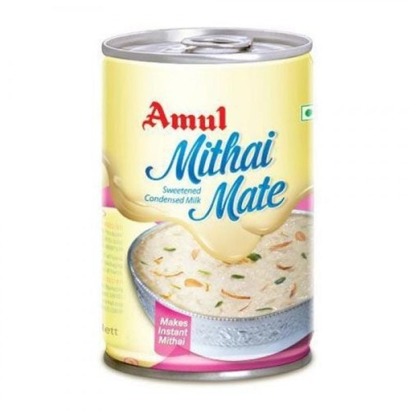
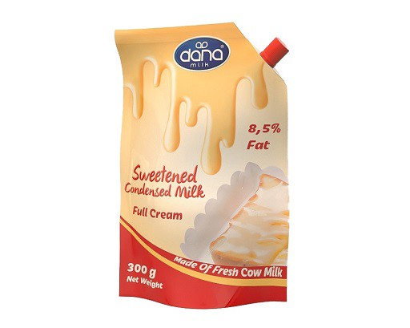
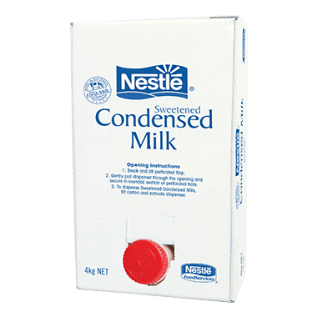
Condensed milk

Slide 19
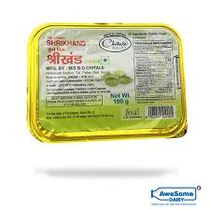
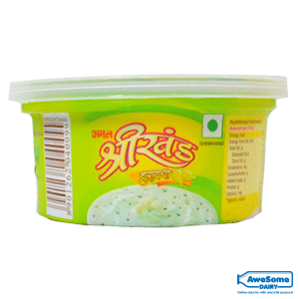
Shrikhand Packages

Slide 20
THANKS

