Slide 1
Impotentia Cocundi and Impotentia Generendi, Testicular Hypoplasia and Degeneration: Causes and Affect on Semen and Fertility
UNIT VII VGO 604, Part 2
DR ANKESH KUMAR
Asstt. Prof.
Department of Veterinary Clinical Complex

Slide 2
Disease of penis and prepuce
Rupture of the corpus cavernous penis – (ruptured, fractured or broken penis) Prognosis -Poor
Persistence of the penile frenulum This is the band of fibrous material that limit the movement of an organ or part. This is results from failure of the separation of the penis and prepuce during puberty. At birth the epithelial surface of the penis and prepuce of bull are fused and ventrally they are united by a band of connective tissue called the frenulum
Penile deviation (Phallocampsis) :-This deviation prevent penis from entering the vagina when bulls try to mate
Spiral or corkscrew
Rainbow deviation
S-shaped deviation
Lateral deviations
Balanoposthitis- inflammation of penis and prepuce (common in dog, bull ram); Dourine diseases In equine T. equiperdum
Pizzle rot-ulcerative prosthitis
Phimosis
Paraphimosis (Dog and Stallion)
Diphallus- double penis
Priapism-Erect penis does not return to its flaccid state
Hpospadias and Epispadias-: Defective development of penis(The urethra fails to reach the tip of the penis)

Slide 3
Treatment: Fascia lata implant technique is used for repair of both spiral and ventral penile deviation. The objective of the technique is to create a firm union of the dorsal apical ligament to the tunica albuginea to prevent its slippage. This technique uses an autogenous or homologous strip of fascia lata from the cranial border of the biceps femoris muscle to provide dorsal reinforcement of the apical ligament and fixation of the ligament to the tunica albuginea. Homologous strips of fascia lata can be harvested from freshly dead cattle and stored in 70% ethyl alcohol until used.

Slide 4
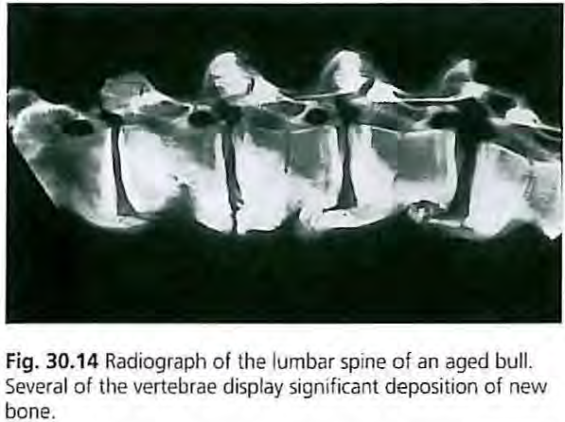
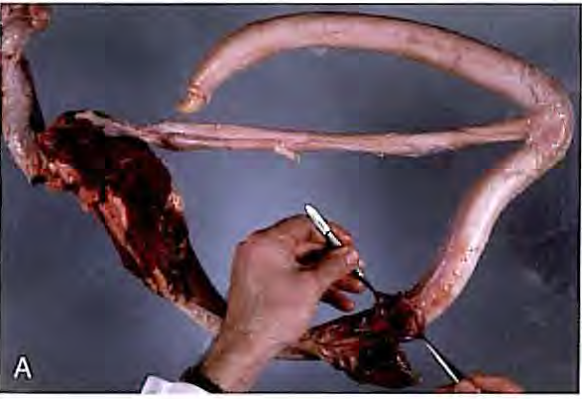
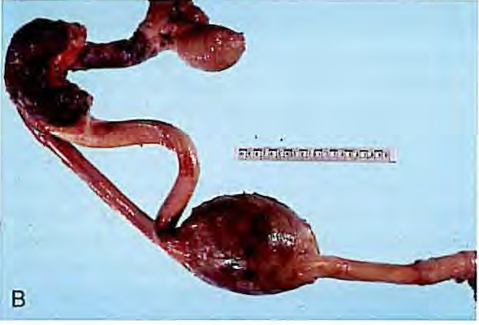
Inability to achieve intromission
Failure of erection
Ruptured penis and corkscrew penis are the most common abnormalities of the genital system of the bull
Occlusion of the longitudinal canals of the penis

Slide 5
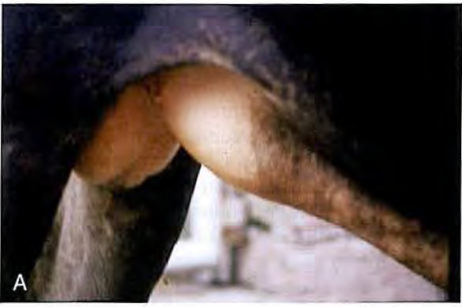
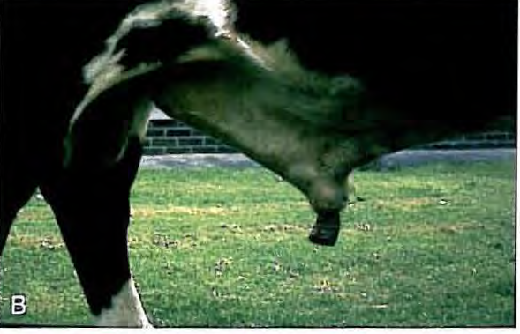
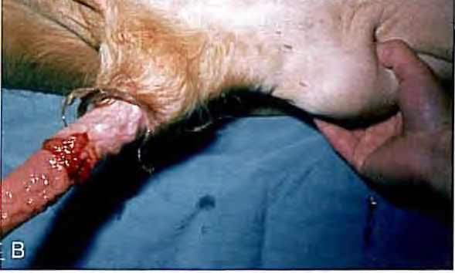
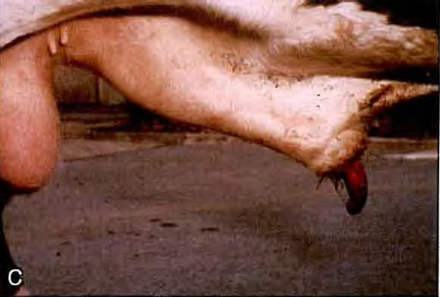
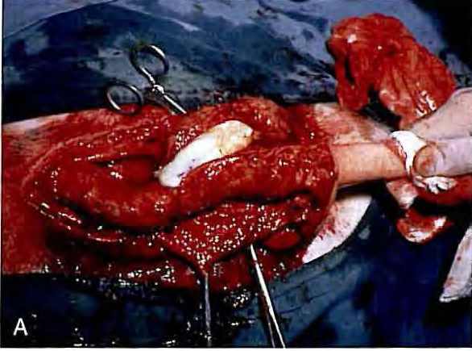
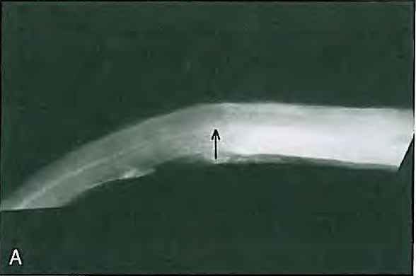

Slide 6
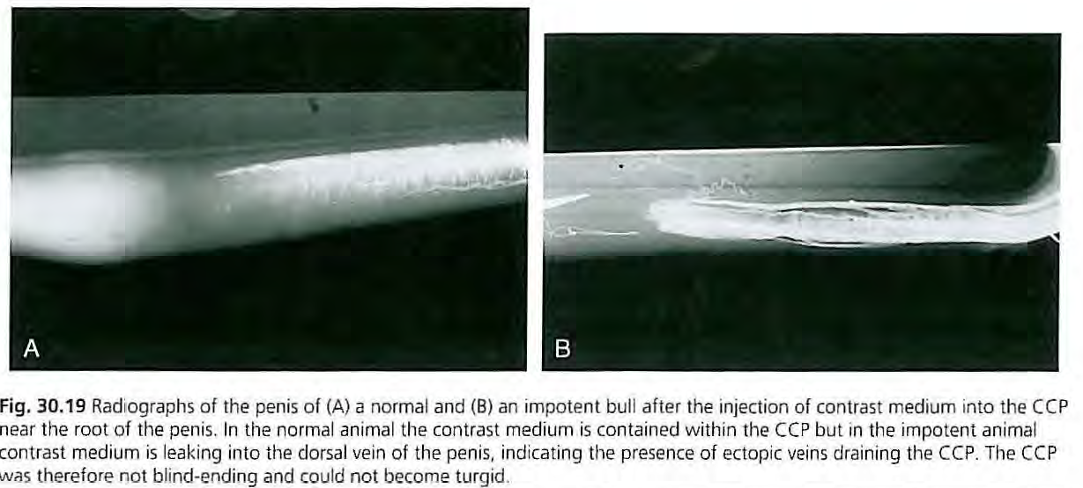
Failure of erection
Abnormal venous drainage (Prognosis-Poor)
Occlusion of the longitudinal canal of the penis
Disease of Joint, Muscle, nerve, Bone and tendons
Coxitis
Gonitis
Honeymoon back
Spastic syndrom (progressive hind limb paralysis)

Slide 7
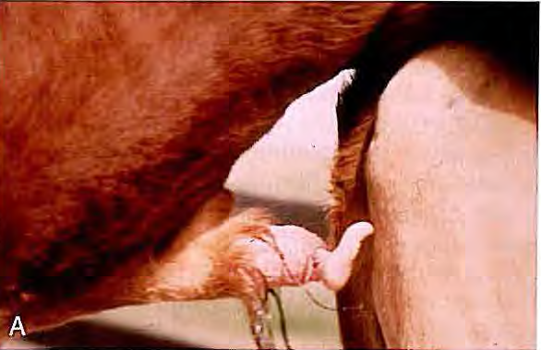
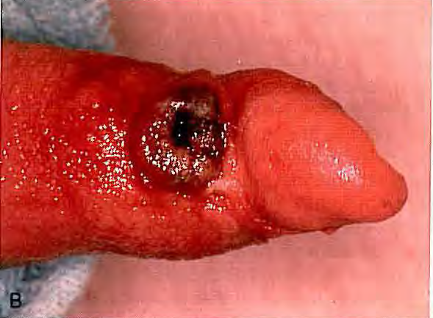
Fig. 30.21 (A) Corkscrew penis ('spiral deviation') manifested after mounting but prior to intromission. (B) Traumatic ulceration of the glans penis secondary to spiral deviation of the penis

Slide 8
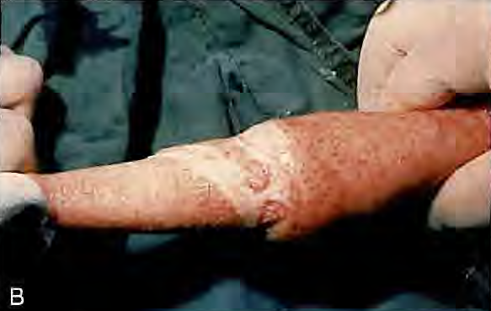
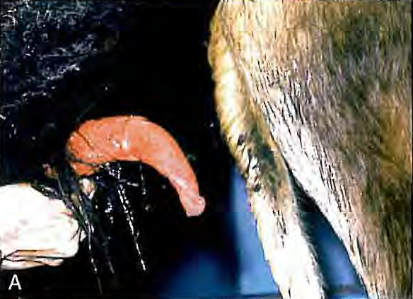
(A) Vent ral 'rainbow' deviation of the penis. This can sometimes be caused by localized fibrosis. (With permission from Parkinson & Bruere 2007.) (B). This animal was treated by excision of the lesion.

Slide 9
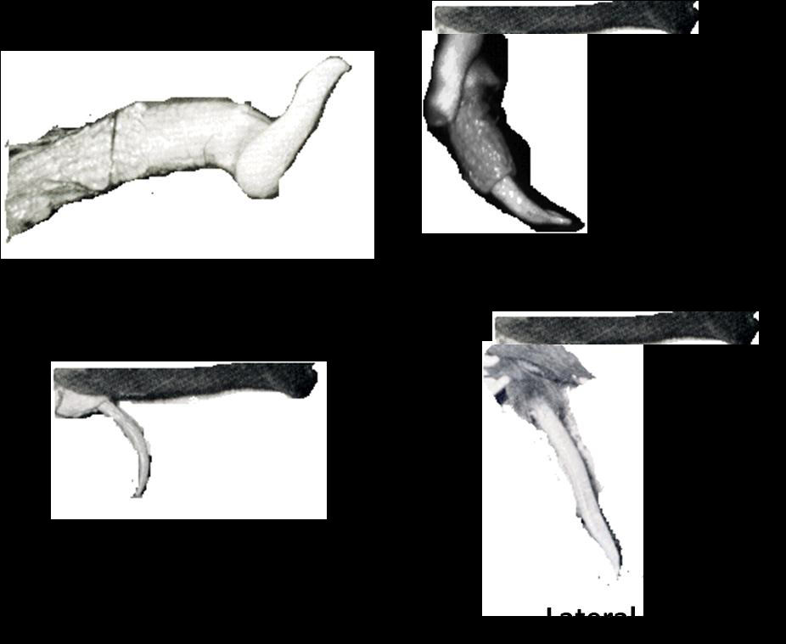
Different types of penile deviations in bull

Slide 10
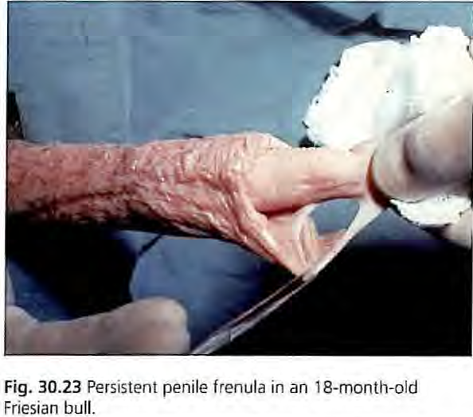
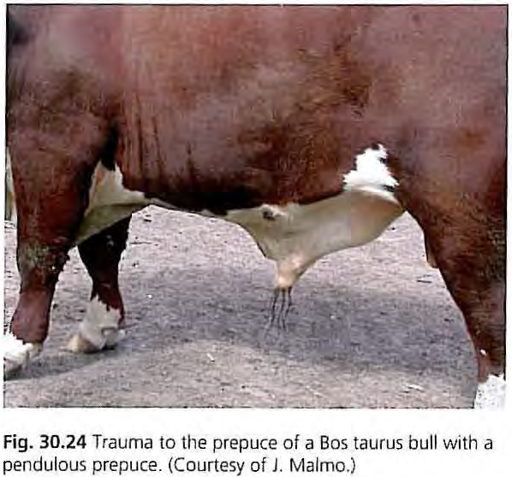

Slide 11
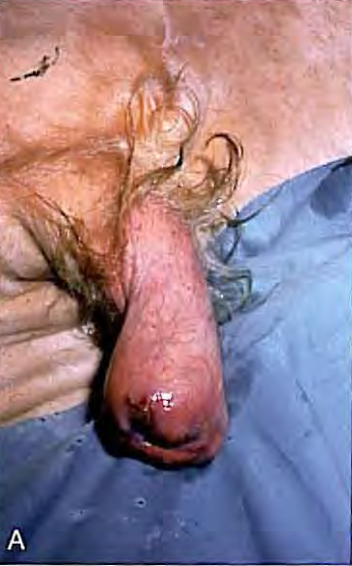
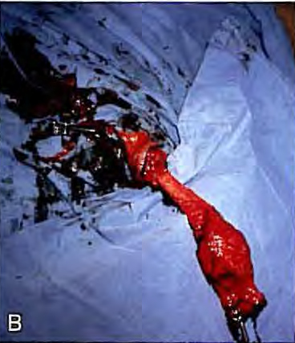
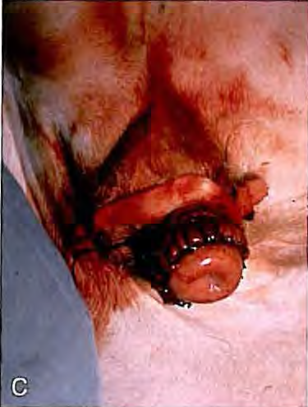
Fig. 30.25 (A) Chronic fibrosis in a prolapse of the distal prepuce in a Hereford bull. (B) Submucosal resection. (C) Final repair of the lesion.

Slide 12
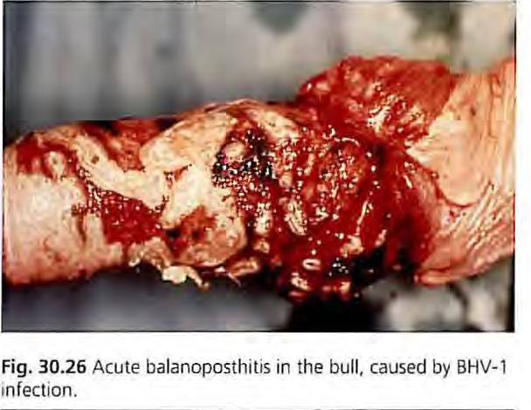
https://www.msdvetmanual.com/

