Slide 1
Protein structure prediction and design- II
P.G.
VBC-603
02.01.2021

Slide 2
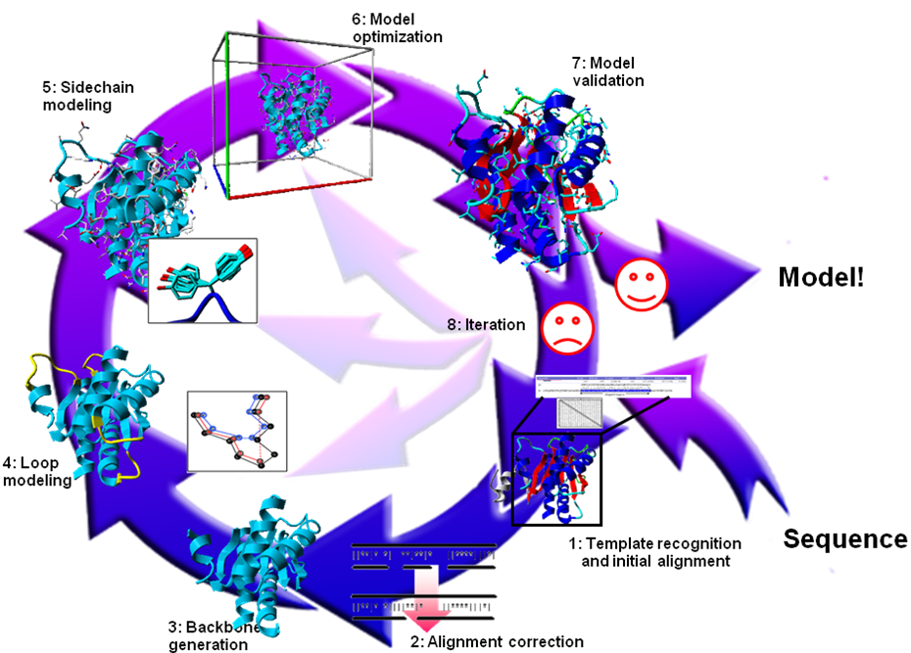
Knowledge Based Approaches
Homology Modelling
Need homologues of known protein structure
Backbone modelling
Side chain modelling
Fail in absence of homology
Threading Based Methods
New way of fold recognition
Sequence is tried to fit in known structures
Motif recognition
Loop & Side chain modelling
Fail in absence of known example

Slide 3
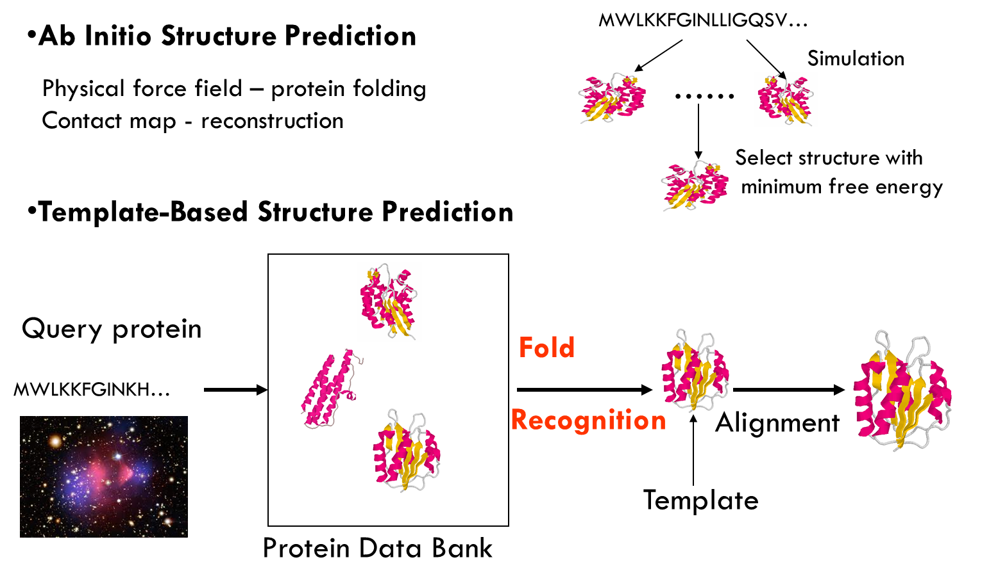
Two Approaches

Slide 4
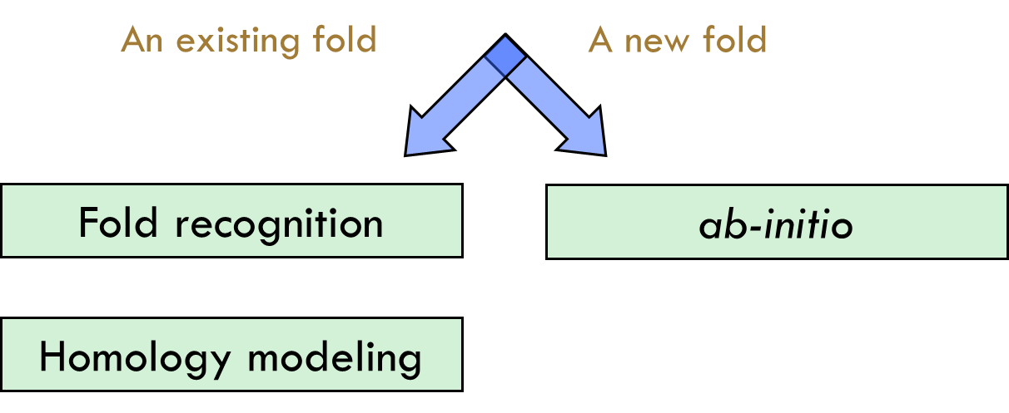
Predicting protein 3d structure

Slide 5
Template-Based Structure Prediction
Template identification
Query-template alignment
Model generation
Model evaluation
Model refinement
Comparative Modeling or homology modeling: if template is easy to identify
Fold recognition: If template is hard to identify, it is often called.

Slide 6
Homology Modelling

Slide 7
input for Homology modeling
The sequence of a protein with unknown 3D structure, the "target sequence."
A 3D “template” – a structure having the highest sequence identity with the target sequence ( >30% sequence identity)
A sequence Alignment between the target sequence and the template sequence

Slide 8
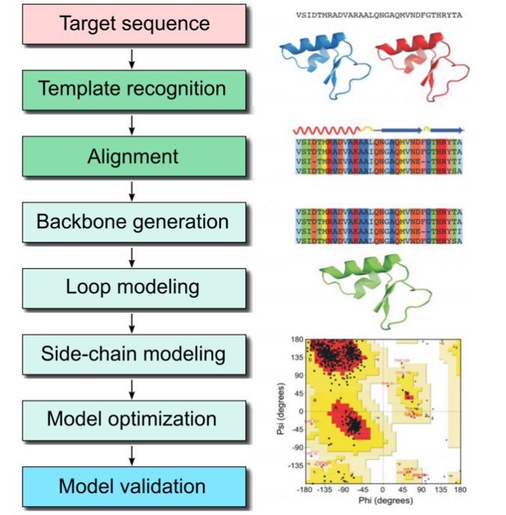
Homology modeling
Based on the two major observations (and some simplifications):
The structure of a protein is uniquely defined by its amino acid sequence.
Similar sequences adopt similar structures. (Distantly related sequences may still fold into similar structures.)

Slide 9
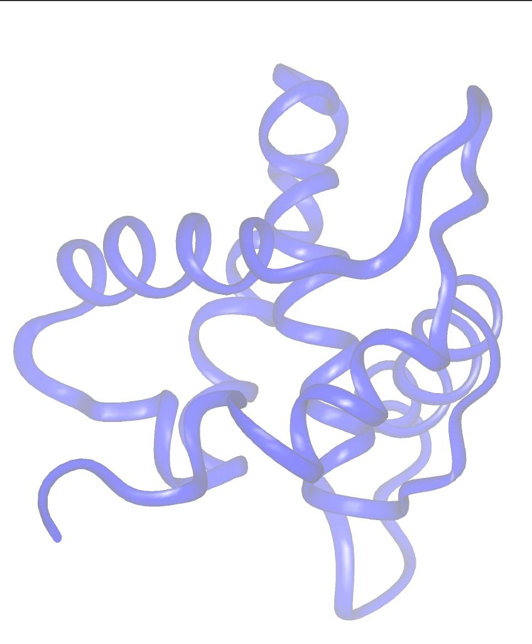
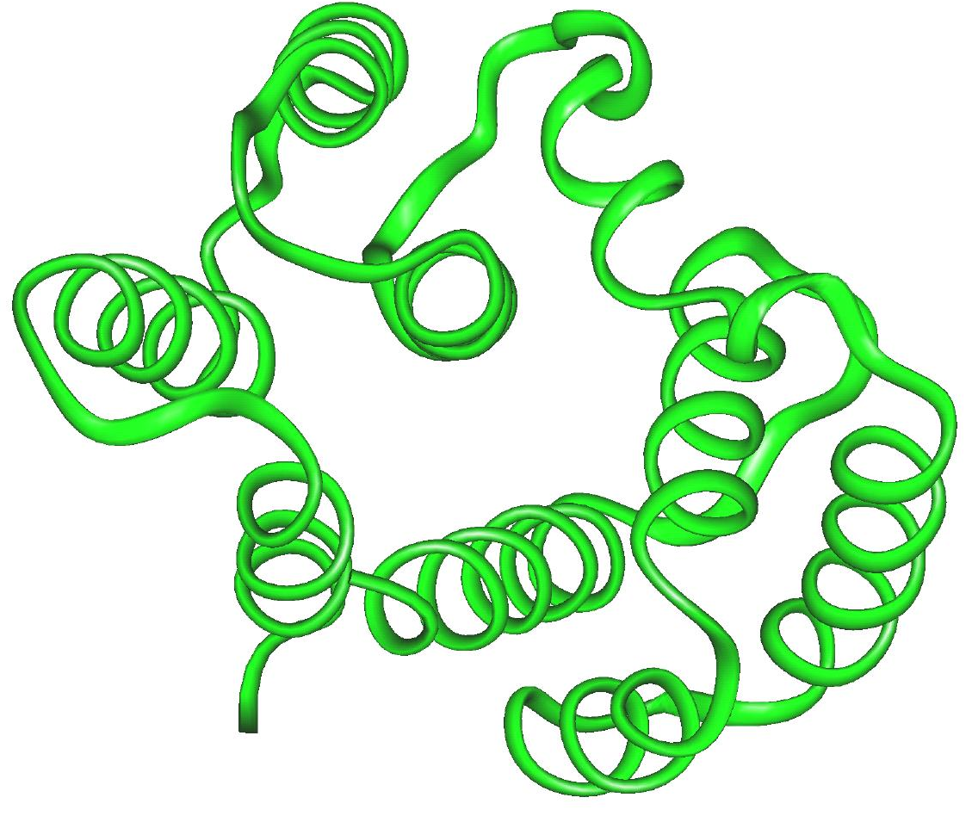
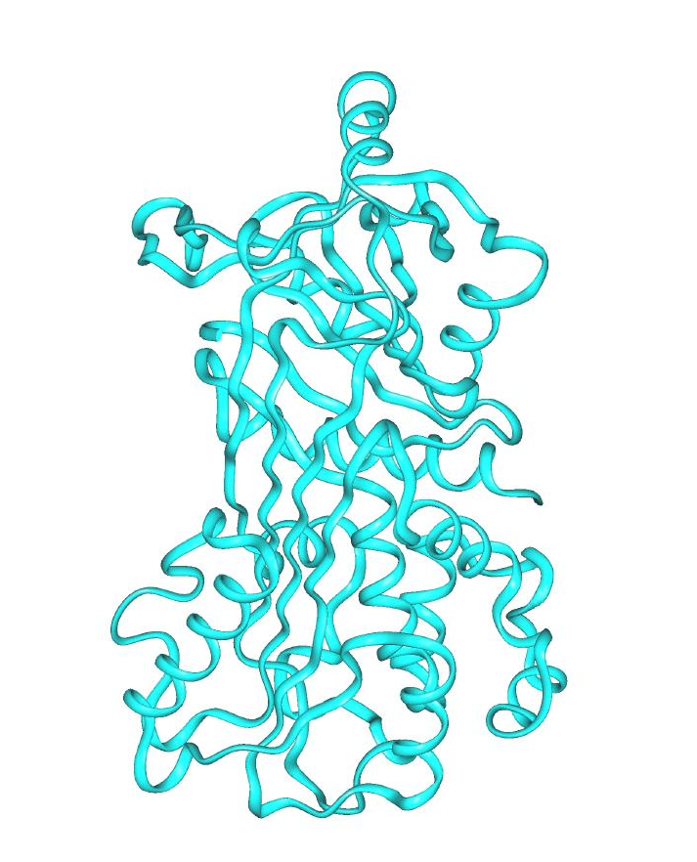
Fold recognition = Protein Threading
Which of the known folds is likely to be similar to the (unknown) fold of a new protein when only its amino-acid sequence is known?

Slide 10
ab-initio folding
Predict structure from “first principles”
Requires:
A free energy function, sufficiently close to the “true potential”
A method for searching the conformational space
Advantages:
Works for novel folds
Shows that we understand the process
Disadvantages:
Applicable to short sequences only

Slide 11
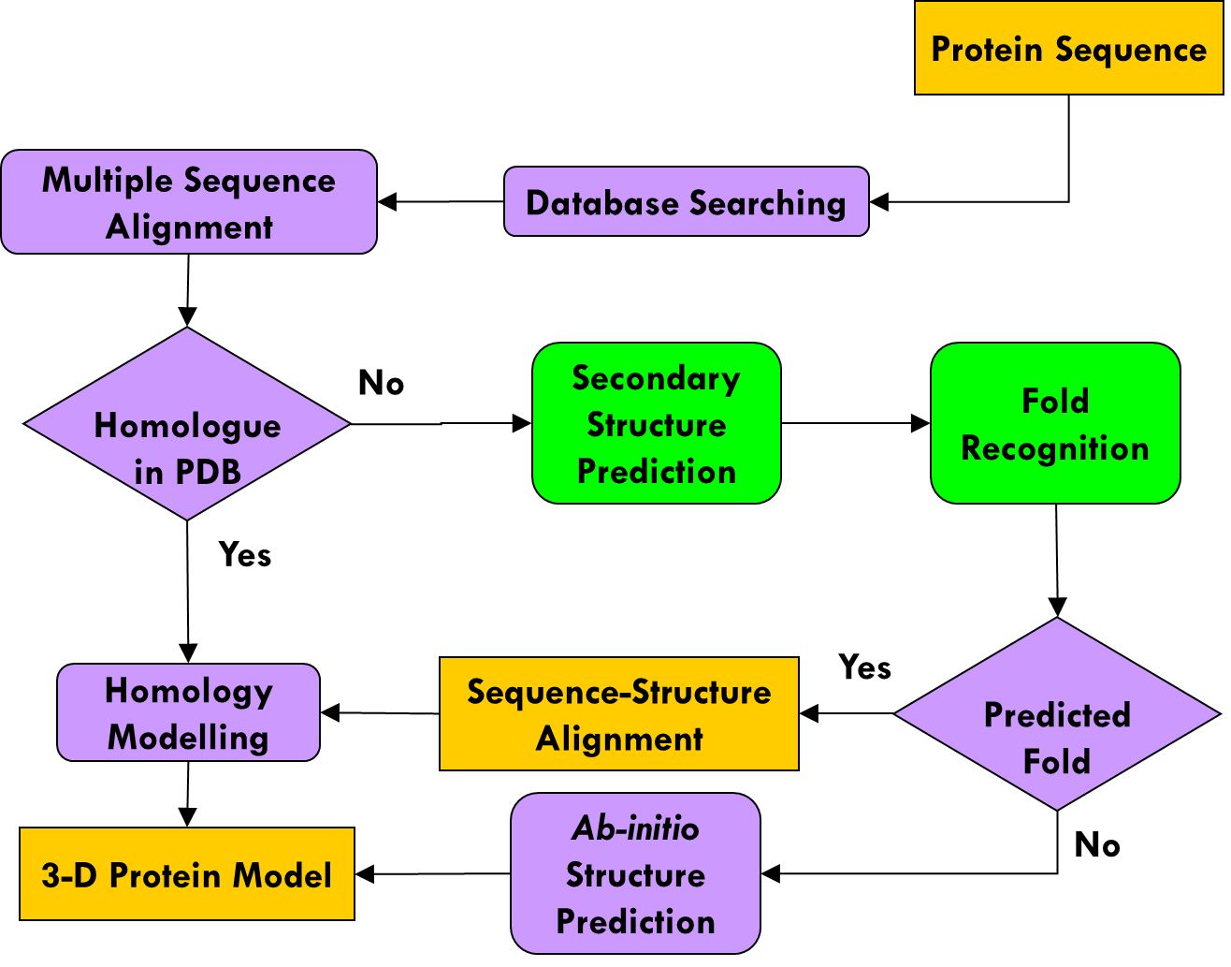
Protein Modelling

Slide 12
3D Structure Prediction Tools
MULTICOM (http://sysbio.rnet.missouri.edu/multicom_toolbox/index.html )
I-TASSER (http://zhang.bioinformatics.ku.edu/I-TASSER/)
HHpred (http://protevo.eb.tuebingen.mpg.de/toolkit/index.php?view=hhpred)
Robetta (http://robetta.bakerlab.org/)
3D-Jury (http://bioinfo.pl/Meta/)
FFAS (http://ffas.ljcrf.edu/ffas-cgi/cgi/ffas.pl)
Pcons (http://pcons.net/)
Sparks (http://phyyz4.med.buffalo.edu/hzhou/anonymous-fold-sp3.html)
FUGUE (http://www-cryst.bioc.cam.ac.uk/%7Efugue/prfsearch.html)
FOLDpro (http://mine5.ics.uci.edu:1026/foldpro.html)
SAM (http://www.cse.ucsc.edu/research/compbio/sam.html)
Phyre2 (http://www.sbg.bio.ic.ac.uk/~phyre2/)
3D-PSSM (http://www.sbg.bio.ic.ac.uk/3dpssm/)
mGenThreader (http://bioinf.cs.ucl.ac.uk/psipred/psiform.html)

Slide 13
Automated Web-Based Homology Modelling
SWISS Model : http://www.expasy.org/swissmod/SWISS-MODEL.html
WHAT IF : http://www.cmbi.kun.nl/swift/servers/
The CPHModels Server : http://www.cbs.dtu.dk/services/CPHmodels/
3D Jigsaw : http://www.bmm.icnet.uk/~3djigsaw/
SDSC1 : http://cl.sdsc.edu/hm.html
EsyPred3D : http://www.fundp.ac.be/urbm/bioinfo/esypred/

Slide 14
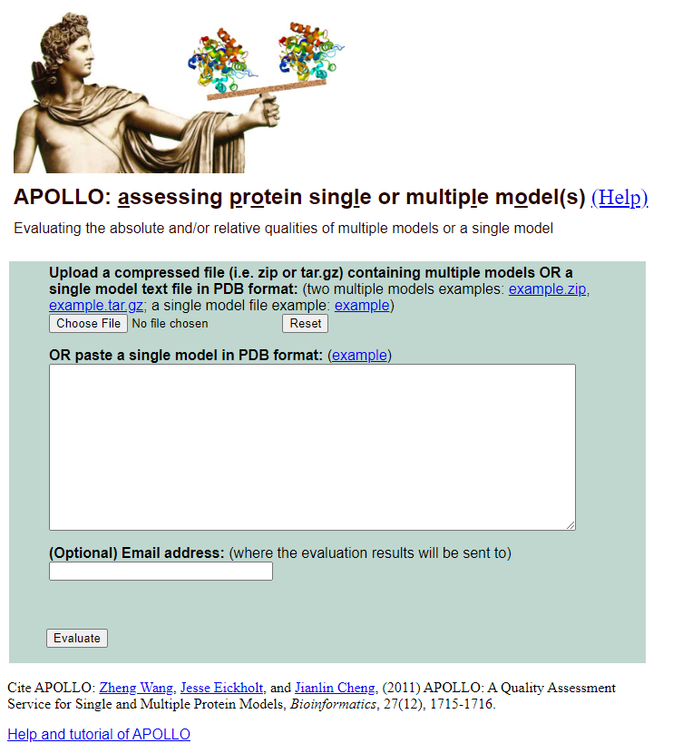
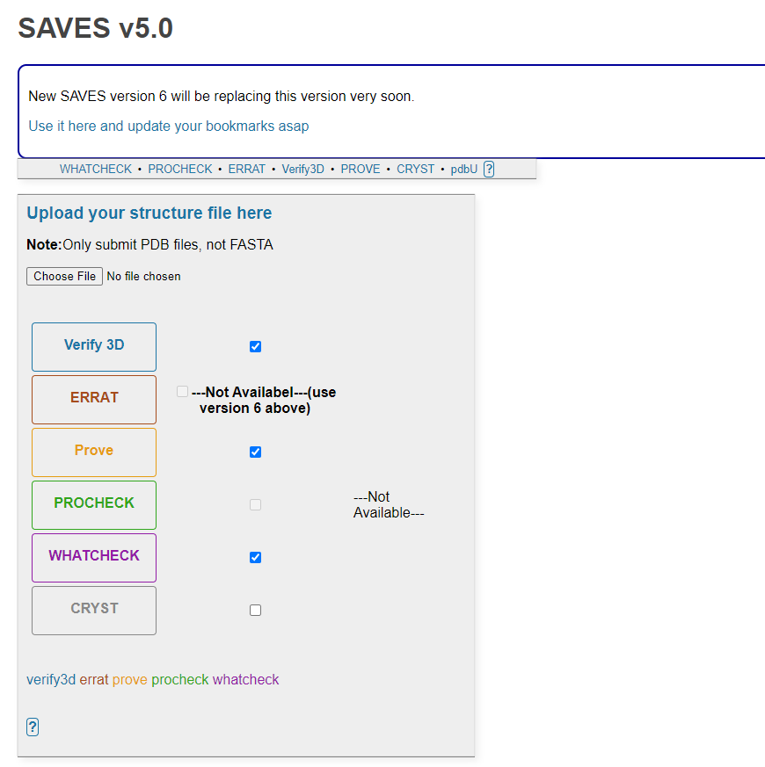
Protein Model Quality Assessment
http://sysbio.rnet.missouri.edu/apollo/
https://servicesn.mbi.ucla.edu/SAVES/

