Slide 1

Protein structure prediction and design
P.G.
VBC-603
30.12.2020

Slide 2
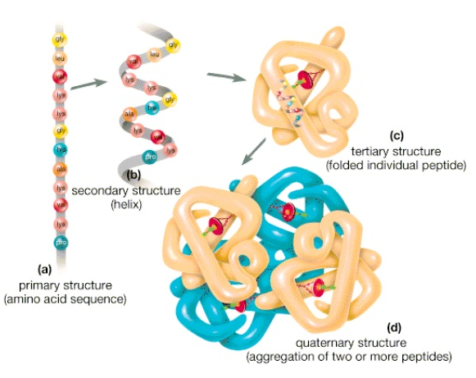
Protein Strucuture

Slide 3
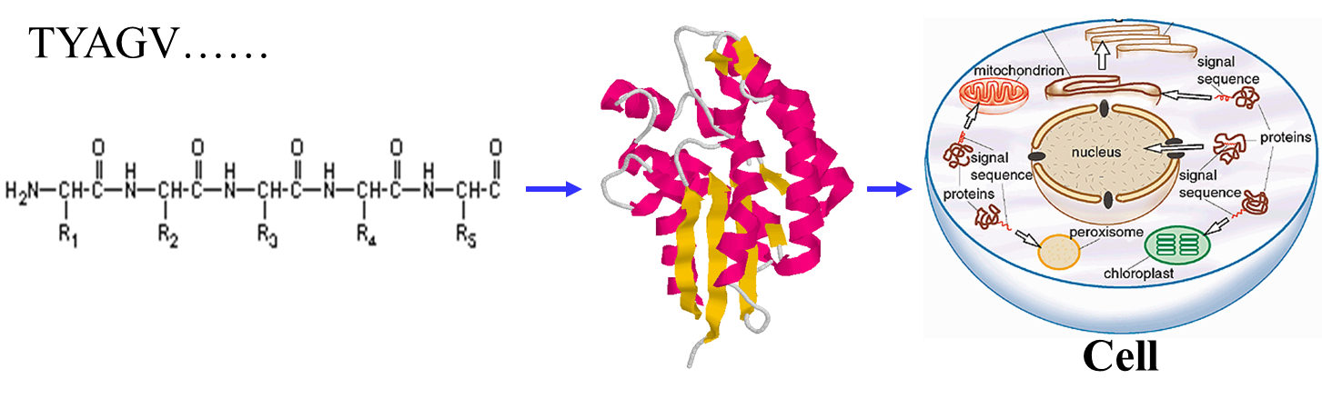
Sequence, Structure and Function

Slide 4
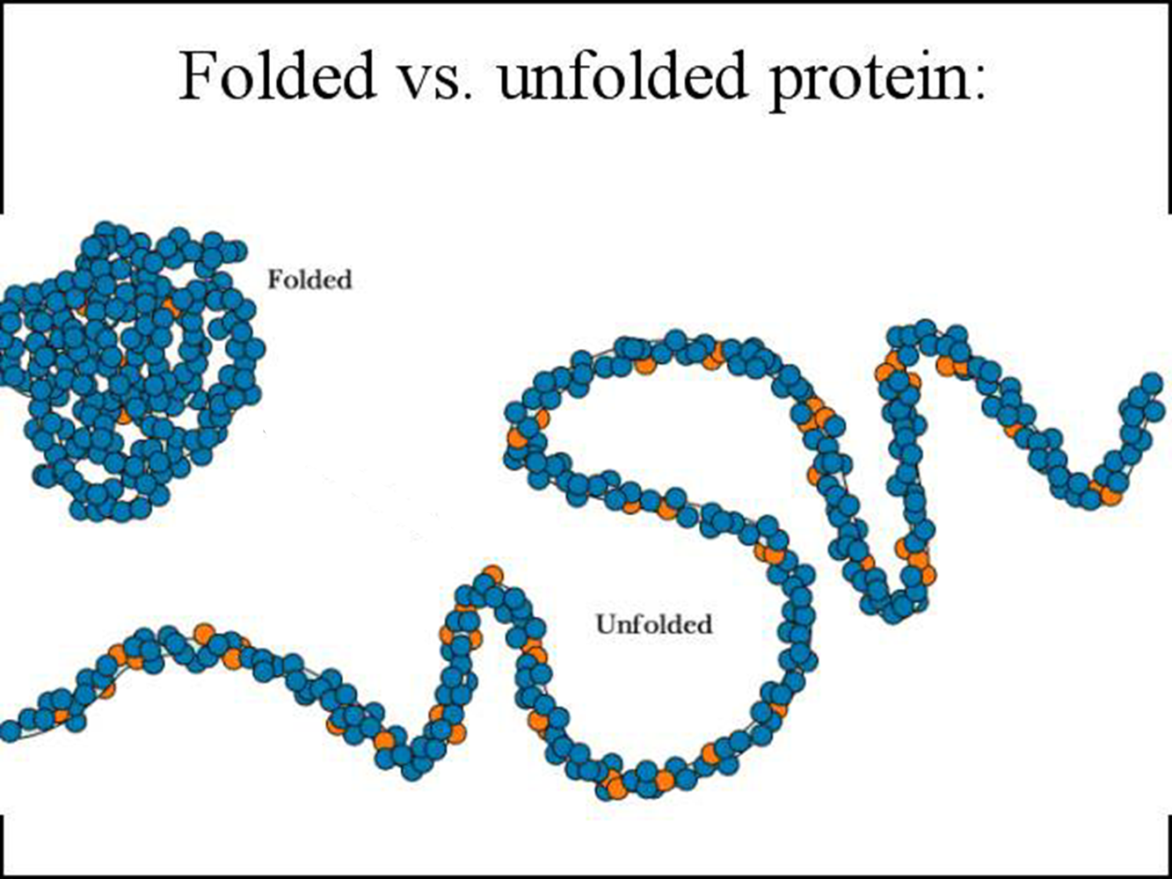
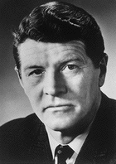
What determines fold?
Anfinsen’s experiments in 1957 demonstrated that proteins can fold spontaneously into their native conformations under physiological conditions. This implies that primary structure does indeed determine folding or 3-D stucture.
Some exceptions exist
Chaperone proteins assist folding
Abnormally folded Prion proteins can catalyze misfolding of normal prion proteins that then aggregate
Christian B. Anfinsen
1916-1995

Slide 5
Protein Structure Determination
1. Experimental Methods
X-ray crystallography
any size, accurate (1-3 Angstrom (10-10 m)), sometime hard to grow crystal
Nuclear Magnetic Resonance (NMR) Spectroscopy
small to medium size, moderate accuracy, structure in solution
Cryo-EM
imaging technology
low resolution

Slide 6
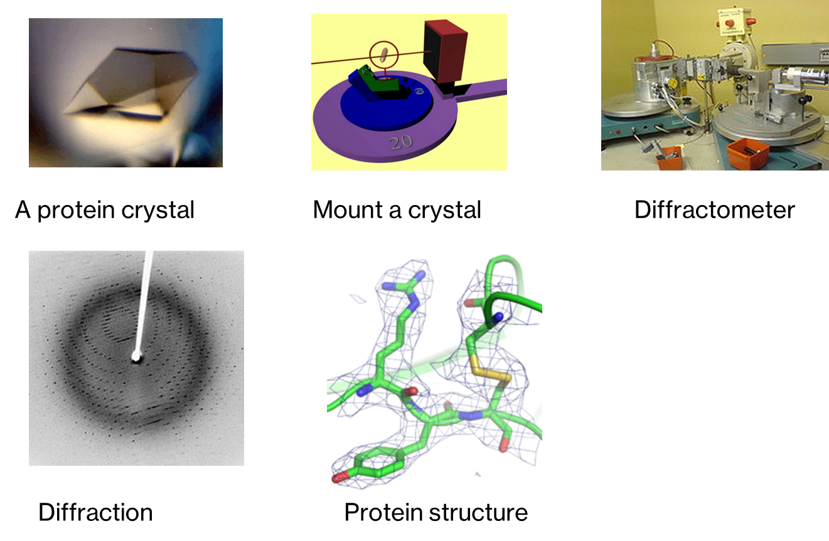
X-Ray Crystallography
Wikipedia

Slide 7
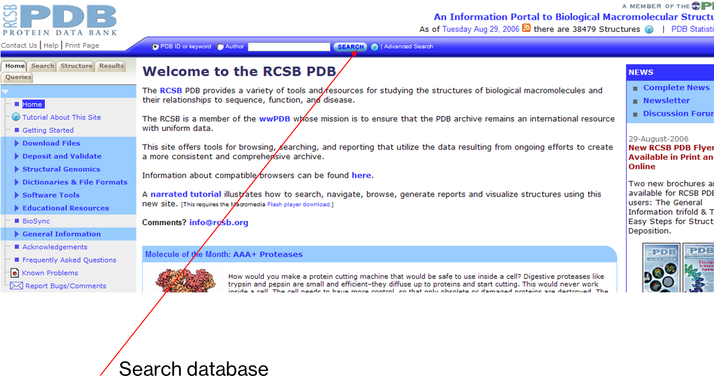
PDB (Protein Data Bank)
http://www.rcsb.org/pdb/

Slide 8
Structure Visualization
Rasmol (http://www.umass.edu/microbio/rasmol/getras.htm)
MDL Chime (plug-in) (http://www.mdl.com/products/framework/chime/)
Protein Explorer (http://molvis.sdsc.edu/protexpl/frntdoor.htm)
Jmol: http://jmol.sourceforge.net/
Pymol: http://pymol.sourceforge.net/

Slide 9
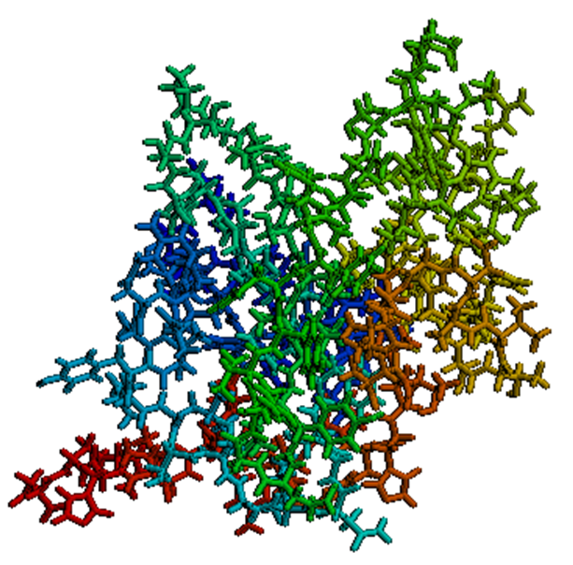
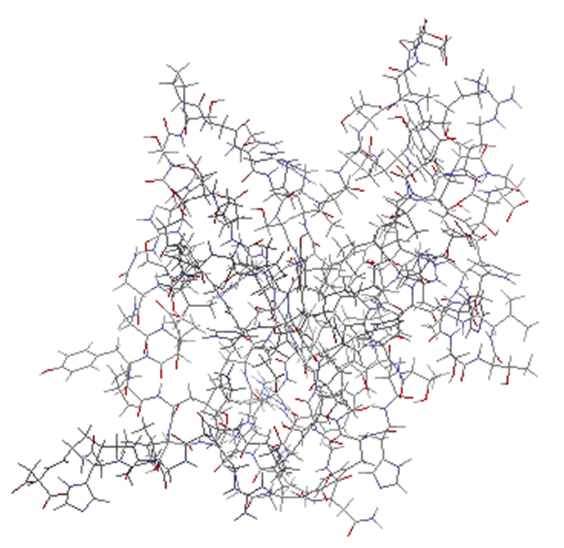
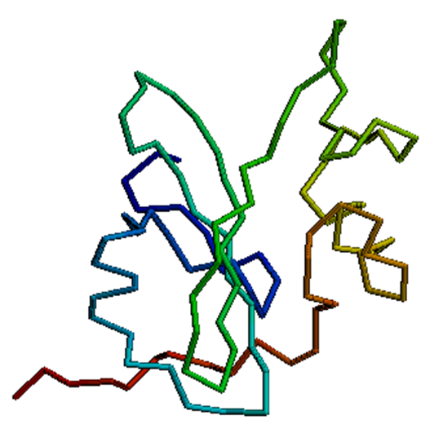
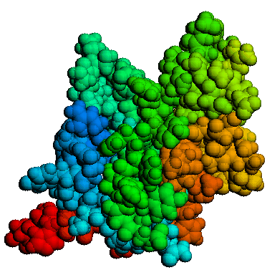
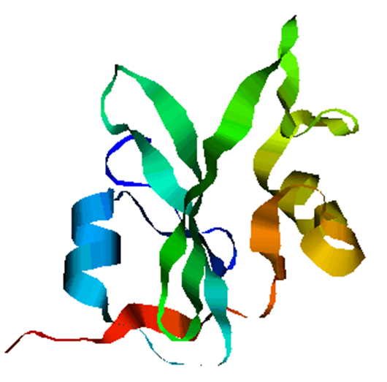
Structure Visualization

Slide 10
Why Prediction?
Structural knowledge = some understanding of function and mechanism of action
Predicted structures can be used in structure-based drug design, enzyme activities, prediction of active site, agonist interaction
It can help us understand the effects of mutations on structure and function
It is a very interesting scientific problem (still unsolved in its most general form after more than 50 years of effort)

Slide 11
Techniques of Structure Prediction
Computer simulation based on energy calculation
Based on physio-chemical principles
Thermodynamic equilibrium with a minimum free energy
Global minimum free energy of protein surface
Knowledge Based approaches
Homology Based Approach
Threading Protein Sequence
Hierarchical Methods

Slide 12
Secondary structure prediction
Historically first structure prediction methods predicted secondary structure
Can be used to improve alignment accuracy
Can be used to detect domain boundaries within proteins with remote sequence homology
Often the first step towards 3D structure prediction
Informative for mutagenesis studies

Slide 13
Assumptions
The entire information for forming secondary structure is contained in the primary sequence
side groups of residues will determine structure
examining windows of 13-17 residues is sufficient to predict secondary structure
α-helices 5–40 residues long
β-strands 5–10 residues long

Slide 14
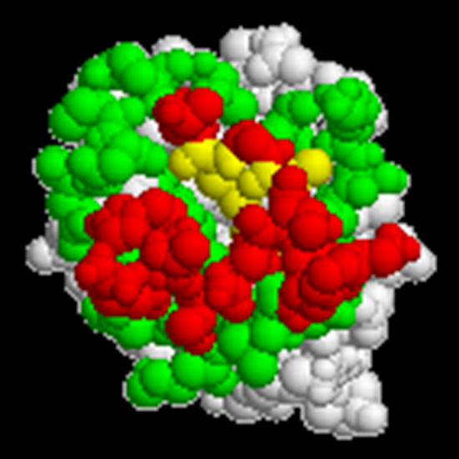
Solvent Accessibility
Size of the area of an amino acid that is exposed to solvent (water)
Maximum solvent accessible
area for each amino acid is its
whole surface area.
Hydrophobic residues like to be
Buried inside (interior).
Hydrophilic residues like to be
exposed on the surface.

Slide 15
Structure Comparison (Alignment)
Are the structures of two protein similar?
Are the two structure models of the same protein similar?
Different measures (RMSD, GDT-TS, MaxSub, TM score)

Slide 16
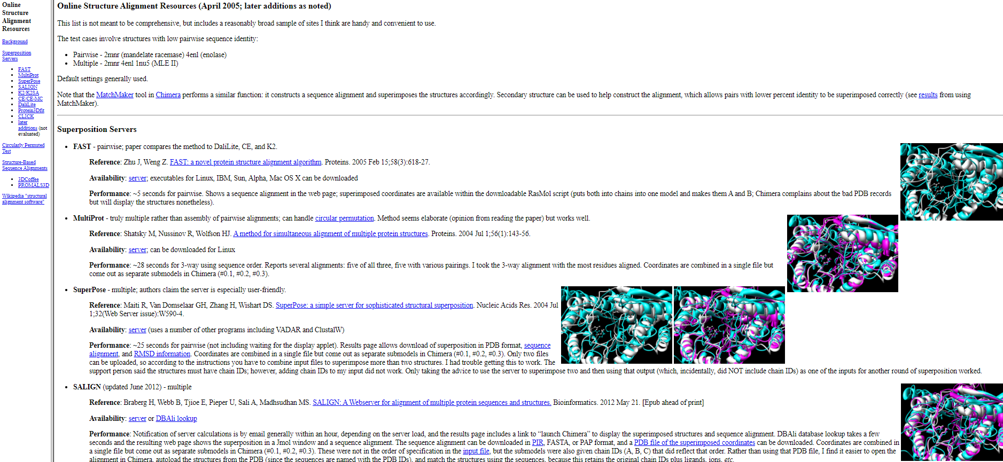
Useful Structure Alignment Tools
CE (http://cl.sdsc.edu/)
DALI (http://www.ebi.ac.uk/dali/)
TM-Align: http://zhang.bioinformatics.ku.edu/TM-align/

Slide 17
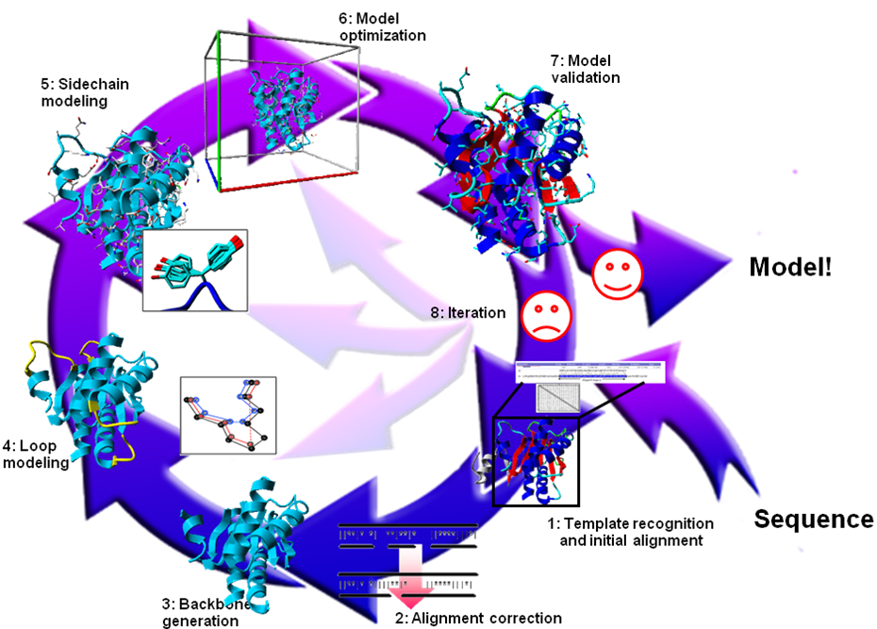
Knowledge Based Approaches
Homology Modelling
Need homologues of known protein structure
Backbone modelling
Side chain modelling
Fail in absence of homology
Threading Based Methods
New way of fold recognition
Sequence is tried to fit in known structures
Motif recognition
Loop & Side chain modelling
Fail in absence of known example

Slide 18
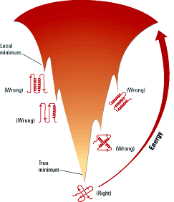
Protein Energy Landscape
http://pubs.acs.org/subscribe/archive/mdd/v03/i09/html/willis.html

Slide 19
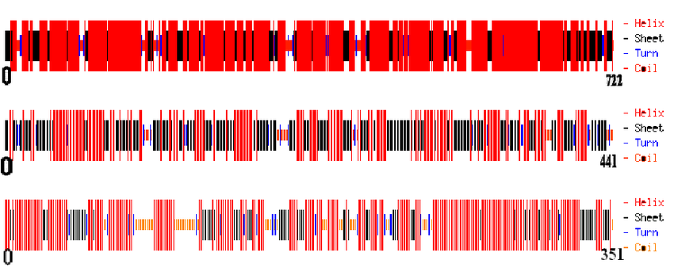
Methods of secondary structure prediction
Chou & Fasman (1974 & 1978) :
Some residues have particular secondary-structure preferences.
Based on empirical frequencies of residues in -helices, -sheets, and coils.
Examples: Glu α-helix
Val β-strand

Slide 20
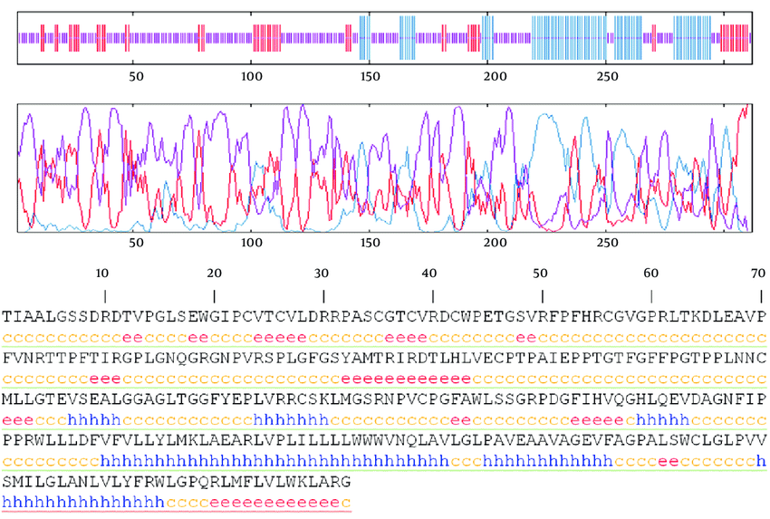
The GOR method
developed by Garnier, Osguthorpe & Robson
build on Chou-Fasman Pij values
evaluate each residue PLUS adjacent 8 N-terminal and 8 carboxyl-terminal residues
sliding window of 17 residues
underpredicts b-strand regions
GOR method accuracy Q3 = ~64%

Slide 21
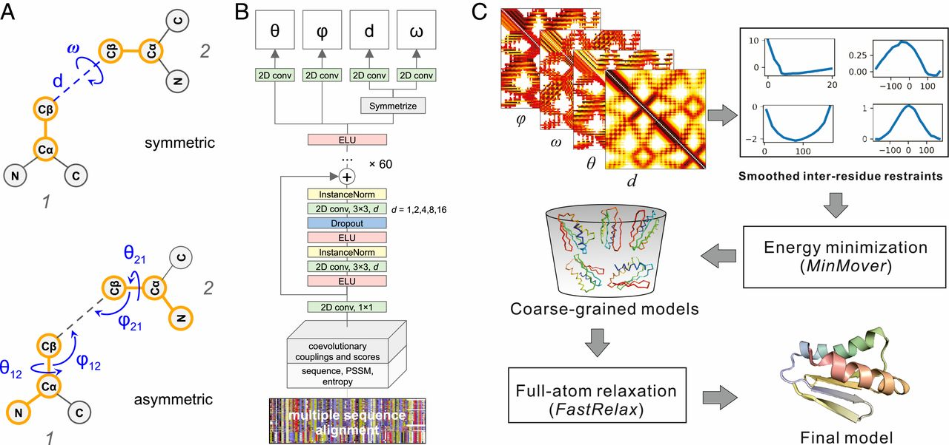
Third generation methods
Third generation methods reached 77% accuracy
consist of two new ideas:
1. A biological idea –
Using evolutionary information based on conservation analysis of multiple sequence alignments.
2. A technological idea –
Using neural networks.

Slide 22
Reasons for improved accuracy
Align sequence with other related proteins of the same protein family
Find members that has a known structure
If significant matches between structure and sequence assign secondary structures to corresponding residues

