Slide 1
LYMPHOID ORGANS OF FINFISH & SHELLFISH
Mr. Bhartendu Vimal
Guest Faculty – Assistant Professor
College of Fisheries, Kishanganj
BASU, Patna

Slide 2
Introduction
The lymphoid organs system consists of those organs which involve in defense mechanism through generating immune cells
Lymphoid organs vary by type of fish
In the jawless fish, true lymphoid organs are absent
These fish rely on regions of lymphoid tissue within other organs to produce immune cells
For example, macrophages and plasma cells are produced in the anterior kidney (or pronephros) and some areas of the gut (where granulocytes mature)

Slide 3
Cyclostomes were able to respond but poorly to T- dependent and T-independent antigens
Neither hagfish nor lamprey possess a thymus and secondary lymphoid organs which consist of lympho-hemopoietic tissues morphologically equivalent to the bone marrow
In lampreys larval form ammocoetes, the main lymphohemopoietic foci include the thyphosole, a fold of the midgut formerly described as primitive spleen, the nephric fold and adipose tissue

Slide 4
These organs resemble primitive bone marrow in hagfish
But, in hagfish only a single population of granulocytes reported (Tomonaga et al. 1973) and plays a role in defense mechanism
In contrast to the hagfish, different subpopulations of granulocytes are distinguishable in lampreys (Rowley et al. 1988) and play a role in defense mechanism
Cartilaginous fishes have a more advanced immune system. They have specialized organs that are unique to chondrichthyes
the epigonal organs (lymphoid tissue similar to mammalian bone marrow) that surround the gonads

Slide 5
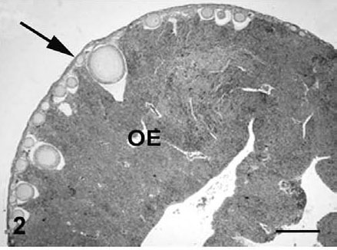
the Leydig's organ within the wall of esophagus
Microscopic general image of the ovaric epithelium (arrow), most of them intermingled with the epigonal organ (OE)

Slide 6
These organs house typical immune cells (granulocytes, lymphocytes and plasma cells)
They also possess an identifiable thymus and a well-developed spleen (their most important lymphoid organ) where various lymphocytes, plasma cells and macrophages develop and are stored
Chondrostean fish (sturgeons, paddlefish and bichirs) possess a major site for the production of granulocytes within a mass that is associated with the meninges
Their heart is frequently covered with tissue that contains lymphocytes, reticular cells and a small number of macrophages.

Slide 7
LYMPHOID organs OF FINFISHES
In all modern fish including both chondrichthyes and oestichthyes, thymus, spleen and somewhat develop gut lymphoid aggregates appear
Lymphoid organ system of finfishes contains lymphoid organs and their functions
Lymphoid system of finfishes is mainly grouped into two groups
The primary lymphoid organs: Thymus and Anterior kidney
The secondary lymphoid organs: Kidney, spleen, epigonal organs and mucosa associated lymphoid tissue
Besides these organs, liver, skin, intestine and heart are also important organs take part in the defense

Slide 8
THE THYMUS
-The thymus plays a pivotal role in the development of the adaptive immune system
-It is a paired organ situated in the dorsolateral region of the gill chamber close to the opercular cavity
-the histology of thymus varies within the species
-may start developing as early as 24 hrs after fertilization
-as development starts the cells gradually differentiate into thymocytes and epithelial cell
-the major site of T-cell development

Slide 9
-unlike mammals, the outer cortex and inner medulla is poorly separated in many fish species
-covered by the modified stratified epithelium of the gill chamber
-the thymocytes are separated by single layer of epithelial cells from the water environment
-first organ to be lymphoid during histogenesis and aquires mature lymphocytes
-thymocytes appear in carp on day 4 post fertilization
-by day 5, immature and intermediate stage lymphocytes are found
-on day 10, B and T lymphocytes appear during organogenesis

Slide 10
-in rainbow trout, thymus appears before hatching and becomes fully lymphoid at the time of hatching
-In marine fishes - head kidney, spleen, and thymus
-small lymphocytes appear first in thymus and later in head kidney & spleen
-seems to originate from haematopoietic stem cells migrating from the head region of the kidney

Slide 11
Anterior Kidney
Like other vertebrates, the kidney is situated retroperitoneally and exterior to the dorsal wall or body cavity
Anatomy varies from species to species
Broadly classified into two parts :
•head or anterior kidney or pronephros
•posterior or trunk kidney or opisthonephros
The anterior kidney losses its excretory role once the fish matures
It contains only haematopoietic tissue

Slide 12
Predominantly a lympho-myeloid compartment
Lymphoid precursor tissue and mostly the generation and maturation of B lymphocytes occur in this tissue
Act as both primary as well as secondary lymphoid organs
Serves as a lymph node analogue, important in the induction and elaboration of immune responses
Indicate the importance of innate immune system during early stage of development
plays important role in non-specific immunity and the clearance of debris and damaged cells

Slide 13
THE SECONDARY LYMPHOID ORGANS
Provide structural organization for trapping and processing them in suitable ways for the cell that are capable of reacting to them
Include spleen, Gut Associated Lymphoid Tissue (GALT) and mucosal
immune system (MIS), epigonal organs in elashmobranch
SPLEEN:
The major peripheral lymphoid organ of all gnathostomus vertebrates
Last organ to develop during histeogenesis of the lymphoid organs of teleost
Has a fibrous capsule and small tubercles extend into the parenchyma- divide spleen into red and white pulp
White pulp poorly developed & contains melano-macrophages
Plays role in both haematopoiesis and immune reactivity

Slide 14
When the filtration happen, the foreign substances are retained in the ellipsoidal wall and subsequently taken up by macrophages surrounding the vessels
These cells then migrate into melano-macrophage centres
Melano-macrophage centres (MMCs)-
large nodule of macrophage aggregates
MMCs also found in intestinal submucosa, thymus, gill, brain and gonads but mostly in liver tissue
It has been described that immunological maturity of fish is attained after development of MMCs

Slide 15
FUNCTIONS OF MMCs:
Trapping of immune complex and production of high level of antibodies
Processing of antigens and prolonged retention of antigens
As bactericidal activity by the pigments such as lipofuscin, haemociderin and ceroid and melanin
Deposition of parasitic spores ad resistant bacterial pathogens

Slide 16
Gut Associated Lymphoid Tissue (GALT)
All vertebrates contain lymphoid cell isolates in the lamina propria and the intestinal epithelium-
Consists of nonencapsulated lymphoid accumulations
In all teleosts, diffuse accumulation of lymphoid tissue appear along the gut
Associated with specific innate immune activities
IgM has been identified in the gut mucus and bile of both chondrichthyes and oestichthyes

Slide 17
MUCOSA-ASSOCIATED LYMPHOID TISSUES (MALT)
The mucosal surface of gut, gills and skin are protected by both humoral and cellular defense mechanisms
Mucus contains several humoral factors and play role in defense mechanism
The wall of the organs is also infiltrated with lymphocytes and other leukocytes

Slide 18
OTHER TISSUES OF IMMUNOLOGICAL IMPORTANCE
Liver:
minor role in the defense mechanism
reticuloendothelial system- poorly developed- scavenging role
Kuffer cells: the liver macrophages
Heart:
endothelial cells have the capacity to take up foreign particle
transformed into macrophages

Slide 19
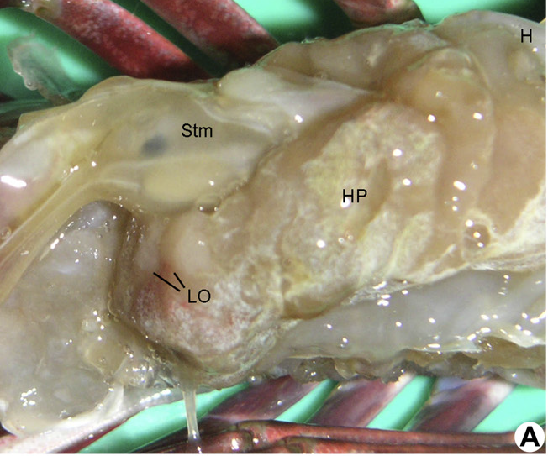
Lymphoid organ in crustaceans
Introduction
Also called as Oka organ
First described in
Penaeus orientalis by Oka
Identified only in
penaeid spp.

Slide 20
Location and Structure
Consists of two lobes situated ventero-anterior to hepatopancreas.
Lobes are similar and are surrounded by connective tissue capsules.
These are connected directly to heart by subgastric artery which supplies hemolymph to them.

Slide 21
Each lobe consists of tubules and the spaces in between which are occupied by hemal sinuses.
Lymphoid tubules (LT) consist of central lumen lined with flattened endothelial cells.
Next to endothelial lining there are two types of stromal cells.

Slide 22
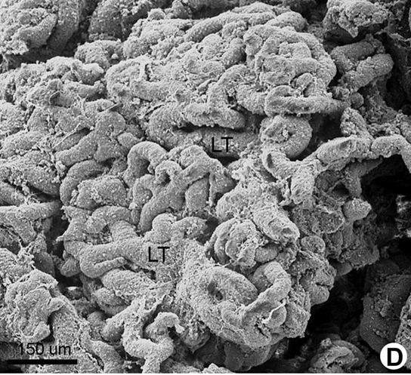
Tubules are encircled with connective tissue fiber.

Slide 24
Functions
Involved in immunodefence against foreign materials.
Major phagocytic organ in penaeid shrimps.
Exerts bacteriostatic effect.
Has trapping ability to immobilise foreign material from hemolymph before this material enters the open circulatory system.
Major site for viral degradation by forming spheroid cells.

