Slide 1
Agronomical Practices for fodder production (Part1)
By-
Sanjay Kumar
Asst. Prof., Dept. of LPM, BVC,
Bihar Animal Sciences University, Patna

Slide 2
Forage crops / Fodder crops
Forage crops- It refers to the plants used for feeding livestock. It includes wild as well as cultivated plants used for feeding animals.
According to definition of forage given by National Academy of Sciences (1971) “ Forage are aerial plant material, mainly grasses and legumes, containing more than 18%crude fibre on dry matter basis.’
Fodder crops- It refers to cultivated plants or crops , that are used for animal feeding. eg. Cereals, legumes etc.

Slide 3
Characteristics of fodder crops
Fodder crops should have
Quick growth and short duration.
Profuse foliage and heavy yield of fodder.
Good palatability and nutritive value.
Adaptability to varying agro-climatic conditions on different soils.
Capacity to ratoon and give a continuous supply of fodder.
Presistence and resistance to pests and diseases.
Seed production ability.
Tolerance to stresses like drought, flooding, etc.

Slide 4
Classification of Fodder
Fodders can be classified into following 6 types-
(1) Non- Leguminous fodders/ Cereals fodder. On the basis of duration/ availability of crop it is further of 2 types-
(i) Annual- cereal fodders such as maize, Sorghum, Bajra, Ragi, Oat etc.
Annual cultivated grass such as Dinanath grass or Deenbandhu grass.
(ii) Perennials- cultivated grasses such as Para grass, Napier grass, Sudan grass, Guinea grass

Slide 5
Cont--
(2) Legumes – it is further of 2 types-
(i) Annual- eg. Berseem, Sweet clover, Cowpea, Horsegram, Groundnut, Beans, Desmodium etc.
(ii) Perennials- Lucerne, Red gram etc.
3. Pasture grasses and Pasture legumes
Pasture grasses- eg. Mollases grass, Sewan grass, Sabi grass, Hariali grass etc.
Pasture legumes-eg.Carribean, Butterfly pea,Centro etc.

Slide 6
Cont--
4.Fodder trees and shrubs-
Subabul, Khejri tree, Sesbania etc.
5. Root crops-
eg. Turnip,Beetroot,Carrot, Potatoes, Sweet potatoes etc.
6. Miscellaneous fodder plants-
eg. Azolla, Water hyacinth etc.

Slide 7
On the basis of seasons-
1. Khariff fodders- Fodder grows from July to October. These fodders are shown in June- Jul eg. Maize, jowar, sorghum, bajra, cowpea, guar etc.
2. Rabi fodders - grows from October to March . These fodders are shown in October- November eg. Oat, Turnip, berseem, lucerne etc.
3.Zaid season- March to June . eg cowpea, sorghum etc.

Slide 8
Fodder maize

Slide 9
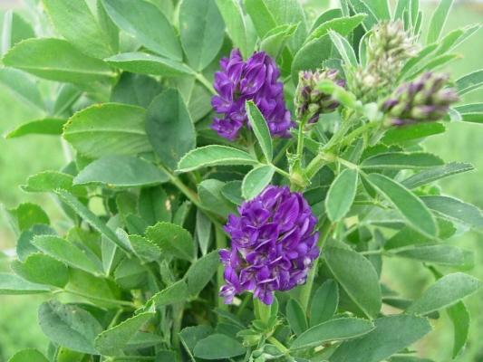
Lucerne

Slide 10
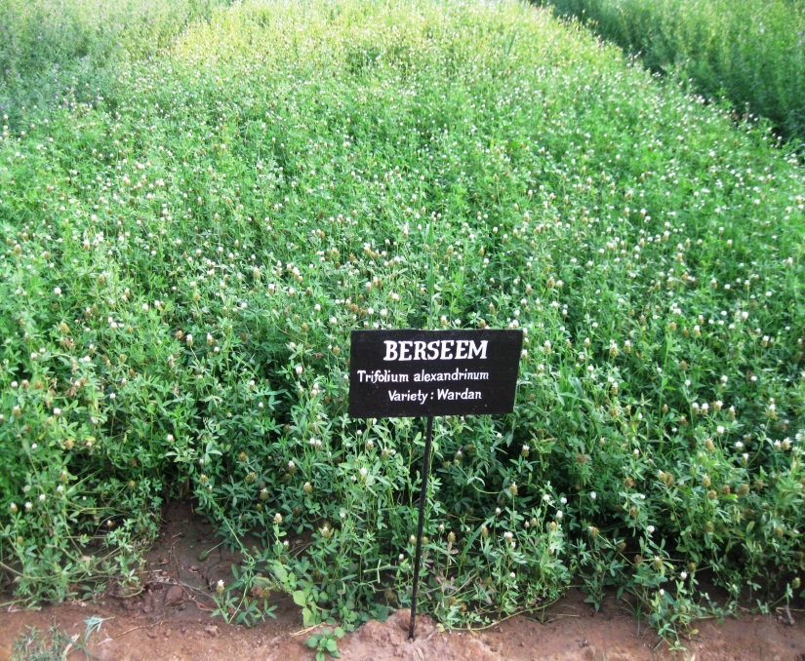
Berseem

Slide 11
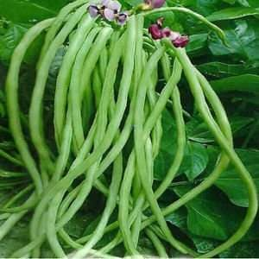
Cowpea (Lobia)

Slide 12
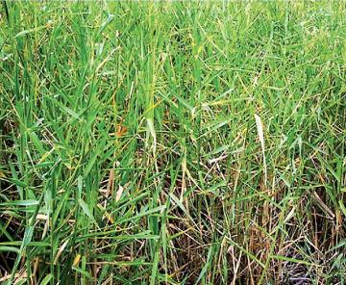
Para grass/ Buffalo grass/ Water grass/ Pani wali ghas ( Brachiaria mutica)

Slide 13
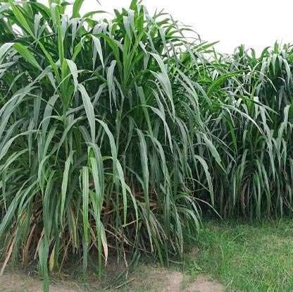
Napier grass (Pennisetum purpureum)

Slide 14
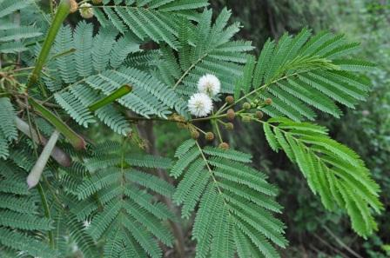
Subabul

Slide 15
Important fodders
Common Name (Botanical Name) Maize (Zea mays) Sorghum ( Sorghum bicolor)/ (Sorghum vulgare) Bajra (Pennisetum typhoides) Oat (Avena sativa) Berseem (Trifolium alexandrium) Lucerne (Medicago sativa) Cowpea (Vigna unguiculata) | 8. Subabul ( Leucaena leucocephala) 9. Sweet potato ( Ipomoea batatas) 10. Water hyacinth ( Eichhornia cressipes) 11. Napier grass ( Pennisetum purpureum) 12. Para grass ( Brachiaria mutica) 13. Napier bajra hybrid grass (cross between napier and bajra)

Slide 16
THANKS

