Slide 1
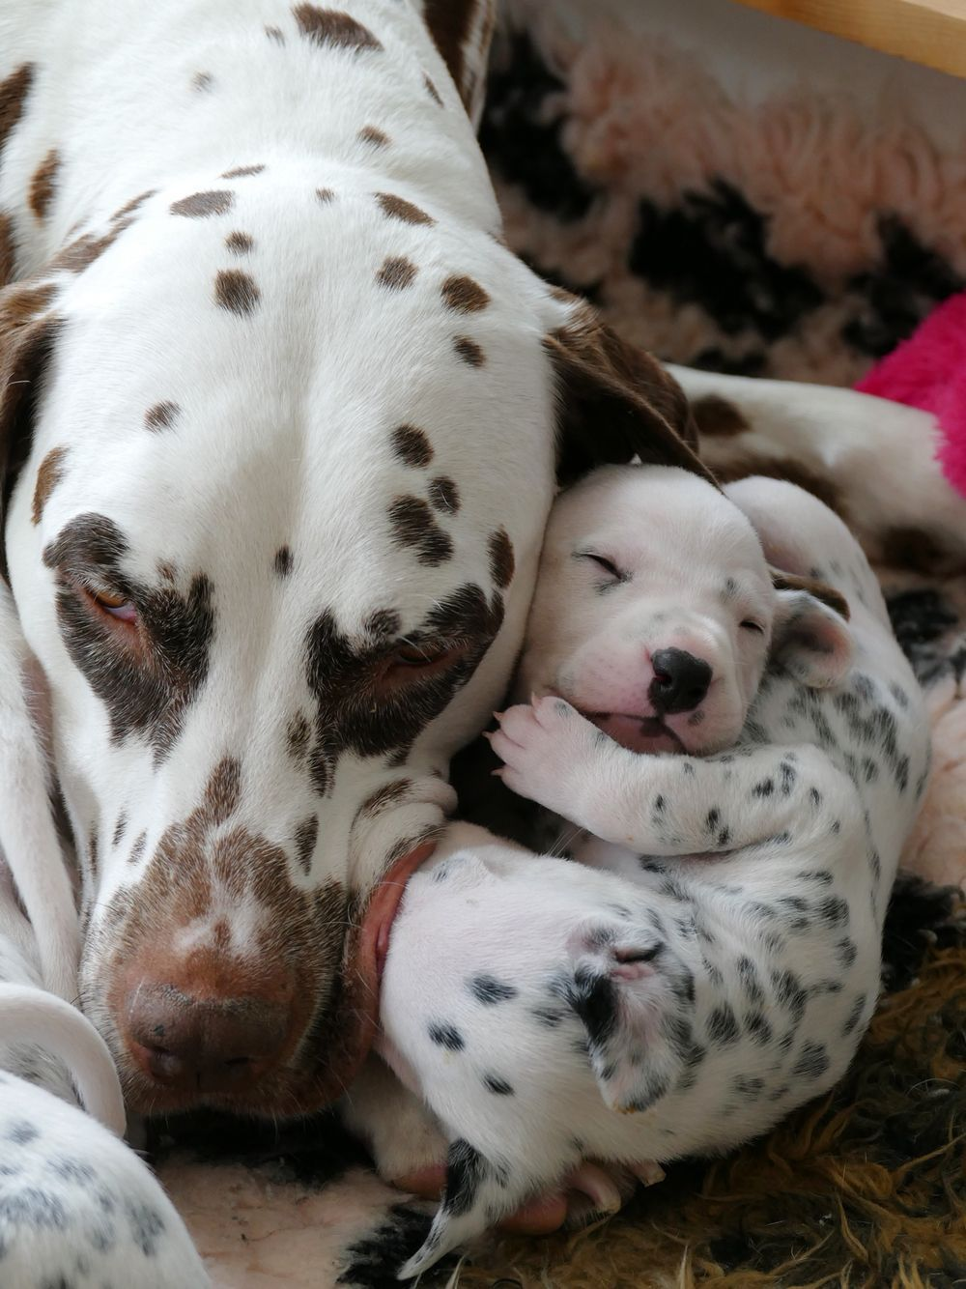
CAESARIAN SECTION
Submitted to
Dr. Mithilesh kumar

Slide 2
Context
Information.
Indication.
Anesthesia.
Site.
Technique.
Post- operative.

Slide 3
Dystocia
Surgical removal of a full term foetus / foetuses other than by the normal vaginal route.
Protocol
History
Predisposing factor such as breed, age, size of litter must be considered.
Establish the following information :
The time of onset of stage II.
The frequency & intensity of expulsive efforts.
The time since the last delivered fetus.
General health of the bitch.
Genital exam .
Vaginoscopy – Digital exam to determine location of puppy.

Slide 4
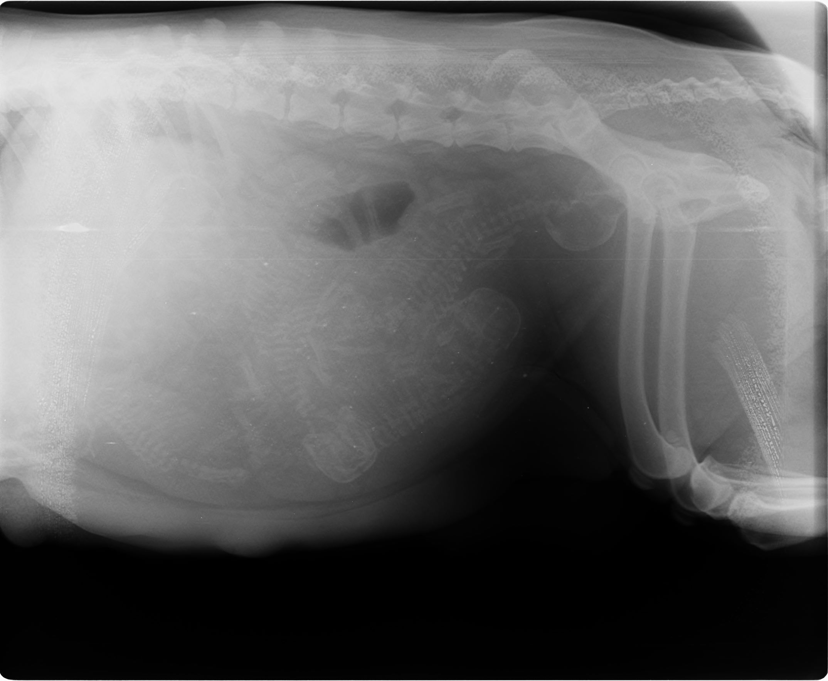
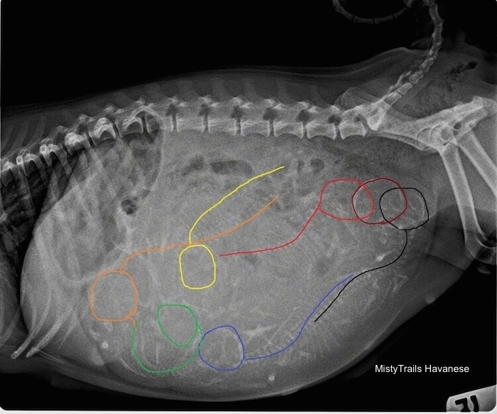
4. Radiography
Radiograph the abdomen to see no. many puppies .

Slide 5
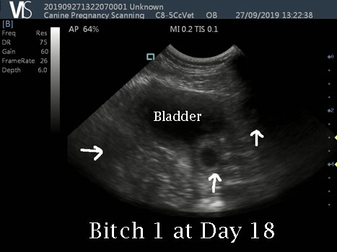
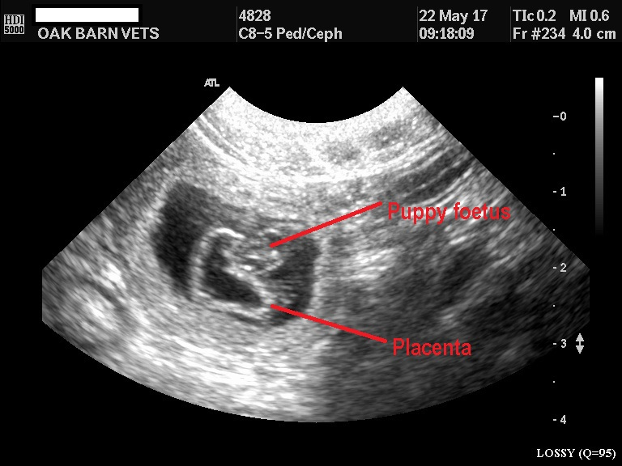
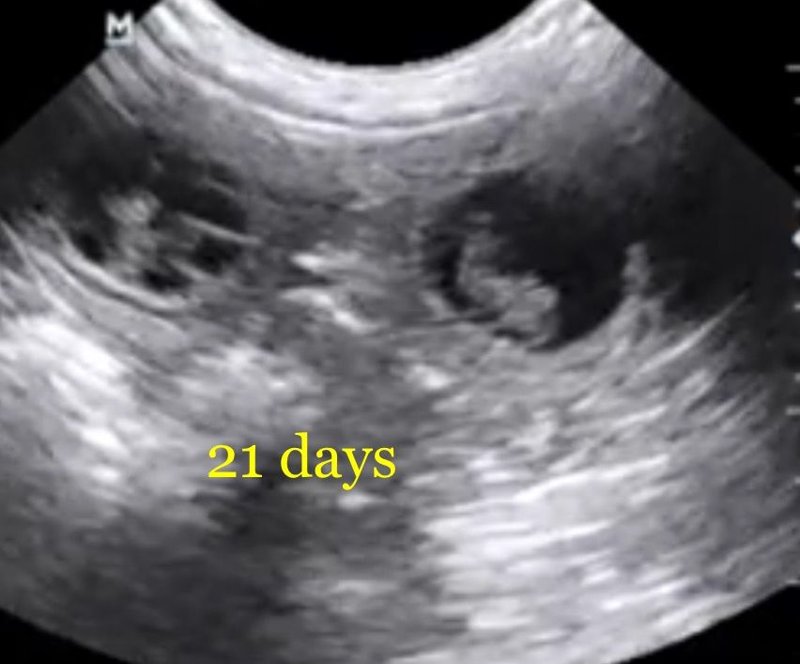
3. Ultrasonography
Use the ultrasound to determine fetal viability by looking for heartbeats.

Slide 6
5. Laboratory tests
PCV
WBC
BUN
Glucose
CBC
Progesterone – bitches will whelp with progesterone over 2ng/ml.

Slide 7
Plan of Action
The plan is determined by the etiology and presenting complaint.
Primary uterine inertia
Primary uterine inertia is a delay in starting the second stage of labor after the first stage signs have been established. The occurs because the uterus is not contracting .
Prolonged gestation
Diagnosis of prolonged gestation information from the owner.
Rule out pseudopregnancy , incorrect breeding date ,incorrect calculation of breeding date in determining if gestation is prolonged.
If ultrasound or radiographs indicate viable fetuses, then waiting may be the best course.

Slide 8
Indication
Uterine inertia unresponsive to oxytocin.
Pelvic obstruction.
Fetal oversize .
Vaginal obstruction that can not be manipulated.
In utero fetal death.
Planned surgery.

Slide 9
Secondary uterine inertia
Secondary uterine inertia is the delay in resuming stage II labor after one or more births ( for example more than 4-6 hours since the preceding delivery ) .
Obstructive dystocia is when the bitch is pushing hard but there are no puppies. ( not pushing= inertia ).
30 minutes of strong onractions with no pups delivered.
2-3 hours of weak and infrequent expulsive eorts falling to produce a pup.
4 of more hours between pups.
Obvious problem ( pup hanging out etc. ).

Slide 10
CS- procedure

Slide 11
Anesthesia
Preanesthesia
Atropine sulphate
Glycopyrrulate
Butorphanol
Xylazine
Diazepam
Induction & Maintainance
Ketamine
Propofol
Isoflurane
Tiletamine + Zolazepam

Slide 12
General anesthesia
Epidural anesthesia combined with local infiltration; dorsal recumbent position.
The pet will not cooperate & lie still for surgery even if all pain is relieved .
Thus general anesthesia is needed to induce pain relief, unconsciousness & relaxation. In the usual case , the pet will receive a pre- anesthetic sedative – analgesic drug to help relax , a brief intravenous anesthetic to allow placement of a breathing tube in the windpipe and subsequently inhalation ( gas ) anesthesia in oxygen during the actual surgery.

Slide 13
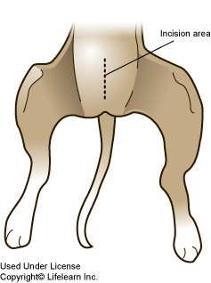
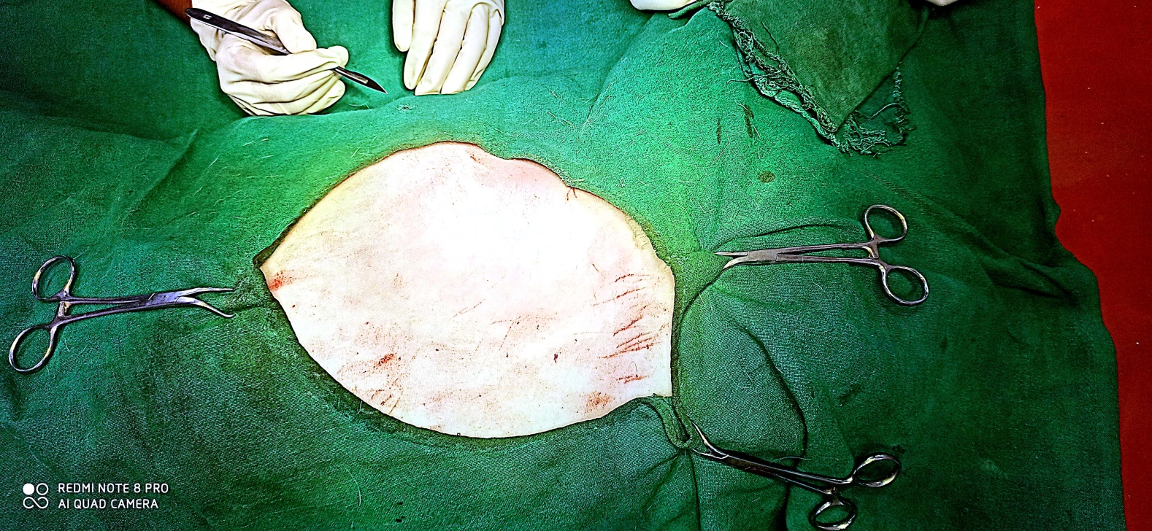
Site
From a point 1 inch behind the umbilicus backwards along the midline for a distance of distance of about 4 inches.

Slide 14
Technique
Give anesthesia.
The pet is place in surgical table lying on her back.
The hair is clipped over the lower abdomen , the skin is scrubbed with surgical soap to disinfect the area & a sterile drape is placed over the surgical site .
Give midline incision .
Skin is tensed using thumb forceps.
A scalpel is used to incise the skin of the lower abdomen & then open the abdominal cavity.
The uterus will be exposed , bifurcation located and then incision mad to remove the fetus.
Then incision is closed with suture that dissolve over time.
The abdominal incision is then closed with one or two layers of self- dissolving suture.
The outer layer of skin closed with suture that must be removed in about 10 to 14 days.

Slide 15
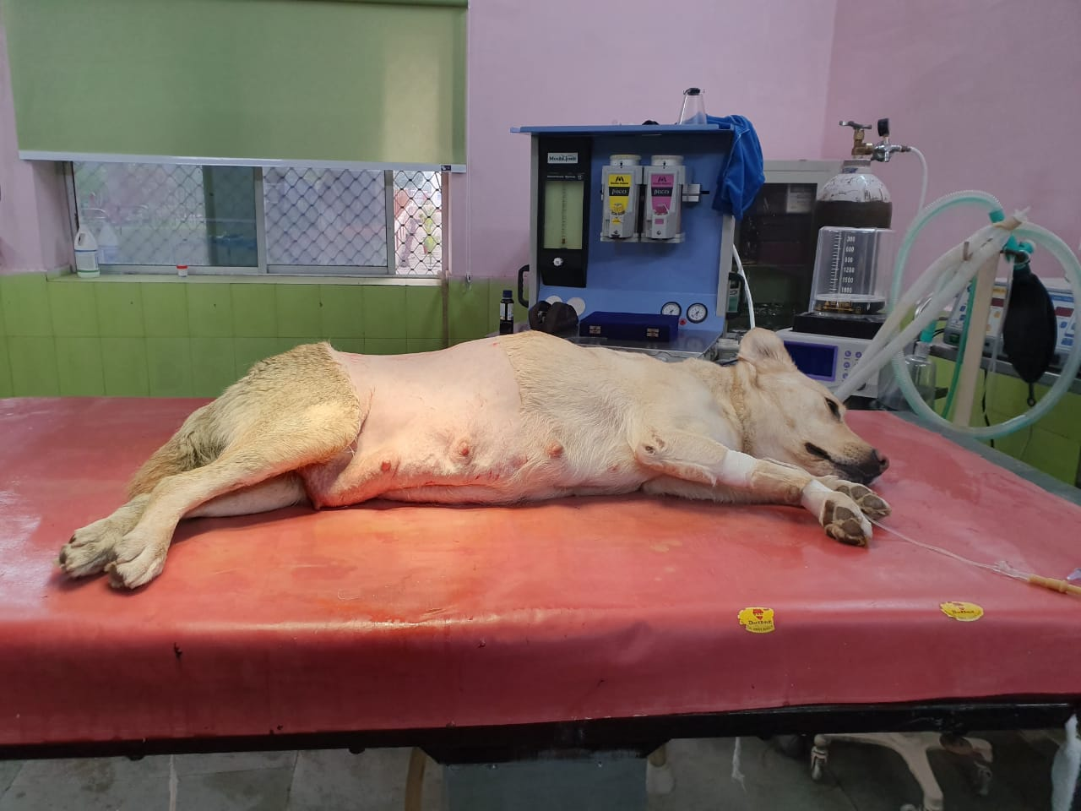
Fig :-

Slide 16
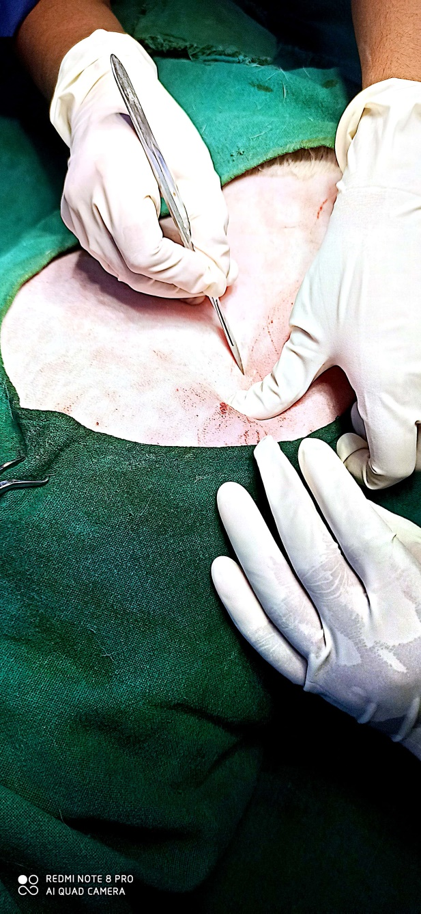
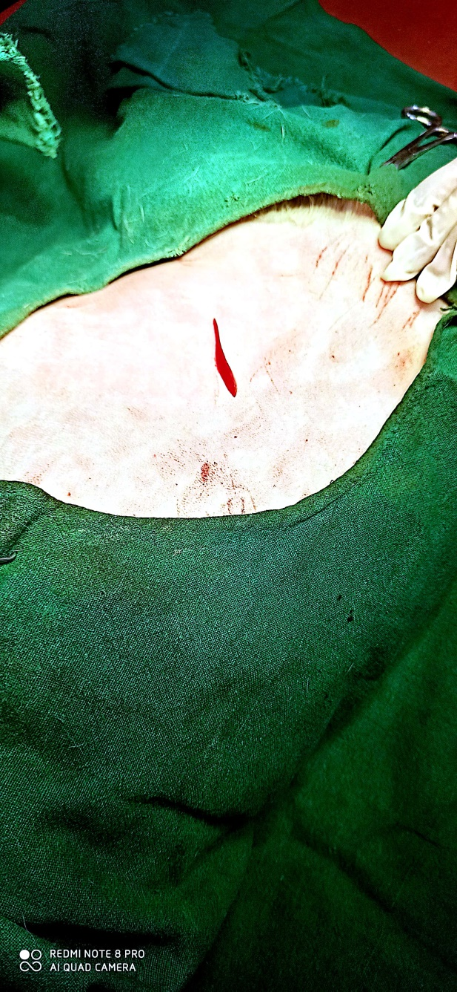
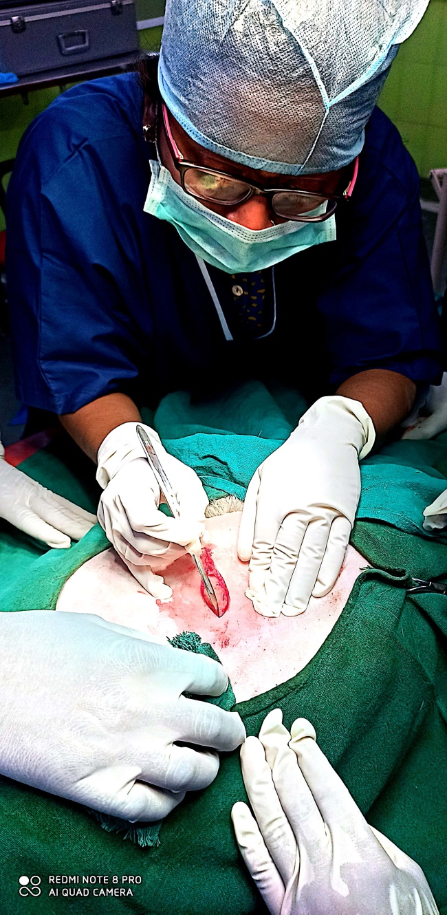
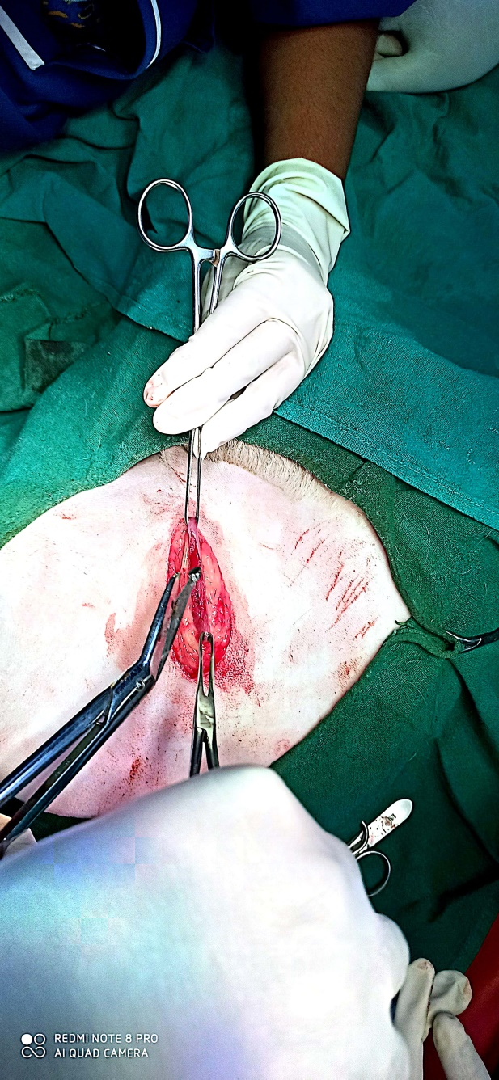
Fig :-

Slide 17
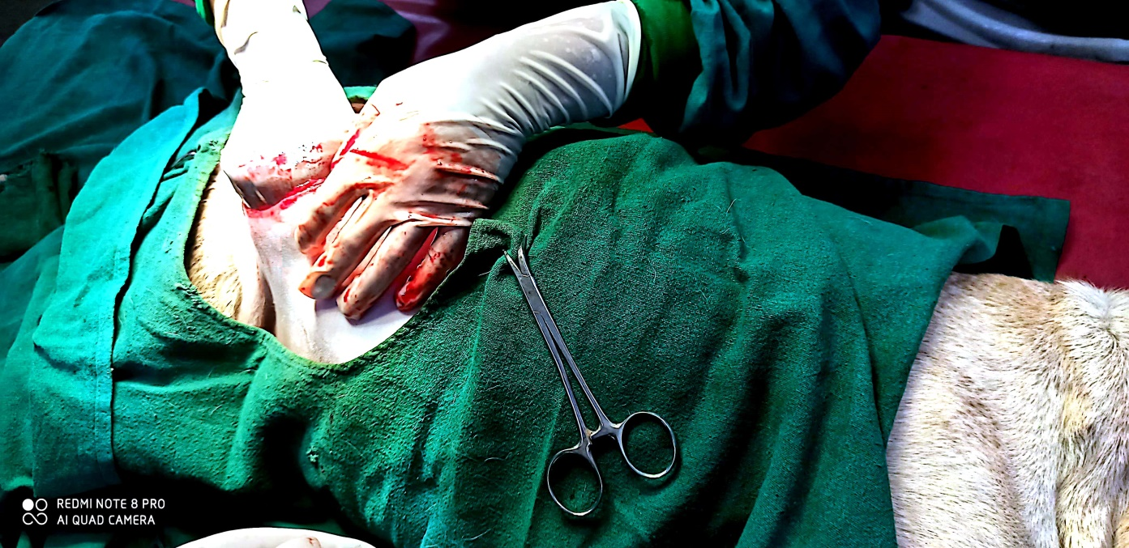
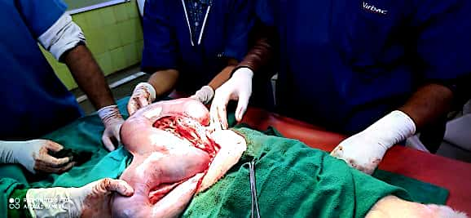
Fig :-

Slide 18
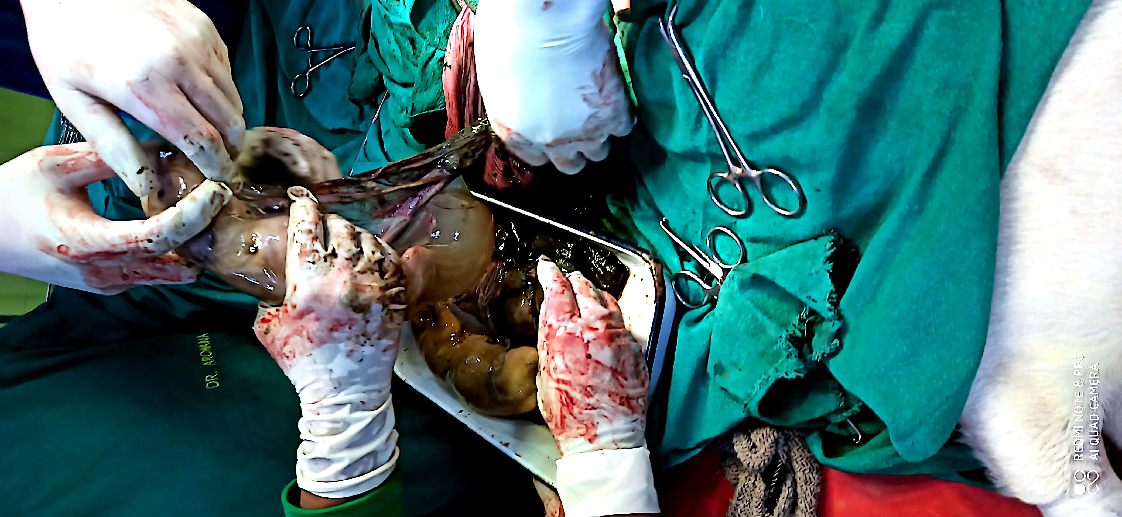
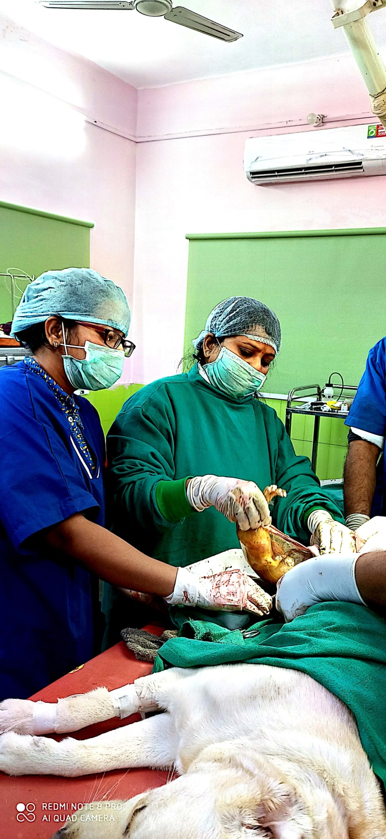

Slide 19
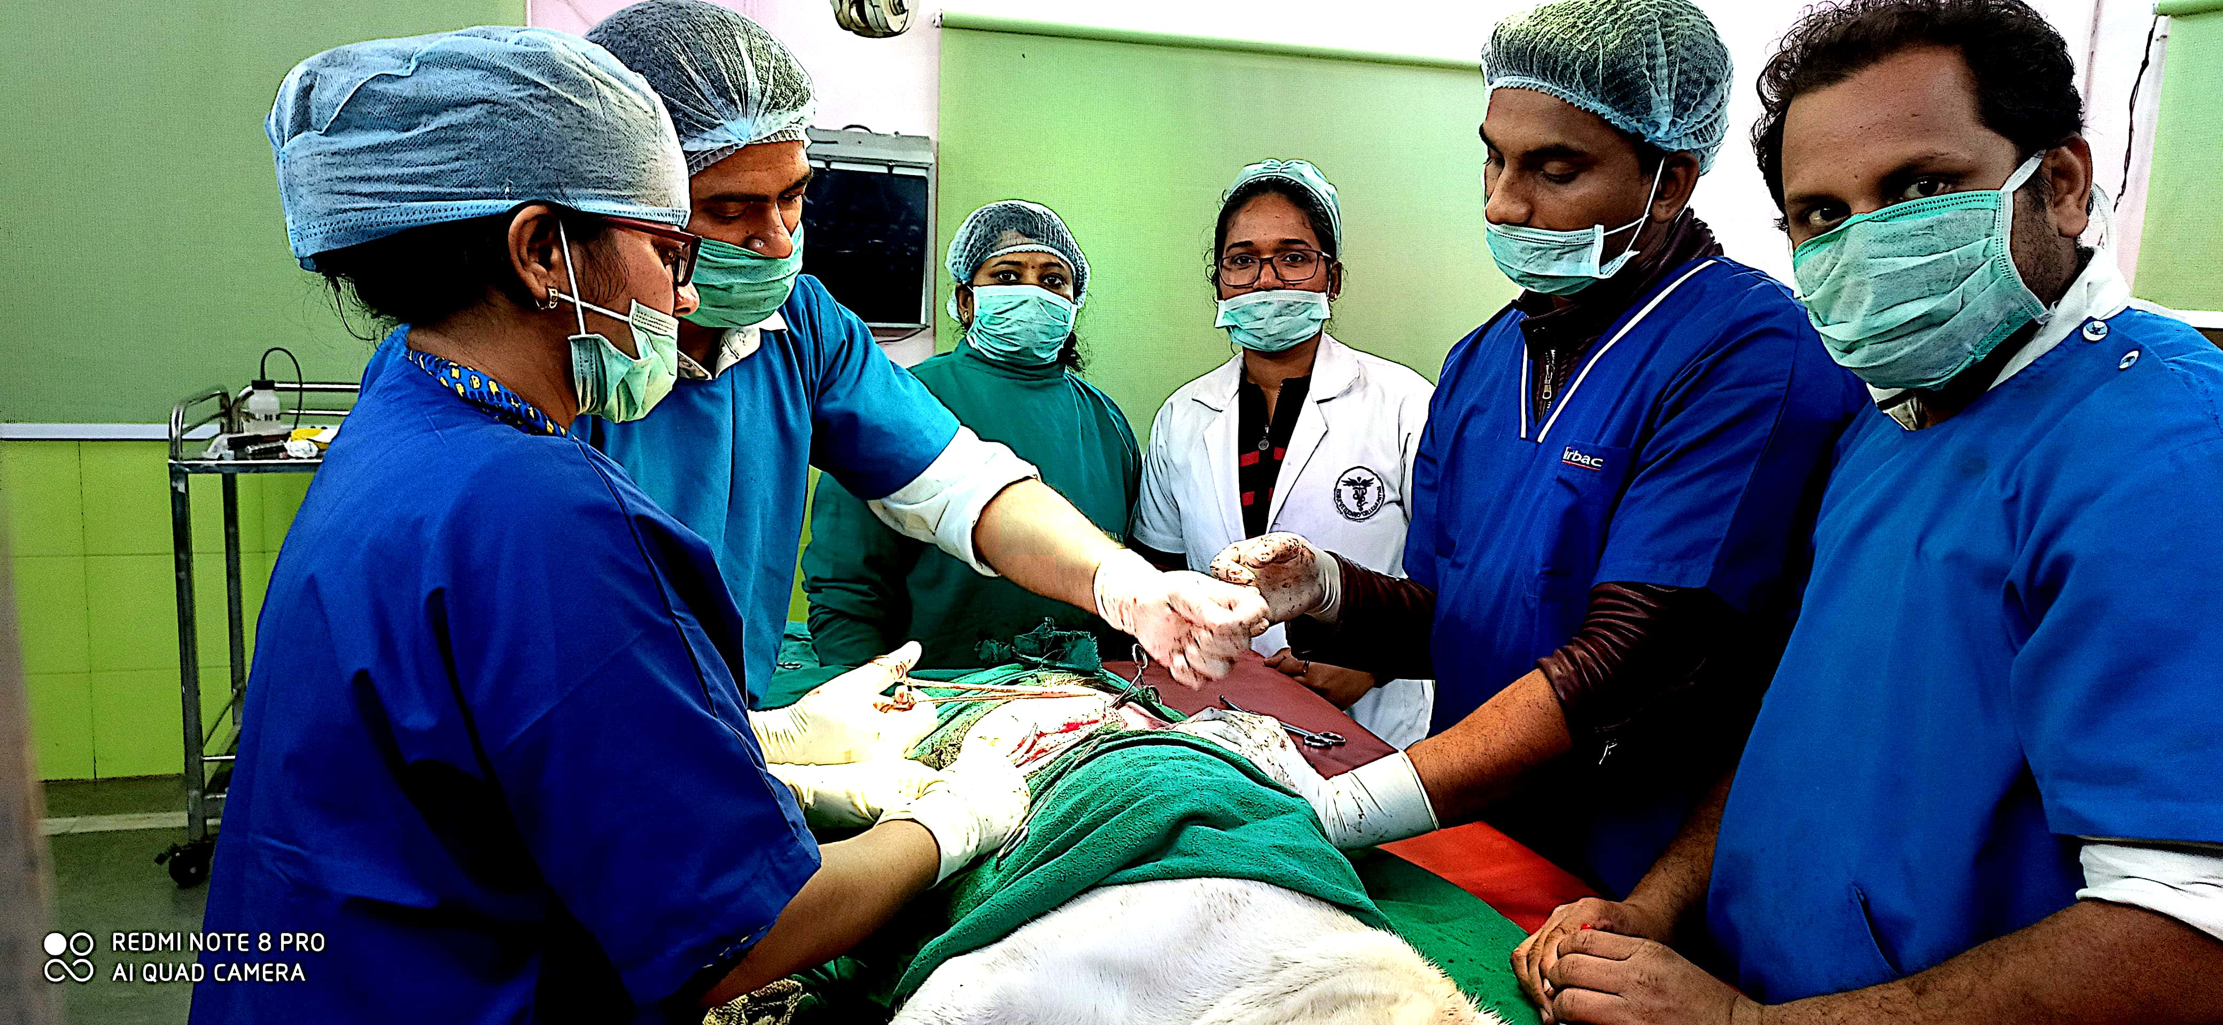
Fig :-

Slide 20
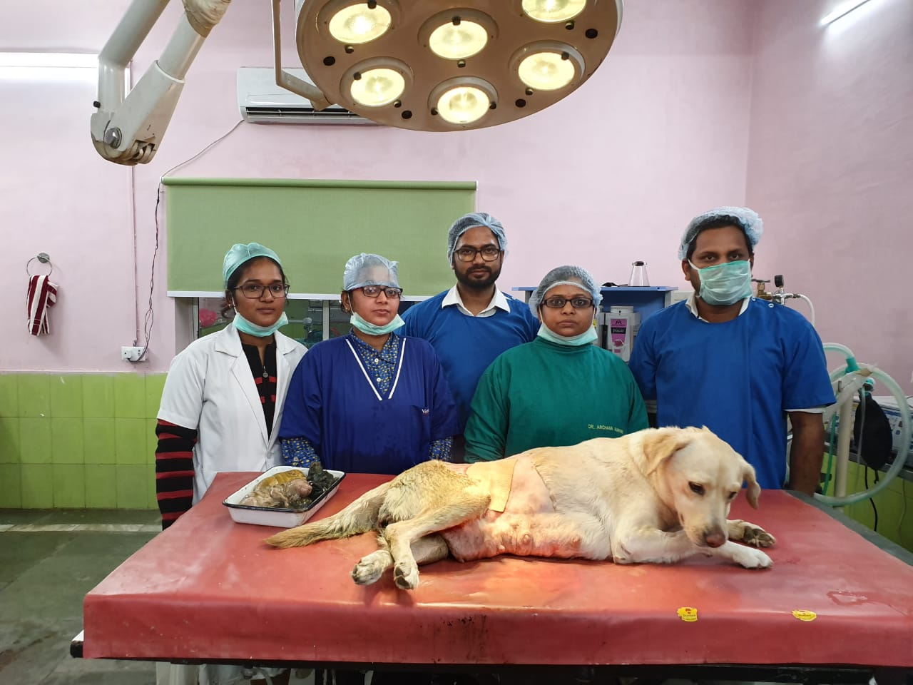
Fig :-

Slide 21
Discussion
The overall risk of this surgery is very low.
The major risks are those of general anesthesia, bleeding ( hemorrhage ) , infection ( peritonitis ) , post – opertative infection & wound breakdown ( dehiscence ) over the incision .
Overall complication rate is low, but serious complications can result in death or the need for additional surgery.

Slide 22
