Slide 1
LESSON-2
BASIC TERMINOLOGY AND CLASSIFICATION OF FATS AND PROTEINS

Slide 2
Objectives:
Know the basic terminology related to fats and proteins.
Know the classifications of fats and proteins.

Slide 3
Basic terminology related to fats and proteins
Fat denotes an ester composed of glycerol (tri-hydric alcohol) and three fatty acids of (triacylglycerol or triglycerides).
Oil is usually a mixture of pure fats and is liquid at room temperature.
Waxes are simple, non-polar lipids, a long-chain fatty acid, combined with a monohydric alcohol of high molecular weight & solid at RT.
Sterol is an alcohol of high molecular weight & basic compound used to synthesize vital chemicals such as cholesterol for both plants & animals.
Glycerol is an alcohol containing three carbons and three hydroxy groups and are main component of a fat.

Slide 4
Cont....
Saturated fat are those fat, contains no fatty acids with double bonds.
Unsaturated fat are those comprising from one to three fatty acids, contain one or more double bonds.
Glycolipids is the compounds in which two of the alcohol groups of the glycerol are esterified by fatty acids & other is linked to a sugar residue.
Galactolipids has two galactose residues at the first carbon atom & rumen microbes are able to break down by microbial galactosidases enzymes to produce galactose, fatty acids and glycerol.

Slide 5
Cont....
Protein is a complex organic compound of high molecular weight formed from combinations of amino acids and, other nonprotein components.
Amino acid is the simplest organic structure of proteins that have the common property of containing a carboxyl group & amino group on the adjacent carbon atom.
Essential/Indispensable amino acid are those which can’t be synthesized by the species in question from materials ordinarily available to the cells at a rate commensurate with the needs for the optimum growth and must be present in the diet (e.g., arginine, histidine, isoleucine, leucine, lysine, methionine, phenylalanine, threonine, tryptophan, and valine).

Slide 6
Cont....
Nonessential/Dispensable amino acid are found in common proteins however, it may be partly or completely synthesized by the animal tissues (e.g., alanine, aspartic acid, citrulline, cystine, glutamic acid, glycine, hydroxyproline, proline, serine, and tyrosine).
Crude protein is the total amount of protein present in the feed/diet of animals, includes both true protein as well as NPN compounds.
Nonprotein nitrogen is a group of nitrogen containing compounds that are not true proteins (e.g., amides, amines, glycosides etc.).
True protein is a precipitable protein rather than nonprotein compounds.

Slide 7
Classification of fat
Based on the numbers of carbon atoms and degree of unsaturation
Saturated fatty acid, having no double bonds.
Unsaturated fatty acid, has one or more double bonds.
Polyunsaturated fatty acids, has two or more double bonds.

Slide 8
Cont....
Based on proximate analysis of foods as ether extract fraction
1. Glycerol-based
Simple | Compound
Fat | Glycolipids | Phosphoglycerides
 | Glucolipids & Galactolipid | Lecithins & Cephalins
2. Non-glycerol-based
Sphingomyelins
Cerebrosides
Waxes
Steroids
Terpenes
Eicosanoids

Slide 9
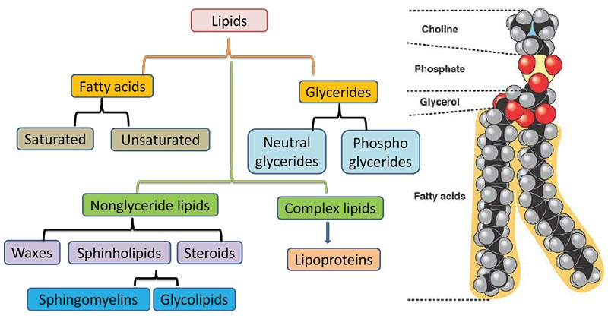
Cont....

Slide 10
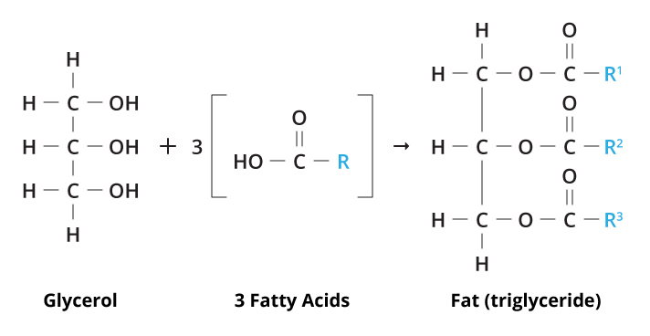
Cont....

Slide 11
Common functions of essential fatty acids
EAA is a vital component of cellular membranes and subcellular structures.
It elaborates in the synthesis of arachidonic acid derivatives.
Prostaglandins is dynamically involved in reproductive cycles, lipid metabolism, etc.
Prostacyclin is involved in vasodilation, inhibition of platelet aggregation, and several other functions.
Thromboxane is involving in vasoconstriction, aggregation, clotting and other activities too.
Likewise, leukotrienes can be a mediator of allergic response and inflammation, also a potent vasoconstrictors and other functions.

Slide 12
Common symptoms associated with essential fatty acid deficiencies
Growth retardation
Increased permeability to water, thus increased water consumption
Increased susceptibility to bacterial infections
Sterility
Less stable biological membranes
Capillary fragility
Kidney damage, haematuria and hypertension
Decreased visual acuity
Decreased myocardial contractility
Decreased ATP synthesis in liver and heart
Decreased nitrogen retention, etc.

Slide 13
Structure of proteins
1. Primary structure
The linkage of individual amino acids into a long chain by peptide bonds is referred as primary structure of the protein.
The peptides molecule contains 2 to 20 residues, polypeptides molecule contains 20 to 100 residues (e.g., insulin) & many proteins contain at least 100 residues of amino acids.

Slide 14
Cont....
2. Secondary structure
It is the conformation of chain of amino acids subsequent from the formation of hydrogen bonds between the imino and carbonyl groups of adjacent amino acids referred as secondary structure.
Moreover, polypeptides do not exist as straight chains, but they are crumpled into a specific three-dimensional conformation,
As α-helix forms (found in horns, nails, skin, hair, wool and several skeletal muscle proteins like myosin and tropomyosin),
β-pleated sheet (found in silk like keratin and other insect fibres) and
Collagen helix (found in hide, tendons and other connective tissues).

Slide 15
Cont....
3. Tertiary structure
The secondary structure further interrelates through the R-groups of the amino acid residues, which causes folding and twisting of the polypeptide chain like myoglobin.
Whereas, polypeptides are folded and tightly twisted into a globular form & stabilized by disulphide linkages between two cysteine residues, salt bonds as well as hydrogen bonding.
It becomes crucial to enzymatic activity of many proteins.

Slide 16
Cont....
4. Quaternary structure
Proteins contain more than one polypeptide chain, which is stabilise by hydrogen bonds & electrostatic or salt bonds formed between residues on the surfaces of the polypeptide chains like haemoglobin.
This is alignment of several tertiary structures into one protein & such as haemoglobin consists of four single strand tertiary forms of proteins that are compactly associated into a single globular protein.

Slide 17
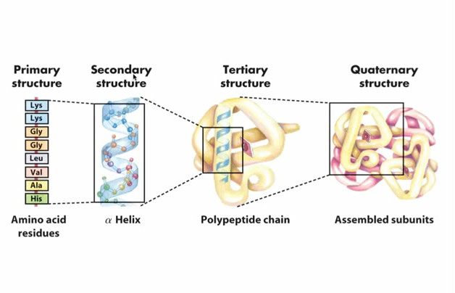

Slide 18
Classification of proteins
1. Simple proteins
They produce only amino acids on hydrolysis & are sub-divided into fibrous and globular proteins, depend on their shape, solubility & chemical composition.
i. Fibrous proteins
Such protein plays structural roles in animal cells and tissues & are insoluble in nature (e.g., collagen, elastin and keratin).
Collagens are the key proteins of connective tissues, constitutes about 30 % of the total proteins in the mammalian body.

Slide 19
Cont....
Elastin is the protein instituted in elastic tissues like tendons & arteries.
Keratins are classified into two categories;
α-keratins are the main proteins of wool and hair &
β-keratins occur in feathers, skin, beaks and scales of most birds and reptiles, & are very rich in the sulphur-containing amino acid like cysteine (wool protein contains about 4 % of sulphur).

Slide 20
Cont....
ii. Globular proteins
The polypeptide chains are folded into compact structures, comprises all the enzymes, antigens & hormones proteins such as;
albumins (occur in milk, blood, eggs and many plants),
histones (occur in cell nuclei),
protamines (occur in male germ cells of vertebrates) &
globulins (occur in milk, eggs, blood and seeds).

Slide 21
Cont....
2. Conjugated proteins
Such proteins contain a non-protein moiety named a prosthetic group, in addition to amino acid, ex- glycoproteins, lipoproteins, phosphoproteins and chromoproteins.
i. Glycoproteins
Proteins having one or more heteroglycans as prosthetic groups referred as glycoprotein (e.g., egg white, ovalbumin).

Slide 22
Cont....
ii. Lipoproteins
The proteins which conjugated with lipids such as triacylglycerols and/or cholesterol &
forms in which lipids are transported in the bloodstream to various tissues, either for oxidation or for energy storage.
They can be classified into five categories in increasing order of their density;
chylomicrons,
very-low-density lipoproteins (VLDL),
low-density lipoproteins (LDL),
intermediate-density lipoproteins (IDL) and
high-density lipoproteins (HDL).

Slide 23
Cont....
iii. Phosphoproteins
Such proteins contain phosphoric acid as the prosthetic group referred as phosphoprotein (e.g., caseins of milk and phosvitin of egg yolk).
iv. Chromoproteins
The protein which contains the pigment as the prosthetic group termed as chromoprotein (e.g., haemoglobin and cytochromes).

Slide 24
Classification of amino acid
Classification based on the nutritional requirement
Essential |  | Conditionally non-essential | Non-essential
Common core | Additional species related requirements
Lysine | Arginine (cats, poultry, fish) | Cyst(e)ine | Glutamate
Histidine | Taurine (cats) | Tyrosine | Glutamine
Leucine |  | Arginine | Glycine
Isoleucine |  | Proline | Serine
Valine |  |  | Alanine
Methionine |  |  | Aspartate
Threonine |  |  | Asparagine
Tryptophan
Phenylalanine

Slide 25
Classification based on chemical structure and their metabolic activity
Glucogenic | Ketogenic | Glucogenic and ketogenic
Threonine | Leucine | Isoleucine
Arginine | Lysine | Phenylalanine
Methionine |  | Tyrosine
Valine |  | Tryptophan
Histidine
Cysteine
Glutamate
Glutamine
Aspartate
Asparagine
Glycine
Serine
Proline
Alanine

Slide 26
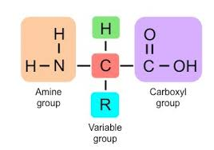
Cont....

Slide 27
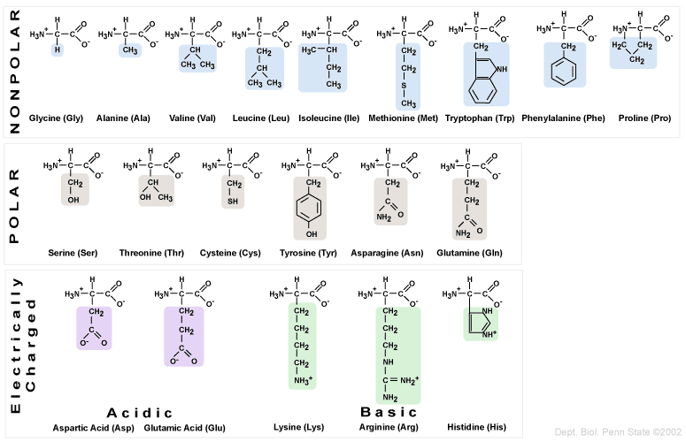
Cont....

Slide 28
THANKS
Discussion..........
Questions, if any?

