Slide 1
DIGESTION & METABOLISM OF FAT IN RUMINANTS AND NON-RUMINANTS
Dr. Kaushalendra Kumar
Assistant Professor (Animal Nutrition),
Bihar Veterinary College, BASU, Patna, India
E-mail: drkaushalbvc@gmail.com

Slide 2
Digestion and absorption of fat in non-ruminant and ruminant species
Digestion before the small intestine
Substantial lipolysis can happen in the stomach of suckling animals, both non-ruminants and ruminants.
Main site of secretion of lipase seems to be in the lingual and pharyngeal regions.
In adult ruminants, microbial fermentation and lipids undergo hydrolysis, followed by hydrogenation
Major difference between ruminant (form of free fatty acid) & non-ruminant (esterified) digestion of lipid appears at the beginning of SI.

Slide 3
Cont......
Digestion in the small intestine of monogastric animals
Dietary triglycerides entering the SI from stomach, mixed with discharges of bile & pancreatic juice in the duodenum.
Lipase and colipase hydrolyse TG droplet into FA & monoglycerides.
In absence of colipase or bile, lipase get absorbed and denatured at the interface.
Bile salt but no colipase, lipase remains in the aqueous phase & colipase is required for the attachment of lipase at the substrate-water interface
Micelle formation, permit cholesterol & fat-soluble vitamins to be solubilized in the hydrophobic core, and then get absorbed.

Slide 4
Cont......
Digestion in the small intestine of ruminants
Dietary lipid reaching the SI of ruminant is the FFA fractions, bounded as an insoluble complex with the feed particles.
Transfer of fatty acid from the insoluble, particulate phase to the soluble, micellar phase.

Slide 5
Common enzymes involve in fat digestion
Cont......
Name of enzymes | Systematic name | Source | Substrate
Enzymes acting on ester links
Triacylglycerol lipase (Lipase) | Triacylglycerol acylhydrolase | Pancreas | Triacylglycerols
Cholesterol esterase | Sterol-ester hydrolase | Pancreas and small intestine | Cholesterol esters
Phospholipase A2 (Lecithinase A) | Phosphatide 2-acyl-hydrolase | Pancreas and small intestine | Lecithin and cephalin
Lysophospholipase (Lysolecithinase) | Lysolecithin acyl-hydrolase | Small intestine | Lysolecithin
Deoxyribonuclease (DNase) | Dexoyribonucleate 5’-oligonucleotido-hydrolase | Pancreas and small intestine | DNA
Ribonuclease 1 (RNase) | Ribonucleate 3’-pyrimidino-oligonucleotido-hydrolase | Pancreas and small intestine | RNA
Nucleosidase | N-Ribosyl-purine ribohydrolase | Small intestine | Nucleosides
Phosphatases |  | Small intestine | Orthophosphoric acid esters

Slide 6
Cont......
Absorption of fat in non-ruminant and ruminant species
Absorption of fat occurs in jejunum of SI & micelle formation is crucial for efficient fatty acid absorption in all species.
In case of non-ruminant species, monoacylglycerols are required for micelle creation,
However, nearly complete hydrolysis of dietary FA in the rumen are absent from digesta present in the SI of the ruminants.
Bile provides, bile salts and lecithin, whereas, pancreatic juice delivers enzymes to convert lecithin to lysolecithins & bicarbonate to elevate pH.

Slide 7
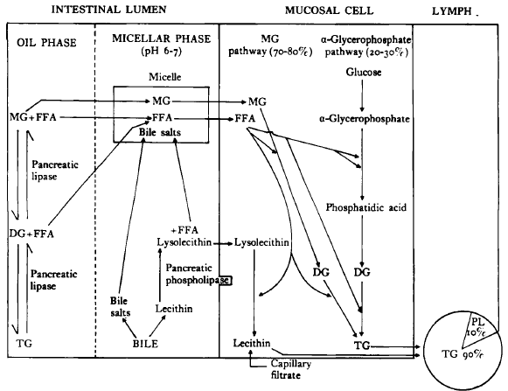
Digestion and absorption of lipids in non-ruminant animals
Cont......

Slide 8
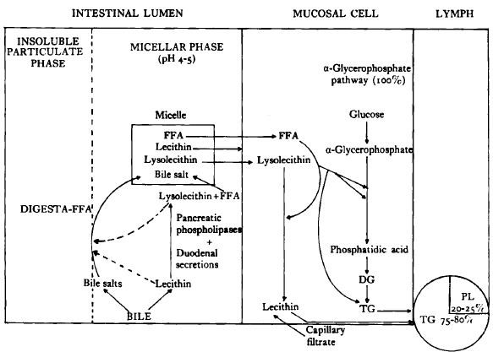
Digestion and absorption of lipids in ruminant animals
Cont......

Slide 9
Cont......
Factors affecting digestion and absorption of fats
Short and medium chained fatty acid are utilized better in comparison with long chain fatty acid.
Unsaturated fatty acids are well utilized than saturated fatty acids.
Degree of esterification of fatty acid i.e. triglyceride > diglyceride > monoglyceride.
• Ratio of unsaturated and saturated fatty acids.

Slide 10
Metabolism of fat in different species of animals
After absorption, either enter oxidative pathways for energy production, or transported to the adipose tissues & incorporated into the body fats.
The complete oxidation of fat yields about 2.25 times more energy than carbohydrates.

Slide 11
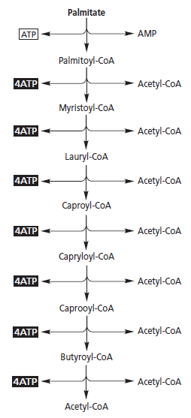
Oxidation of FA to Acetyl CoA & β-Oxidation of palmitic acid
Cont......

Slide 12
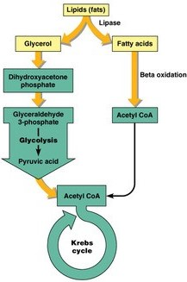
Overview of fat metabolism
Cont......

Slide 13
Net yield of energy on oxidation of tripalmitin and starch
Cont......
1. Tripalmitin (806 g/mole)
C₅₁H₉₈O₆ (+3 H₂O) + 72.5 O₂ = 51 CO₂ + 52 H₂O + 7657 Kcal
Glycerol |  | 19 ATP
Palmitate
 | Phosphorylation | -2 ATP
 | 7 cleavages x 5 ATP | +35 ATP
 | 8 acetyl CoA x 12 ATP | +96 ATP
 | Net (129 ATP x 3) | 387 ATP
Total yield |  | 406 ATP

Slide 14
Cont......
2. Starch (162 g/mole, glucose basis)
C₆H₁₀O₅ (+H₂O) + 6O₂ = 6 CO₂ + 6 H₂O + 680 Kcal
Glycolysis |  | 10 ATP
 | Phosphorylation | -2 ATP
 | NADH – mitochondria | -2 ATP
Net yield |  | 6 ATP
Oxidation of 2 pyruvate |  | 6 ATP
2 acetyl CoA x 12 |  | 24 ATP
Total yield |  | 36 ATP

Slide 15
Cont......
3. Based on gross energy
a) | 7657 Kcal ÷ 806 g = 9.5 Kcal/g of fat
b) | 680 Kcal ÷ 162 g = 4.20 Kcal/g of carbohydrate
Net yield | 9.5 Kcal ÷ 4.20 Kcal = 2.26
4. Based on ATP production
a) | 406 ATP ÷ 806 g = 0.504 ATP/g of fat
b) | 36 ATP ÷ 162 g = 0.222 ATP/g of carbohydrate
Net yield | 0.504 ATP ÷ 0.222 ATP = 2.27

Slide 16
Synthesis of fatty acid
Cont......
Synthesis of fat (glycerides) occurs in the body from fatty acyl CoA & L-glycerol-3-phosphate, take place in most tissues, but is confined mostly to the liver & adipose tissue.
Three systems of fatty acid synthesis;
In the cell cytoplasm, mainly in the production of palmitate from acetyl CoA or butyryl-CoA,
Another occurs chiefly in ER & minor extent in mitochondria, elongation of FA chains by 2-C addition with malonyl CoA as donor,
Finally they confined to the ER which carries about desaturation of preformed fatty acids.

Slide 17
Cytosolic synthesis of palmitate
Cont......
Desaturation of preformed fatty acids
Synthesis of triacylglycerols
Elongation of fatty acid chain

Slide 18
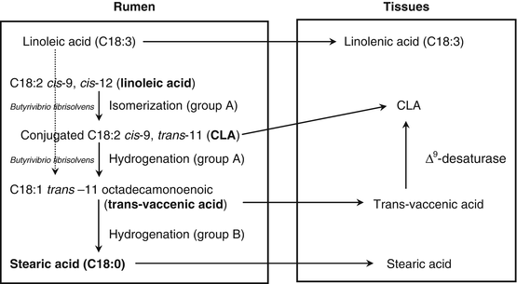
Fat metabolism in ruminants
Cont......
Hydrolysis
Biohydrogenation

Slide 19
THANKS
Discussion..........
Questions, if any?

