Slide 1
DISEASES OF URINARY SYSTEM
Unit-II Veterinary Medicine
[ Part-I]
By
Dr. Anil Kumar
Assistant Professor
Department of VCC, BVC, BASU, Patna

Slide 2
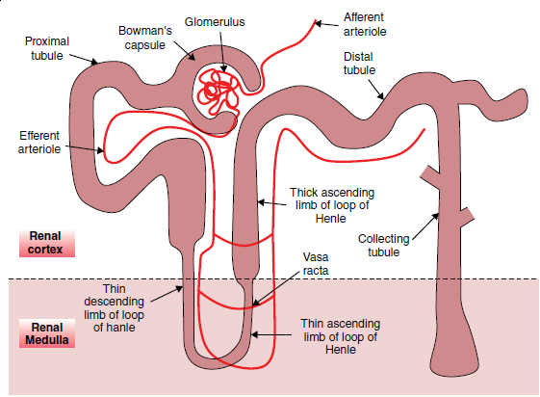
Anatomy and Physiological Functions
Maintaining the volume and composition of body fluids
Clean the body fluids of end‐products
Produce hormones such as erythropoietin, renin‐angiotensin, and calcitriol
Have metabolic functions

Slide 3
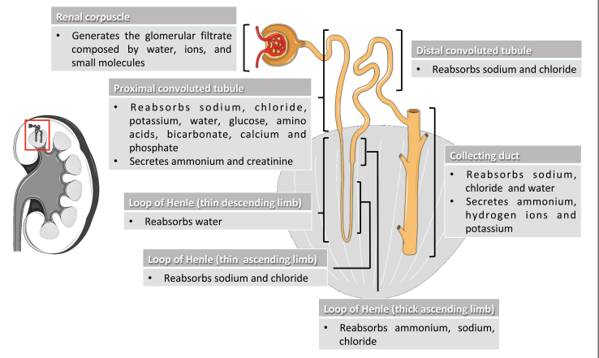
Normal physiological function of Nephron

Slide 4
Urine Production
Urine production relies on two factors:
Proper function of the nephron
Blood supply to the glomerulus
Glomerular filtration rate (GFR) of 3–5 mL/min/kg for dogs and 2.5–3.5 mL/min/kg for cats
The mean renal arterial pressure is 100 mmHg, for both dogs and cats
While the pressure within the glomerular capillary is 55 mmHg in dogs and 59 mmHg in cats.
The pressure within the glomerular capillary is substantially higher than the pressure within Bowman’s space, thus leading to a difference in hydrostatic pressure of 35 mmHg, facilitating rapid filtration through the glomerular capillary wall

Slide 5
The glomerular capillary wall has both size and charge selectivity, i.e. all molecules<4 nm and positively charged molecules to pass easily through the membrane
Filtration is the initial step in urine production via the passive movement of protein and cell‐free plasma from the glomerular capillaries into Bowman’s space to form a plasma ultrafiltrate.
The proximal tubule’s (Reabsorption):
Reabsorption of 50–55% of filtered water and sodium, and virtually all the glucose, phosphate, and amino acids found in the ultrafiltrate
Reabsorption of solutes uses mechanisms of active transport, while water moves passively along the concentration gradient as solutes move out of the tubule lumen and into the tubular

Slide 6
The distal tubule :
it is relatively impermeable to water but continues to reabsorb sodium and chloride.
Parathyroid hormone acts on the distal tubules to regulate
calcium reabsorption
The loop of Henle:
Continues to reabsorb sodium and chloride as well as calcium and magnesium through an active transport mechanism
A concentration gradient is no longer established following the removal of solutes (glucose, phosphate, and amino acids) in the proximal tubules.
Very little water is reabsorbed in the loop of Henle and causes a dilution of the filtrate and a hyposmotic fluid

Slide 7
Collecting duct:
The fluid reaching the collecting duct is hyposmotic to plasma.
Under the influence of antidiuretic hormone (ADH), released from the posterior pituitary, the collecting ducts begin to reabsorb water
Fluid in the collecting ducts is deposited in the renal pelvis as urine, where it enters the ureter and finally the bladder, where it awaits micturition
The kidneys are highly sensitive organs and can easily be damaged.
Kidney receive 20% of the cardiac output, and 90% of that blood goes to the kidney cortex, where key structures of the nephron are exposed to toxins concentrated in the blood.

Slide 8
While autoregulation is used to keep renal blood flow(RBF), and therefore GFR, at a constant level
The periods of hypotension (MAP <60 mmHg) can cause an interruption of oxygen delivery to the kidney.
Cells of the proximal tubule and thick ascending loop of Henle are particularly sensitive to ischemia as they have a very high metabolic rate

Slide 9
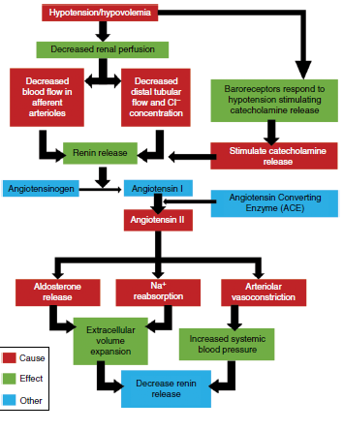
Causes and effects of therenin‐angiotensin‐aldosterone system (RAAS)

Slide 10
If the kidneys are damaged, they must lose 66% of their function before clinical signs of renal insufficiency will appear, and 75% before developing renal failure and bloodwork changes
Azotemia
An abnormal concentration of urea nitrogen and creatinine in the blood
Causes:
Diminished capacity of the kidney to remove these substances
Changes in the volume of blood reaching the kidneys
Impaired outflow of urine, AND consequently lead to---Renal failure
When azotemia is identified, it is important to distinguish among prerenal, renal, and postrenal causes

Slide 11
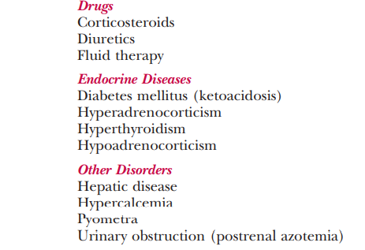
Prerenal azotemia:
Any disorder that decreases renal perfusion (e.g., dehydration, heart failure, or hypovolemia)
or that results in increased production of urea (e.g., gastrointestinal hemorrhage).
With few exceptions dogs and cats with purely prerenal causes of azotemia produce concentrated urine (i.e., specific gravity >1.035 in dogs and >1.040 in cats).
Prerenal azotemia quickly resolves when the cause of decreased renal perfusion is corrected (e.g., fluid therapy).
Table:1 DISORDERS ASSOCIATED WITH AZOTEMIA AND INADEQUATE URINE CONCENTRATION DESPITE NORMAL RENAL FUNCTION IN DOGS AND CATS

Slide 12
Postrenal azotemia:
Result from either an obstruction in urine outflow or leakage of urine into the abdomen.
With a urinary obstruction, the blockage causes increased pressure proximal to the impasse.
This results in increased hydrostatic pressure in Bowman’s capsule and decreased glomerular filtration rate (GFR). This is most commonly observed in urethral
A rupture of the urinary tract results in the accumulation of fluid in the abdomen. Because urea is highly diffusible, it is quickly resorbed back into circulation while creatinine, which is not diffusible, becomes trapped in the fluid.
Patients WITH a rupture of the urinary tract develop an accumulation of fluid, and it has a BUN comparable to serum plasma with elevated creatinine.

Slide 13
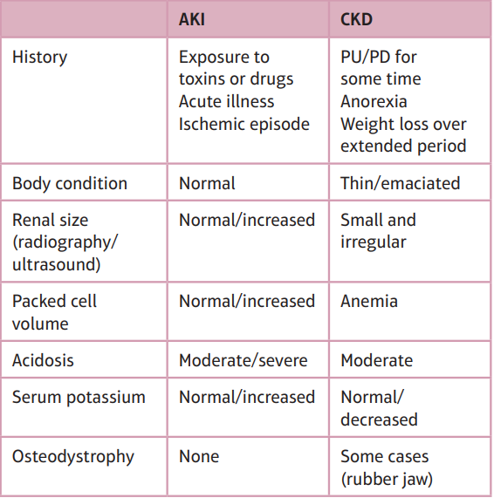
Renal azotemia:
It is a direct result of renal parenchymal disease
Primary renal disease is classified clinically into acute kidney injury (AKI) or chronic kidney disease (CKD) and histologically as glomerular or tubular disease.
Differentiation between AKI and CKD is important in determining etiology, prognosis, and treatment options(Table 2)

Slide 14
Differential diagnosis between AKI &CKD is based on a combination of history, clinical signs, physical examination findings, and diagnostic tests.

