Slide 1
DISEASES OF URINARY SYSTEM
[ Part-II ]
By
Dr. Anil Kumar
Assistant Professor
Department of VCC, BVC, BASU, Patna

Slide 2
ACUTE KIDNEY INJURY
A rapidly progressive impairment in the kidney’s ability to filter metabolic waste, as well as maintain the body’s fluid and electrolyte balance
Etiology:
Ischemia, nephrotoxins, infectious agents, or systemic disease
In companion animal medicine, AKI is most commonly the result of exposure to toxins and infectious agents.

Slide 3
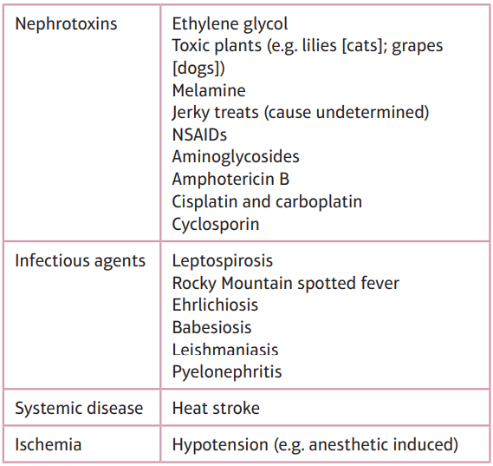
Table-1 Common causes of acute kidney injury(AKI)

Slide 4
Pathophysiology:
Many specific mechanisms depending upon the cause
Example: NSAIDs
Block the cyclo-oxygenase pathway preventing the formation of locally protective prostaglandins in the kidney.
Activation of the renin–angiotensin system leads to vasoconstriction in the glomerular capillary bed.
As the arterioles constrict, blood flow out of the glomerulus and into peritubular capillaries decreases.
If left as such, the resulting decreased blood flow to the medulla of the kidney leads to ischemic injury.
Suppression of the renin–angiotensin system by IV fluid therapy can help prevent this vasoconstriction

Slide 5
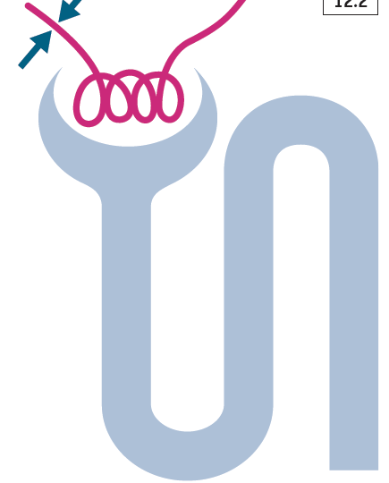
An insult to the kidney is dependent on a combination of 4 features:
Injury decreases glomerular permeability (Figure 1) and causes vasoconstriction (Figure 2).
This leads to decrease GFR and ultrafiltrate production.
Filtration of the blood significantly decreases.
Fig-1
Fig.-2

Slide 6
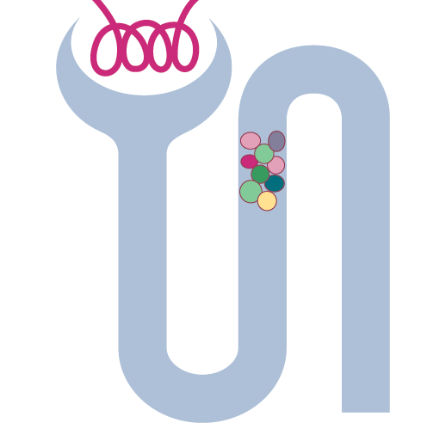
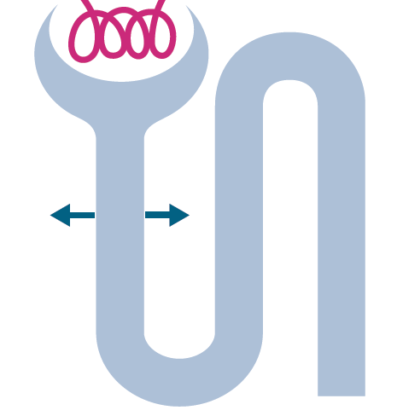
As a result of the injury, dead epithelial cells, cellular debris, and proteins are discarded into the tubular lumen and form obstructive casts
Lastly, swelling and inflammation of the damaged renal parenchyma externally compresses renal tubules.
These obstructive forces increase hydrostatic pressure within Bowman’s capsule and block glomerular filtration.
Due to death of tubular epithelial cells there in no barrier to prevent diffusion electrolytes and fluids (Fig.-4).
Thus, up to 50% of glomerular filtrate can be lost to ‘back leak’, and urea, creatinine, electrolytes, and fluids undergoing glomerular filtration fail to be excreted.
Fig.3-Tubular obstruction
Fig.4-Back leak

Slide 7
Toxic and ischemic insults
Intrarenal vasoconstriction
Decreases blood flow delivered to the glomerulus
Decrease in GFR
Resulting hypoxia in the PCT and ascending loop of Henle.
Due to high Metabolic activity and limited blood supply(PCT & Ascending loop
Further permanent nephron loss.

Slide 8
Clinical presentation:
Depends on the underlying cause, severity of the azotemia, and electrolyteimbalances
Depression, weakness, dehydration, anorexia, vomiting, diarrhea, uremic breath, oral ulcers and hypothermia
Diagnosis:
History(exposure to environmental nephrotoxins, current medications andrecent travel history
Presence of azotemia (increased BUN, creatinine, and phosphorus) s/be confirmed and Differential diagnosis from pre-renal and CKD s/be done
The hallmark of prerenal azotemia is a moderate elevation in BUN and creatinine with an increase in USG
Post-renal azotemia (Elevations in BUN and creatinine that present with a distended bladder or free fluid in the abdomen), if, this fluid is from the urinary tract, then, its BUN=patient’s serum but a creatinine concentration that is higher.
CBC, serum chemistry, urinalysis, aerobic urine culture, ultrasound, and serology

Slide 9
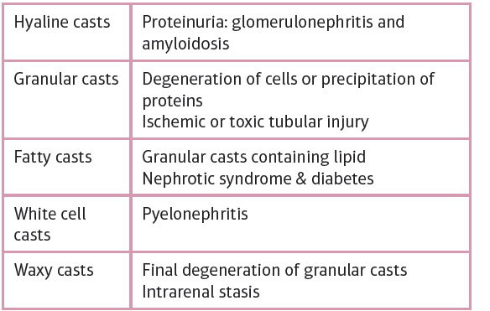
Urinalysis: Quickly differentiate between prerenal and renal azotemia
In AKI- Isosthenuria
In Pre-renal azotemia-USG of >1.025 in the dog and >1.035 will found
Glucosuria in the absence of hyperglycemia is suggestive of acute proximal tubule dysfunction
Casts, often observed in AKI, can help determine the underlying cause:
Table 2: Types of casts and associated conditions

Slide 10
Urine culture:
Suggested if urine sediment is present
Complete blood count
The CBC are often non-specific.
However, elevations in the WBCscan be associated with pyelonephritis and systemic infectious diseases.
The absence of a stress leukogram (neutrophilia, lymphopenia, and eosinopenia) in a sick patient should raise the suspicion that the patient could have hypoadrenocorticism (Addison’s disease), not AKI.
Serum chemistry:
Elevation in BUN and creatinine. Elevations in phosphate
Decreases HCO3 while potassium increases with the degree of renal dysfunction.
Anion gap (([Na+ +K+] – [Cl- + HCO3-]) increases in AKI, [12 to 24 mEq/l-Dog/canine and 13–27 mEq/l- in Cat/feline]
ULTRASOUND:
In AKI-KIDNEY-normal to increased size
In CKD-small, irregular shaped

Slide 11
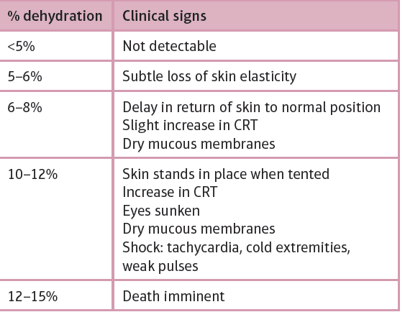
Management
Depends on:
Determining an underlying cause
Correcting dehydration
Diuresis
Correcting life-threatening electrolyte imbalances
As inappetence, vomiting, and an impaired ability to concentrate urine, dehydration is common in AKI patients.
1. Correcting dehydration
Initial fluid therapy:
Patient dehydration status (degree of dehydration)
Maintenance fluids and
Insensible losses
Correcting dehydration:
Deficit in liters = % dehydration × kg body weight

Slide 12
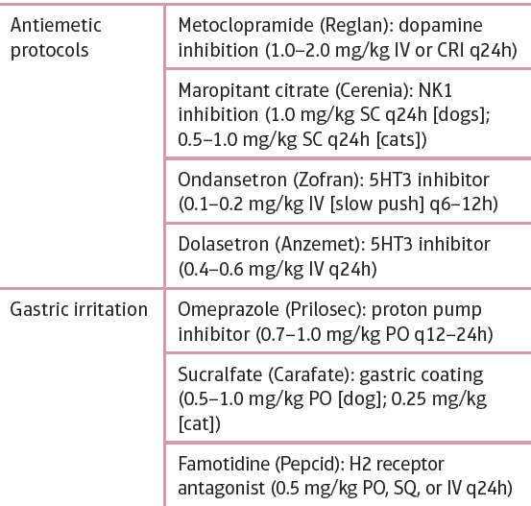
2. Diuretics:
In oliguric and anuric animals that are not fluid overloaded and are well hydrated, mannitol is the initial treatment of choice. Mannitol-increase renal blood flow/ shrink swollen tubular cells/ dislodge tubular obstructions/ and scavenge free radicals.
Dose: 0.25–1.0 g/kg IV bolus over 30 minutes. If urine production improves, a CRI of 1–2 mg/kg/minute can be started
Note: contraindicated in ethylene glycol intoxication
Furosemide @ 2 mg/kg as a bolus
Note: In Aminoglycoside toxicity
3. Ani-emetics: (Table-4)
Table-4: Protocols used to control emesis in acute kidney injury patients

Slide 13
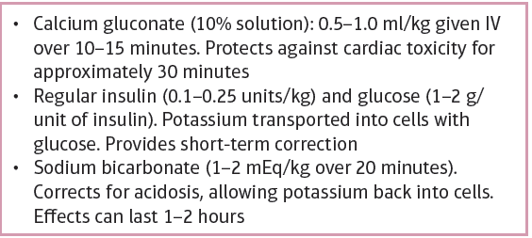
Oliguric and anuric renal failure patients that do not respond to medical management develop fatal hyperkalemia and metabolic acidosis.
Hyperkalemia
Most common life-threatening electrolyte imbalance in AKI is hyperkalemia.
Causes a reduction of the transmembrane electrochemical gradient and changes nerve and muscle cell excitability
Clinically: have
Muscle weakness
Reduced cardiac contractility
Arrhythmias and
Neurologic abnormalities
In ECG: bradycardia, disappearance of the P wave, spiking of the T wave, and widened QRS complexes, WHEN, >6.5 mEq/l.
Table 5:Management of hyperkalemia

