Slide 1
Canine ehrlichiosis
(VMD-Unit-5)
Anil Kumar
Associate Professor
Department of Veterinary Medicine
BVC, BASU, Patna

Slide 2
Introduction:
Canine ehrlichiosis is a worldwide tick borne diseases caused by Ehrlichia canis
Also recognized as canine rickettsiosis, canine typhus, canine hemorrhagic fever, tropical canine pancytopenia, and tracker dog disease
It affects platelets, monocytes, and granulocytes
E. chaffeensis is considered the main etiological agent of human monocytic ehrlichiosis (HME), it is also reported in canines
Five different species of ticks (Amblyomma americanum, Haemaphysalis longicornis, Rhipicephalus sanguineus, Haemaphysalis yeni, and Dermacentor variabilis) have been identified as vectors
Rhipicephalus sanguineus (the brown tick of dogs) is generally considered the main vector responsible for canine ehrlichiosis
Risk Factors:
Siberian Huskies and German Shepherds are more prone to exhibit severe clinical symptoms due to low intensity of the cell-mediated immune response
High temperature and low humidity favors the growth of vectors

Slide 3
Transstadial transmission is well-established
Pathogenesis:
Pathogen enters the host cell (mononuclear phagocytic cells especially Monocytes)
Other immune cells such as metamyelocytes, lymphocytes, and promyelocytes
Forms membrane-bound partitions (endosomes) and maintains its distinctive cytoplasmic shape.
Monocyte contains one to two morulae.
Persistent infection develop a more lethal form of chronic disease where the pathogen attacks the bone marrow and destroys the immune system
Spreads to the whole lymphatic system including the liver and spleen
Abnormal fast growth of cells and the increased size of these organs(Hyperplasia)
Further cell division and replication leads to bacteremia and eventually results in hemolysis.
High fever, anemia, and thrombocytopenia
Massive hemorrhages and death

Slide 4
Clinical Signs:
Clinical presentation varies and depends on many factors (status of the immune system of the dog/ virulence of the strain/ and existence of co-infections with other tick/flea-born diseases)
The principal host cell targets for E. canis and E. chaffeensis are agranulocytes
presentations which may be categorized as acute, chronic, and subclinical
The common clinical findings are fever, pale mucosa due to anemia, lymphadenomegaly, bleeding disorders, hepatomegaly, lethargy, petechial and ecchymotic hemorrhages(Fig 1 &2) , vasculitis, and extended bleeding period during estrus
In addition, other signs like ataxia, vestibular dysfunction and seizures, and chronic or myelosuppressive form also reveal stomatitis, scrotal or hind limb edema, jaundice, glossitis, and pyoderma
Bleeding tendencies found frequently in the chronic form of CME

Slide 5
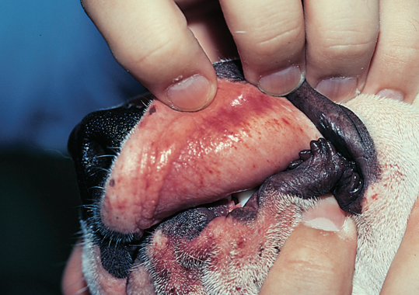
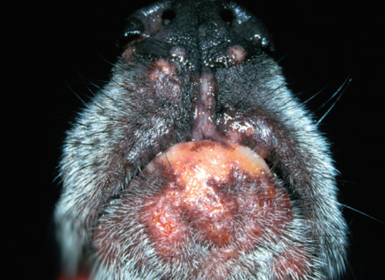
Fig. 1 : Petechiae and ecchymotic hemorrhages caused by thrombocytopenia in E. canis infection
Fig. 2: Bruising on the oral mucosa
Fig.3: Depigmentation erosive dermatitis
on the chin, muzzle, and nasal planum

Slide 6
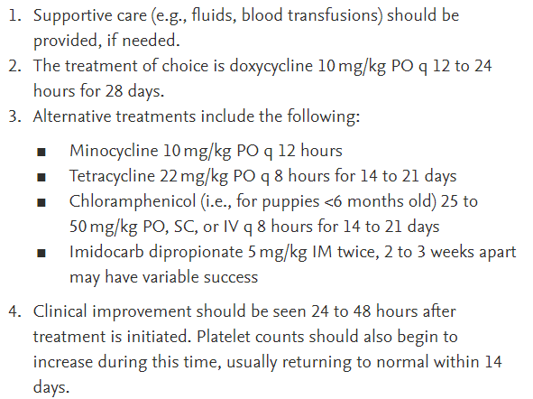
Diagnosis:
Microscopy
Serology (Immunofluorescence antibody test (IFAT) and enzyme-linked immunosorbent assay (ELISA)
Molecular (PCR)
Treatment:

