Slide 1
Canine Adenovirus-2 & Parainfluenza Virus Infection
Dr Mritunjay Kumar
Associate Professor
VMD, BVC, BASU, Patna

Slide 2
Canine adeno virus-2 causes respiratory disease and characterised by dry hacking cough, retching, sneezing, watery nasal discharge, fever and lethargy in severe cases
Aetiology
Canine adeno virus-2 (CAV-2) is in the family Adenoviridae
PI is caused by single stranded RNA virus of family Paramyxoviridae
Epidemiology
Distribution is world wide and mainly present as mixed infection in kennel cough
Members of Canidae

Slide 3
Transmission
Virus are transmitted primarily by inhalation of aerosolised droplets from infected dog
Virus is part of a complex of pathogens causing infectious tracheobronchitis in dog
Dense population such as in Kennels or shelters facilitate viral spread to naïve dogs
Pathogenesis
Incubation period- 3-10 days
Virus replicates in epithelial cells and cause damage to upper respiratory tract of infected dogs
Damage to epithelial barrier and disruption of normal respiratory defenses predispose to infection with other respiratory tract infection (Mycoplasma, Bordetella etc)
Viral sheding can occur for one week after recovery

Slide 4
Clinical signs
Hacking cough with terminal retch and serous nasal discharge- typical signs of viral infection
Paroxysmal coughing
Tracheal palpation elicits coughing
Coughing may produce foamy white mucous
Clinical signs of short duration and subsides by 7 days after onset
Some dogs may show clinical signs up to 10 days
Differential Diagnosis
Boretella bronchiseptica infections
Para-influenza infection
Common cold

Slide 5
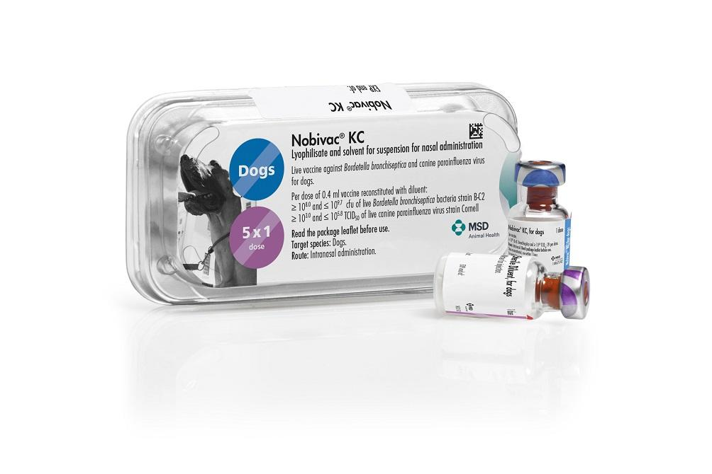
Diagnosis
Based on history and clinical signs
No pathognomonic laboratory abnormalities
Isolation of virus from nasopharyngeal or tracheal swabs
Radiography- No typical changes observable in uncomplicated cases
Treatment
No specific treatment, only supportive treatment
Antimicrobial- Amoxycillin, ampicillin, trimethoprim-sulfa may limit the secondary bacterial infections
Anti-inflammatory dose of gluco-corticoids
Cough suppressants-Hydrocodone or Butorphenol tartrate
Prevention and Control
Strict isolation and sanitation
Vaccination
Nobivac KC(Parainfluenza & B. brochiseptica) –Intra-nasaI in one nose
Dose-0.4 ml Age-2 weeks old Protection-1 year
CAV-2 vaccine is part of core vaccination programme as it provides protection against CAV-1

Slide 6
Multiple type questions
Q. 1. Kennel cough in dog is caused by
PI b) B. bronchiseptica c) Adeno virus 2 infections d) All
Q.2. Canine adeno virus causes respiratory tract infections
CAV-1 b) PI c) CAD-2 d) All
Q.3. Virus commonly associated with kennel cough
a) CAV-1 b) PI c) CAD-2 d) b & c
Q.4. Which of the following vaccine is also used intra-nasally
Parvo virus infection b) PI c) B. brochiseptica d) All
Q.5. Dry hacking cough with terminal retch and serous nasal discharge is indicative of
a) PI b) B. bronchiseptica c) Adeno virus 2 infections d) a & c

Slide 7
Thanks

