Slide 1


African Horse Sickness (Equine Plague)
Dr Mritunjay Kumar
Associate Professor
VMD, BVC, BASU, Patna

Slide 2
It is highly fatal haemorrhagic infectious disease of horses, mule and donkeys (Equidae) and characterised by respiratory and circulatory impairment
Etiology
African horse sickness virus (AHSV) is a RNA virus of genus orbivirus, family rheoviridae
The characteristics are similar to blue tongue virus and nine antigenic strains have been identified
Epidemiology
Incidence
Reported from India, Pakistan and Sub Saharan Africa (Endemic)
In India in 1960 about 10,000-30,000 equines died in an outbreak of this disease
The mortality rate varies but the mortality rate in horse in 90% and mules and donkeys in 50%
Severe disease occurs in horses followed by mules, donkeys and Zebras
Zebra acts as reservoir
Transmission
By haematophagous arthopodes like biting insects like biting midges or gnats
Culicoides sp. and mosquitoes

Slide 3
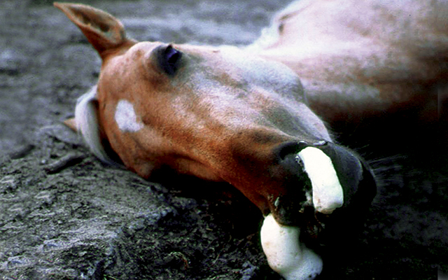
Pathogenesis
Upon the bite of the insect, the virus enters the blood and causes viraemia (for 30-90 days) and then localizes in the lungs, hearts and other organs
Clinical findings
IP 1-3 weeks.
There are three forms of the disease
Acute form (Pneumonic)/Dunkop horse sickness
Fever
Later on laboured breathing
Paroxysms of coughing
Profuse yellowish frothy nasal discharge
Profuse sweating
Depression
Weakness
Incoordination, recumbency and finally death
The course of the disease 4-5 days

Slide 4
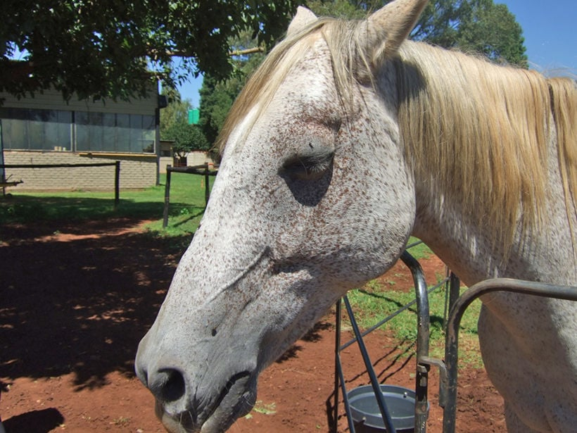
2. Subacute horse sickness (Cardiac form)/Dikkop horse sickness
High fever
OEDEMA of face especially the temporal fossa, eyelids, lip which may spread to the chest
Followed by petechial haemorrhages in the tongue, the oral mucosa will be blue in later stage
Paralysis of the oesophagus, inability to ingest feed and water and if ingested will be regurgitated back
Increase in the heart and respiratory rates
The course of the disease is 2 weeks
3. Mild form/Horse sickness fever
Fever (105⁰F)
Poor appetite
Slight conjunctivitis
moderate dyspnoea

Slide 5
Necropsy findings
In pneumonic form there will be hydrothorax, pulmonary oedema, ascites and yellow serous fluid in the upper respiratory tract
In the cardiac form marked hydropericardium, haemorrhages in the endocardium and oedema of the head are seen
Diagnosis
Provisional diagnosis based on clinicopathologic findings
Definitive diagnosis is made by agent identification to rule out differential diagnoses
EDTA-anticoagulated whole blood or fresh organs (spleen and lung especially) on ice are samples of choice
Confirmation best by OIE-validated real-time PCR assay
Treatment
Administer a course of antibiotic to overcome secondary bacterial infection
Make the horse to inhale the vapour of vicks vaporub or amruthaanjan in a bucketful of warm water

Slide 6
Prevention and Control
Control the vector by using ecto-parasiticides like malathione, flumetrin etc
Keep the horse in fly proof sheds
Vaccinate the horse either with the polyvalent live attenuated vaccines or killed vaccines
In India during the 1960 outbreak polyvalent live attenuated vaccine containing seven strains has been used with success

Slide 7
Q.1. Which of the is a exotic disease
Tuberculosis b) Filariosis c) AHS d) None of these
Q.2.Which of the following is vector-borne disease
AHS b) Blue tongue c) Dirofilariosis d) All of these
Q.3.AHS causes more severe infection in
Horse b) Mule c) Donkey d) All of these
Q.4.Which of the following disease comes under genus orbivirus
Blue tongue b) AHS c) Both d) None of these
Q.5.Cardiac form of horse sickness is also known as
Dikkop horse sickness b) Dunkop horse sickness
c) Mild form d) All of these

Slide 8
Q.6.Pneumonic form of horse sickness is also known as
Dikkop horse sickness b) Dunkop horse sickness
c) Mild form d) All of these
Q.7. Profuse yellow froathy nasal discharge is present in
Dikkop horse sickness b) Dunkop horse sickness
c) Mild form d) All of these
Q.7. Oedema of face specially temporal fossa, eye lids and lip present in
Dikkop horse sickness b) Dunkop horse sickness
c) Mild form d) All of these
Q.8. OIE validated confirmatory test for AHS
ELISA b) Real time PCR c) VNT d) All of these
Q.9. Which of the following species act as reservoir of AHS
Zebra b) Horse c) Donkey d) All of these

Slide 9
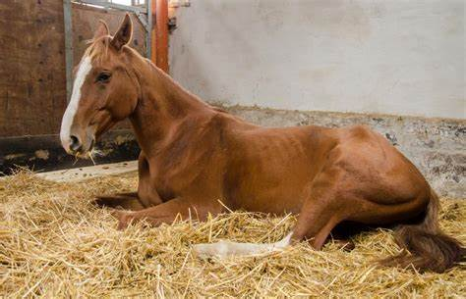
Equine Infectious Anaemia (EIA, Swamp fever)
It is a infectious disease of horse caused by a EIA virus (EIAV) and characterised by intermittent fever, anaemia, loss of weight, thrombocytopenia and progressive emaciation
Etiology
It belongs to genus- lentivirus, subfamily- lentriniviridae and family retroviridae
It is an RNA virus measuring about 80-120 nm with helical symmetry
The virus is inactivated by formalin, sodium hypochlorite, chlorhexidine and sodium hydroxide

Slide 10
Epidemiology
Incidence
Worldwide, horse of all age group are susceptible
Morbidity rate is 100% and the case mortality rate is 50% and above
Once the horse is infested it must be considered infected for life
Transmission
Biting flies like tabanus (horse fly) and also by mosquitoes
Contaminated syringes and needles and surgical equipments
Intra-uterine transmission also can occur
Semen of infected stallion and
Blood transfusion

Slide 11
Pathogenesis
The virus enters the blood by bite of the flies and cause viraemia and then localizes in various organs like spleen, liver, kidney and lymph nodes and also in the epithelium of the arteries
The disease is characterised by anaemia which may be due to
The virus will bind to the surface of RBC through the nuraminidase and the antibody will bind to the antigen and forms a antigen- antibody complex This complex along with the RBC will be phagocytosed by the macrophages
Also such complexes with complement can result in haemolytic anaemia which can be intravascular and extravascular
Anaemia due to haemolysis is exaggerated by depression of bone marrow activity and erythropoiesis
The life span of RBCs will be reduced from 120-150 day to 28-87 days

Slide 12
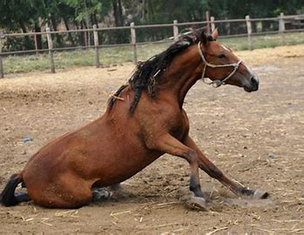
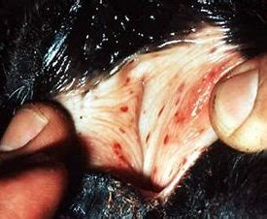
Clinical findings
IP is 2-4 weeks
Usually disease occurs in acute form
Intermittent fever (102-106⁰F) and this fluctuation can be within a day or between hours
Anorexia, depression weakness, jaundice and edema of ventral aspect of the abdomen, prepuce and legs
Petechial haemorrhages on oral mucosa and tongue and conjunctiva Increase in heart and respiratory rates
The course of disease is 10-14 days
In the chronic form, the above process is repeated i.e. anaemia, fever, anorexia etc., leading the marked loss of body weight, weakness, pale mucous membrane, emaciation and finally death
Relapses continue to occur at intervals about 2 weeks but usually cease after a year

Slide 13
Necropsy findings
Petechia or echymotic haemorrhages on serosa, splenomegaly, accumulation of fluid in cavities, pale mucous membrane and pale muscles
Diagnosis
By signs: Fluctuating fever, anaemia and progressive emaciation in a horse which is not responding to treatment then suspect for EIA
Siderocyte counts: Siderocyte is leukocyte containing non-haemoglobin iron/haemosiderin and upon staining such leukocytes is significant and is attributed to EIA
Serological Tests: AGID and Enzyme linked ELISA commonly used for detection
AGID is commonly known as Coggins test is very reliable test for the diagnosis of EIA by detecting antibodies against EIA virus

Slide 14
Differential Diagnosis
Equine babesiosis
Ehrlichiosis
Equine strongyles
Leptospirosis
Purpuria haemorrhagica
Equine strangles
Equine viral rhinopneumonitis
Equine viral arteritis
Treatment
No treatment available, if coggins positive better to euthanize the horse
Blood transfusion and haematinics can be used
Prevention and Control
Thoroughly sterilised the surgical equipments
Control of vectors by using ectoparasiticides
Live attenuated vaccine (virus passaged in horse leukocytes tissue culture)
Best method is to identify the infected animals and euthanize them

Slide 15
Multiple choice questions
Q.1. EIAV belonged to
Flaviviridae b) Retroviridae c) Paramyxoviridae
Q.2.EIA is characterized by
Intermittent fever b) Thrombocytopenia c) Both
Q.3. Which of the following causes EIA
Mosquito b) Tabanus fly c) Contaminated syringe d) All of these
Q.4.Petechial haemorrhage and intermittent fever is characteristic by
AHS b) EIA c) Both d) None of these
Q.5.Coggin test is used for the detection of
a) AHS b) EIA c) EVA d) All of these
Q.6. EIA is characterized by the presence of
a) Siderocytes b) Heinz bodies c) Poikiocytosis d) All of these

Slide 16


