Slide 1
Babesiosis (Piroplasmosis/Red water fever/Cattle tick fever/Texas fever)
Department of Veterinary Medicine
Bihar Veterinary College, BASU, Patna
Dr Mritunjay Kumar
Associate Professor
VMD, BVC, BASU, Patna

Slide 2
Babesiosis is a haemoprotozoan disease of a wide range of domestic and wild animals, caused by various species of intra-erythrocytic Babesia spp., transmitted by ticks and characterized by high fever, haemolytic anaemia, jaundice and haemoglobinuria
Etiology
Cattle
B bigemina and B bovis—are widespread in tropical and subtropical areas
B. bovis is small piroplasm, with the parasites in paired form at an obtuse angle to each other and measuring ~1–1.5 × 0.5–1 µm.
B bigemina is larger piroplasm (3–3.5 × 1–1.5 µm), with paired parasites at an acute angle to each other. Single forms of both parasites are also commonly seen.
Babesia divergens (causes pipestem diarrhea) transmitted by Ixodes Ricinus Babesia argentina
Babesia major

Slide 3
Sheep and goats: B. motasi, B. ovis, B. foliate
Swine: B. trautmanni, B. peroncitoi
Horse, Donkey, Mule:
B. caballis (T. caballis), B. equi (T. equi, usually four in number, arranged like cross also called maltese appearance)
Dogs:
Large form (B. canis, B. vogeli,B. rossi)
Small form (B. gibsoni, B. vulpes, B. conrade)
Cats: B. felis
Human: Babesia microti, B. bigemia, B. divergens

Slide 4
Epidemiology
Incidence:
worldwide and all the species of domestic animals including man are susceptible
Cattle of 6-12 months of age group are highly susceptible
Severe form in puppies when compared to adults
Causing severe economic loss and common in our country
In endemic areas, three features are important in determining the risk of clinical disease:
1) Calves have a degree of immunity (related both to colostral-derived antibodies and to age-specific factors) that persists for 6 month
2) Animals that recover from Babesia infections are generally immune for their commercial life (4 yr), and

Slide 5
3) The susceptibility of cattle breeds to ticks and Babesia infections varies
eg, Bos indicus cattle tend to be more resistant to ticks and the effects of B bovis and B bigemina infection than Bos taurus–derived breeds
At high levels of tick transmission, virtually all calves become infected with Babesia by 6 month of age with few or no clinical signs, and subsequently become immune
Transmission
The main vectors of B. bigemina and B. bovis are 1-host Rhipicephalus (Boophilus) spp ticks, in which transmission occurs trans-ovarially and transtadially
Transmission to the host occurs when larvae (in the case of B bovis) or nymphs and adults (in the case of B bigemina) feed
Blood inoculation
By intra-uterine

Slide 6
Life cycle
Sexual cycle (definitive tick host) Tick ingests Babesia spp. gametocytes (IH blood)
Gametocytes differentiate into gametes
fuse to form zygote
Ookinetes
kinetes enter into the salivary glands
sporozoites (Infective stage)
A tick transmits sporozoites while feeding on vertebrate host
Transovarial transmission in a tick can also occur
Asexual cycle (intermediate host)
Sporozoites invade erythrocytes and undergo asexual reproduction
Trophozoites
Merozoites (spreads throughout the blood)
Trophozoite male and female gametocytes (Some of the merozoites produce )
Gametocytes in the red blood cells (intermediate host's)
Tick Gut

Slide 7
Pathogenesis
Anaemia
Lysis of RBCs (multiplication of pyriform bodies Decreased production of cortisol from
of babesia by binary fission inside the RBCs cholesterol by the action of progestron due to damage of liver in babesiosis
less formation cortisol ( hypocortisolaemia)
RBCs becoming more fragile ending in lysis of RBCS
Increased prostaglandin level -Increases the vascular permeability; inhibit the most immune response and initiation of the systemic platelet aggregation vascular stasis and subsequent hypoxia of parenchymatous organs resulting in clinical manifestation of disease
Severe haemolysis haemoglobinaemia haemoglobinuria
Haemoglobin
Haem and globin
Iron and biliverdin
Bilirubin (Jaundice)

Slide 8
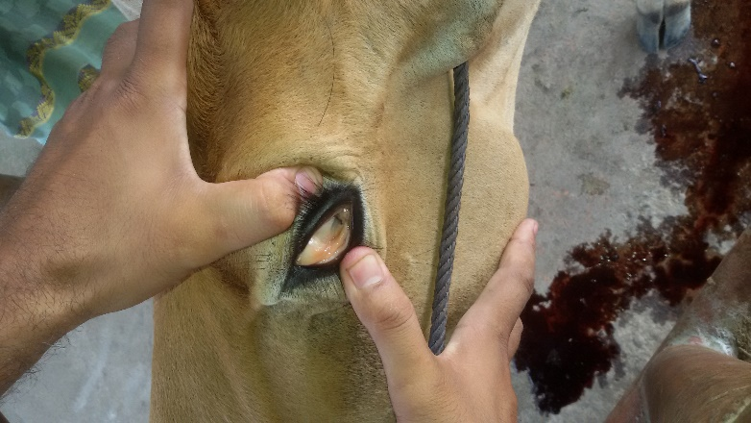
Clinical signs
IP-1 to 4 weeks
B bovis is a much more virulent organism than B bigemina
B bigemina: pathogenic effects relate more directly to erythrocyte destruction
B bovis: hypotensive shock syndrome, combined with generalized non-specific inflammation, coagulation disturbances, and erythrocytic stasis in capillaries, contribute to the pathogenesis
The acute disease generally runs a course of 1 week
The first sign is fever (frequently ≥106°F [41°C]), which persists throughout, and is accompanied later by inappetence, increased respiratory rate, muscle tremors, anemia, jaundice, and weight loss; hemoglobinemia and hemoglobinuria
CNS involvement due to adhesion of parasitized erythrocytes in brain capillaries can occur with B bovis infections (Cerebral Babesiosis)

Slide 9
Constipation or diarrhea may or may not be present
Late-term pregnant cows may abort, and temporary infertility due to transient fever may be seen in bulls
Animals that recover from the acute disease remain infected for a number of years with B. bovis and for a few months in the case of B bigemina
No clinical signs are apparent during this carrier state
Dog: Lack of energy Lack of appetite Weight loss Fever Swollen abdomen Unusual urine color, unusual stool color, yellow or orange-tinged skin Pale Gums, haemoglobinuria (B.canis) and hepato and splenomegaly
Horse and Donkey:
Piroplasmosis in horse is a fatal disease with variable clinical sigs of fever, anaemia, haemoglobinuria, colic and jaundice
Intra-vascular and extra-vascular haemolysis along with erythrocytic phagocytosis contributes in anaemia, bilirubinuria and haemoglobinuria.

Slide 10
Necropsy findings
Lesions (particularly with B bovis) include an enlarged and friable spleen; a swollen liver with an enlarged gallbladder containing thick granular bile; congested, dark-colored kidneys; and generalized anemia and jaundice
Most clinical cases of B bigemina have hemoglobinuria, but this is not invariably the case with B bovis
Other organs, including the brain and heart, may show congestion or petechiae

Slide 11
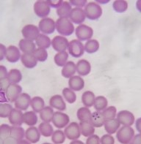
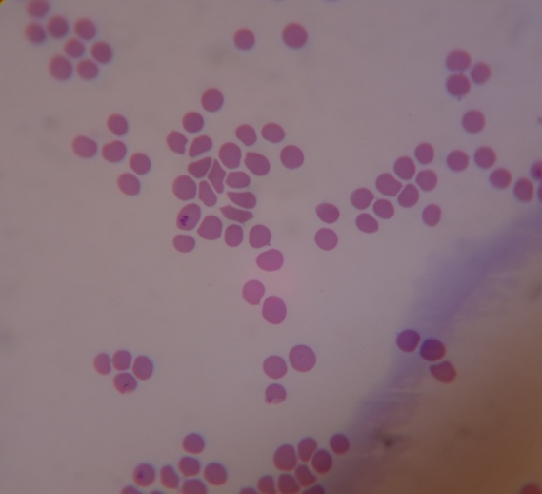
Diagnosis
Based on clinical signs of high fever, anaemia and haemoglobinuria.
By blood examination
Giemsa or Leishman or Wright staining: Pyriform or pear shaped organisms (merozoites) inside the RBC under oil immersion (100X)
Wet mount method: Place a drop of blood on slide and mix with drop of normal saline and observe under the low power.
Haematology: PCV, TEC, Hb are reduced
Serological tests: IFAT, ELISA, PCR, CFT etc
B. equi (Maltese appearance)
B. bigemina (acute angle)
B. gibsoni (ring form)

Slide 12
Differential Diagnosis
1) Anaplasmosis: Anaemia, No haemoglobinuria, blood examination spherical body either at the center or periphery of RBC
2) Theileriosis: Anaemia, high fever, enlargement of peripheral lymph nodes, no haemoglobinuria and blood smear examination reveals rod,comma and oval bodies in RBC
3) Leptospirosis: Fever, haemolytic anaemia, no pyriforma bodies in blood smear
4) Post parturient haemoglobinuria: After parturition, anaemia, haemoglobinuria and due tophosphorous deficiency
5) Bacillary haemoglobinuria: Fever, haemoglobinuria, caused by B.haemolyticum
6) Coccidiosis: Seen in young animal having diarrhea, dysentery, anaemia
Faecal examinationfor the presence of oocyst

Slide 13
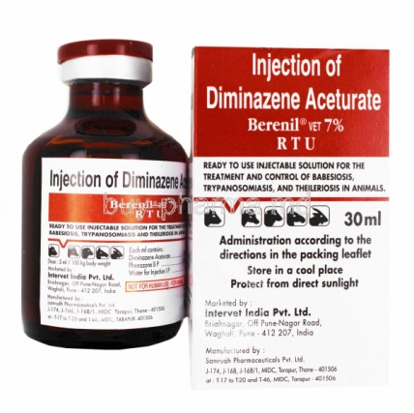
Treatment and Control
Earlier trypan blue 1% (100ml for cattle), 5% acriflavine (20 ml for cattle)
Presently- Diminazene aceturate and imidocarb dipropionate.
Cattle
Diminazene aceturate @ 3.5 mg/kg IM single dose, may be repeated after 48 hours
Imidocarb dipropionate @ 1.2 mg/kg SC or IM for curative and 3 mg/kg provides protection from babesiosis for 4 weeks
It eliminate B bovis and B bigemina from carrier animals
Dog and cat
Diminazine aceturate is given @ 3.5-5 mg/kg b wt im or s/c and repeated at 14 days intervals (B. canis)
Imidocarb dipropionate @ 6.6 mg/kg SC or IM, repeat at 14 days intervals
Clindamicin @ 15 mg/kg bid b. wt, Doxycycline @ 10 mg/kg OD b wt, and Metronidazole @ 10-15 mg/kg b wt for 7-10 days (B. gibsoni)
Atovaquone @ 13.3 mg/kg b wt thrice daily (15 mg/kg thrice-cat) and Azithromycin@ 10 mg/kg b wt -10days (B. gibsoni)

Slide 14
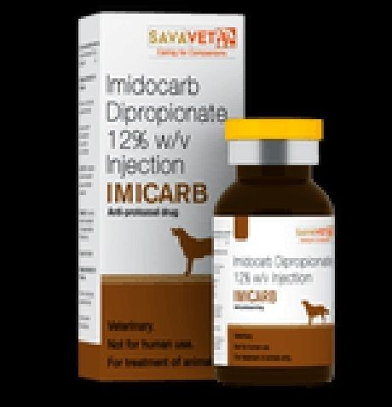
Horse
Diminazene aceturate @ 3.5 mg/kg IM single dose, may be repeated after 48 hours
Imidocarb dipropionate @ 5mg/kg SC or IM
Cholinergic effect of Imidocarb
Salivation, lacrimation, tachypnea, tachycardia, and pain at the injection site, as a result of massive acetylcholine accumulation
Anti-dote: Atropine sulphate (0.045 mg/kg s/c or IM)
Supportive treatment is advisable, particularly in valuable animals, and may include the use of anti-inflammatory drugs, corticosteroids, and fluid therapy
Blood transfusions may be life-saving in very anemic animals
Vaccination using live, attenuated strains of the parasites has been used successfully
Vector Control: Acaricides like deltamethrin (12.5%), Flumethrin (1%), Amitraz (12.5%), Fipronil etc may be used for tick control
Zoonotic Risk
A number of cases of human babesiosis have been reported
The rodent parasite B microti and the cattle parasite B divergens are the most commonly implicated species in North America and Europe, respectively

Slide 15
Q. Multiple choice questions
Cerebral babesiosis in cattle is caused by
B. bovis b) B. bigemmina c) B. divergens d) None of these
2. Pipe stem diarrhea is caused by
B. bovis b) B. bigemmina c) B. divergens d) None of these
3. Maltese appearance in RBC in babesiosis in horse indicate
B. caballis b) B. equi c) Both d) None of these
4. Small form of babesiosis in dog are
a) B. gibsoni b) B. vulpes c)B. conrade d) All of these
5. Cholinergic effect is associated with
a) Diminazine b) Imidocarb c) Clindamicin d) None

Slide 16
Thanks

