Slide 1
Equine Viral Rhinopneumonitis Foul nasal discharge, Herpesvirus-4, Rhino, Snots
Dr Mritunjay Kumar
Associate Professor
VMD, BVC, BASU, Patna

Slide 2
It is a herpes virus infection of equine and characterized by respiratory tract infection and abortion
Etiology
Equine herpesvirus type 1 (EHV-1) and equine herpesvirus type 4 (EHV-4) of genus varicellovirus which infect the respiratory tract, the clinical outcome of which can vary in severity from sub-clinical to severe respiratory disease
Most of these outbreaks are caused by strains of EHV-4
Epidemiology
It mainly affects the horse but mule and donkey may also be affected
Both EHV-1 and EHV-4 spread primarily by the respiratory route, by direct and indirect (fomite) contact with nasal secretions (Inhalation and Ingestion)
In the case of EHV-1 and infrequently EHV-4, by contact with aborted fetuses, placental and fetal fluids
Most horses carry the EHV-1 and EHV-4 viruses in an inactive state
The infection remains dormant (latent) for most of the horse’s life, although stress or immune system problems may result in “-reawakening” of disease and shedding of infectious virus
Infection of pregnant mares with EHV-1 may result in abortion 2 to 12 weeks after infection

Slide 3
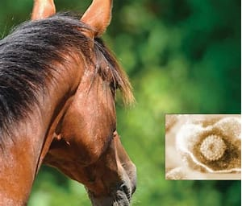
Pathogenesis
Through inhalation/ingestion disease-carrying material (fomites) attaches itself to cell receptors in the horse's respiratory system and enters the cell
New viral particles are released into the airway and infect other cells or become aerosolized resulting in protein-rich fluids pouring into the horse's airways
The copious nasal discharge, often referred to as 'snots’ can accumulates, secondary bacterial infections may develop
This excessive discharge or buildup of mucus in the throat and nose leads to congestion, fever, coughing, and mild to severe paralysis of the hind quarters
Mares may abort after three to twelve weeks of exposure, most commonly in the eighth to eleventh month of gestation

Slide 4
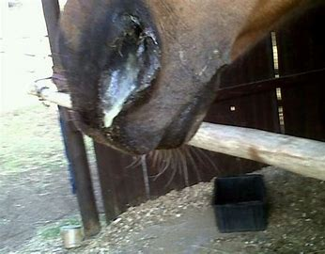
Clinical Signs
Listlessness and lack of appetite for food and water
Flu-like symptoms
Fever
Dry hacking cough
Nasal discharge
Swollen lymph nodes
Weakness and paralysis of hind limbs
Abortion
If nervous system disease develops, signs may vary from mild incoordination to paralysis of the hind end (forcing the horse to be unable to rise or stand)
Loss of bladder and tail function, and loss of sensation to the skin around the rectal, genital, and groin areas
In rare cases, the paralysis can progress to all 4 legs (quadriplegia) and death

Slide 5
Diagnosis
Diagnosing equine viral rhinopneumonitis is difficult because symptoms cannot be differentiated from equine viral arteritis and equine influenza
Using clinical signs may be the first step in making a diagnosis, but it is necessary to confirm the disease through the use of virus isolation and serology testing in a laboratory
Treatment
No specific treatment is available

Slide 6
Prevention & Control
Isolating infected horses and initiating good sanitary and hygiene management including disinfecting stalls, equipment, and surfaces
Intensive nursing care to avoid pulmonary congestion, pneumonia, ruptured bladder or bowel problems
Effective vaccines (Inactivated vaccines & Modified live vaccine) are available and horses should be vaccinated several times a year to ensure immunity
Inactivated vaccine- 4 to 6 months of age then at 5 to 7 months of age then 6 to 8 months of age and then at every 3 months intervals
Modified live vaccine: At 3 months of age or older as an aid in preventing respiratory disease caused by equine herpesvirus type 1 (EHV-1)
The immunity induced by vaccination against EHV-1 and EHV-4 generally lasts for only 2 to 4 months, hence, depending on the vaccine used, a second and third dose may be given
Available vaccines do not cover all strains to which horses can be exposed
Periodic booster vaccinations may be given until the horse reaches maturity
Vaccination programs against EHV-1 should include all horses on the premises

Slide 7
Multiple choice questions
Q.1. Equine Rhinopneumonitis is caused by
EHV-1 b) EHV-2 c) EHV-4 d) a & c
Q.2.Most of the outbreak of Equine rhinopneumonitis is caused by
a)EHV-1 b) EHV-2 c) EHV-4 d) a & c
Q.3.Abortion in pregnant mare is mostly caused by
a)EHV-1 b) EHV-2 c) EHV-4 d) a & c
Q.4. Equine rhinopneumonitis is characterized by
Flu like signs b) Abortion c) Paralysis d) All of these
Q.5. Frequent vaccination is needed in which disease
Equine rhinopneumonitis b) EIA c) ASF d) All of these
Q.6. Latent infection is present in
a) Equine rhinopneumonitis b) EVI c) ASF d) All of these

