Slide 1


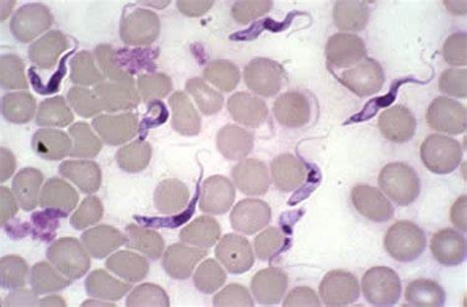
Trypanosomiasis (Surra, Tibersa)
Department of Veterinary Medicine
Bihar Veterinary College, BASU, Patna
Dr Mritunjay Kumar
Associate Professor
VMD, BVC, BASU, Patna

Slide 2
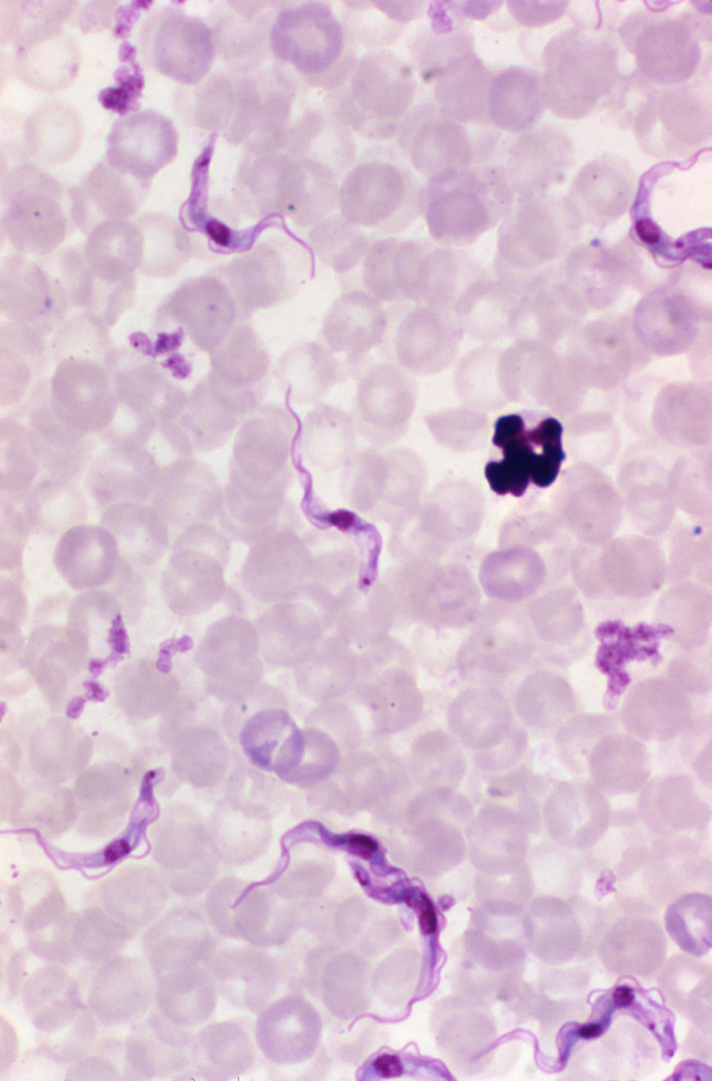
Infectious disease characterized by intermittent fever, progressive anaemia, oedema of dependent parts and loss of conditionfollowed by terminal nervous signs
Aetiology
Surra is caused by Trypanosoma evansi
Morphologically, T. evansi are 15-34µm in length, 1.5-2.5 µm in breath and pleomorphic
The parasites occurs in vertebrates mainly in the blood and tissue fluids as intercellular parasites
Epidemiology
Surra was first reported by Sir Griffith Envas in 1818 in India in the blood of horses and camels in the area known as Dera Ismail Khan (Pakistan)
Hot or warm and temperate climates and widely prevalent in Africa, Mediterranean, Arabian, Middle Eastern, South Asia and far eastern countries

Slide 3
Camels, horses, donkeys, mules, cattle, buffaloes, elephants, pigs, dogs, cats, sheep, goats and a wide variety of wild animals are usually affected
The maximum cases of trypanosomiasis are observed in rainy season and post monsoon months when the vector density is quit high through latent cases are encountered throughout the year
Mechanical transmission-Horse flies of genus Tabanus, Stomoxys, Haematopota and Lyperosia
The interrupted feeding behavior of these insects helps in carrying the trypanosomes infected blood between members of herds of livestock
Indian crow which pecks at the animal wounds can also transmit the infection
At the time of vaccination during outbreaks when the sterilization precautions are not adequately exercised.
Oral penetration by T. evansi is also suggested as one of the mode of transmission

Slide 4
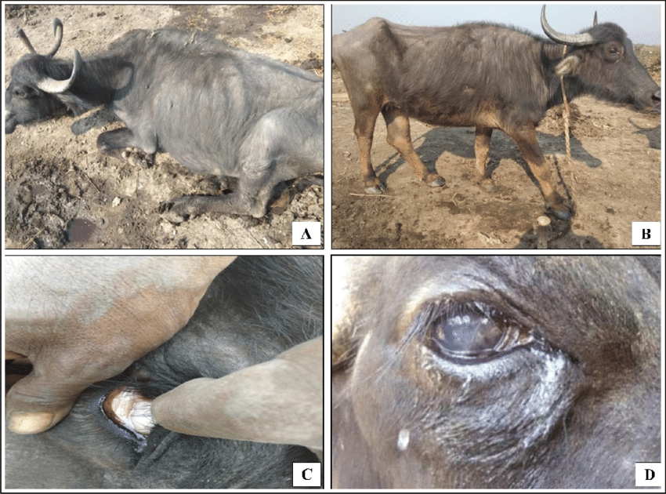
Clinical findings
Cattle and Buffaloes: The incubation period is 6 to 14 days and course varies from symptomless carrier to a per-acute infection
The symptoms vary in per-acute, acute and chronic cases.
Peracute form: Animals die within 2 to 3 hr of showing nervous symptoms like convulsion
Acute form: Animals appear dull and sleepy with staggering gait, eyes staring and wide open, with rise in body temp. to 105⁰F
Difficult breathing with effort and noise, nervous excitement and animals strikes or beats hard against the wall and mangers
Apparent blindness, circling movements, stumping of feet, bellowing, frequent micturation, profuse salivation, twitching of muscles and shivering of body followed by coma, collapse and ultimately death within 6 to 12 hours

Slide 5
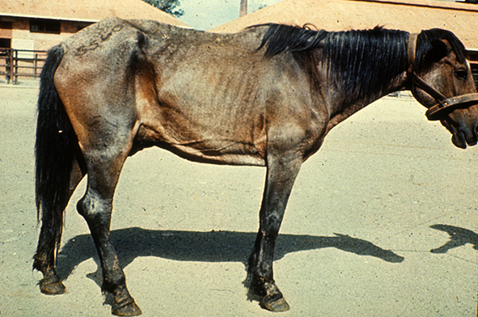
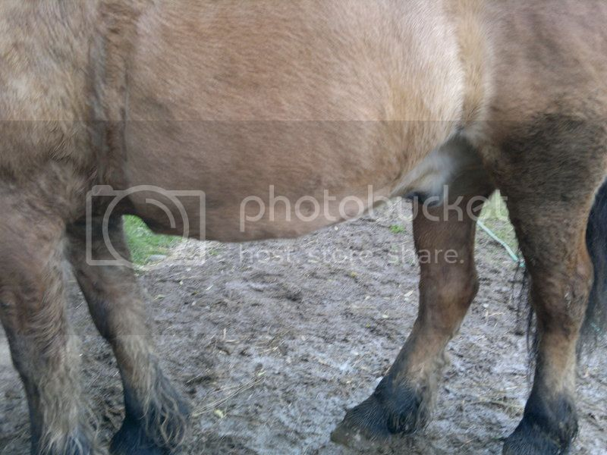
Sub Acute and Chronic form:
Animal appears dull and sleepy and there is bilateral lacrimation.
Progressive emaciation, rapid pulse, intermittent fever, progressive anaemia, oedema of legs, diarrhea, loss of body condition, nasal and ocular discharge and death from exhaustion
Pregnant animal may abort
The disease has long course of 16-64 days
Cattle and buffaloes act as carrier state was reported upto 190 days in buffalo calves
Equines, mules and donkey:
Intermittent fever, progressive weakness, anaemia, emaciation and odema of dependent parts of the body Urticarial plaques may appear in neck and flank
Loss of condition despite of good appetite, difficulty in walking, lacrimation, conjunctivitis, hypertrophy of superficial lymph nodes and ascites
The nervous signs like paraplegia, paralysis and convulsion occur only in terminal stages of disease
Camel: Surra usually occurs in acute, sub-acute and chronic form.

Slide 6
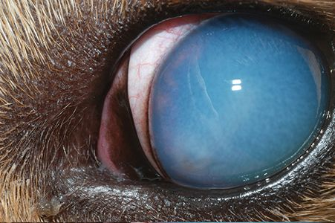
Acute form:
It occurs just after monsoon season and animal suffers from high temperature (3-4⁰F) above normal and pachy haemorrhages of mucous membrane
There is intense anaemia, drooping hump and affected animals unable to walk long distance
Oedema may develop in the legs, brisket, under the belly and eyelids
The is sudden death and the rate of mortality may reach 50% or above
Chronic form:
It is associated with progressive anaemia, emaciation, intermittent fever, alopecia, oedema of dependent parts and abortion in pregnant animals
The name tribersa in India indicated the duration of disease as 3 years
Dog: Fever, anorexia, pale conjunctiva, oedema of head and thorax, corneal opacity or even blindness
Cat : Chronic cases reported and these may some times be fatal

Slide 7
Pathogenesis
The trypanosoma is inoculated into the host via contaminated mouth parts of biting flies
The parasites multiply in blood and body fluids including the cerebrospinal fluid and cause inflammatory changes and anaemia
It causes severe organ damage particularly in horses, camel, cattle, buffaloes, elephant, dogs, small ruminant and occasionally in pigs
Trypanosoma can also pass through the placenta - abortion and pre-mature calves birth in some cows
A cerebral form of disease can occurs sometimes even after successful treatment because trypanosomes are protected through commonly used chemotherapeutics agent in brain and cerebrospinal fluid by the blood-brain-barrier
Such trypanosomes are believed to be source of some relapsed infections

Slide 8
Clinical pathology
Microcytic hypochromic anaemia characterized by reduced Hb, PCV and TEC , hypoglycaemia, hyperkalemia
Necropsy findings
The carcass is emaciated, pale and may be icteric but there are no pathogonomic gross and microscopic lesions like spenomegaly, enlargement of lymph nodes and kidneys, leukocytic infiltration of liver parenchyma and petechia haemorrhages
Diagnosis
Prevalence of biting flies and symptoms like progressive emaciation, anaemia, oedema and paleness of mucous membrane
Microscopic examination: Blood collect at height of temperature are positive for trypanosomiasis
Dark field/phase contrast microscopy: Motile trypanosome may be observed
Laboratory animal inoculation: The suspected blood or lymph nodes aspirate or CSF can be inoculated in laboratory animals like rat, white mice, guinea pigs, rabbits and dogs by intra-peritoneal or subcutaneous route
Parasitaemia-4-5 days post inoculation while in dogs it occurs after 7 days

Slide 9
Chemical test: Less reliable than animal inoculation test
Mercuric chloride test: Reliable for detection of surra in camel. A drop of test serum is added to 1 ml 1:20,000 solution of mercuric chloride. In positive case (after 2-3 weeks generally) white precipitate is produced.
Stilbamidine test: Reliable test for detecting surra in bovines. About 0.5-2.5 ml of freshly prepared 10% of stilbamidine is taken in agglutination tube and one drop of suspected serum (inactivated at 56⁰C) is added. A positive case shows coagulation which begins to settle down in 30 sec and dissolves in 5-10 min.
Formalin gel tube test: Reliable in camel and equines. 2-4 drops of commercial formaldehyde solution is added to 1 ml of suspected serum and tube is shaken and allowed to stand. In positive case gel formation occurs within 2-4 hours.
Thymol turbidity test: It is used in camel and one drop of suspected serum is added to 1ml of aquous thymol solution having a concentration of 1:100 to 1:2000. In positive cases white turbidity appears within few minutes.
Antigen detection through ELISA is more reliable and can detect trypanosomal concentration of protein upto 1.5µg/ml. Other tests like indirect fluorescent antibody, gel diffusion, card agglutination etc are helpful in confirming the disease.

Slide 10
Differential Diagnosis
Nervous form may differentiated from Polioencephalomlacia and nervous form of ketosis
Babesiosis, Ehrlichiosis, Theileriosis, Parasitic infestation and hypoproteinaemai
Treatment: Commonly used drugs for trypanosoma
1. Quinapyramine sulfate (3-5mg/kg s/c)
Horses, camels, pigs, dogs
T. vivax, congolense, brucei, evansi, equiperdum, simiae
Curative and Prophylactic
2. Diminazene aceturate (3.5 to 7mg/kg im)
Cattle
T. vivax, congolense, brucei
Curative
Curative

Slide 11
3. Homidium bromide(1mg/kgim)
Equids
T. vivax
Curative, some prophylactic activity
4. Isometamidium chloride (0.25-1mg/kg, iv or deep im)
Cattle
T. vivax, T. congolense
Curative and prophylactic
5.Suramin (7-10mg/kg iv)
Horses, camels, dogs
T. brucei, T. evansi
Curative, some prophylactic activity

Slide 12
6. Melarsomine dichlorhydrate (0.25-0.5 mg
Camels
T. evansi
Curative
7.Quinapyramine dimethylsulfate
Horses, camels, pigs, dogs
T. vivax, T. congolense, T. brucei, T. evansi, T. equiperdum, T. simiae
Prophylactic
Supportive therapy
Symptomatic treatment for anaemia, oedema, pyrexia etc.

Slide 13
Prevention and Control:
Vector flies can be partially controlled - Spraying and dipping of animals, aerial and ground spraying of insecticides on fly-breeding areas, us of insecticide-impregnated screens and targets, bush clearing, and other habitat removal methods
Animals can be given drugs prophylactically in areas with a high population of trypanosome-infected tsetse
Monitoring of drug resistance by frequent blood examinations for trypanosomes in treated animals.
Several breeds of cattle and water buffalo have been identified that have innate resistance to trypanosomiasis and could play a valuable role in reducing the impact of the disease in these areas
Control is ideally achieved by combining methods to reduce the fly challenge and by enhancing host resistance with prophylactic drugs.

Slide 14
Dourine
Dourine is a chronic venereal disease of horses that is transmitted during coitus and caused by T equiperdum
The disease is recognized on the Mediterranean coast of Africa and in the Middle East, southern Africa, and South America
Clinical Signs
It may develop over weeks or months
Early signs include mucopurulent discharge from the urethra in stallions and from the vagina in mares, followed by gross edema of the genitalia
Later, characteristic plaques 2–10 cm in diameter appear on the skin, and the horse becomes progressively emaciated
Mortality in untreated cases is 50%–70%.
Infected horses can be detected with the complement fixation test but only in areas where T evansi or T brucei are not found because they have common antigens. An ELISA test may become available for diagnosis.

Slide 15
Chagas’ Disease
Chagas' disease, or American trypanosomiasis, is a zoonotic, vector borne disease transmitted by triatomine bugs and caused by T cruzi
All mammals are considered susceptible to infection, with infection demonstrated in >100 mammalian species. Avian species are not susceptible
The disease is best recognized in dogs and people, with dogs serving as a major domestic reservoir
Domestic pigs and cats can also be infected, but their role as reservoirs for human infection is limited
Wildlife reservoirs include opossums, armadillos, raccoons, woodrats, and nonhuman primates
Tsetse-transmitted Trypanosomiasis
This group of diseases caused by protozoa of the genus Trypanosoma affects all domesticated animals
The major veterinary species are T congolense, T vivax, T brucei brucei, and T simiae. T brucei rhodesiense and T brucei gambiense are zoonotic, with people as the predominant host

Slide 16
Q. Choose the most appropriate answer
1. Which species of Trypanosoma is primarily responsible for Nagana in cattle?
A) Trypanosoma brucei rhodesiense
B) Trypanosoma cruzi
C) Trypanosoma evansi
D) Trypanosoma brucei brucei
2.What is the main vector responsible for the transmission of Trypanosomiasis?
A) Ticks
B) Mosquitoes
C) Tsetse flies
D) Sandflies
3. Which of the following animals is NOT commonly affected by trypanosomiasis?
A) Cattle
B) Dogs
C) Cats
D) Horses
4. In which continent is trypanosomiasis most prevalent in livestock?
A) Asia
B) North America
C) Europe
D) Africa
5. What role does the environment play in the transmission of trypanosomiasis?
A) It has no effect.
B) Deforestation decreases the risk.
C) Wet, warm climates promote tsetse fly populations.
D) Cold climates prevent transmission

Slide 17
6. Which of the following is a potential preventive measure against trypanosomiasis?
A) Vaccination
B) Vector control
C) Dietary supplements
D) Antibiotic administration
7.What type of trypanosomiasis is caused by Trypanosoma evansi?
A) African sleeping sickness
B) Nagana
C) Surra
D) Chagas disease
8.Which age group of animals is typically more susceptible to trypanosomiasis?
A) Neonates
B) Adult animals
C) Elderly animals
D) All ages are equally affected
9.What is the primary method of transmission for Trypanosoma cruzi?
A) Tsetse fly bite
B) Contaminated food or water
C) Blood transfusion
D) Kissing bug bite
10.Which of the following is a sign of chronic trypanosomiasis in animals?
A) Sudden death
B) Severe fever
C) Weight loss and lethargy
D) Diarrhea

Slide 18
11. Sir Griffith Envas first reported
Babesiois
Ehrlichiosis
Surra
All of these
12. Surra is also known as
Tribarsa
Trypanosomiasis
Both
None
13. Mercuric chloride test is used for the detection of surrra in
Bovine
Buffaloes
Camel
All of these
14. Stilbamide test is used for the detection of surra in
Bovine
Buffaloes
Camel
All of these
15. Trypanocide with both curative and prophylactic effects
Quinapyramide sulphate
Diminazine aceturate
Melorsamine
All of these

Slide 19
Thanks

