Slide 1
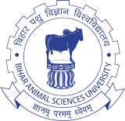

Aims and scope of Veterinary Public Health
&
Role of veterinarians in public health

Slide 2
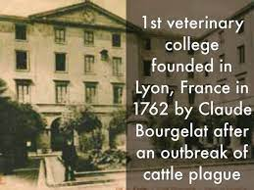
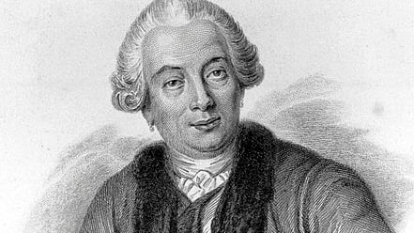
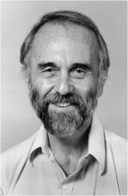
INTRODUCTION
The relationship between animal health and human health has been recognized since ancient time
First Veterinary School…..Lyon France
Rudolph Virchow (1821–1902)
    “Between animal and human medicine there is no dividing line –nor should there be.”
Schwabe has dealt with the philosophy of “One Medicine”
Father of Veterinary Epidemiology
Concept of Veterinary Public Health Evolved at CDC in late 1940s
Notes:
Schwabe has dealt with the philosophy of One Health

Slide 3
WHO defines HEALTH as "Health is the state of complete physical, mental and social well-being and not merely the absence of disease or infirmity.“
Public health: The science and art of preventing disease, prolonging life, and promoting health and efficiency through organized community efforts (WHO, 1952)
In 1975, the FAO/WHO joint technical report defined Public Health as:
“VETERINARY PUBLIC HEALTH is a component of public health activities devoted to the application of professional veterinary skills, knowledge and resources for the protection and improvement of human health".

Slide 4
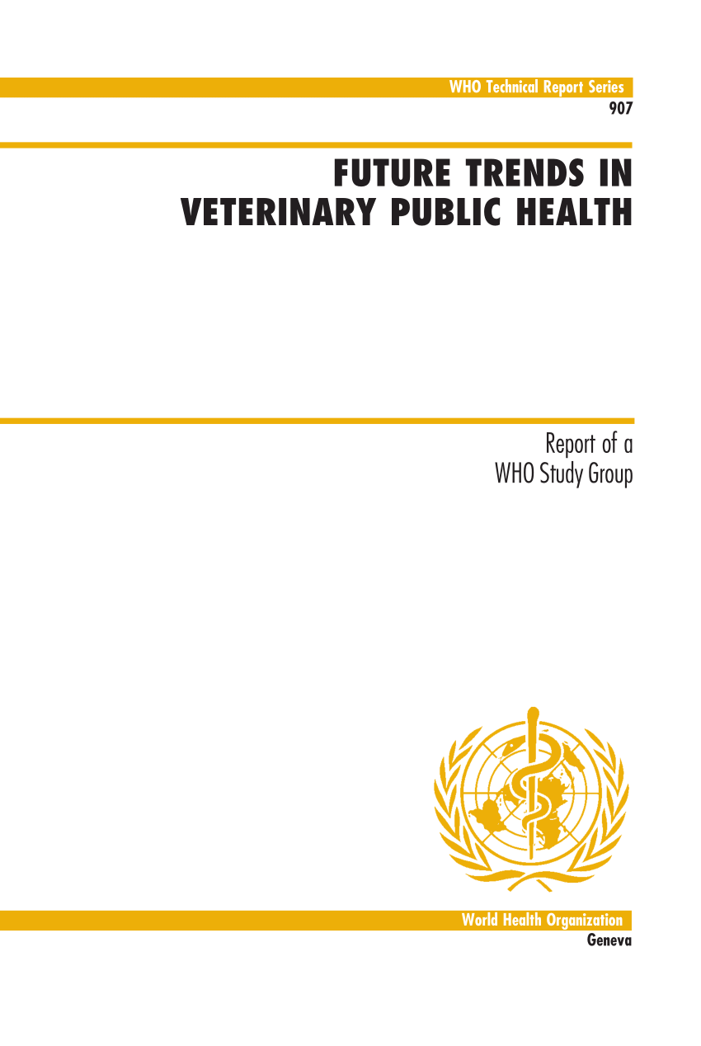
The currently accepted definition of VPH endorsed by the WHO, FAO and OIE was the output of a 1999 WHO consultation on “Future trends in veterinary public health”:
“Veterinary Public Health is the sum total of all contributions to the physical, mental and social well being of humans through an understanding and application of veterinary science".
It recognizes that the animal itself, animal health and veterinary science are related to the physical, mental and social well-being of humans and the contribution of veterinary public health in this field is considered fundamental.

Slide 5
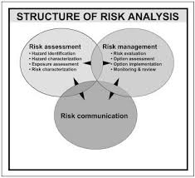
Components of Veterinary Public Health
The 1999 WHO report considered veterinary science as a core discipline that performs essential public health functions.
The report also indicated that veterinary science emphasizes preventive, economic and population aspects of animal health and production, as they relate to human health and well-being.
The main components of VPH can be :
• Zoonosis
• Food Hygiene
• Environmental Hygiene
    Biomedical research
    Epidemiology and population medicine
In order to contribute effectively to activities covered by VPH the veterinarian will need to draw on the expertise, knowledge and resources gained from the five components

Slide 6
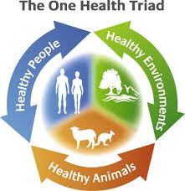
Aims and Scope of Veterinary Public Health/ Role of veterinarian in Public Health
Traditionally VPH activity was focused primarily on zoonoses and food hygiene, which in spite of all the changes and new developments in the last decade remain the core activities.
With the advent of the “One Health” programmes and the all embracing FAO/OIE/WHO definition these activities have expanded although they may vary from country to country
AIMS & SCOPE:
Zoonoses prevention and control
Food safety and increasingly food security
Environment protection
Biomedical research
Liaison
Other areas
The scope of VPH is clearly multi-disciplinary, involving veterinarians, health professionals and scientists as well as paraprofessionals who treat, control or prevent diseases of animal origin

Slide 7
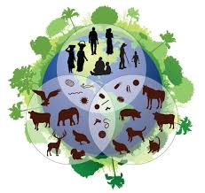
1. Zoonoses prevention and control
• Diagnosis
• Surveillance
• Early Identification of New and Emerging Infections
• Risk Analysis
• Epidemiology
• Prevention
• Control and elimination of the zoonotic agents
• All aspects of occupational health.
Any disease and/or infection which is naturally transmissible between vertebrate animals and man" is classified as a zoonosis (WHO)
      ~75% of human emerging infectious diseases are zoonotic
      ~60% of human infectious diseases are zoonotic
      ~60% of infectious diseases of most hosts have another host
      33% of zoonoses are transmissible between humans
Endemic Zoonoses: Salmonella, campylobacter, toxoplasmosis.
Emerging and Re-emerging zoonoses: Avian influenza, Bovine Spongiform Encephalitis (BSE), Nipah virus, SARS, A/H1N1.
Neglected zoonoses: Brucellosis, dog rabies, cysticercosis/taeniasis, echinococcosis/ hydatidosis, tuberculosis, anthrax, trypanosomiasis , Leishmaniasis.

Slide 8
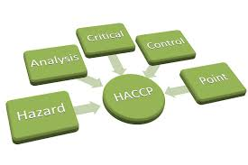
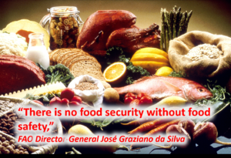
2. Food safety and food security
Food quantity (Food security) and Food Quality/Safety
SECURITY: Some estimates suggest that world production of food animals is reduced by more than 20% due to disease, which means that even animal diseases not transmissible to humans may lead to serious public health problems due to the shortages and deficiencies that can follow.
SAFETY AND QUALITY: Food and waterborne diarrhoeal diseases are leading causes of illness and death in less developed countries, killing approximately 2.2 Million people annually 1.9 million of whom are children.
On Farm Disease control, Hygiene, Residues, Antibiotics use, Farm assurance, Farm health planning
To minimize the risk of biological, chemical and physical contamination entering the food chain
Meat hygiene-Milk hygiene-Fish hygiene

Slide 9

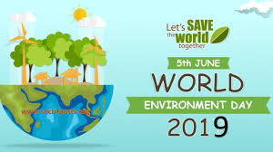
3. Environment protection
Environment protection includes:
Waste management
Disposal of animal by products/
Impact of medicines
Range of activities linked to:
  Vectors control
  Water sanitation
  Wildlife health
  Disaster Management
  Biodiversity
  Farm hygiene
  Human Activities onto wildlife habitat
  Sewage treatment and disposal
  Monitoring and control of air, soil, water, radiation pollution
  Bioterrorism

Slide 10

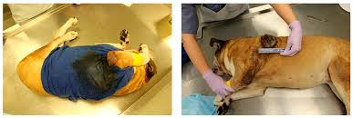
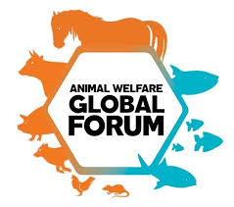
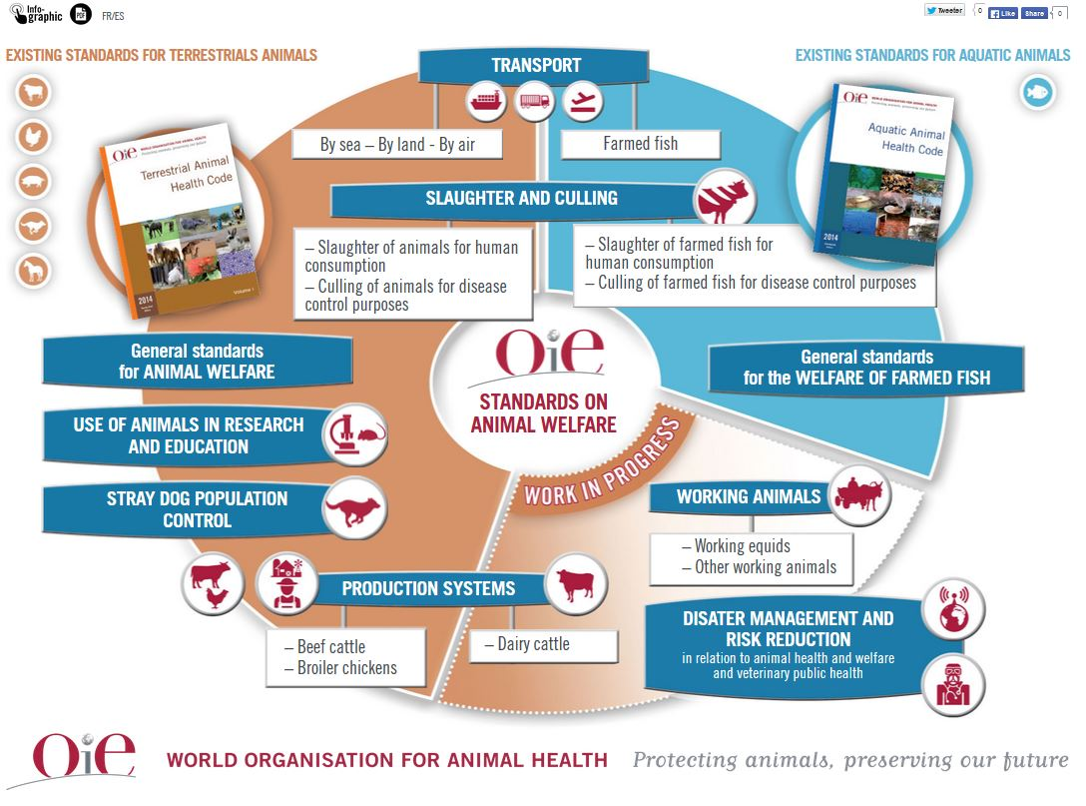
4. Biomedical research

Slide 11



5. Liaison
Liaison between all those professionals involved in protecting human health.
• Identify new problems
• Develop joint policies to protect humans
• Successfully solve problems
• Identify and conduct research
• Implement control programmes in animals and humans
• Foster good communication depend on good liaison between the medical and veterinary professions

Slide 12
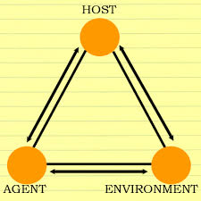
6. Other areas
Veterinary public health is an essential part of public health and includes various types of cooperation between the disciplines that link the health triad, people- animals-environment and all of its interactions.

Slide 13
The present status of veterinary public health in India
Although VPH is recognized as an important component of public health in various international forums, especially in the developed world, most developing countries, such as India, still lack the capacity, capability and expertise required to integrate VPH into overall public health activities

Slide 14
The Division of Zoonoses was established at the NCDC in 1964.

Slide 15
A key institute in early VPH initiatives in India was the National Institute of Communicable Diseases in Delhi, which is now known as the National Centre for Disease Control (NCDC).
This is an important institute which operates as part of the Ministry of Health and Family Welfare and provides a platform for veterinary–medical interaction.
The Division of Zoonoses was established at the NCDC in 1964.
Indian Veterinary Research Institute, was established in Poona (now Pune) in 1889 as the Imperial Bacteriological Laboratory, upon the recommendation of the Indian Plague Commission.
The IVRI Division of Veterinary Public Health was established in 1971 on the Izatnagar campus.

Slide 16
All India Institute of Hygiene and Public Health (AIIH&PH) was established in Calcutta (now Kolkata) on 30 December 1932 and is now the oldest school of public health in Southeast Asia.
The School of Public Health and Zoonoses was established by Guru Angad Dev Veterinary and Animal Sciences University (GADVASU), Punjab, in 2012.

Slide 17
Location of undergraduate and postgraduate veterinary teaching institutes in India

Slide 18


