Slide 1
UNIT-IV
Environmental Hygiene
(Credit Hours-3+1)

Slide 2
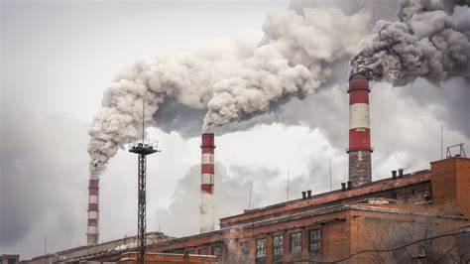
Air Pollution

Slide 3
Introduction
Atmosphere:
Gaseous envelope surrounding a celestial body (earth)
It consists of a mixture of gases (air): vital for the propagation of life processes
Atmospheric pollution:
The presence of substances in air in concentrations sufficient to cause harmful effects on the health of animals & man, vegetation & property or to interfere with the enjoyment of life & property
Pollution: means to make (air) impure or unwholesome
(Presence of dust, smoke, fumes, mist, odour or gases (including oxides of carbon, sulphur & nitrogen) in quantities or of a duration that unreasonably alters the average (acceptable purity) condition of the atmosphere)

Slide 4
Pure and impure air
The composition (%) of fresh (pure) air by volume:
Component | Percent
Nitrogen | 20.946
Oxygen | 78.084
Argon | 0.934
Total | 99.964
Neon | 0.0018
Helium | 0.0005
Krypton and methane | 0.0001
Hydrogen and Nitrous oxide | 0.00005
Xenon | 0.000008
Variable components:
Vapour | 0-5
Carbon dioxide | 0.01-0.1 (average 0.032)
Ozone | 0-0.01
Sulphur dioxide | 0-0.0001

Slide 5
Composition of air Cont…
The composition:
Change of season,
Altitude &
Solar activity
Oxygen: highly reactive (oxidation)
Exerts marked influence on various geochemical cycles
Most of the atmospheric oxygen: photosynthesis & ultraviolet radioactivity
Expired air: concentration reduced to 16.4%
concentration of CO₂ increased to 4.24%
concentration of other gases: unaltered

Slide 6
Sources of pollution
The pollution of outdoor air from: diverse sources
Cause of pollution is traced to one or more of human activities
Ex.
Combustion of coal & oil: pollution by SO₂, CO₂ & NO
The treatment of wastes: release ammonia & H₂S in the atmosphere
The nature of pollution in an area will, therefore, be related to the type of activities indulged in by the communities inhabiting the area
Many natural sources: volcanoes and forest fires

Slide 7
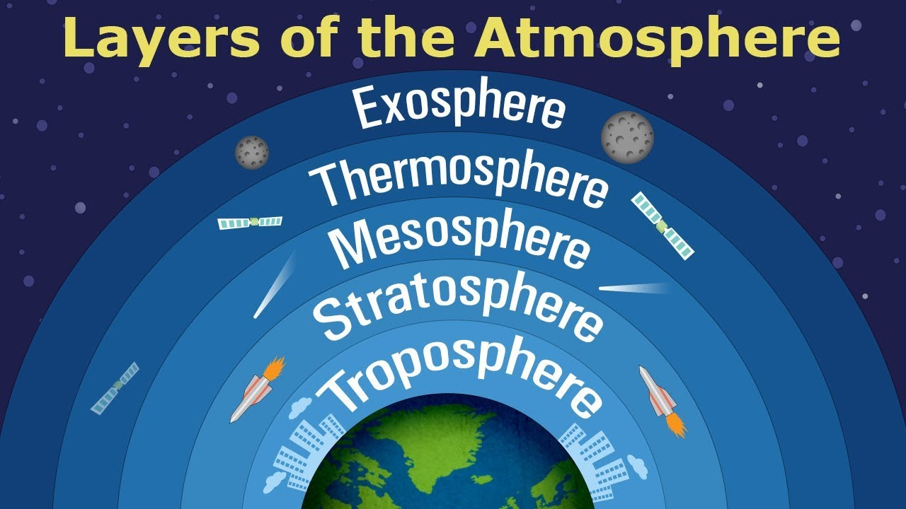
Zones of atmosphere
Zones:
Homosphere: chemically uniform up to above 100-120 km the earth
Heterosphere: above homosphere, structurally uneven
Altitude increases: change in temperature pattern of atmosphere
On the basis of this change atmosphere has been divided into 4 distinct strata/zones:
Trophosphere
Stratosphere
Mesophere
Thermosphere

Slide 8
Zones of atmosphere _{cont….}
1. Troposphere:
Immediately above surface of earth,
A gradual decline in temperature
Thickness: 10-20 km
At 20 km the temperature falls to -56^{O} C (from 15⁰ C)
The rate of temperature drop: 6.4⁰ C/100 m
The zone contains: 99% mass of gases found in the atmosphere (nitrogen, oxygen and carbon dioxide)
2. Stratosphere:
Height from the earth: 40-50 km
Thin layer above troposphere
Uniform temperature
The zone comprises of ozone layer
Protects the earth against the ill-effects of UV irradiation
Ozone shield increases the temperature from -56⁰ C to -2⁰ C at 50 km height
3. Mesophere:
Height from the earth: 70-80 km
Marked reduction in the temperature
At an altitude of 70 km,
the temperature falls to -92ºC (from -2⁰C)
4. Thermosphere:
Height from the earth: above 80 km
Temperature: very high (upto 12000 C)
Thickness of the zone is 500 km
It contains O2, nascent oxygen & nitrogen oxide.

Slide 9
Influence of metrological conditions
The atmospheric pollution is influenced: meteorological conditions present in an area
Meteorological factors influences: magnitude of vertical & horizontal transfer of air pollution
Major parameters are:
Temperature:
Direct bearing on the movement of air pollutants
Influences the diffusion of pollutants
Wind:
The direction & speed of wind is an important determinant in the movement of air pollutants
Humidity
Influences the precipitation of pollutants on earth
Many toxic pollutants combine with water vapor precipitate to the surface of earth
Atmospheric pressure
Influenced the movement of pollutants in an area
Important consideration for many pollutional parameter

Slide 10
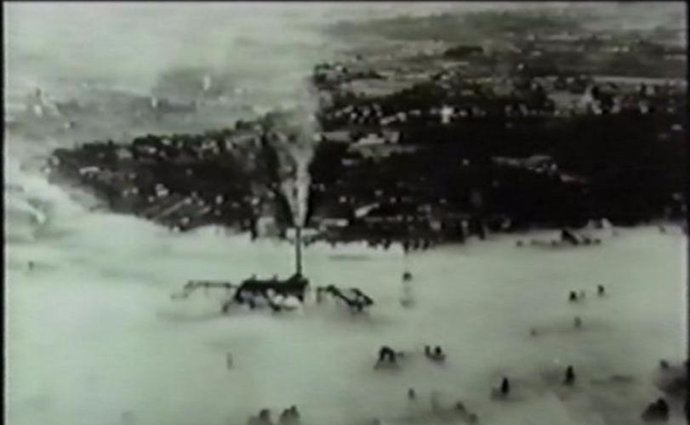
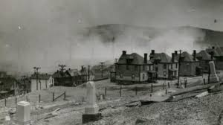
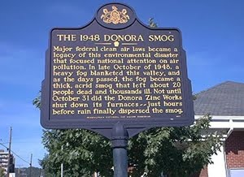
Air pollution: a historical perspective
1. Meuse Valley (Belgium), December, 1930
The area was covered by a blanket of thick fog for about 5 days
More than 60 persons died as a result of toxicity due to oxides of sulphur (and metals) & soot
A large section of the population became ill
2. Donora (Pennsylvania), October, 1948
Intense foggy condition that lasted few days.
A large proportion of the population (more than 40%) became ill due to exposure to
Manifested ocular & throat irritation, cough & other respiratory symptoms &vomiting
Caused due to excessive sulphur compounds including sulphuric acid from industries

Slide 11
Air pollution: a historical perspective
3. London, December, 1952, 1962
Famous smog disaster (1952) for 5 days
Death of thousands people, children & the old
Caused acute respiratory disease in cattle
Another episode of smog (Dec., 1962) that also caused substantial morbidity& mortality
Sulphur compounds: probable causes of the illness
4. New York (United States)
Air pollution disasters were reported during 1953, 1962 & 1966
The smog caused substantial morbidity and mortality in 1962
5. Bhopal (India),1984
Leakage of a toxic gas (methyl isocynate) from a pesticide plant.
More than 5000 people died
Many more thousands were affected by a variety of illnesses including respiratory dysfunction, blindness & deformities in the infants

Slide 12
Air pollution: a historical perspective
Chernobyl (erstwhile USSR), 1986
Most famous radiation disasters that occurred in as a result of massive leakage of radioactivity from a nuclear reactor
The melting of & explosion in the reactor led to death of about 2000 persons & contamination of the environment in the neighboring areas
Los Angeles (California)
The smog pollution in the city has more to do with petrol than coal
The area is highly industrialized and densely populated
The problem that was associated with various respiratory symptoms was recognized as early as 1940(s)
Caused ocular & respiratory irritation& damage to vegetation

Slide 13
Air pollution: a historical perspective
Coal dust explosion (China, 1942 and Chasnala, India, 1957)
Forest fires (South East Asia, 1997-98): impact on health & productivity
Nitrogen oxide & hydrocarbons present in the atmosphere (following use of petrol by the automobiles) reacted with sunlight
Toxic compounds were produced through a photochemical reaction between sunlight & the two pollutants
The photochemical smog pollution of 1969 has been reported in detail as a part of episode 104 (associated with hurricane Camille emanating from Gulf of Mexico)

Slide 14
Classification of air pollutants
A wide variety of pollutants are present in the atmosphere
In order to understand their impact on health & ecology, & to evolve appropriate strategies for their control, the pollutants are classified in a number of ways:
Source of emission,
Physico-chemical characteristics &
Effects on life processes

Slide 15
Sources of air pollutants
Sources
Natural sources
Man induced activities
Geochemical contamination,
Photochemical reactions,
Change in climatic conditions,
Volcanic eruptions,
Gaseous discharge from marshes & swamps,
Forest fires
Dust, fog & radiation fall-outs
Microbial agents
Incineration: wood, coal, petroleum products,
Automobile industry: oxides of sulphur & nitrogen, carbon monoxide, smoke & fly ash
Oil refineries
Iron/steel mills, fertilizer plants & rendering units metal fumes & fluorides into the atmosphere
Agricultural, textile, paper & pharmaceutical industries
Dust particles: milling, crushing /grinding
pesticide & drug residues
Organic/inorganic vapours

Slide 16
Physico-chemical characteristics
Two major groups
Particulate pollutants:
Dust particles,
Mist,
Fly ash
Droplets,
Fog,
Smoke,
Fumes & soot
Gaseous pollutants:
Oxides of Sulphur & Nitrogen,
Carbon monoxide
Hydrogen sulphide
Vapours of gasoline & trichlorethylene
Toxic to animals & man
Organic decomposition of waste
Methanogenesis: methane (gobar gas) & Carbon dioxide
Carbon dioxide: respiration

Slide 17
Effects of pollutants
Direct bearing on the health of animals & man, & planetary bio-diversity
Toxic gases & substances present in the atmosphere cause:
Retardation of growth,
Promote ageing,
Bleaching of leaves
Necrosis in plants
The degree of damage:
Dose of pollutant &
Duration of exposure
Loss of valuable plant materials especially around industrial areas
damage to physical structures, monuments and buildings.
Ex: damage of Taj Mahal

Slide 18
Effects of pollutants
Nonirritant pollutants (carbon monoxide) may not always be associated with overt clinical manifestations.
Studies have shown that zinc & lead pollution of air: marked fatalities in cattle & horses in Germany
Arsenic: Bloody diarrhea, vomiting & excessive thirst in animals
Smog pollution: Variety of respiratory problems in animals
Lead pollution: Teeth grinding & laryngeal paralysis (roaring sound) in cattle
Fluorosis: Cattle & sheep reared near brick kilns and iron/steel aluminum plants & ceramic factories
In soil (0.1-1.0 g/kg)
Water (in some areas in India, 25 mg/litre)
Air (Volcanic eruptions & in the dust particles originating from soil)
Conditions: lameness, mottled teeth, fragile bones & loss of milk yield in dairy cattle
Metallic pollutants: Induce anaemia & emaciation in animals

Slide 19
Effects of pollutants
In humans (atmospheric pollution due to metallic & gaseous substances is manifested by
Bronchitis, pulmonary asthma & inflammation of upper respiratory tract
Nitrogen oxide: Pulmonary oedema & congestion
Sulphur oxide: Injury to mucosa
Ozone: Effects similar to ionizing radiation
Carbon monoxide: Depriciation of blood oxygen level following its combination with haemoglobin)
Particulate matter have been described in detail by many workers

Slide 20
Pollution within animal houses
The quality of environment within animal houses: on the health of animals & their productivity
High densities of animals: not well ventilated lead to accumulation of excessive moisture and carbon dioxide
Atmospheric oxygen level to 10-12% may not prove fatal to animals,
An increase of atmospheric Carbon dioxide level to 6.0% may lead to asphyxia
A concentration of Carbon dioxide 30% for some hours could result in death
In horses Carbon dioxide concentration of 3-5% may cause rapid breathing
A combination of high moisture & carbon dioxide makes animals uncomfortable & leads to a reduction in production
Major gases: include ammonia, hydrogen sulphide & methane besides carbon dioxide
Ammonia: irritating gas that is frequently found in the dirty farm houses
Concentration between 0.04% and 0.5% of the gas causes much irritation of mucous membranes, asphyxia and death.
Hydrogen sulphide (0.01 - 0.14%): irritation of eyes, throat & nose, & lung oedema
Excessive amounts of methane may prove explosive
Turbulence activity may also lead to production of harmful particulate pollutants

Slide 21
Microbial pollution of air
A variety of microbes are carried by air
Meteorological conditions (temperature, humidity, solar radiation)
Amount of particulate & gaseous pollutants contribute immensely to the variation in the load and type of microbes
Most of the atmospheric microflora emanates from the soil or due to stirring action induced by animal/human activity within the animal houses
The microbes are adsorbed on the dust particles
Carried over long distances under favorable weather conditions (high wind velocity) especially during outbreaks of diseases
A large numbers of organisms (many of them pathogens) can be transmitted through air in an area
Animals suffering from respiratory diseases discharge the microorganisms during sneezing & coughing

Slide 22
In man:
Sneeze can release upto 10,000-10,00,000 droplets
Microbes released by animal & human sources survive in the environment for varying lengths of time
Some organisms may not survive for more than few minutes (Leptospira in dry atmosphere),
Can resist the adverse environmental conditions for as long as 28 years (spores of Bacillus anthracis in soil)
Brucellae can survive in soil for about one month
Exposure to sunlight causes destruction of many environmental microorganisms (Mycobacterium spp)
In soil: mycobacteria can survive for upto 6 months

Slide 23
Measurement of air contamination
The microbial load of moving air is determined
To assess the level of contamination within a building or given area
Several techniques are used
To collect the samples & conduct qualitative & quantitative analysis of air
Sedimentation
Impaction
Impingement
Precipitation
Filtration
Sieve cascade sampler

Slide 24
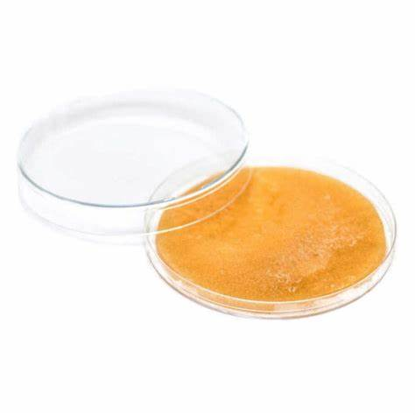
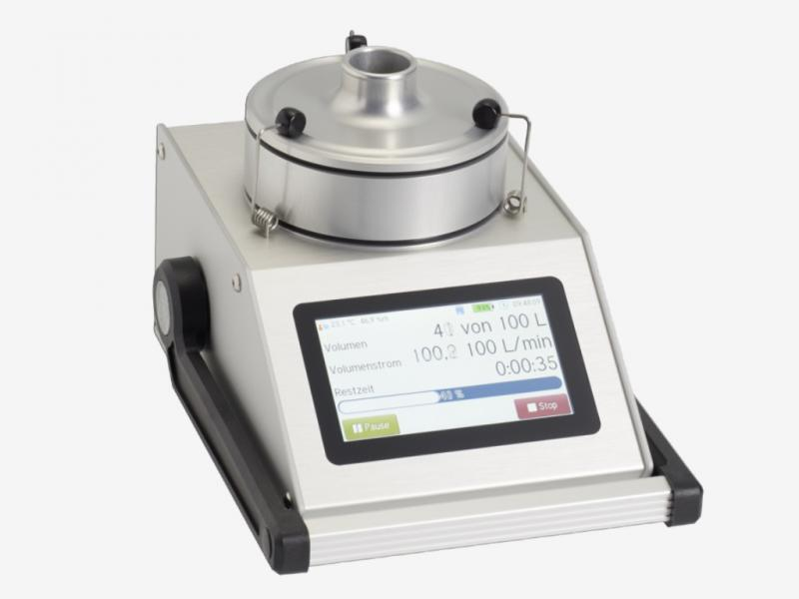
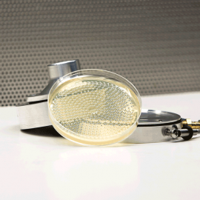
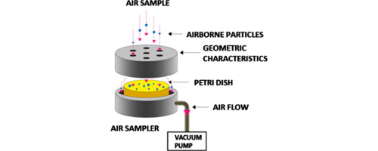
Methods of air sampling
1. Sedimentation (settling plate method)
Permits settlement of atmospheric air on the surface of an agar plate for 10 min or more
It does not allow the settlement of suspended particles the air
2. Impaction
Collecting the atmospheric particles on the surface of a solid/semi-solid agar medium
Air centrifuge is used
The air flow on the sides of a rotating cylinder lined with a culture medium
Suitable for large sized particles
A better known device called slit sampler is preferred by many to test air quality
The air is sucked through a slit onto a rotating culture plate kept underneath the device
The flow rate one cu ft .( 28.3 cu cm)/min
Rotation rate is kept at 0.5, 2 or 6 min/revolution

Slide 25
Methods of air sampling
3. Impingement
To collect atmospheric particles in a liquid medium
The air is sucked through a glass instrument at a defined rate into the fluid
The microbial load: determined by examining the fluid
4. Precipitation
The precipitation of atmospheric particles in two ways:
1. Thermal precipitation
A slowly moving air current (3 lit/min) is directed between heated & cooled surfaces (distance 0.038 cm)
The heated wire/surface repulses the particles towards cold surface
They get collected in cold surface
The organisms are then transferred on to the agar medium
2. Electrostatic precipitation
Collects the organisms on the basis of their electric charge
It is a highly efficient instrument for collecting the airborne particles

Slide 26
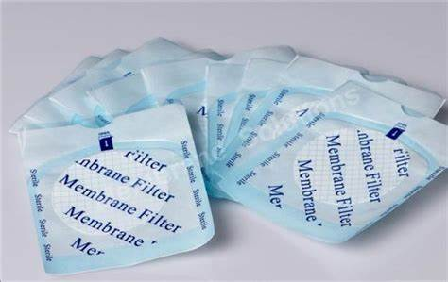
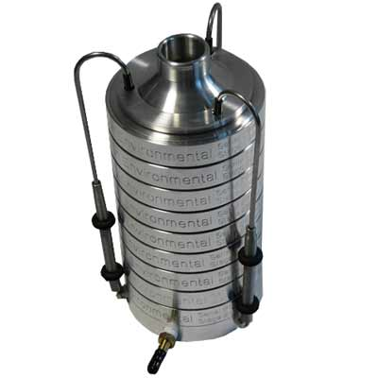
Methods of air sampling
5. Filtration
The microorganisms are trapped on a filter (cotton, glass wool or paper) or membrane filter
Membrane filter technique is considered to be better for the purpose
Air is filtered through the membrane
The particles (with microbes) are impunged on this membrane
The membrane is then placed on a paper saturated with an appropriate medium & incubated
6. Sieve (cascade) samplers
It is desired to collect samples of air on the basis of the particle size of the pollutant
Sieves of varying sizes are arranged in a cascading manner (one upon the other)
Larger particles are collected on top
Smaller ones towards the bottom sieves
Cascade impactor is a highly efficient trap

Slide 27
Control of air pollution
Minimize the production & release of pollutants near the animal or human dwellings
Control of dust particles: by improving sanitary conditions within the houses
Frequent washings of floor & equipment: controlling the dust within the buildings
Vacuum cleaners: used effectively
Proper ventilation: a prompt clearance of foul gases & particulate pollutants
Filters can be installed to check the entry of external contaminants
Use of laminar air flow systems for closed compartments/ cabins
Allows unidirectional passage of air through cellulose acetate filters

