Slide 1
Bases of Selection
Dr. Jay Prakash Gupta
Associate Professor, Animal Genetics & Breeding
Bihar Veterinary College
BASU, Patna
Bihar - 800014

Slide 2
Introduction
Population of different families (FS, HS)
F₂
Compute the mean phenotypic value of each family i.e. family mean
F₁
F₃
F₄
F₅
F₆
Now we have measurements of
Each individual and
means of every family.
A choice of procedure for applying selection to these population is then open, we may utilize these measures

Slide 3
Bases of selection
Individual
Individual value
How to decide??
Suppose value borderline bet. Selection and rejection
Favourable
Individual’s poor value is due to poor environment but high family mean suggests its high BV
Family
Un-favourable
High family mean may be due to favorable environment (mother), therefore individuals’ BV may be less
Family Mean

Slide 4
Bases of selection
Only three things to know,
Kind of family: Full Sib or Half sib
Number of individuals in the family
Phenotypic correlation between family members
But before going to this detail we may see the general description of different basis (Information available) of selection

Slide 5
Bases of selection
Phenotypic value of individual (P)
Deviation from Population mean ($\overline{P})$
P_{f}
P_{w}
Deviation of family mean from population mean ($\overline{P})$
Deviation of individual from family mean (Within family deviation)
Procedure of selection varies as per the weight given to these two parts

Slide 6
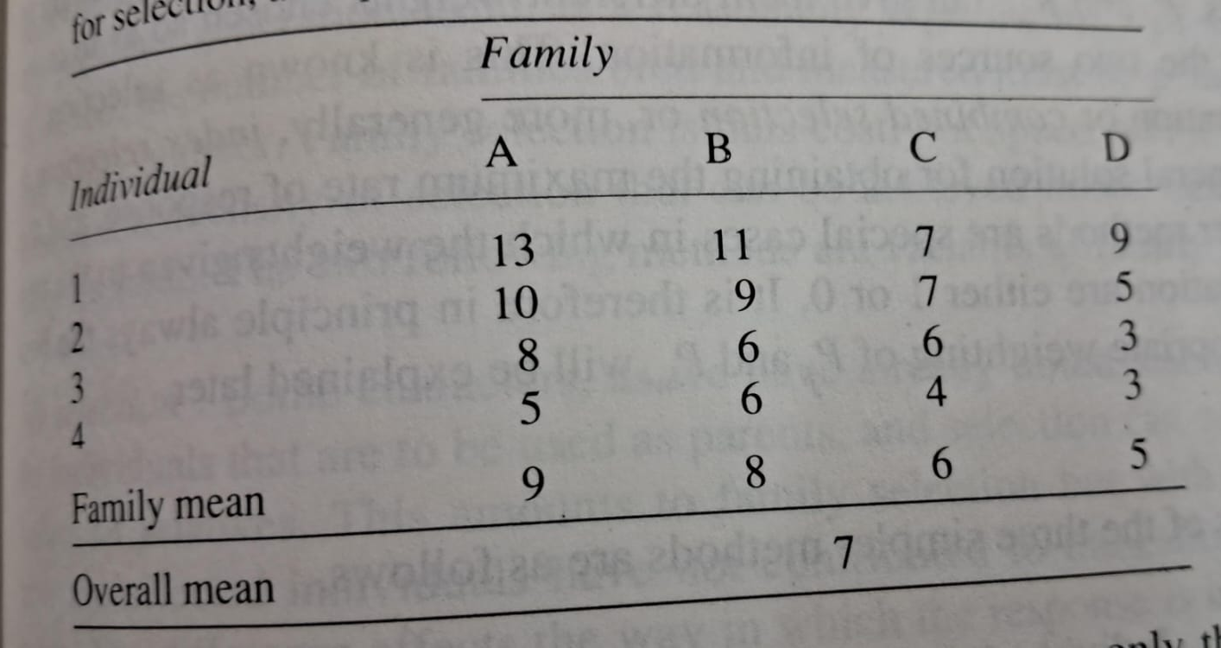

Slide 7
Bases of selection
Individual Selection
Family Selection
Within family selection
Equal weight to both P_{f} and P_{w}
Weight to family mean P_{f} alone, ignoring the within-family deviation P_{w} entirely
Weight to the within-family deviation P_{w} alone, ignoring the family mean P_{f}, entirely
Combined Selection
Take account of both components P_{f}, and P_{w} but given with different weights chosen so as to make the best use of the two sources of information

Slide 8
Thanks!
Any questions?
You can find me at:
@JP_AAtrey
jp.prakash01@gmail.com

