Slide 1
Individual Selection
Dr. Jay Prakash Gupta
Associate Professor, Animal Genetics & Breeding
Bihar Veterinary College
BASU, Patna
Bihar - 800014

Slide 2
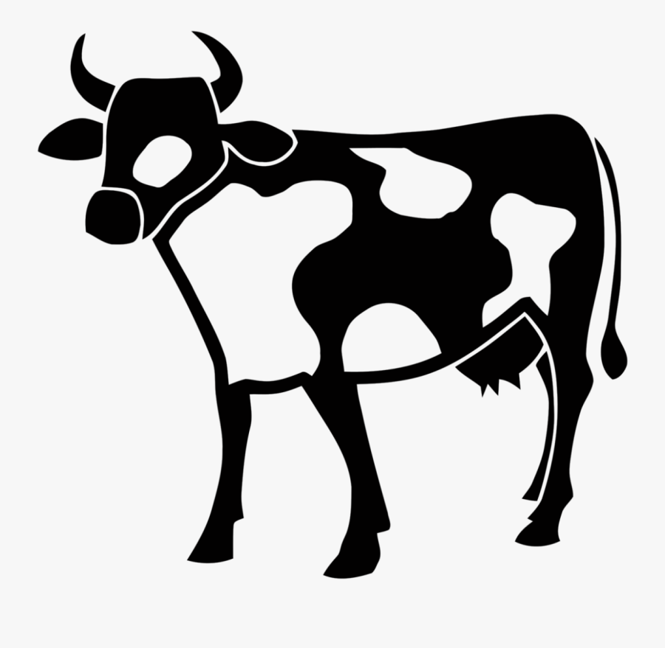
Individual Selection
Individual selected on their own phenotypic performance
Single record or mean of several records
Simplest to operate and yield rapid results
It should used unless there are good reasons for preferring another methods
Preferred when the heritability of the trait under consideration is high.
Done for traits whose records are maintained

Slide 3
Individual selection
Most useful for traits expressed in both the sexes
Only option in the absence of systematic record keeping
All animals can be evaluated simultaneously
Gives an indication of high correlation between genotype and phenotype when heritability of a trait is high.
Advantages
Disadvantages
For traits, expressed only in ♀s, individual selection is not possible for ♂s.
Characters that are expressed late in life,
Traits having low heritability.
Mass selection is another term often used for individual selection, in poultry especially when the selected birds are put together en masse for mating

Slide 4
Pedigree selection
A pedigree is a record of an individual’s ancestors that are related through his parents, and the selection of individuals based on such records is known as pedigree selection.
Selection based on pedigree information is determining the genetic worth of animals on the basis of the performance of their ancestors.
Pedigree selection importance decreases when information is available on individuals or family members

Slide 5
Pedigree selection
Practical difficulties
Ancestors records not always available
May be faulty records due to stray mating
Most characters have low h²
Advantages
Less costly, only pedigree compilation is necessary
Allows selection at younger ages
Good for multistage selection
Good for sex limited and traits expressed in later life
Demerits
Individuals from part. Pedigree can be culled inspite of having good genes, likewise some pedigree may get undue emphasis and favored
introduces nonrandom bias as records are of diff. envt.
not applicable for indivs. having same pedigree

Slide 6
Family selection
Collateral relatives
Those relatives that are not related to an individual directly either as ancestors or as their progeny. Ex: half sibs, cousins etc.
Whole families are selected or rejected as units according to the mean phenotypic value of the family.
Individual values are only used in determining the family mean
Conditions
low h², mean value of a no. of relatives provides a more reliable guide to breeding value than the individual‘s own phenotypic value.
The larger the family the closer is the correspondence between mean phenotypic value and mean genotypic value.
Consider the intensity of selection and the avoidance of inbreeding.

Slide 7
Family selection
Environmental deviations of the individuals tend to cancel each other out in the mean value of the family
So the phenotypic mean of the family comes close to being a measure of its genotypic mean
The advantage gained is greater when environmental deviations constitute a large part of the phenotypic variance i.e. when h² is low
Common environment
Impairs family selection
F₁
F₂
F₃

Slide 8
Family selection
Advantage:
Selection at an early age for the traits,
traits that are expressed only in one sex
supplement individual selection for lowly heritable traits.
Disadvantage:
Common environmental effect
small family size not suitable for family selection, only applicable in animals with high reproduction rate
costly of space and time
Some characters, cannot be measured on the individuals that are to be used as parents, and selection can only be based on the values of relatives.
This is actually a family selection but with the difference that now the selected individuals have not contributed to the estimate of their family mean.
Sib selection
Ex: Slaughter traits

Slide 9
Within Family selection
Reverse to family selection
Deviation of individual’s performance from the mean of the family to which it belongs.
The animals that exceed their family mean by greatest amount are considered as the most desirable.
This method is advantageous over the other is a large component of environmental variance common to members of a family,
for example pre-weaning growth in pigs.
Here, a large part of the variation of individual’s weaning weight is attributable to the mother and is therefore common to members of a family. Selection within families would eliminate this large non-genetic component from the variation operated on by the selection.
F₁
F₂
F₃

Slide 10
Thanks!
Any questions?
You can find me at:
@JP_AAtrey
jp.prakash01@gmail.com

