Slide 1
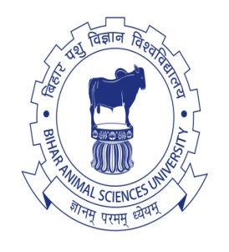
Basic application of bio-techniques for genetic improvement of livestock and poultry
Dr. Jay Prakash Gupta
Associate Professor, Animal Genetics & Breeding
Bihar Veterinary College
BASU, Patna
Bihar - 800014

Slide 2
Biotechnological Application
The genetic variation in a population and the method to exploit these variability will determine the genetic improvement.
During last 3 – 4 decades many newer biotechnological breakthrough in the field of reproduction and genetics have opened the new area of animal improvement

Slide 3
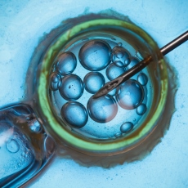
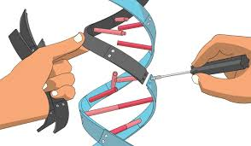
Biotechnological Application
Two Aspects:
Reproductive biotechniques
Genetic biotechniques

Slide 4
Reproductive biotechnology
These technologies may not always improve but they offer solutions to problem related to creation and spread of genetic improvement
Semen technology: Artificial Insemination, cryopreservation, preservation of oocytes at lower temperature.
Embryo production: MOET, cryopreservation of embryo, preservation of embryo stem cells, in vitro matured (IVM) and in vitro fertilized (IVF) embryo production

Slide 5
Reproductive biotechnology
Animal Cloning: This has been successfully achieved in animals using early embryonic source material, nuclear transfer, embryonic stem cell lines and somatic cell lines etc.
Sexing of semen and embryo: The sperm containing X and Y chromosomes are separated female is inseminated to get desired progeny.
Sexing of embryo can also be done by enzyme activity, H-Y antigen, DNA probing, Karyotyping, PCR etc.

Slide 6
Reproductive biotechnology
Transvaginal oocyte recovery and ovum pick up (TVOR-OPU)
Embryo cryopreservation: Useful in conservation programme of endangered species
Embryo splitting: Aim of this technique is to get greater number of offspring from a donor.

Slide 7
Genetic biotechnology
Main strategy for this technique is identification of gene responsible for a trait, map and sequence those genes:
Genome map: Genetic linkage and physical maps for major livestock species should be prepared
Sequence analysis: Sequence analysis provides the functional structure of gene system and expression

Slide 8
Genetic biotechnology
Quantitative trait loci: Location of all markers and protein coding genes in chromosome.
Gene chips: In this technique DNA corresponding to thousand of genes are arranged on small matrices and probed with labelled cDNA from a tissue of choice and information is read by device.

Slide 9
Genetic biotechnology
Genetic characterisation: Genetic characterisation of population of targeted species to be conserved using microsatellite markers, RFLPs, AFLPs, SSCPs, mini satellite, breed specific DNA signature has been developed.
Transgenesis: This has been employed with aim to improve growth, increased disease resistance, improvement in quality of animal products, gene farming etc.

Slide 10
Genetic biotechnology
Feed biotechnology (Nutrogenomics)
Vaccine and pharma biotechnology (Pharmacogenomics)

Slide 11
Thanks!
Any questions?
You can find me at:
@JP_AAtrey
jp.prakash01@gmail.com

