Slide 1
CRIMEAN-CONGO- HEMORRHAGIC FEVER
Central Asian Hemorrhagic fever
Congo fever

Slide 2
Introduction
Crimean-Congo hemorrhagic fever (CCHF) is caused by infection with a tick-borne virus (Nairovirus) in the family Bunyaviridae.
The disease was first characterized in the Crimea in 1944 and given the name Crimean hemorrhagic fever.
It was then later recognized in 1969 as the cause of illness in the Congo, thus resulting in the current name of the disease.
The CCHF virus causes severe viral haemorrhagic fever outbreaks, with a case fatality rate of 10–40%.

Slide 3
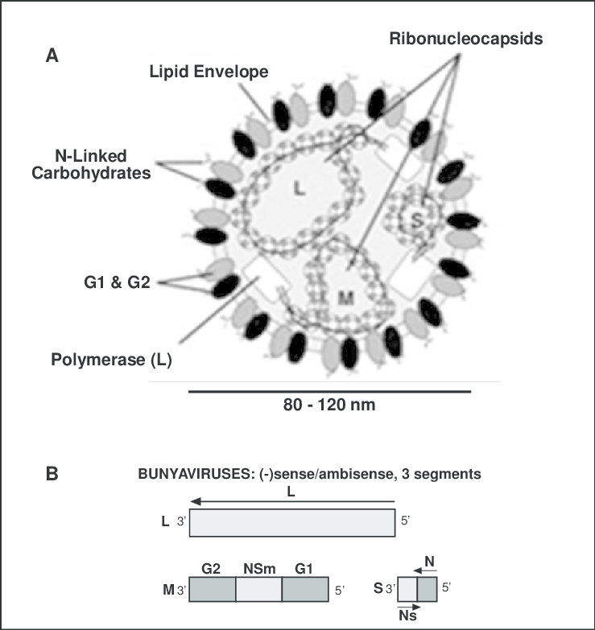
Etiology
Segmented RNA genome (3 segments)
Spherical
Bilayered lipid enveloped
Genus: Nairovirus
Family: Bunyaviridae
Belongs to the group of tick borne hemorrhagic fever viruses, together with the agents of Omsk hemorrhagic fever and Kyasanur forest disease

Slide 4
Geographical distribution
Crimean-Congo hemorrhagic fever is found in
Eastern Europe, particularly in the former Soviet Union,
Throughout the Mediterranean,
In northwestern China, central Asia,
Southern Europe, Africa,
The Middle East, and the Indian subcontinent

Slide 5
Sources and transmission cycle
Natural foci of virus: Steppes, savannahs, semidesert areas foothill biotope
Tick: Hyalomma, Dermacentor, Rhipicephalus, and Boophilus
Several species of Hyalomma play a prominent role as vectors & reservoirs
The larvae & the nymphs of these ticks feeds on hares, hedgehogs, & birds
Adult ticks feed on large wild & domestic animals & are easily attracted to man

Slide 6
Role of animals in the epidemiology
Vertebrate serve as a reservoir
They are simply a food source for the vector ticks
Tick act as a vector as well as reservoir
Ticks can transmit the infection transovarilly & transstadially

Slide 8
Sign & Symptoms
The incubation period is usually 1 to 3 days, with a maximum of nine days after tick bite
The incubation period following contact with infected blood or tissues is usually five to six days, with a documented maximum of 13 days
Onset of symptoms is sudden, with fever, myalgia, (muscle ache),
dizziness, neck pain & stiffness,
backache, headache, sore eyes &
photophobia (sensitivity to light)

Slide 9
Sign & Symptoms
There may be signs of
nausea, vomiting, diarrhoea,
abdominal pain & sore throat early on, followed by sharp mood swings & confusion
After two to four days, the agitation may be replaced by sleepiness, depression & lassitude,
The abdominal pain may localize to the upper right quadrant, with detectable hepatomegaly (liver enlargement)

Slide 10
Sign & Symptoms
Tachycardia (fast heart rate),
lymphadenopathy (enlarged lymph nodes), and
a petechial rash (a rash caused by bleeding into the skin) on internal mucosal surfaces, such as in the mouth and throat, and on the skin.
The petechiae may give way to larger rashes called ecchymoses, & other haemorrhagic phenomena.
There is usually evidence of hepatitis, & severely ill patients may experience rapid kidney deterioration, sudden liver failure or pulmonary failure after the fifth day of illness.
CFR: 30%

Slide 11
Diagnosis
Isolation of virus:
Inoculations of blood of acute phase patients or autopsy material intracerebrally in new borne mice
By the cell culture: VERO and CER cell culture
Serological diagnosis:
Complement fixation test
Serum neutralization test
Indirect HI
Radial gel diffusion
ELISA
Immunoflurence
RT-PCR

Slide 12
Treatment
General supportive care with treatment of symptoms is the main approach to managing CCHF in people
The antiviral drug ribavirin has been used to treat CCHF infection with apparent benefit.
Both oral and intravenous formulations seem to be effective.

Slide 13
Control
There is no vaccine available for either people or animals
( An inactivated, mouse brain-derived vaccine against CCHF has been developed and used on a small scale in eastern Europe, there is currently no safe and effective vaccine widely available for human use)
Control of ticks population & tick bite: acaricides
Isolation of patients
Tests on patient samples present an extreme biohazard risk and should only be conducted under maximum biological containment conditions.
Proper disinfection: blood from the infected patients may be treated with chlorinated disinfectants
PPE kit required for the health care workers

Slide 14
Control
Reducing the risk of tick-to-human transmission:
wear protective clothing (long sleeves, long trousers);
wear light coloured clothing to allow easy detection of ticks on the clothes;
use approved acaricides (chemicals intended to kill ticks) on clothing;
use approved repellent on the skin and clothing;
regularly examine clothing and skin for ticks; if found, remove them safely;
seek to eliminate or control tick infestations on animals or in stables and barns; and
avoid areas where ticks are abundant and seasons when they are most active.

Slide 15
Control
Reducing the risk of animal-to-human transmission:
wear gloves and other protective clothing while handling animals or their tissues in endemic areas, notably during slaughtering, butchering and culling procedures in slaughterhouses or at home;
quarantine animals before they enter slaughterhouses or routinely treat animals with pesticides two weeks prior to slaughter.

Slide 16
Control
Reducing the risk of human-to-human transmission in the community:
avoid close physical contact with CCHF-infected people;
wear gloves and protective equipment when taking care of ill people;
wash hands regularly after caring for or visiting ill people.

