Slide 1


Clostridium perfringens as food borne pathogen
“Application of Novel methods in prevention and
control of Zoonoses and Ensuring Food Safety”
Dr. Anjay
Assistant Professor
Department of Veterinary Public Health & Epidemiology
Bihar Veterinary College
Bihar Animal Sciences University
Patna

Slide 2

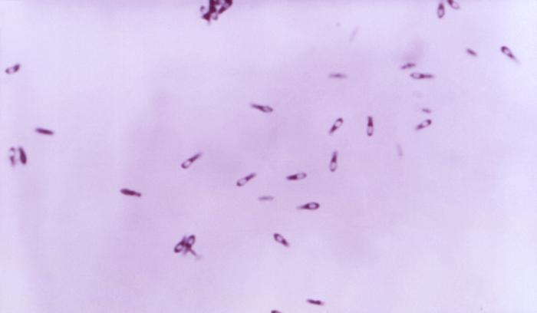
Clostridium perfringens
Previously recognised as Bacillus aerogenes capsulatus, Bacillus perfringens, Bacillus welchii or Clostridium welchii
Morphology
  Gram positive rod shaped with rounded ends
  4-6 ×1 µm in size, occurring single or in chains
  Anaerobic, nonmotile, spore-forming
  Central or sub terminal spores
(Hassan et al., 2015)
First isolated & recognized in 1891 by William H. as a novel bacterium

Slide 3
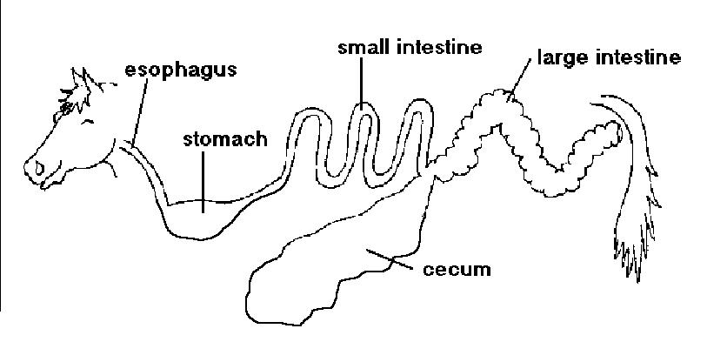
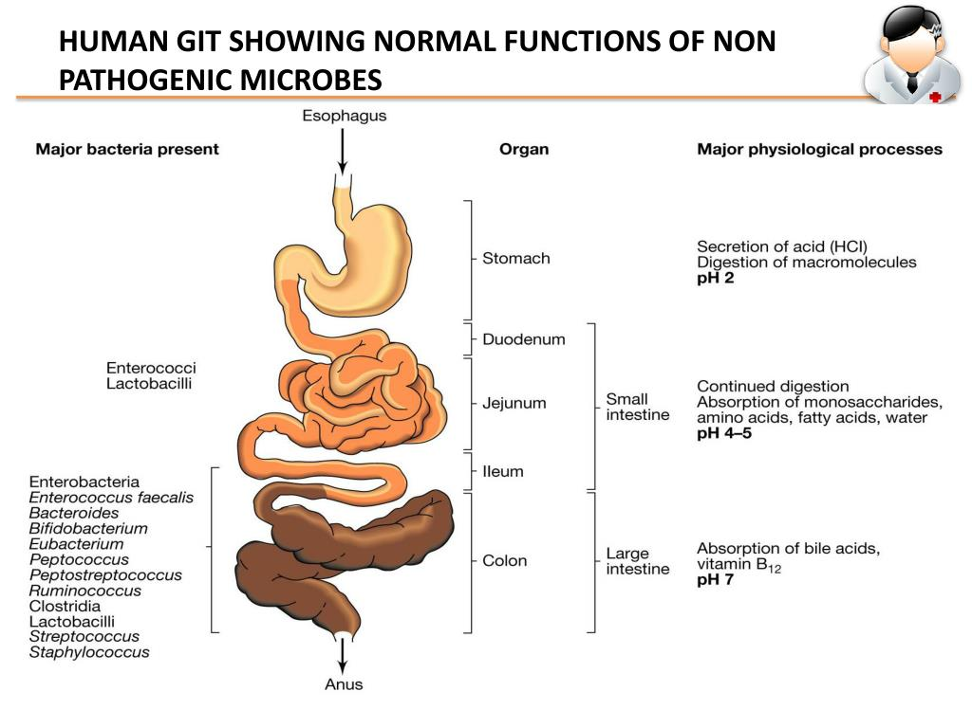
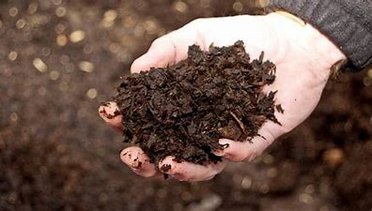
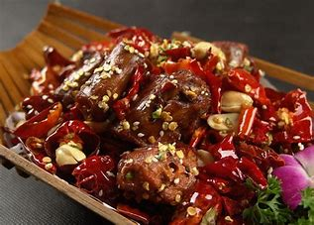
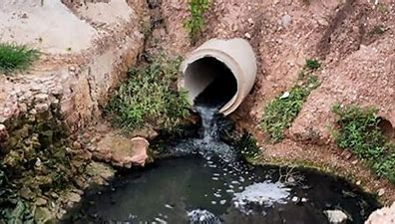
C. perfringens are present in diverse environments

Slide 4
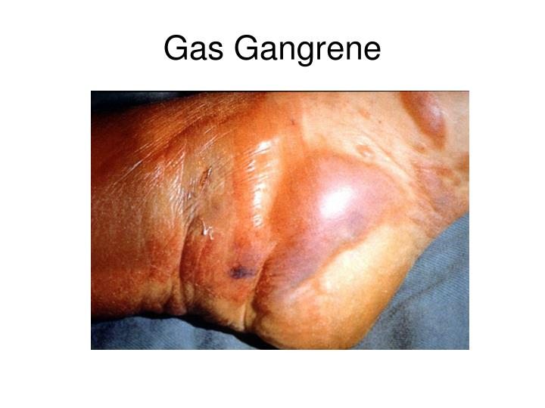
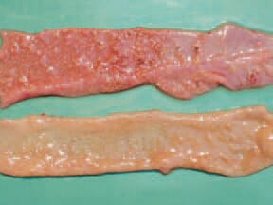
C. perfringens responsible for various clinical systemic & enteric diseases in humans & animals
  Gas gangrene
  Necrotic enteritis
  Food poisoning
  Non-food borne diarrhoea & enterocolitis
  (Heida et al., 2016)
The pathogenicity of C. perfringens may be governed by the toxins & virulent enzymes encoded by virulence genes

Slide 5
More than 16 different toxins have been identified from human & veterinary disease isolates
Lethal toxin | Types | Activity of toxins
Alpha-toxin | A, B, C, D, E | Lethal, necrotizing, haemolytic lecithinase C
Beta-toxin | B, C | Lethal, necrotizing
Gamma-toxin | B, C | Lethal
Delta-toxin | B, C | Haemolytic, lethal
Epsilon-toxin | B, D | Lethal, necrotizing (activated by trypsin)
Eta-toxin | A | Lethal (validity questionable)
Theta-toxin | A, B, C, D, E | Haemolytic (oxygen labile, lethal)
Iota-toxin | E | Necrotizing, lethal (activated by trypsin)
Kappa-toxin | A, C, D, E | Collagenase (lethal, necrotizing, gelatinase)
Lambda-toxin | B, D, E | Proteinase
Mu-toxin | A, B, D | Hyaluronidase
Nu-toxin | A, B, C, D, E | Deoxyribonuclease
Enterotoxin | A, C, D | Complex with plasma membrane

Slide 6
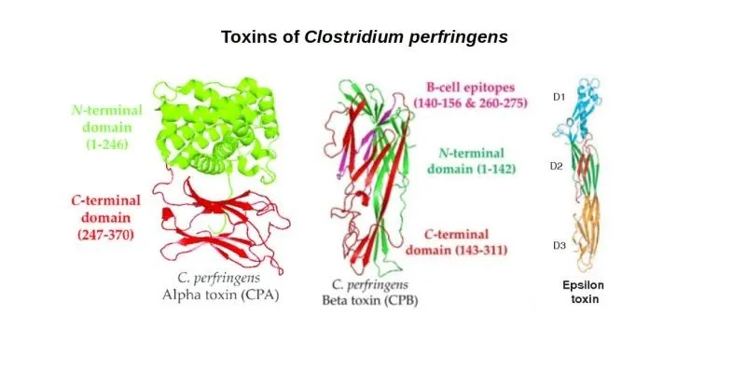
Toxinotypes of C. perfringens
Toxinotype | Major toxins
 | Alpha (CPA) | Beta (CPB) | Epsilon (ETX) | Iota (ITX)
A | X
B | X | X | X
C | X | X
D | X |  | X
E | X |  |  | X
Robertson et al., 2014

Slide 7

Main diseases associated with C. perfringens in human & animals
Type | Major toxin(s) | Human disease | Animal Disease
A | Alpha-toxin | Human myonecrosis (gas gangrene) | Gas gangrene in sheep, cattle, horses, and other spp.; yellow lamb disease in sheep
 | Alpha-toxin, CPE | Human food poisoning; non-food-borne GI diseases | Enteritis in dogs, pigs, horses, foals, and goats
 | Alpha-toxin, NetB | Not reported | Necrotizing enteritis in chickens
 | Alpha-toxin, CPB2 | Not reported | Possible enteritis in pigs; possible enterocolitis in horses
B | Alpha-toxin, beta-toxin, epsilon-toxin | Not reported | Necrotizing enteritis and enterotoxemia in sheep, cattle, and horses
C | Alpha-toxin, beta-toxin | Human enteritis necroticans | Necrotizing enteritis and enterotoxemia in pigs, lambs, calves, foals, and other spp. (usually neonatal)
D | Alpha-toxin, epsilon-toxin | Not reported | Enterotoxemia in sheep, goats, and cattle
E | Alpha-toxin, iota-toxin | Not reported | Enteritis in rabbits, lambs, and cattle
Li et al., 2013

Slide 8
The 2018 C. perfringens toxin-based typing scheme
Toxinotype | Major toxins |  |  |  |  |  | Disease conditions
 | Alpha (cpa or plc ) | Beta (cpb) | Epsilon (etx) | Iota (iap & ibp) | CPE (cpe) | NetB (netB)
A | X
B | X | X | X
C | X | X |  |  | X/−
D | X |  | X |  | X/−
E | X |  |  | X | X/−
F (CPE-positive type A) | X |  |  |  | X |  | Human food-poisoning and non-foodborne C. perfringens-mediated diarrhea, including some instances of antibiotic-associated diarrhea
G (Avian necrotic enteritis type A) | X |  |  |  |  | X | Necrotic enteritis in chickens
10th International Conference on the Molecular Biology and Pathogenesis of the Clostridia held in Ann Arbor, U.S.A. in August 2017 (Rood et al., 2019).

Slide 9
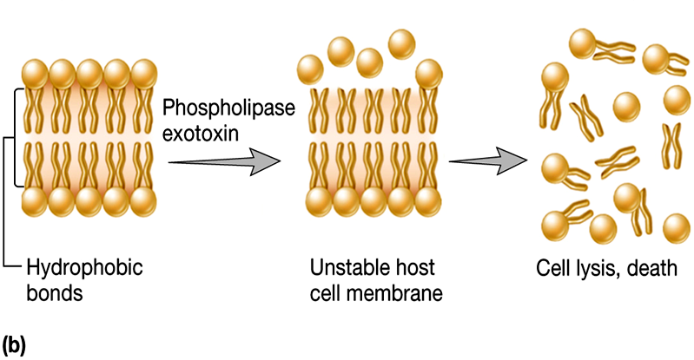
The alpha-toxin (cpa gene): zinc metallophospholipase C that has both phospholipase C (PLC) & sphingomyelinase activity
Alpha-toxin cleaves charged phosphorylcholine head groups from the outer surface of host cell phospholipid bilayers, thereby disrupting the function of host cell membranes, leading to cell lysis and tissue necrosis

Slide 10
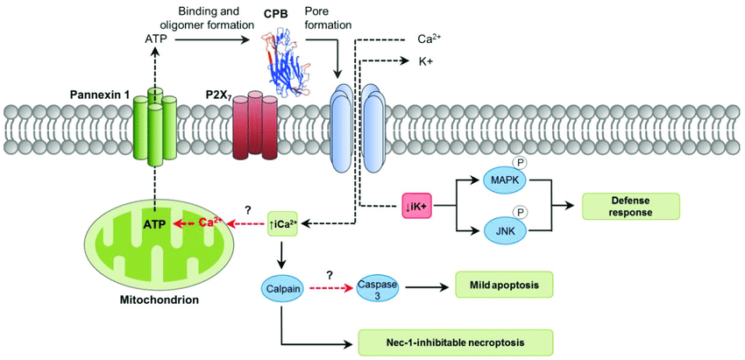
Beta-toxin (cpb gene): a plasmid-encoded pore-forming toxin responsible for intestinal necrotic and systemic enterotoxaemia in humans and neonatal animals
(Uzal et al., 2009)

Slide 11
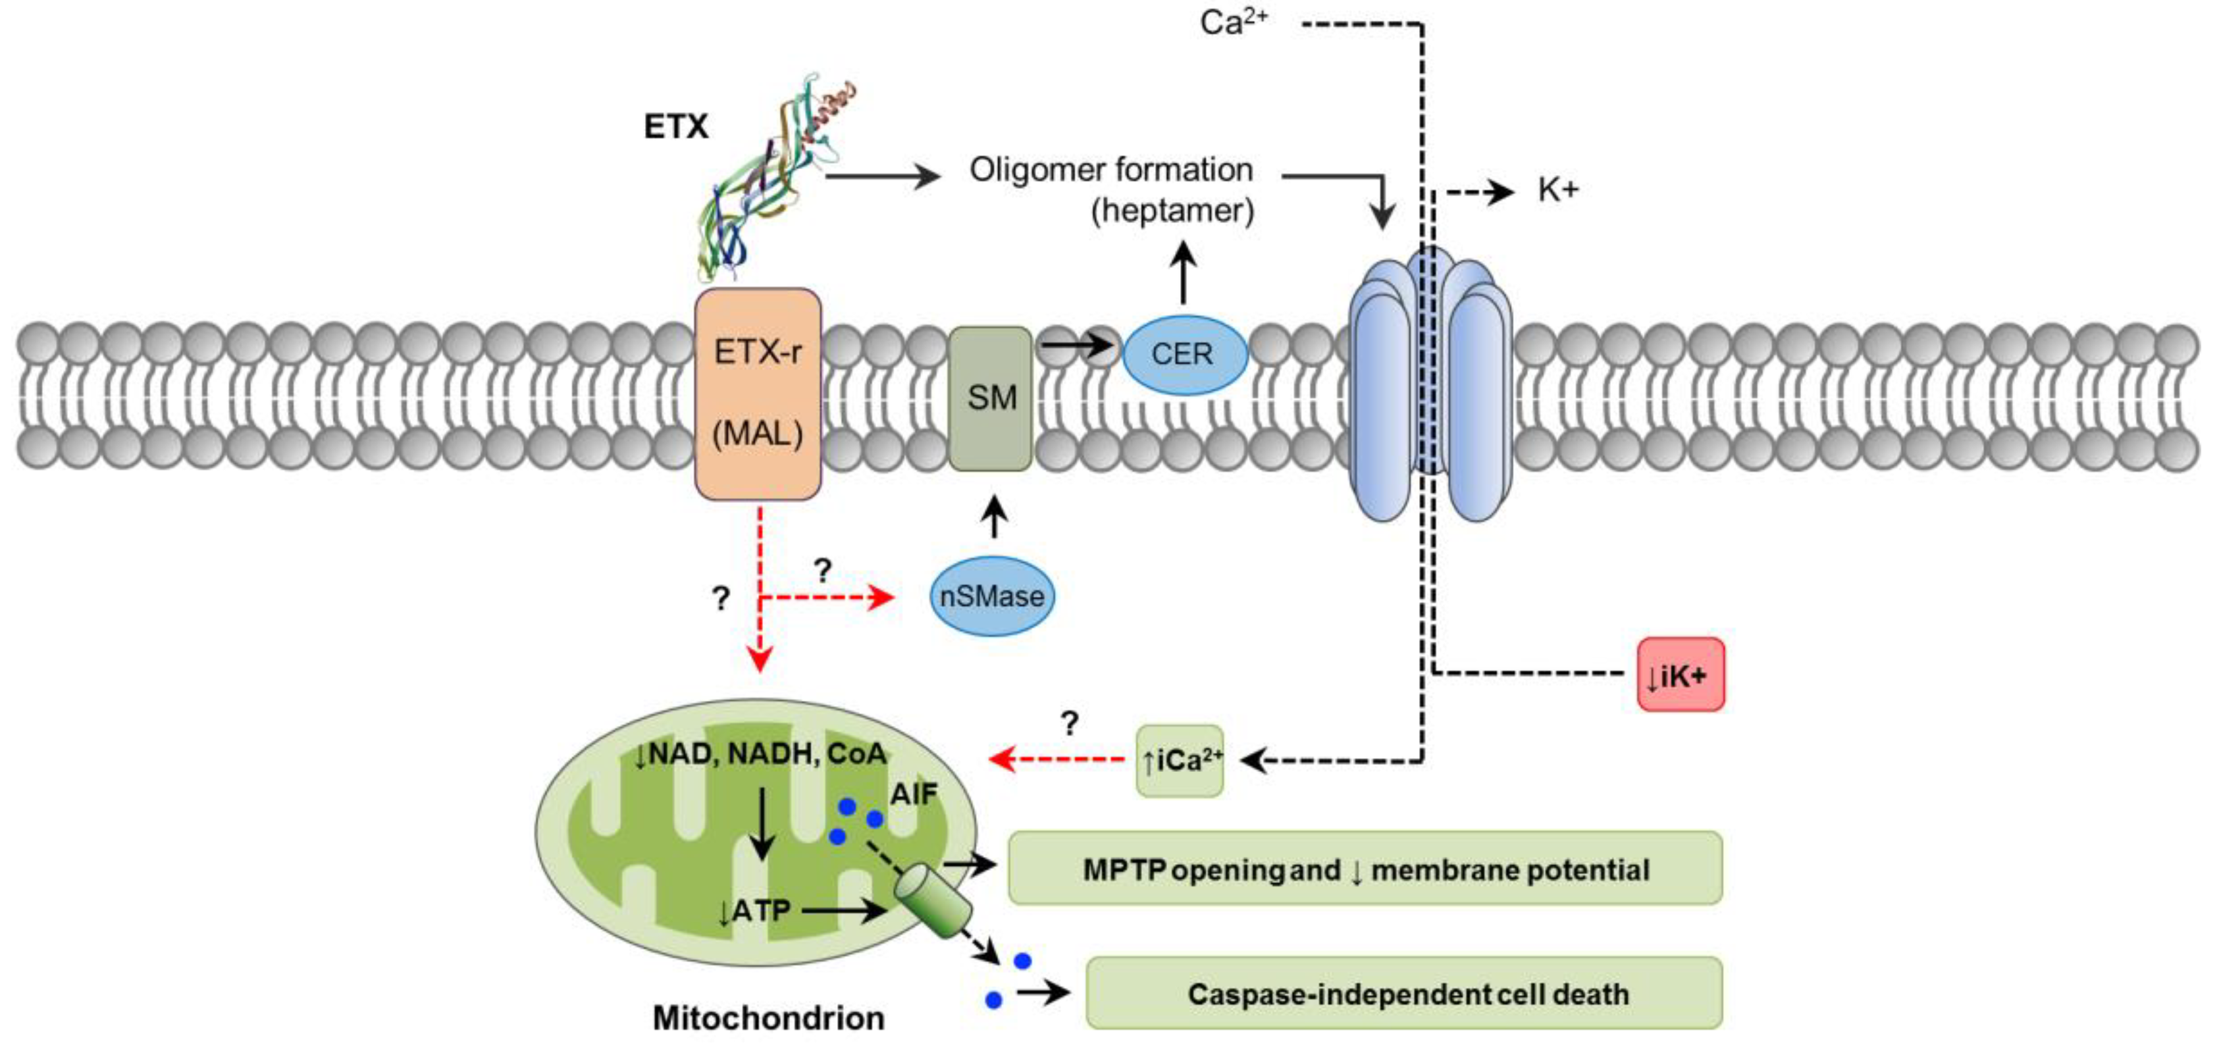
Epsilon-toxin: encoded by plasmid associated etx gene
Produced by C. perfringens type B & D strains responsible for enterotoxaemia in sheep and goat
(Popoff, 2011)

Slide 12
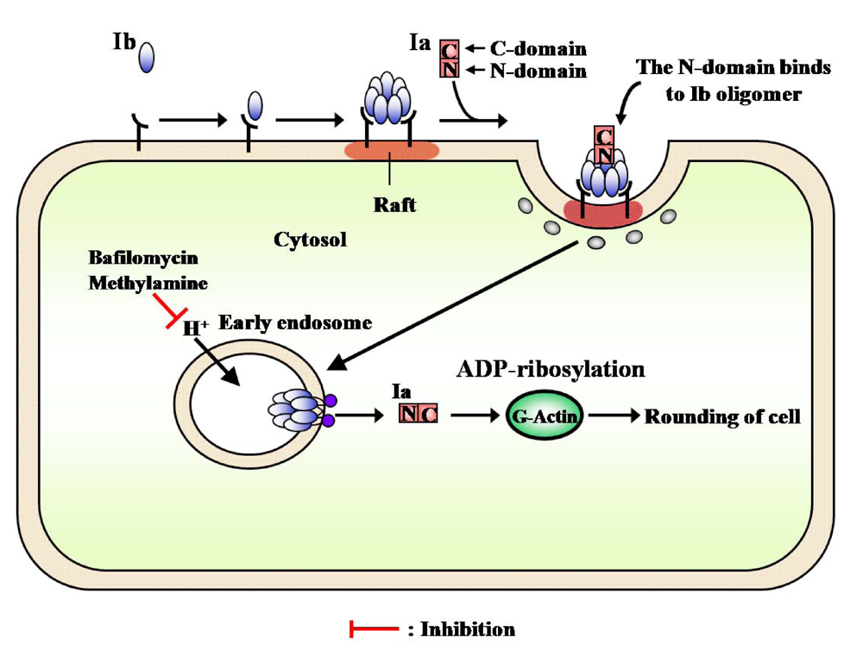
The iota-toxin: cytoskeleton-damaging toxin
Encoded on plasmids by iap & ibp gene
Responsible for apoptosis & cell death
(Hilger et al., 2009)

Slide 13
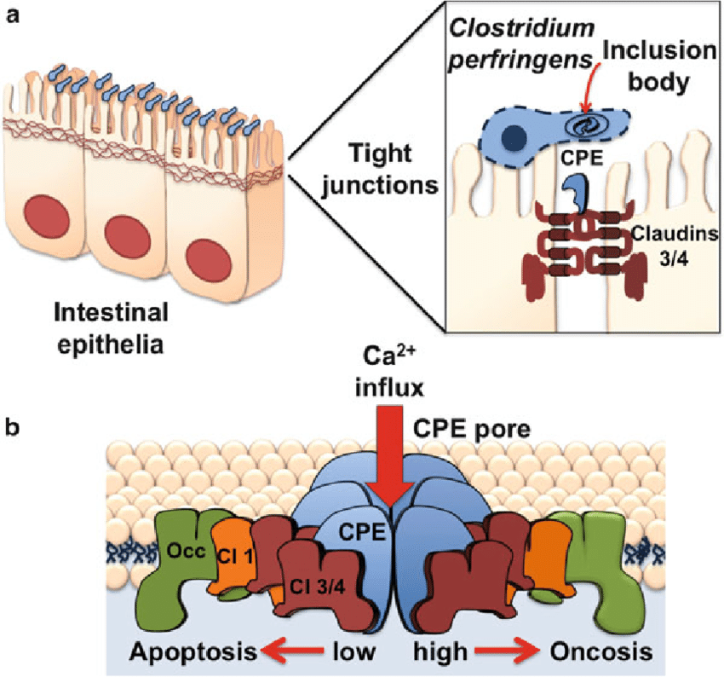
C. perfringens enterotoxin (CPE)
  Produced by some type A, C, D, & E strains but not by any known type B isolates
  Aerolysin family of small pore-forming toxins
  CPE action begins by binding of the toxin to its receptors, which include certain members of the claudin tight junction protein family
  Responsible for disruption of intercellular claudin tight junctions in gut epithelial cells
  (Eichner et al., 2017)
  Induces necrosis, epithelial desquamation, & villus blunting in all sections of the small intestines, but it is particularly active in the ileum

Slide 14
Beta2-toxin
  Pore-forming cytolytic toxin \
  Encoded on plasmid by cpb2 gene
  Recognised as a novel toxin
  Shares <15% sequence homology with β-toxin (Hunter et al., 1993)
  Responsible for NE in piglets, and enterocolitis in foals (Gibert et al., 1997)
  It is reported as an accessory toxin in C. perfringens-associated non-foodborne diarrhoea
(Fisher et al., 2005)

Slide 15
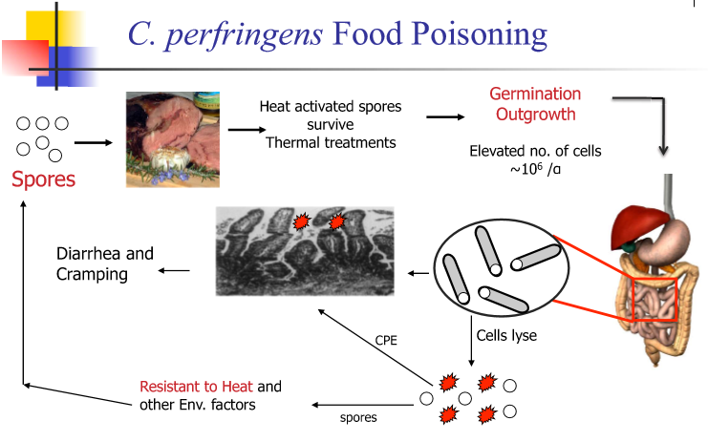
C. perfringens Food poisoning
Raw protein foods of animal origin are frequently contaminated with C. perfringens
Food poisoning occurs typically from the ingestion of 10⁶ viable vegetative cells of the organism in temperature abused foods
(Labbe and Juneja, 2002)
Acidic conditions encountered in the stomach may actually trigger the initial stages of sporulation of the vegetative cells of C. perfringens
Once in the small intestine, the vegetative cells sporulate, releasing an enterotoxin

Slide 16
C. perfringens Food poisoning
cont..
A large proportion of C. perfringens found in raw foods is enterotoxin negative, lacking toxin genes.
Human food poisoning of C. perfringens is depend on three toxins:
  CPE
  beta-toxin
  beta2-toxin
Toxin-producing ability is crucial for human GI diseases

Slide 17
C. perfringens Food poisoning
cont..
C. perfringens food poisoning isolates have several other biological abilities:
  A rapid doubling time (<10 min for vegetative cells)
  The ability of vegetative cells to grow in relatively high optimal growth temperatures (43–45⁰C)
  The ability to form environmental stress-resistant spores
  Tolerance to air exposure in spite of being classified as an anaerobic bacterium
These properties also play important roles in the induction of C. perfringens foodborne illness

Slide 18
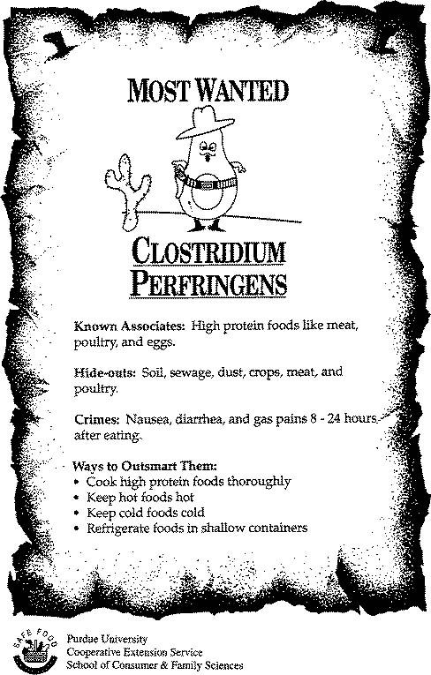
The typical incubation period before onset of symptoms is 8 to 24 hours.
Acute diarrhea with severe abdominal cramps and pain.
Acute symptoms usually last less than 24 hours.
Full recovery within 24 to 48 hours is normal.
Fatalities are rare in healthy individuals.

Slide 19
Detection of C. perfringens
The many available methods of detection can be categorized as:
Metabolite-based biochemical (phenotyping/biotyping) assays
Toxin, antigen based immunological methods
Nucleic acid based molecular techniques.

Slide 20
Method | Detection limits | Considerations | Reference
Mouse neutralization | 6 MLD50/ml | Inhumane and costly | Uzal et al. (2003)
ELISA | 5 ng CPE/g feces | Sporulation variability in foods | Bartholomew et al. (1985)
4-Layer ELISA | 6.25 ng/ml | Toxin Proteolysis | El Idrissi (1989)
PC-ELISA | 0.075 MLD50/ml | False positives | Uzal et al. (2003)
MC-ELISA | 0.75 MLD50/ml | Lower sensitivity | Uzal et al. (2003)
CIEP | 200 MLD50/ml | False negatives | Uzal et al. (2003)
Vero cell assay | 40 ng CPE/g | Feces Sensitivity and reproducibility | Berry et al. (1988)
Reversed passive latex agglutination | 50–100 ng CPE/g | Faeces Nonspecific interference | Brett (1998)
Colony hybridization | 10 CFU/g food | 48-h detection | Baez and Juneja (1995)
Hydrophobic grid membrane filter | 10 CFU/g | Food Isolation of cpe-positives | Heikinheimo et al. (2004)
Real-time PCR | 50 fg genomic DNA 20 cells (pure culture) | Unidentified PCR inhibitors | Wise and Siragusa (2005)
Multiplex PCR | Enrichment culture | False positives | Baums et al. (2004)
PFGE | DNA preparations from enriched samples | Problematic nucleases | Maslanka et al. (1999)
AFLP | DNA preparations from enriched samples | Multiple genetic elements | Keto-Timonen et al. (2006)
Ribotyping | DNA preparations from enriched samples | Costly equipment and existing databases | Schalch et al. (1997)
Oligonucleotide microarrays | DNA preparations from enriched samples | Fluorescently labeled DNA probes hybridized to single-stranded DNA on a chip | Al-Khaldi et al. (2004)

Slide 21
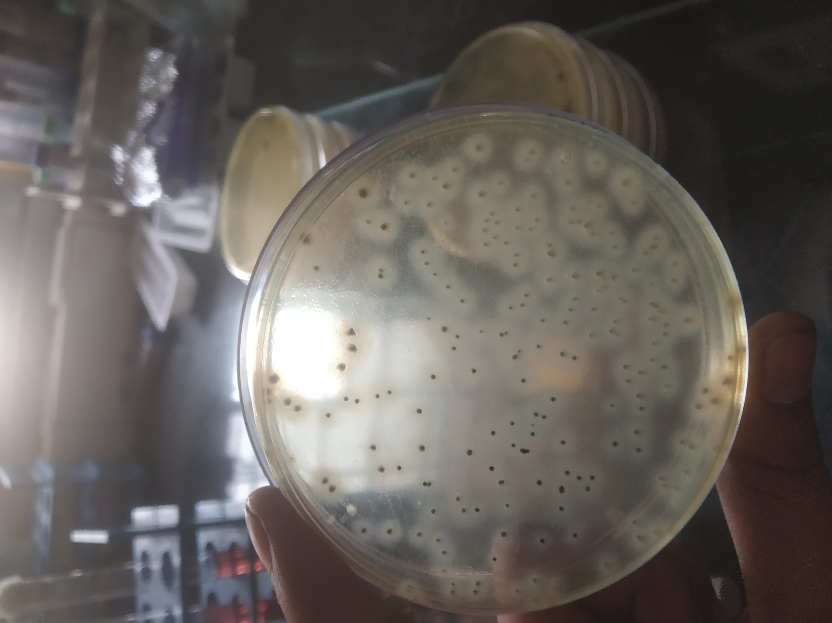
Enumeration & identification of C. perfringens in foods
Methods for the enumeration & identification in foods based upon:
  The microorganism’s innate ability to reduce sulfite to sulfide
  Distinctive black ferrous sulfide precipitate on tryptose-sulfite-cycloserine (TSC) agar
  (Harmon et al., 1971)
  U.S. Food and Drug Administration Center for Food Safety and Applied Nutrition (FDA/CFSAN), Bacteriological Analytical Manual.

Slide 22
Selective & differential media for C. perfringens
Iron sulfite agar
Shahidi-Ferguson perfringens agar
Sulfite cycloserine azide (SCA)
Differential clostridial agar (DCA)
Oleandomycin polymyxin sulfadiazine perfringens agar
All these media effective for enumeration studies.
SCA and DCA were less effective at low concentrations of C. perfringens in food
Shahidi Ferguson perfringens and oleandomycin polymyxin sulfadiazine perfringens agars produced low counts at times
DCA and SCA were very laborious to prepare Iron sulfite agar lacked selectivity
(de Jong et al., 2003)

Slide 23
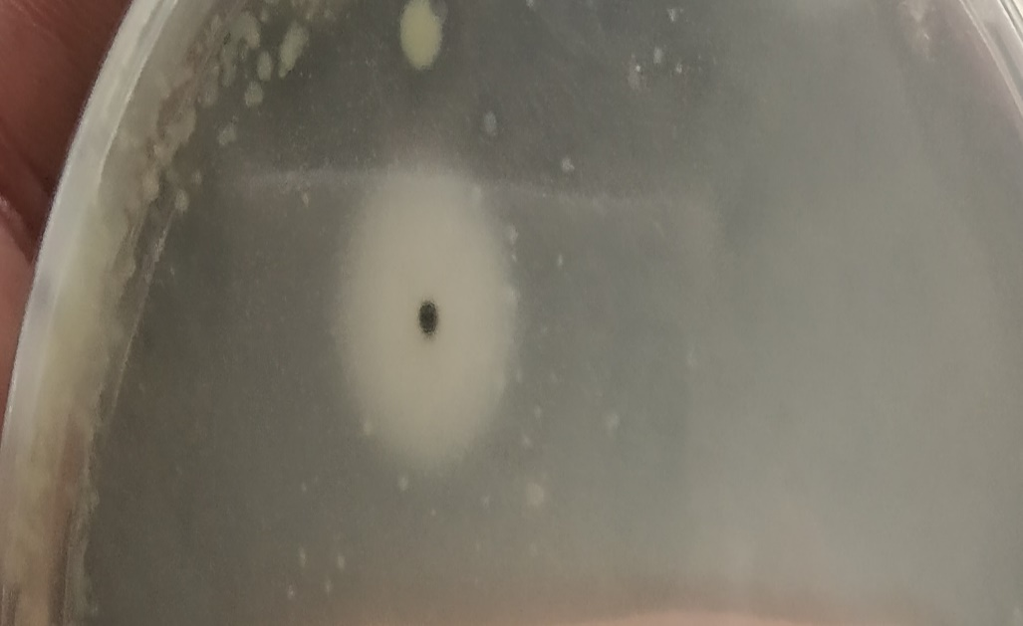
Presumptive tests for identification of C. perfringens
Food-borne outbreaks of C. perfringens can be confirmed if 10⁵ CFU/g of the organism or 10⁶ spores/g are detected in the implicated food or feces, respectively.
(Labbe and Juneja, 2002)
2- to 4-mm opaque white zone surrounding the colonies, as a result of lecithinase activity

Slide 24
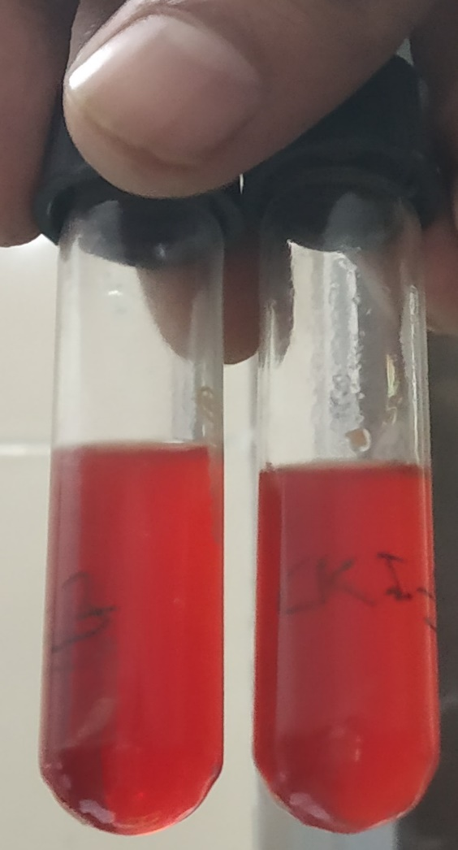
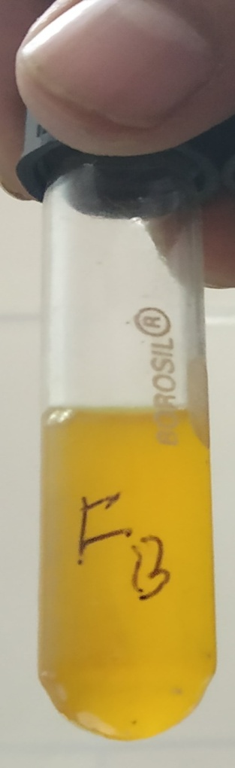
Rapid coagulation of an iron-milk medium
Liquefaction of gelatin in lactose-gelatin medium
Fermentation of lactose-producing acid and gas
-
+

Slide 25
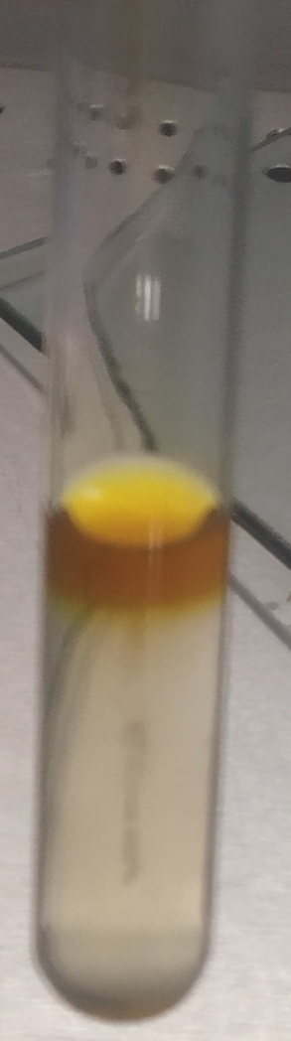
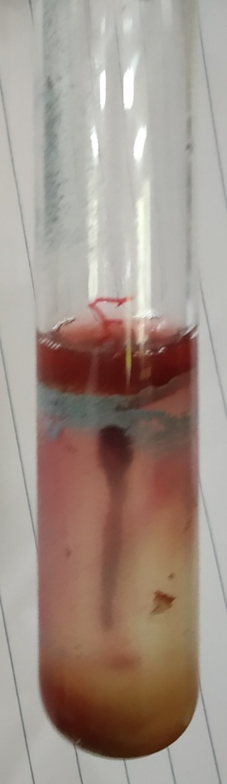
Lack of motility in motility-nitrate medium
An ability to reduce nitrates to nitrites
(Rhodehamel & Harmon, 1998)
+
-

Slide 26
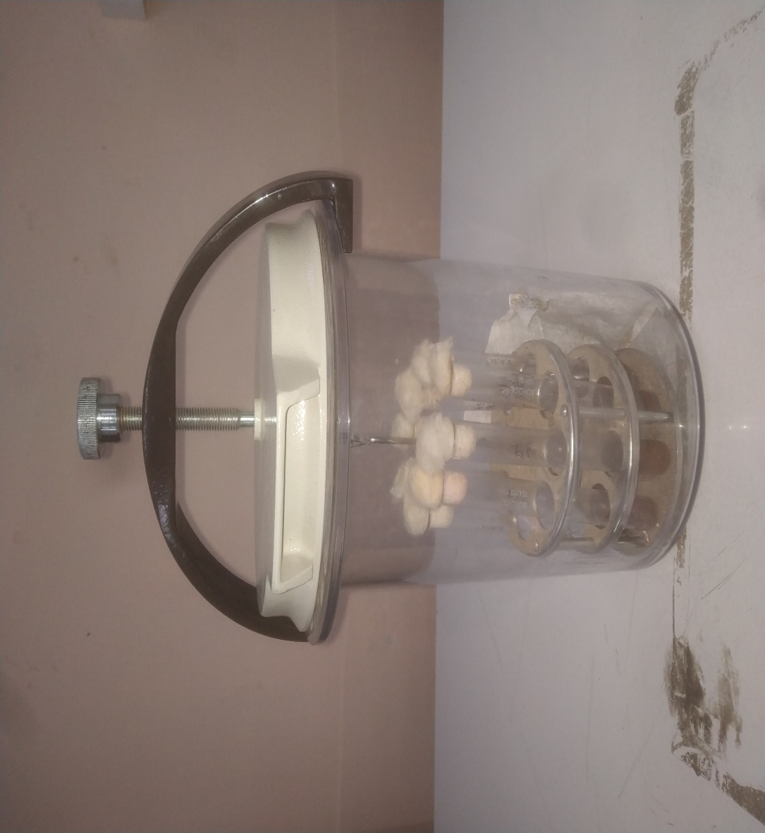
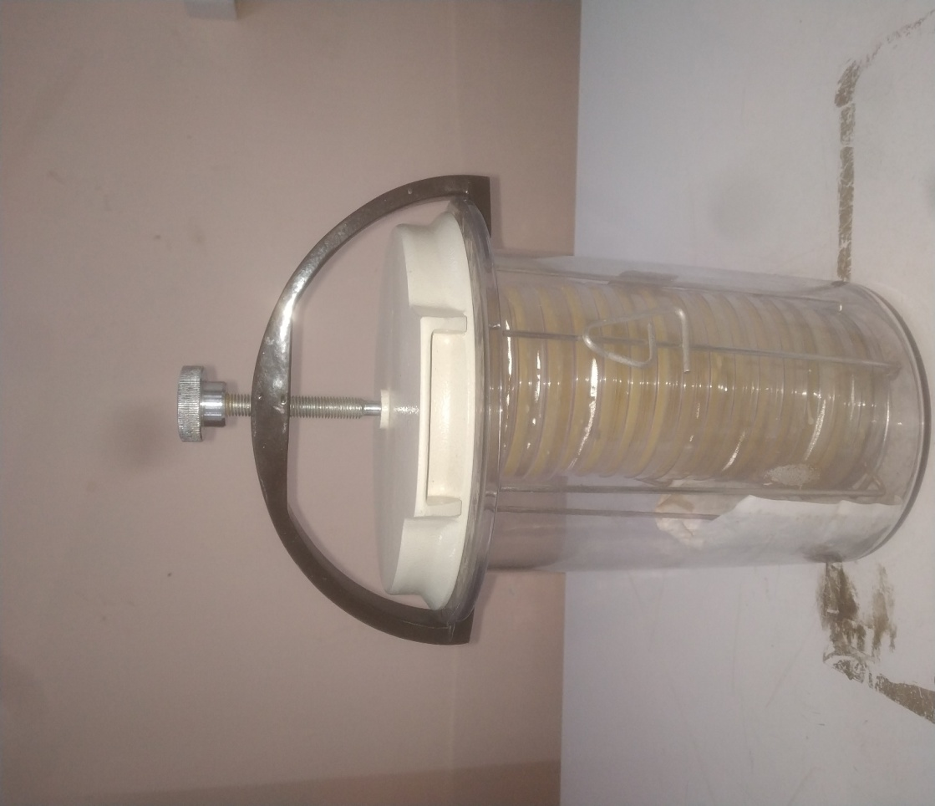
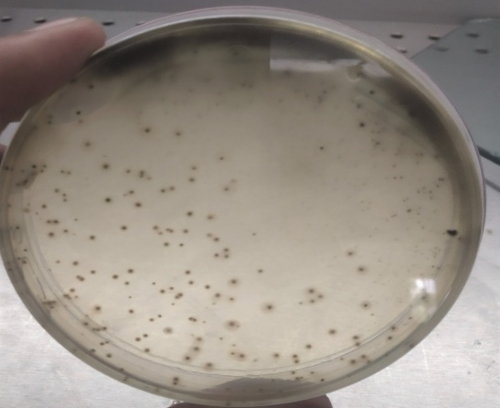
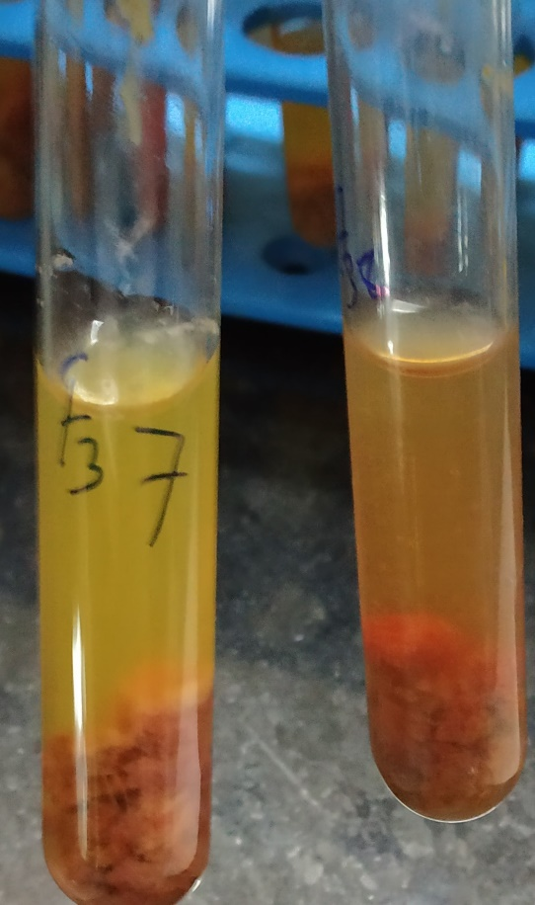
Isolation of C. perfringens from food or fecal samples
SFP Agar with Kanamycin (6mg/100ml) & Polymixin B (15000 IU/100ml)
Lactose fermentation in MCMM broth

Slide 27
Molecular methods for identification of C. perfringens
There are numerous PCR methods for detection of C. perfringens from foods & stool samples
DNA samples are isolated from suspected isolates of C. perfringens on selective agar
Then amplified using specific primer pairs for a gene encoding a product such as
  16S rRNA
  alpha toxin (cpa)
  beta toxin (cpb)
  epsilon toxin (etx)
  iota (iap)
  enterotoxin (cpe)
  beta2 toxin (cpb2) & others
Sr. No. Primer Sequence Target Gene Product Size (bp) References
1 F: TAACCTGCCTCATAGAGT
R: TTTCACATCCCACTTAATC 16S rRNA 481 Tonooka et al., 2005
2 F: GCTAATGTTACTGCCGTTGACC
R: TCTGATACATCGTGTAAG cpa 324 Titball et al., 1989
3 F: GCGAATATGCTGAATCATCTA
R: GCAGGAACATTAGTATATATCTTC cpb 196 Hunter et al., 1993
4 F: GCGGTGATATCCATCTATTC
R: CCACTTACTTGTCCTACTAAC etx 655 Hunter et al., 1992
5 F: GGAGATGGTTGGATATTAGG
R: GGACCAGCAGTTGTAGATA cpe 233 Czeczulin et al., 1993
6 F: AGATTTTAAATATGATCCTAACC
R: CAATACCCTTCACCAAATACTC cpb2 567 Garmory et al., 2000

Slide 28
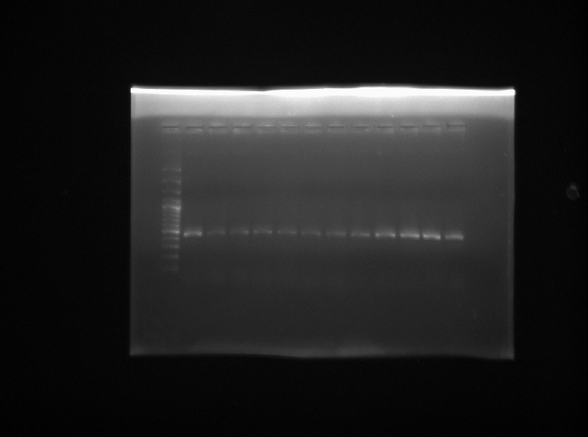
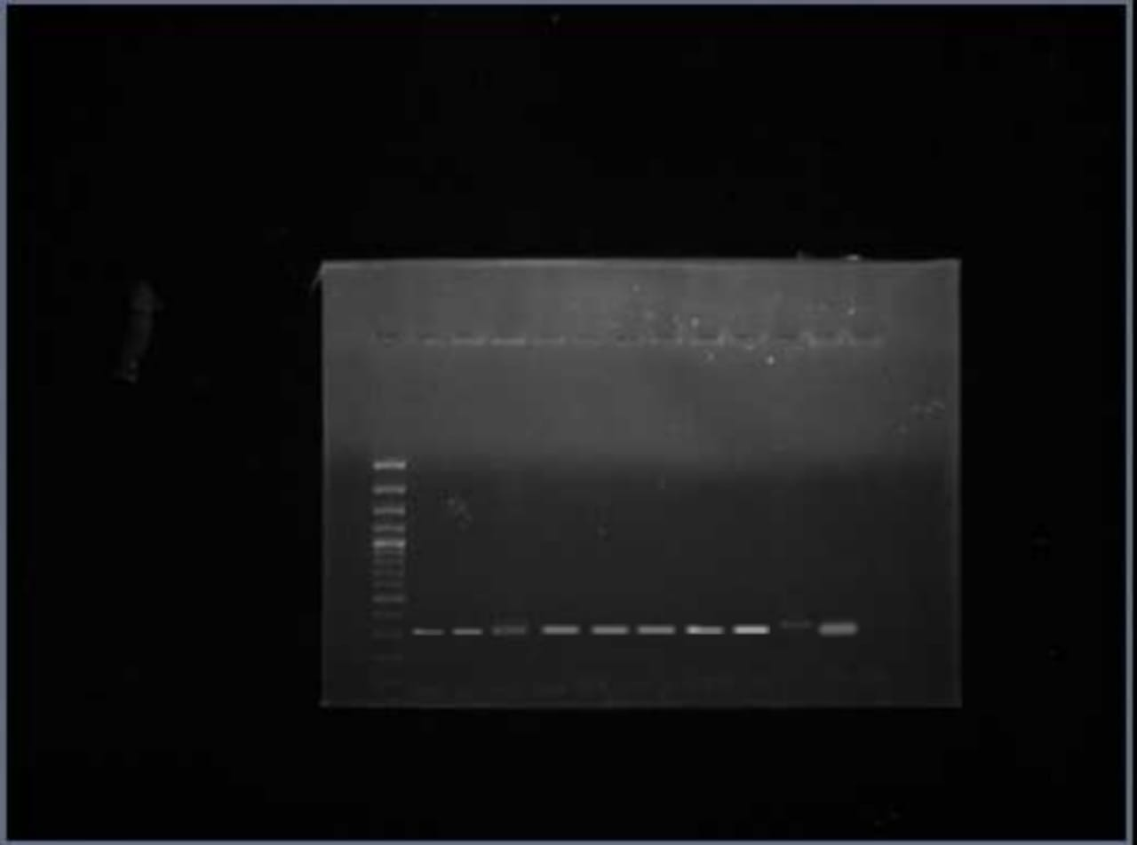
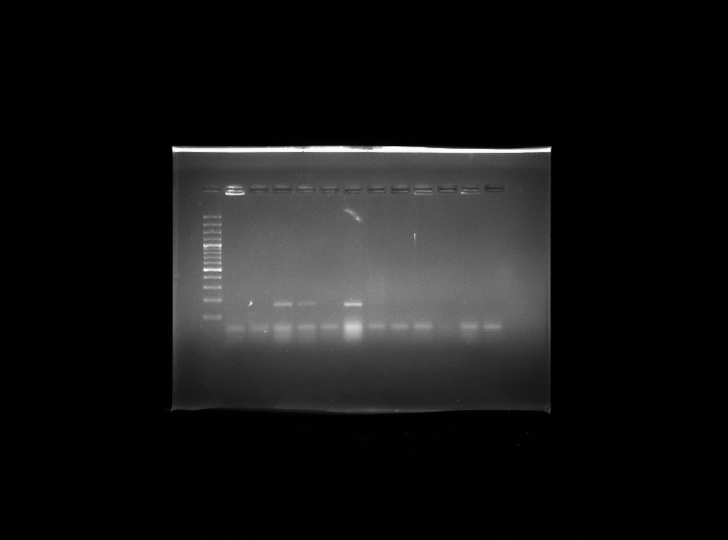
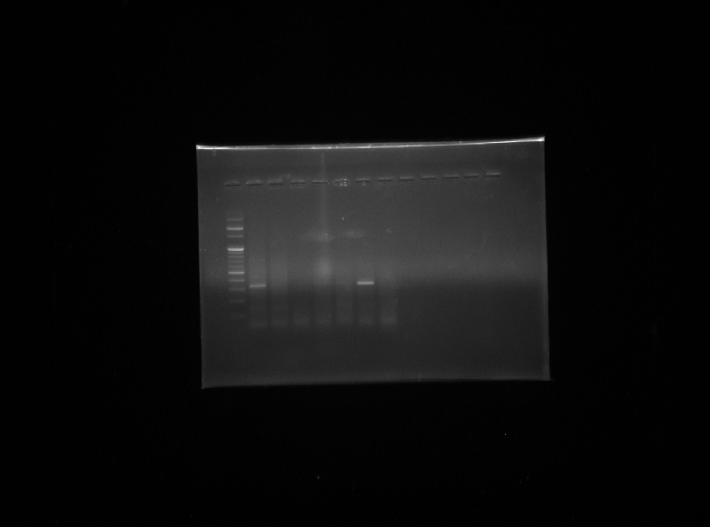
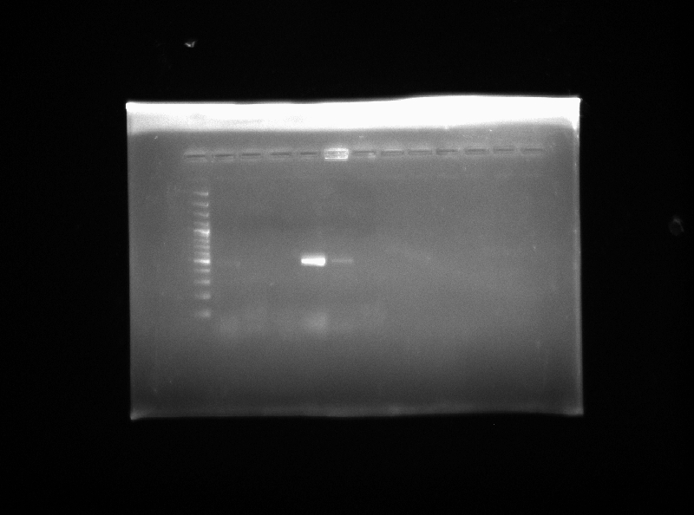
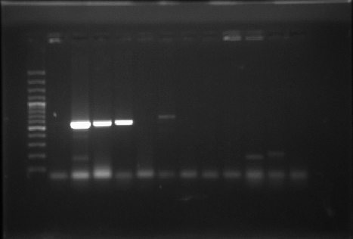
Species specific 16S rRNA gene
cpa gene
cpb gene
481 bp
cpe gene
etx gene
cpb2 gene

Slide 29
In addition to single gene PCR assays, multiplex PCR assays have been developed to simultaneously detect more than one gene target, such as the cpa, cpb, etx, iap, cpe, and cpb2 providing very useful C. perfringens genotyping diagnoses
(Baums et al., 2004)

Slide 30
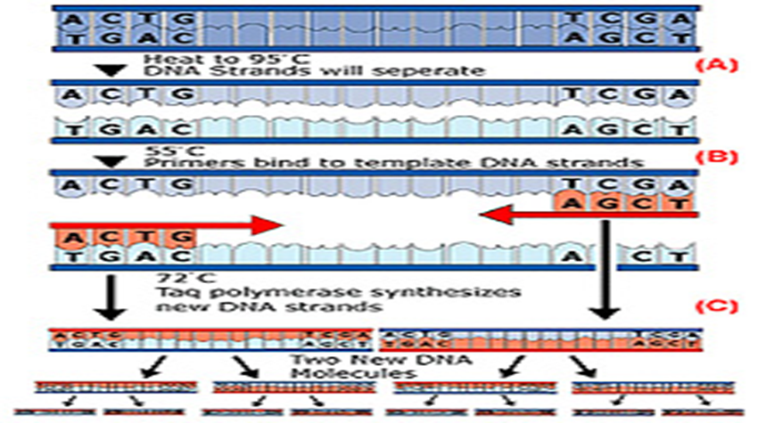
A quantitative real-time PCR assay
Enables an even more rapid detection (within a few hours) & enumeration scheme for C. perfringens isolates in a food or fecal sample
(Wise and Siragusa, 2005)

Slide 31
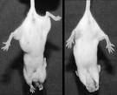

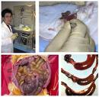
BIOASSAY METHOD
MOUSE LETHALITY
Cl. perfringens enterotoxin
GUINEA PIG SKIN TEST
Erythemal activity- Cl. perfringens enterotoxin
LIGATED LOOP TECHNIQUE

Slide 32
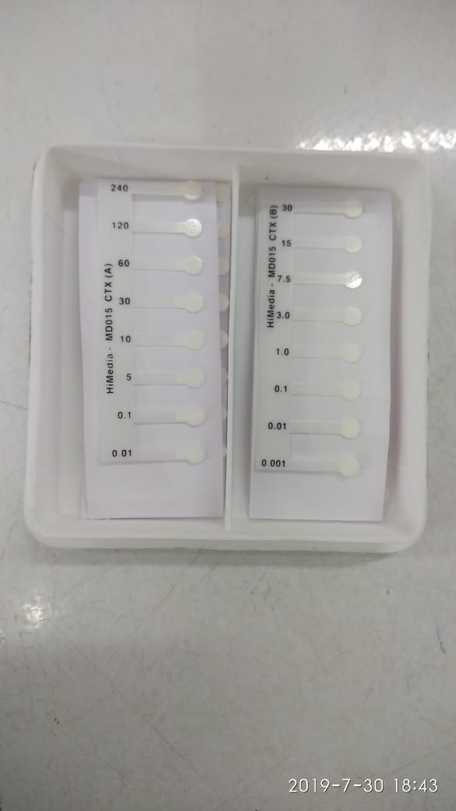
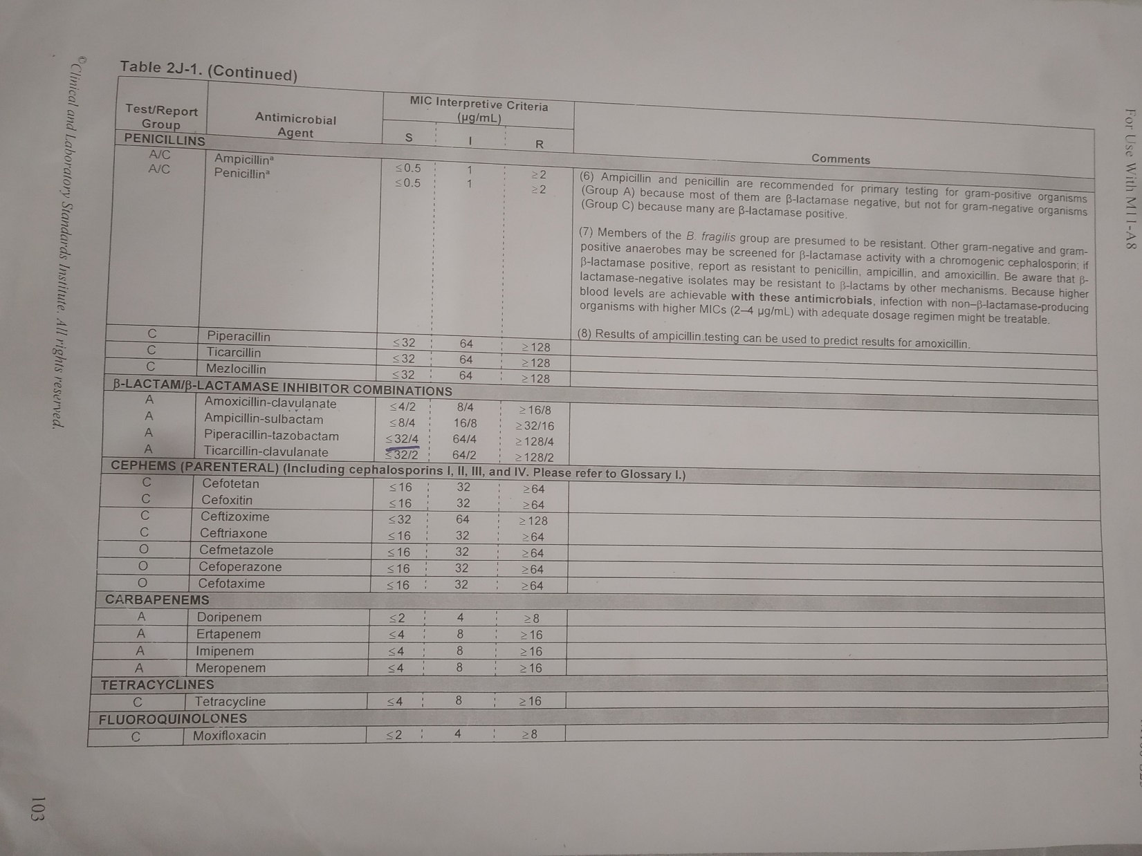
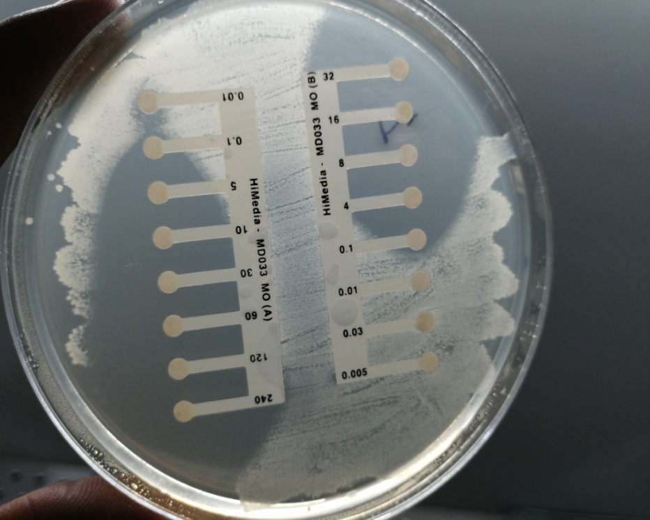
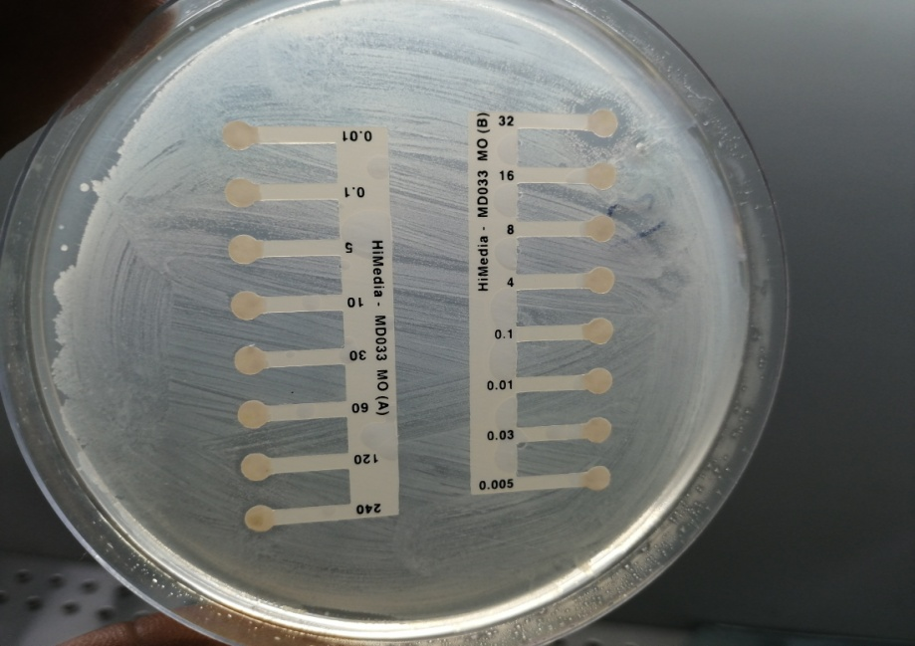
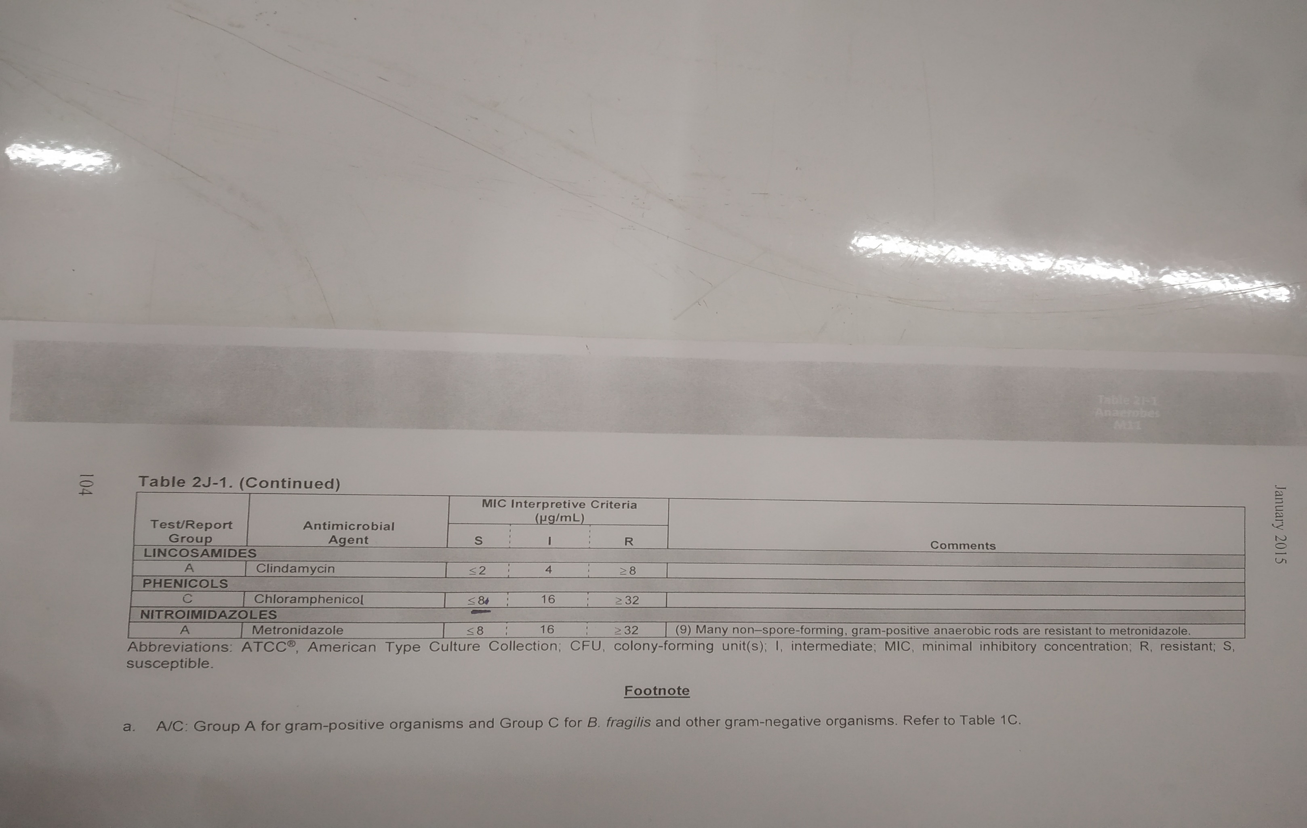
Determination of Minimum Inhibitory Concentration and antibiotic sensitivity profile of C. perfringens isolates
CLSI, 2017

Slide 33
Phylogenetic analysis of C. perfringens isolates
An elementary principle for microbial subtyping:
  Isolates harboured from an epidemiologically interrelated cluster arise from a common clone which share common characteristics that discriminate them from epidemiologically unrelated isolates categorized as the same species
  Since, it is always possible to isolate the similar subtypes of the organisms from different unrelated sources,
  The epidemiological relationship between subtype can be determined by several typing methods
  However, subtyping practices are evaluated on different parameters including typeability, discrimination & utility

Slide 34
The recent techniques using molecular method available for studying genetic relationship of bacterial pathogens included
  Pulsed-field gel electrophoresis (PFGE),
  Multilocus sequence typing (MLST),
  Amplified fragment length polymorphism (AFLP),
  Restriction fragment length polymorphism (RFLP),
  Repetitive extragenic palindromic- PCR (REP-PCR),
  Random amplification of polymorphic DNA (RAPD) PCR
  Anterobacterial repetitive intergenic consensus polymerase chain reaction (ERIC-PCR)
Out of these molecular methods PFGE has been recognised as one of the best typing methods for various microorganisms (Alavandi et al. 2001)
However, other techniques such as RAPDs and ERIC-PCR assays for typing of pathogens are easier, inexpensive & faster to accomplish & are therefore appropriate for epidemiological studies of the pathogenic microorganisms
(Versalovic et al., 1991; Talon et al., 1996)

Slide 35
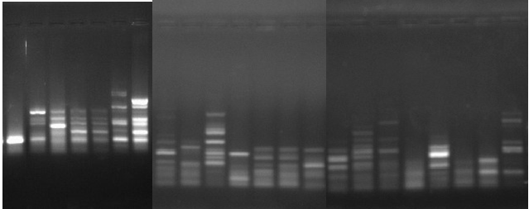
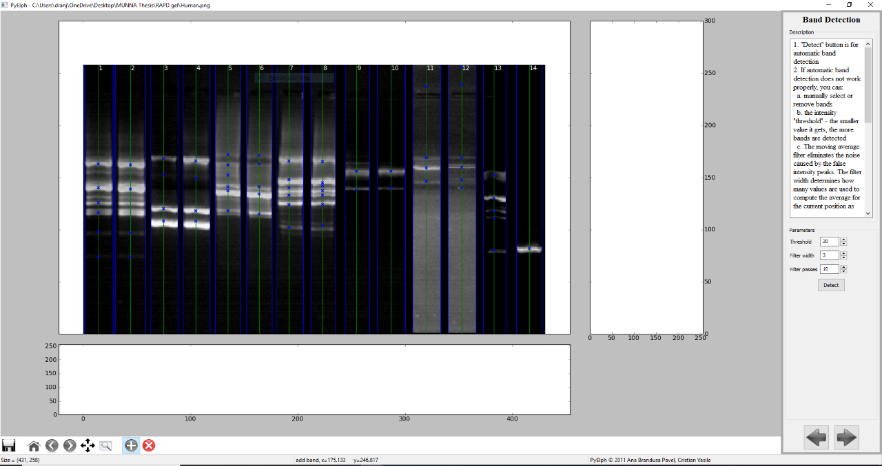
ERIC-PCR:
eric1 | ATGTAAGCTCCTGGGGATTCAC
eric 2 | AAGTAAGTGACTGGGGTGAGCG

Slide 36
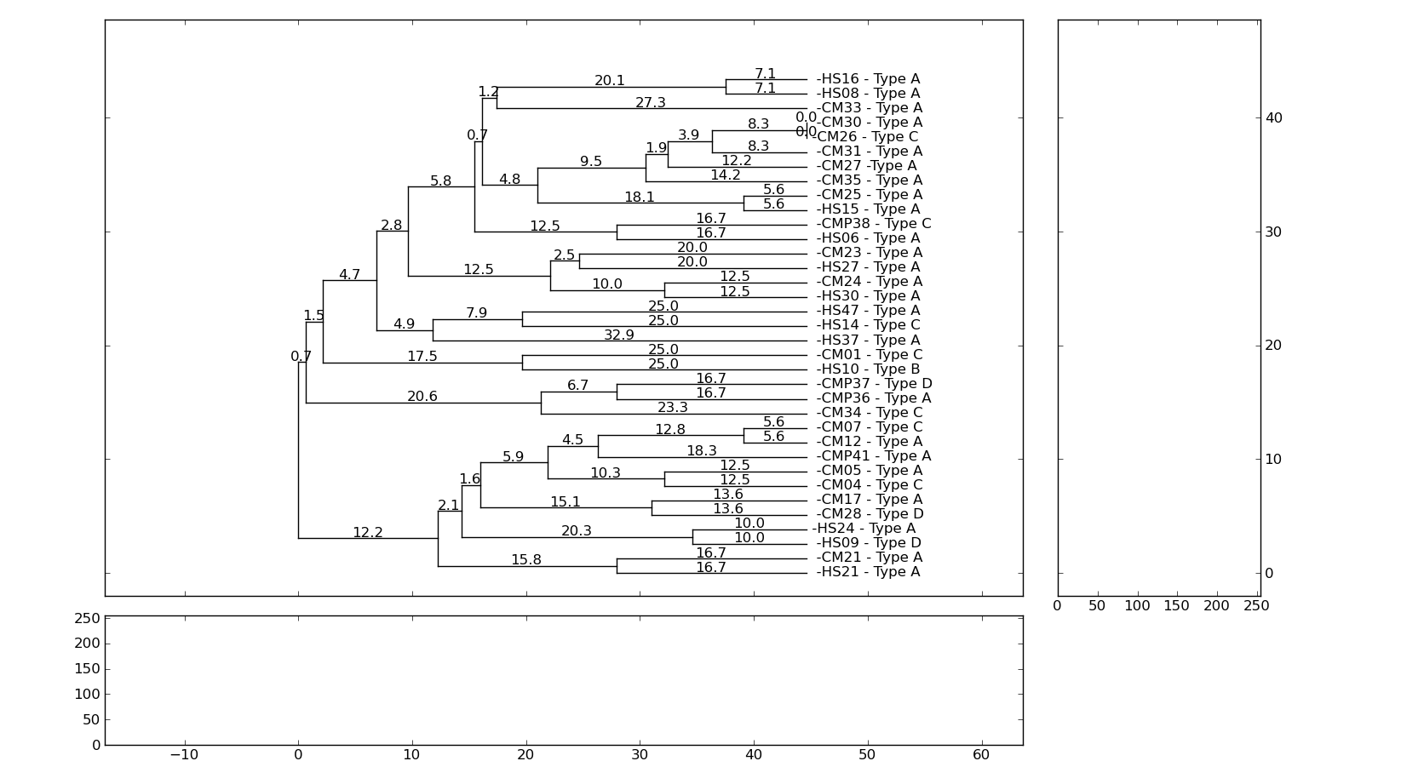

Slide 37
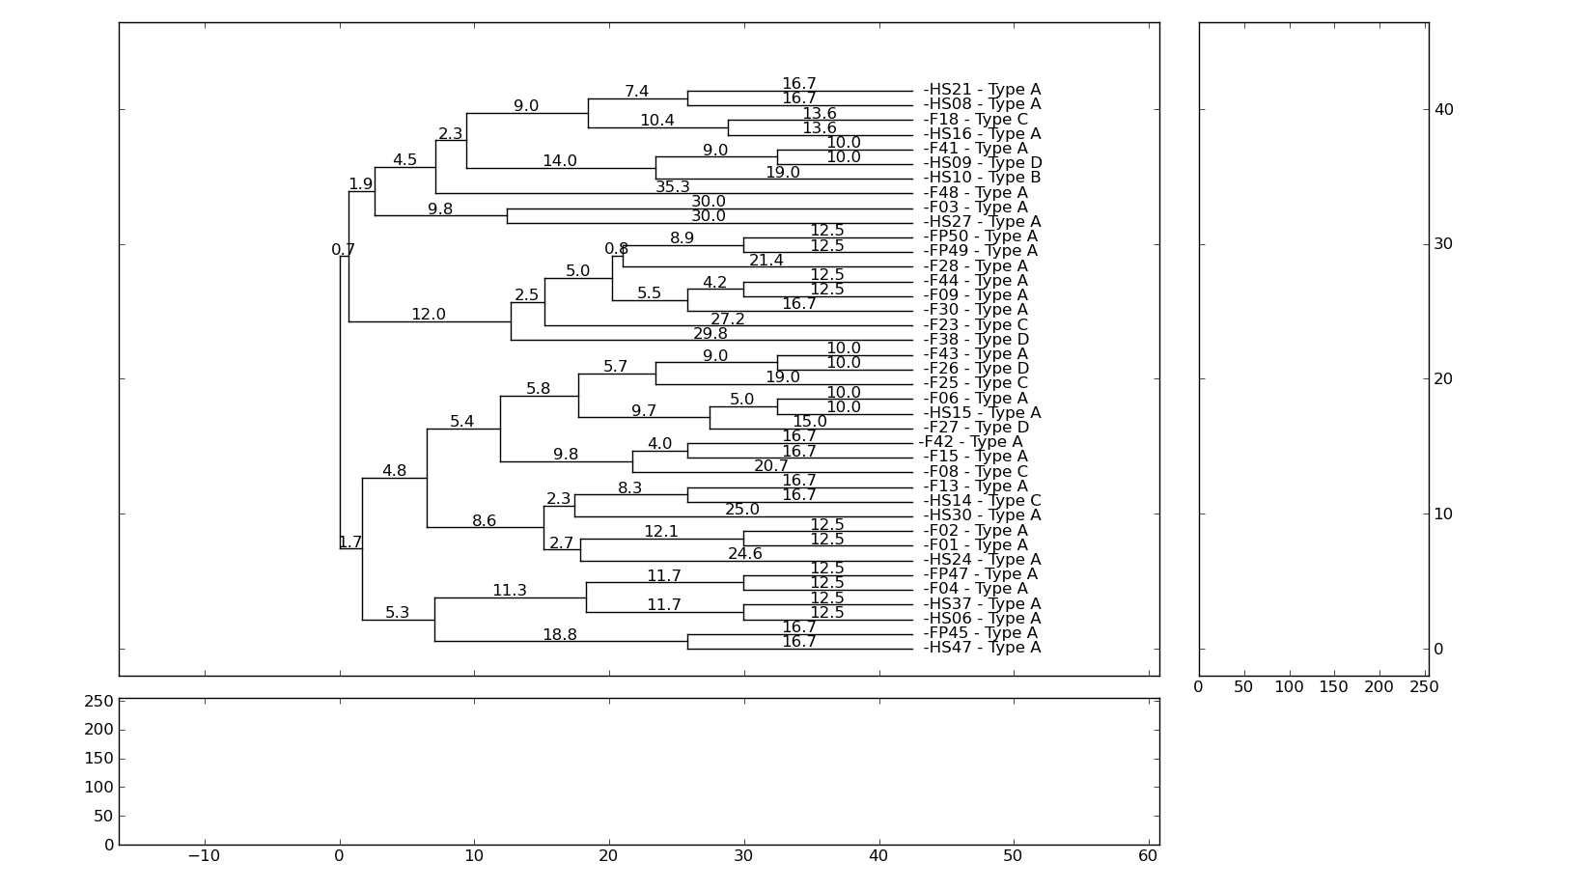
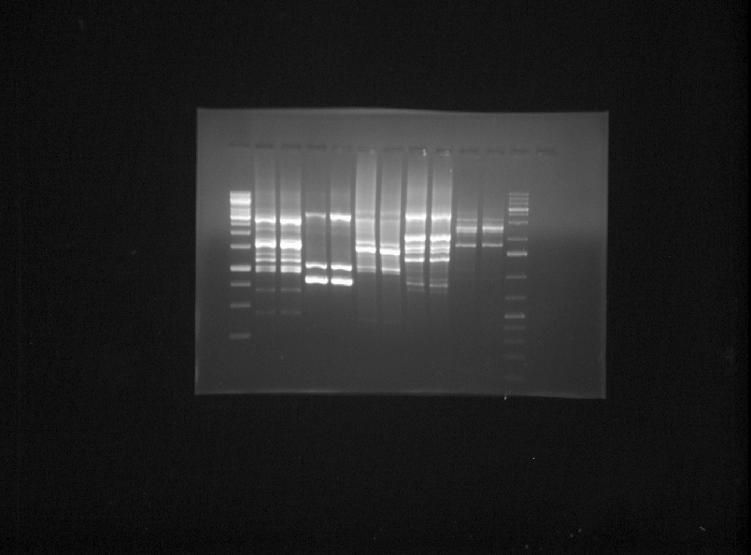
RAPD-PCR:

Slide 38
THANKS

