Slide 1
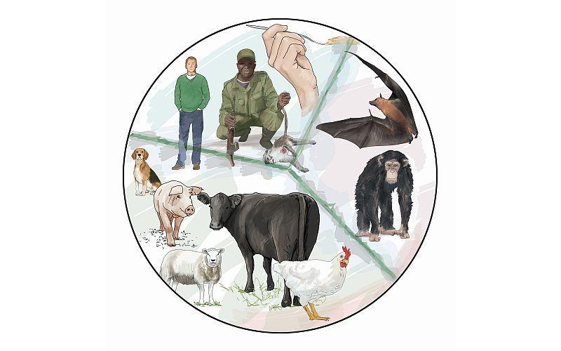
Emerging, Re-emerging and Occupational Zoonoses

Slide 2
Definition
Emerging Zoonoses
According to the WHO emerging zoonoses is "a zoonosis that is newly recognized or newly evolved, or that has occurred previously but shows an increase in incidence or expansion in geographical, host or vector range”
An emerging infectious disease is a one that is caused by a newly discovered infectious agent or by a newly identified variant of a known pathogen, which has emerged and whose incidence in humans has increased during the last two decades and is threatening to increase in the near future.
• This term also refers to that disease which was formerly confined to one geographic area, has now spread to other areas.

Slide 3
Definition
Re-emerging Zoonoses
Disease that once were major health problem globally and then decline dramatically but are again a health problem for a significant proportion of population.
The diseases which was previously controlled but once again has risen to be a significant health problem
• Recently, decreased compliance with vaccination policy has also led to reemergence of diseases such as measles and pertussis, which were previously under control
The use of deadly pathogens, such as smallpox or anthrax, as agents of bioterrorism is an increasingly acknowledged threat

Slide 4
Emergence and re-emergence of zoonotic diseases may be any one of the following categories
A known agent appearing in a new geographic area.
A known agent appearing in a unsusceptible species.
A previously unknown agent detected for the first time.
Total human pathogens known
Emerging human pathogens

Slide 5
Global Examples of Emerging & Reemerging infectious diseases
*Emergence of COVID-19 (December, 2019, China), Pandemic in 170 Count.
(NIH, 2015)

Slide 6
Viral Diseases | Bacterial Diseases | Parasitic Diseases
COVID-19 | Nontyphoid strains of Salmonella | Alveolar Echinococcosis
Ebola Virus Disease | Borrelia burgdorferi (Lyme borreliosis) | Cryptosporidiosis
Nipah virus | Ehrlichia and Anaplasma spp. (Ehrlichiosis),
Avian influenza, | Mycobacteria paratuberculosis (Johne’s/ Chronne’s disease),
Bovine Spongiform Encephalitis (BSE), | Francisella tularensis (Tularemia)
Rift Valley fever, | Bartonella spp. (Bartonellosis)
Severe acute respiratory syndrome (SARS), | Enterohemorrhagic Escherichia coli (Bloody diarrhoea)
Monkeypox | Campylobacter spp
Orphan viruses such as Enteroviruses
Myxoviruses,
Herpesviruses

Slide 7
Emergence and Re-Emergence of diseases: Broad factor

Slide 8
Emergence and Re-Emergence of diseases: Factors
AGENT
H5N1/ H1N1
EBOLA
Genetic Modification
Drug Resistance
COVID-19
Hanta virus
MDR TB
BSE

Slide 9
Occupational Zoonoses
Disease and infections that are transmitted in nature between man and animals on account of their occupation
Examples: Anthrax, Brucellosis, Leptospirosis, Q fever etc.
WHO Expert Committee on Bacterial and Viral Zoonoses (1982) categorized the occupational groups in seven categories depending upon the type of exposure

Slide 10
1. Agricultural e.g. Anthrax, Brucellosis
2. Animal product manufacturers e.g. Tularemia
3. Sylvan and Campestral e.g. Rabies, KFD
4. Recreational e.g. Psittacosis, campylobacteriosis
5. Clinical/Laboratory e.g Brucellosis, TB
6. Epidemiological e.g. Plaque, JE, Yellow fever
7. Emergency e.g. Leptospirosis

