Slide 1
Food borne zoonoses

Slide 2
EVENTS OF FOOD BORNE DISEASES
Reservoir of Pathogen
Contamination of food
Viral or Parasitic
infection
Growth of pathogenic bacteria
Food+ Live cells
Food +Toxin
Mycotoxin
Infection
Intoxication
Invasive Infection
Toxicoinfection

Slide 3
BACTERIAL TOXIN
ENDOTOXIN
EXOTOXIN

Slide 4
ENDOTOXIN

Slide 5
CHARACTERISTICS OF BACTERIAL ENDOTOXINS AND CLASSIC EXOTOXIN
PROPERTY | ENDOTOXIN | EXOTOXIN
CHEMICAL NATURE | LPS (mw = 10kDa) | Protein (mw = 50-1000kDa)
RELATIONSHIP TO CELL | Part of outer membrane | Extracellular, Diffusible
HEAT STABILITY | Yes (60⁰ C) | Relatively No
ANTIGENIC | Yes | Yes
FORM TOXOID | No | Yes
POTENCY | Relatively low (100ug) | Relatively high (1 ug)
SPECIFICITY | Low degree | High degree
ENZYMATIC ACTIVITY | No | Often
PYROGENICITY | Yes | Occasionally
SYNTHESIS CONTROL | Chromosomal gene | Extrachromosomal gene

Slide 6
Food infection. The ingestion of viable pathogenic bacteria alongwith the food leads to their lodgement and establishment in consumers organ. This is called as “Food infection”.
Food intoxication. Ingestion of toxins already produced by microorganisms in the food brings about poisoning syndromes in the consumers. This is called as “Food intoxication”.
Toxi-infection. A certain group of organisms which can infect intestines when ingested alongwith the food and produce toxins in situ to bring about symptoms of poisoning. This condition is called as “toxi-infection”.

Slide 7
Invasive Infection
Toxicoinfection
Intoxication
Salmonella
L. monocytogenes
E. coli
( enteric type)
Shigella
Campylobacter
Yersinia
Vibrio parahaemolyticus
Aeromonas
Bacillus cereus
(Diarrhoel)
Cl.botulinum
( Infant)
Cl . perfringens
Vibrio cholarae
E. Coli
(Enterotoxigenic)
Staph. Aureus
B.Cereus
(Emetic type)
Cl. botulinum

Slide 8
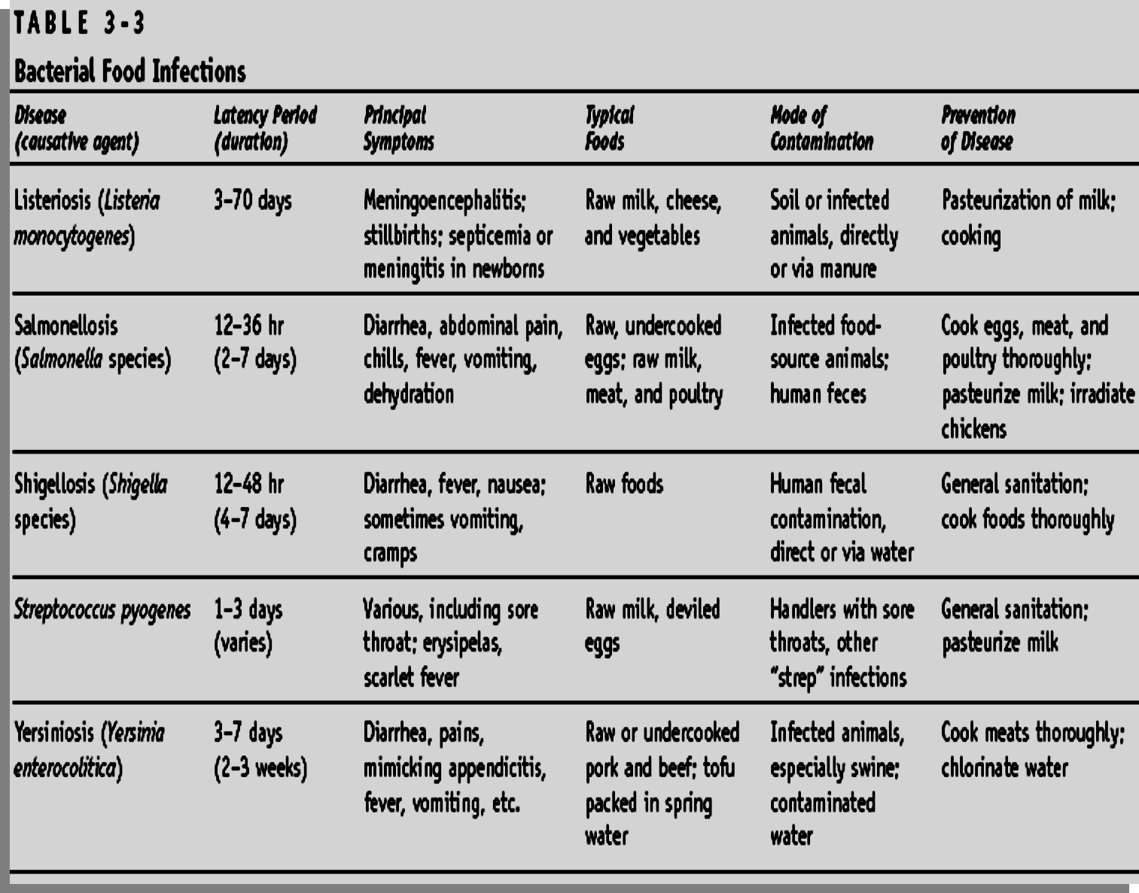
FOOD BORNE BACTERIAL ILLNESS

Slide 9
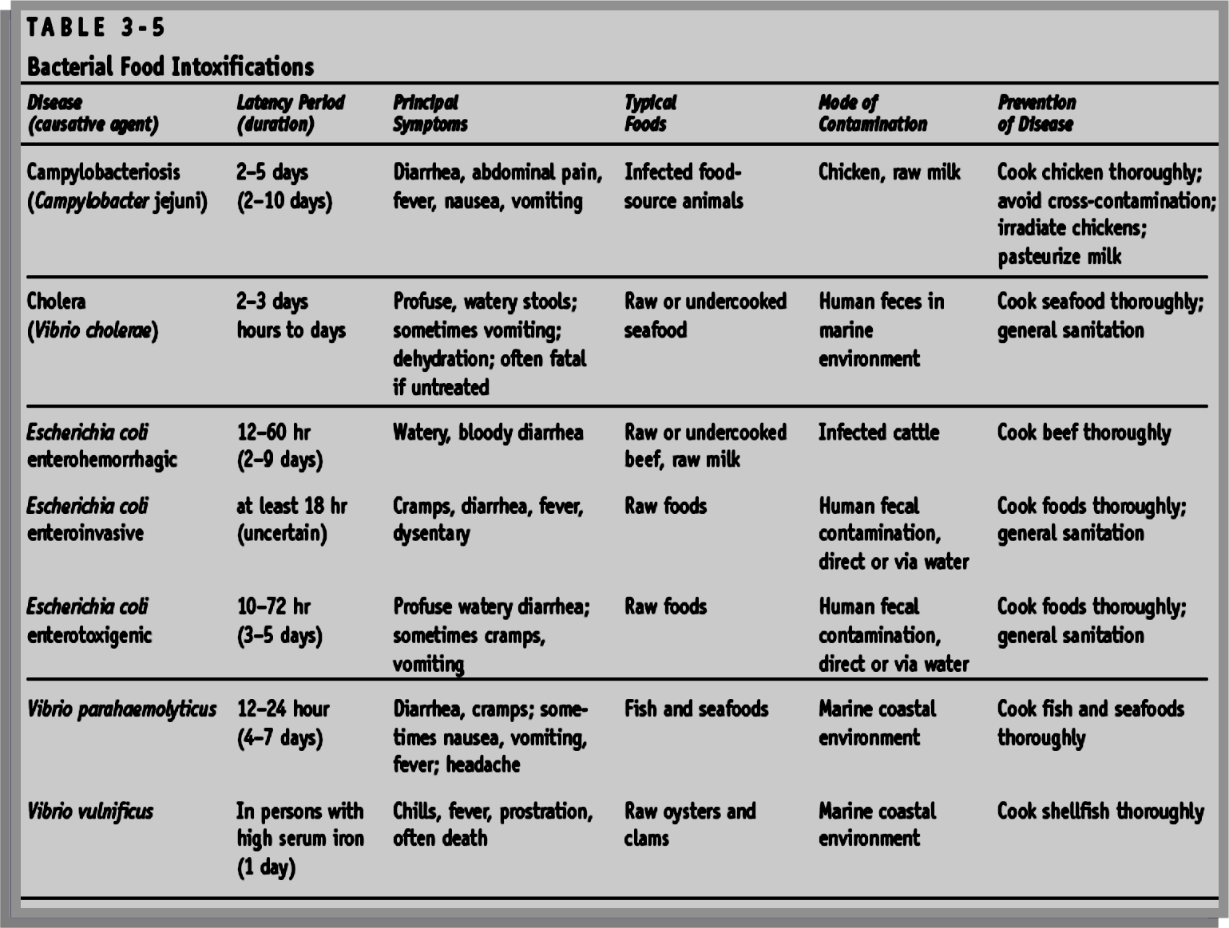
FOOD BORNE BACTERIAL ILLNESS

Slide 10
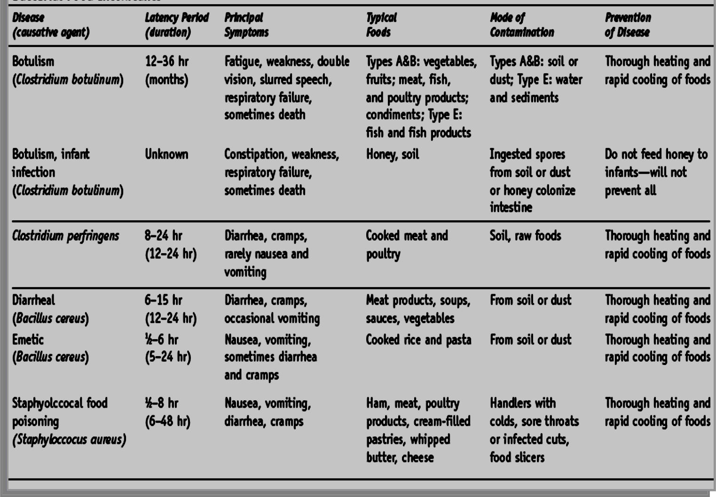
FOOD BORNE BACTERIAL ILLNESS

Slide 11
Important helminthic zoonoses
Flukes:
Fasciolosis: (F. gigantica, F. hepatica)
Fasciolopsosis: (Fasciolopsis buski)
Amphistomosis: (Gastrodiscoides hominis)
Schistosomosis/Cercarial Dermatitis:
Animal and bird schistosomes
Paragonimosis:
Paragonimus westermanii
Tapeworms:
Taeniosis/Cysticercosis
Hydatidosis
Diphyllobothriosis
Sparganosis
Nematodes:
Visceral Larva Migrans/Ocular Larva Migrans
Cutaneous Larva Migrans/Eosinophilic Enteritis
Gnathostomosis
Filariosis

Slide 12
Food borne viral zoonoses
Rota virus
Poliovirus
Norwalk virus
Picornaviridae
Hepatovirus
Hepatitis A & E virus
Astrovirus
Adenoviruses
Arenavirus
Hantavirus
Foot-and-Mouth Disease virus
Aichi virus

Slide 13
Thanks

