Slide 1
Indirect Selection
Dr. Jay Prakash Gupta
Associate Professor, Animal Genetics & Breeding
Bihar Veterinary College
BASU, Patna
Bihar - 800014

Slide 2
Explanation
Selection applied to some character other than the one it is desired to improve. We shall refer to the character to which selection is applied as the "secondary" character.
Might go for selection
Trait X
Want to Improve
Can achieve progress through correlated response to X
Trait Y

Slide 3
Indirect Selection: Basic Concept
Indirect selection is the selection applied to some character other than the one to which it is desired to improve.
If we want to improve character x, we might select for another character y and achieve progress through the correlated response of character x.
The character to which selection is applied is called as secondary character

Slide 4
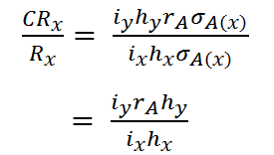
Suppose,
R_{x} = Direct response to selection in desired character
CR_{x} = Correlated response of character x resulting from selection applied to the secondary character Y
So,

Slide 5
Advantages or application of indirect selection
Applicable when the two characters have high genetic correlation
Heritability of character under selection (h²_{x}) is sufficiently high than h²_{y}
Difficult to measure character Y than X
Information on character X is early in life
Information on character X is costly to measure
desired character is measurable in only one sex
Used for reducing the generation interval

Slide 6
Thanks!
Any questions?
You can find me at:
@JP_AAtrey
jp.prakash01@gmail.com

