Slide 1
‘Veterinary Epidemiology & Zoonoses’
VPH-321
(Credit Hours-2+1)

Slide 2
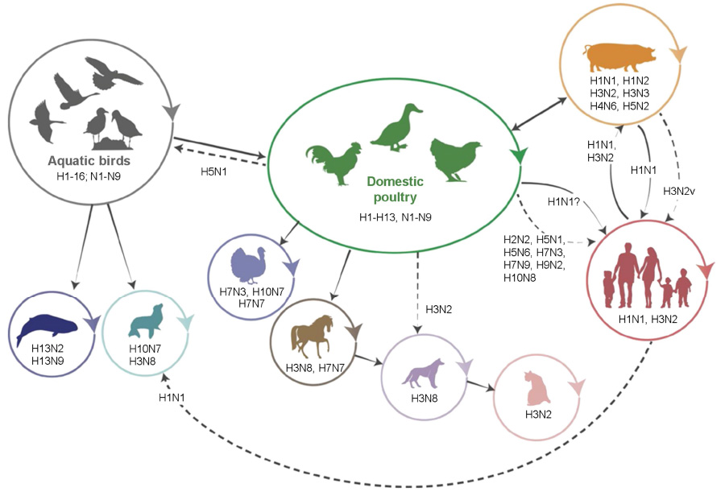
Zoonotic Influenza
Influenza is a contagious, acute respiratory illness caused by influenza viruses, usually influenza A or B subtypes

Slide 3
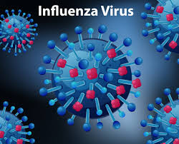
Etiology
Family-Orthomyxoviridae
RNA genome
Four types are recognized:
A: In human, pig, horse, pig: causes pandemic
B: In human
C: Mild illness
D: Effect cattle
Two surface antigens: Protein subunit of viral envelope
Haemagglutinin (H): Sixteen (H1 to H16)
Neuraminidase (N): Eleven (N1 to N11)
Immunologic & epidemiologic interest
Occur in a number of different combinations
Each combination: different subtypes of the virus
(CDC, WHO)

Slide 4
Structure of Influenza A Virus
Eight segment RNA virus
Rod shape
Mashroom shape

Slide 5
Nomenclature of the virus
1. Virus type;
2. Host of origin;
3. Geographic origin;
4. Strain number;
5. Year of isolation and
6. Antigenic description of subtype
Ex: A/Duck/Ukraine/1/63 (H3N8)

Slide 6
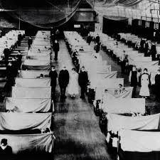
Known human Pandemic
H1N1:
Spanish flu (1918)
H2N2:
Asian flu (1957)
H3N2:
Hong Kong flu (1968)
H5N1:
Bird flu (2004) - highly pathogenic avian influenza virus of type A of subtype H5N1 (HPAI-A H5N1)

Slide 7
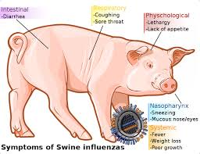
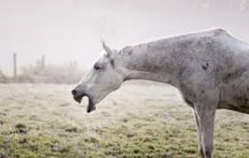
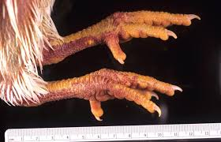
Reported influenza subtypes in animals
Swine:
H1N1 (Classical swine influenza)
H3N2
H1N2
Horses:
H7N7
H3N8
Birds:
H5N1
H3N2
H1N2

Slide 8
Antigenic Drift
Minor antigenic changes in HA or NA, results in frequent epidemics
A(H3N2) A/Sydney/05/97
A(H3N2) A/Panama/2007/99
Avian strains show less antigenic drift than mammalian strains.

Slide 9
Antigenic Shift

Slide 10
Difference Between Antigenic Drift And Antigenic Shift
S.N | Antigenic drift | Antigenic shift
1 | Minor change within subtype | Major changes between two subtypes
2 | Point mutation | Exchange of genetic material (genetic re-assortment)
3 | Occurs in A and B subtypes | Occurs in A subtypes only
4 | May cause epidemic | May cause Pandemic
5 | Example: A/Sydney/05/97 (H3N2) replaced A/Panama/2007/99 (H3N2) | Example: H3N2 replaced H2N2 in year 1968

Slide 11
Risk Factors
Age:
Adults over age 65
Children under 5 years old
Young adults & children under age 19: receiving long-term aspirin (Bufferin) therapy
People with compromised immune systems: AIDs
Pregnant women
People with chronic illnesses:
Asthma,
Heart disease,
Diabetes mellitus,
Neuromuscular disease

Slide 12
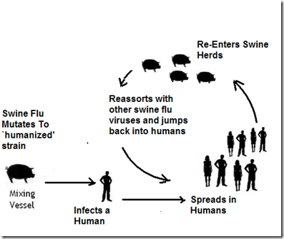
Swine flu: Transmission
Transmission usually occurs from person to person,
Spread through saliva & mucus particles
People may spread it by:
Sneezing
Coughing
Touching a germ-covered surface and then touching their eyes or nose
Can’t spread swine flu from eating properly cooked pork products

Slide 13
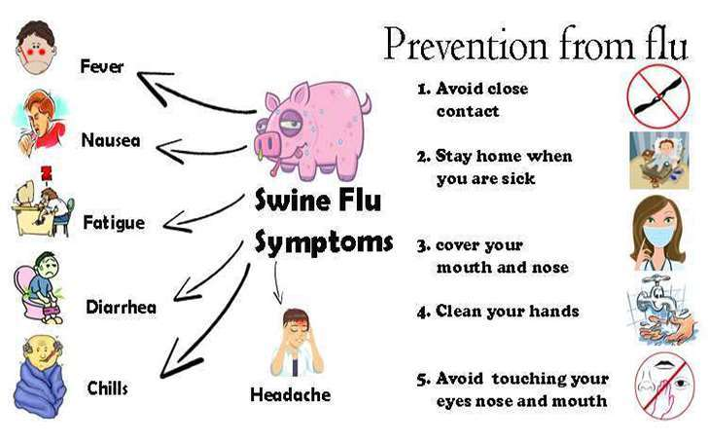
Swine flu: Clinical manifestations
In humans
Characterized by high fever & bronchitis,
Primarily in the upper respiratory tract, which may lead to secondary bacterial infections & pneumonia
More severe than a common respiratory tract infection

Slide 14
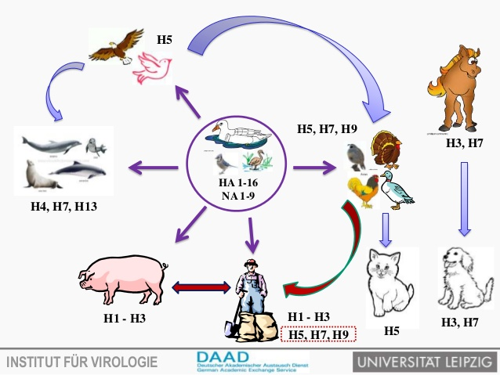
^{Avian flu}-Transmission
Transmitted to humans primarily by contact with live birds
Not by contact with meat & animal product
All patients in Hong Kong were infected by contact with infected birds not by contact with infected person

Slide 15
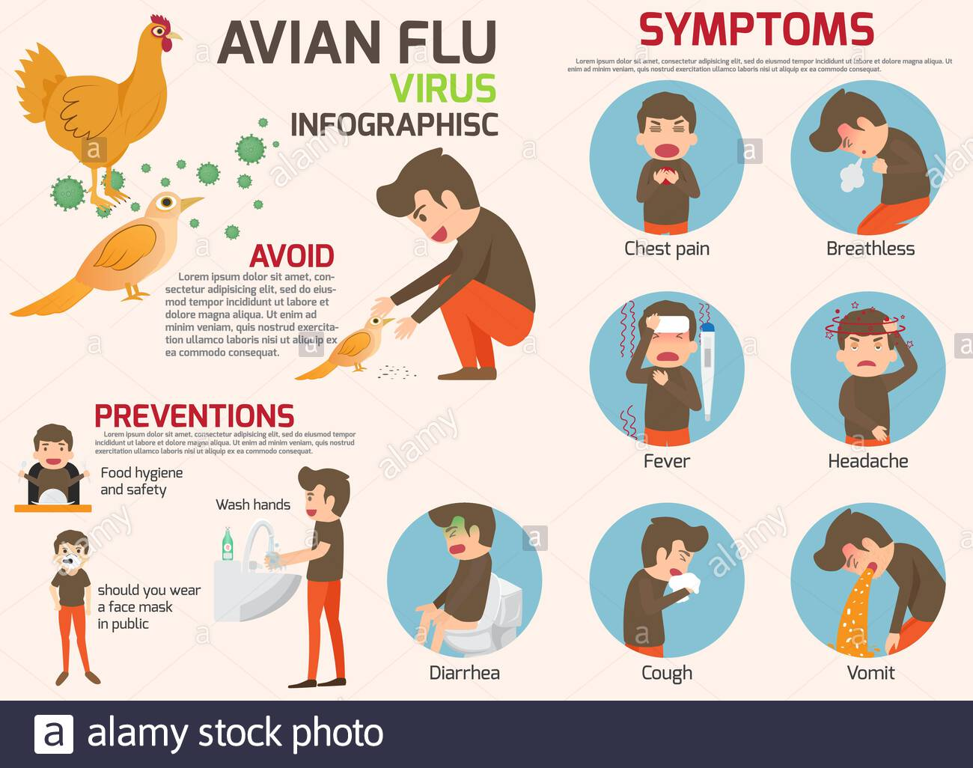
^{Avian flu}-Clinical manifestation
A 3 years-old child infected with avian influenza virus H5N1 in Hong Kong in 1997 died with sign of a systemic infection and of Reyes syndrome after the child had been treated with antipyretic drugs
Cough
Diarrhea
Respiratory difficulties
Fever (over 100.4°F or 38°C)
Headache
Muscle aches
Malaise
Runny nose

Slide 16
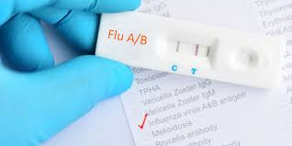
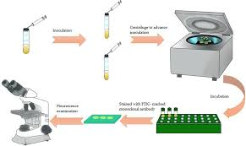
Diagnosis
Isolation and Identification-
Embryonating chicken eggs
In cell culture
Serological test:
Complement fixation test
HI test
Direct immunofluorescence assay
ELISA
Virus specific IgM can be detected in the children but not in the adults
Molecular method
PCR
RT-PCR
Rapid influenza diagnostic tests (RIDTs)

Slide 17
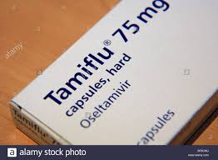
Treatment
AmantadineHCL-5mg/kg body weight/day
Rimantadine-100mg twice a day
Oseltamivir (Tamiflu)
Zanamivir (Relenza) two daily doses of 5 mg per inhalation), has become available; it inhibits the neuraminidase activity of the virus
Corticosteroids in asthma & other specific conditions

Slide 18
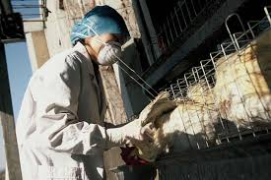
Prevention & control
Through personal protective measures
Regular hand washing with proper drying of the hands
Good respiratory hygiene –
Covering mouth & nose when coughing or sneezing,
Using tissues & disposing of them correctly
Early self-isolation of those feeling unwell, feverish and having other symptoms of influenza
Avoiding close contact with sick people
Avoiding touching one’s eyes, nose or mouth
Careful handling of dead/ live poultry
Anti-influenza drugs: prophylacticaly
Swine should not be held in close contact with fow

Slide 19
H1N1 vaccine is for use in adults & children who are at least 6 months old
Prevention
The best way to prevent swine flu is to get a yearly flu vaccination:
Vaccine: Pandemrix (1 dose) & Celvapan (2 dose)
(first vaccinate the susceptible group)

Slide 20
INFLUENZA VACCINE (HUMAN, LIVE ATTENUATED), (FREEZE-DRIED) PANDEMIC (H1N1) (INTRANASAL)
INDICATION
Indicated in individuals above 2 years of age
ROUTE OF ADMINISTRATION
For administration by intranasal spray.
DOSAGE
A single intranasal dose of 0.5 ml is administered as 0.25 ml per nostrilPRENTATION:
1 dose vial plus diluent (0.5 ml)

Slide 21
Human vaccine for Avian influenza
In April 17, 2007, FDA licensed the first vaccine in the United States for the prevention of H5N1 influenza, commonly referred to as avian influenza or "bird flu.“
This vaccine is derived from the A/Vietnam/1203/2004 influenza virus. The vaccine is manufactured by Sanofi Pasteur Inc. of Swiftwater, PA and has been purchased by the federal government for inclusion within the Nation's National Stockpile.

