Slide 1


Types of epidemiological investigation/Epidemiological methods
Lecture 09
UNIT-2 (VETERINARY EPIDEMIOLOGY) (Credit Hours 3+1=4)
Dr. Anjay
Assistant Professor
Department of Veterinary Public Health & Epidemiology
Bihar Veterinary College
Bihar Animal Sciences University
Patna

Slide 2
Epidemiological investigation
There are four approaches to epidemiological investigation that traditionally have been called 'types’ of epidemiology.
Descriptive epidemiology
Analytical epidemiology
Experimental epidemiology
Theoretical epidemiology
D
A
E
T

Slide 3

Descriptive epidemiology
It is the first part of an investigation.
It involves observing and recording the disease and possible causal factors.
The observations sometimes may be partially subjective and later on the hypothesis will be generated and will be rigorously tested.
Procedure:
1. Defining the population to be studied.
2. Defining the disease under study.
3. Describing the disease by time, place and person.
4. Measurement of disease.
5. Comparing with the known indices.
6. Formulation of an etiological hypothesis.

Slide 4
Here after defining the things properly, the data is collected and analyzed to arrive at a etiological hypothesis.
An epidemiological hypothesis should specify the following:
1. The population
2. Specific cause
3. The expected outcome
4. Dose – response relationship: the amount of the cause needed to produce the effect.
5. The time – response relationship: the period of exposure to the cause and effect.
Example: The smoking of 30 – 40 cigarettes per day causes lung cancer in 10% of smokers after 20 years of exposures.

Slide 5
Uses of descriptive epidemiology:
It gives lot of information regarding the magnitude of a disease and the types of disease problems existing in a community or a population.
It gives clue to the disease etiology and later on help in formulation of an etiological hypothesis.
It helps in planning and undertaking of therapeutic, preventive and control measures.

Slide 6
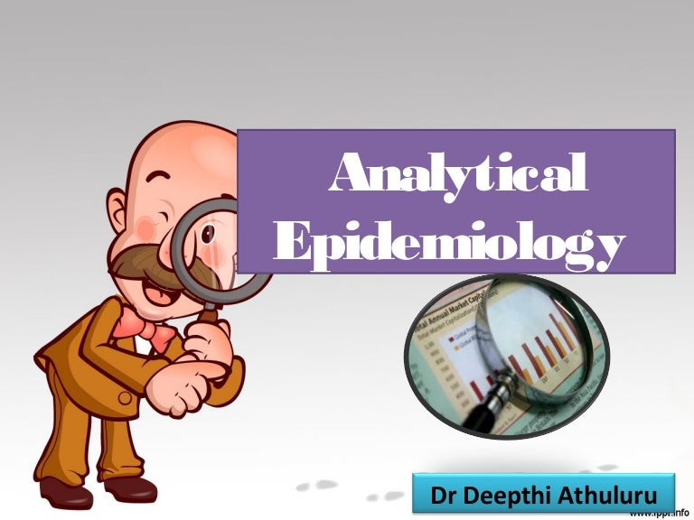
Analytical epidemiology:
It is the analysis of the observations by using the suitable diagnosis and statistical tests.

Slide 7
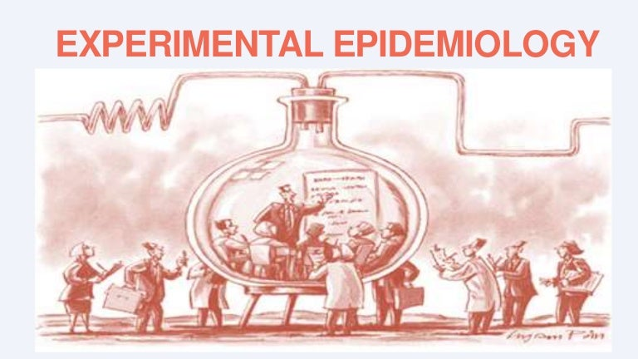
Experimental epidemiology:
The experimental epidemiologist will observe and analyze the data by conducting experiments.
Here, the epidemiologist will allot the animals into different groups and he can alter the factors associated with the groups. There is control over the groups.
The difference between this type of epidemiology and the other types of epidemiology is that the experimental epidemiology is having control over the groups and whereas the other types deals with the natural cases without having much control over the groups.
Most of the research activities in Veterinary field deal with the experimental observations as compared to the descriptive observations made in natural cases in human medicine.

Slide 8
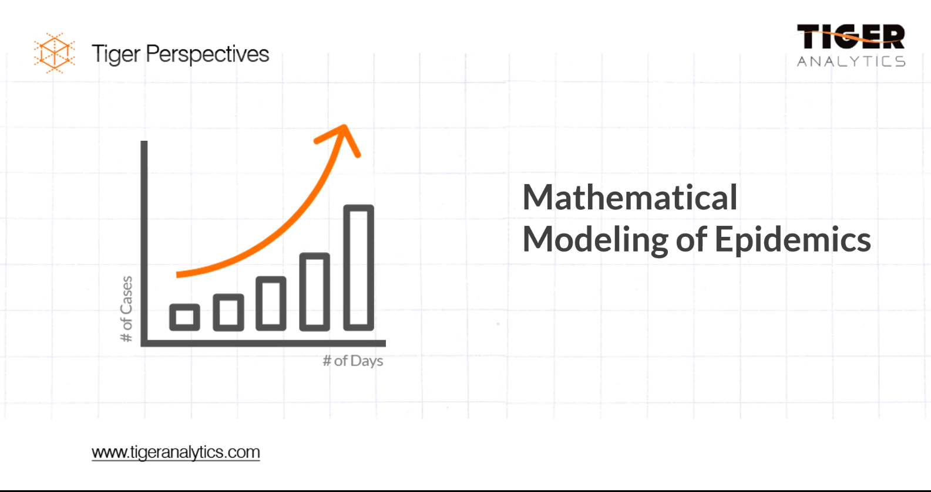
Theoretical Epidemiology:
It is the representation of disease using mathematical 'models' that attempt to simulate natural patterns of disease occurrence.

Slide 9
Epidemiological subdisciplines
Various epidemiological sub-disciplines are now recognized.
These reflect different areas of interest, rather than fundamentally different techniques.
They all apply the four types of epidemiological investigation.

Slide 10
Clinical epidemiology:
It is the use of epidemiological principles, methods and findings in the care of individuals, with particular reference to diagnosis and prognosis.
It is concerned with the frequency and cause of disease, the factors that affect prognosis, the validity of diagnostic tests, and the effectiveness of therapeutic and preventive techniques.
Therefore, is an important component of evidence-based medicine which is concerned with patient care based on evidence from the best available studies.

Slide 11
Computational Epidemiology:
It involves the application of computer science to epidemiological studies.
This includes the representation of disease by mathematical and the use of the Expert systems.
These systems are commonly applied to disease diagnosis which incorporates:
A set of rules for solving the problems.
Details of clinical signs.
Details of lesions
Details of laboratory results.
Opinions of the experts.
Eg. (1) Identification of the cause of coughing in dogs.
(2) Diagnosis of bovine mastitis.

Slide 12
Genetic Epidemiology:
It is the study of the cause, distribution and control of disease in related individuals and of inherited defects in populations.

Slide 13
Field epidemiology:
Field epidemiology is the practice of epidemiology in response to problems of a magnitude significant enough to require a rapid or immediate action.
For example, when outbreaks of foot-and-mouth disease occur, field epidemiologists promptly trace potential sources of infection in an attempt to limit spread of the disease.
Field epidemiology is a timely, judgemental process based on description, analysis, common sense and the need to design practical control policies.
It is sometimes termed 'shoe-leather epidemiology' because the investigator is often required to visit the field to study disease.

Slide 14
Participatory epidemiology:
The techniques that are employed evolved in the social sciences, and consist of simple visual methods and interviews to generate qualitative data.
This approach became known as 'participatory appraisal' and its application in veterinary medicine is now termed 'participatory epidemiology’.
It is a tool for the field epidemiologist, which is increasingly used in developing countries.
This area of interest is closely related to 'ethnoveterinary medicine', which is concerned with local knowledge of, and practices relating to, the health of animals.

Slide 15
Molecular Epidemiology:
Recently Microbiologists and Molecular Biologists have used new biochemical techniques to study small genetic and antigenic differences between viruses and other micro-organisms.
The methods include peptide mapping, nucleic acid finger printing, hybridization, restriction enzyme analysis, monoclonal antibodies and polymerase chain reaction.
These techniques are better than the serological techniques.

Slide 16
Other sub-disciplines:
Chronic disease epidemiology:
It is involved with diseases of long duration, many of which are non-infectious.
Environmental epidemiology:
It is concerned with the relationship between disease and environmental factors. Eg. Industrial pollution, Occupational hazards.
Micro-epidemiology:
It is the study of a disease in a small group of individuals with respect to factors that influence its occurrence in longer segments of the population.
It frequently uses animal biological models of disease and is closely related to comparative epidemiology. Eg. Feline AIDS studies revealed insights into human AIDS

Slide 17
Macro-epidemiology:
It is the study of national patterns of disease and the social, economic and political factors that influence them.
Nutritional epidemiology
Sub-clinical epidemiology
Social epidemiology
Psychosocial epidemiology

Slide 18
THANKS
FOR
KIND ATTENTION

